Slide 1
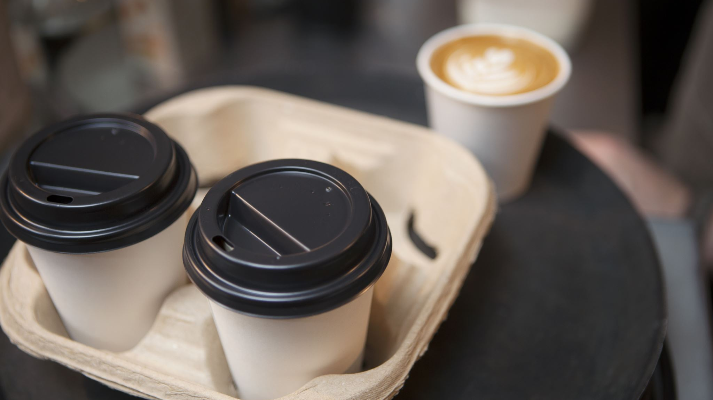
Hello everyone!

Slide 5
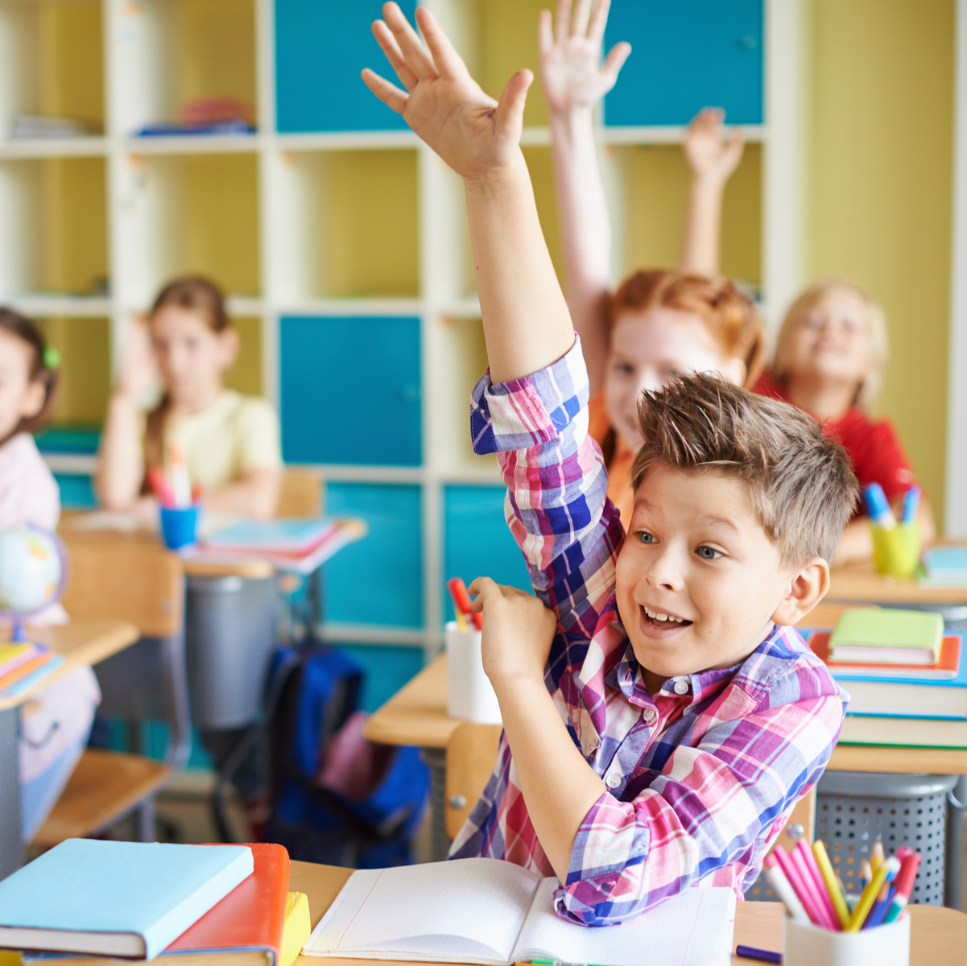
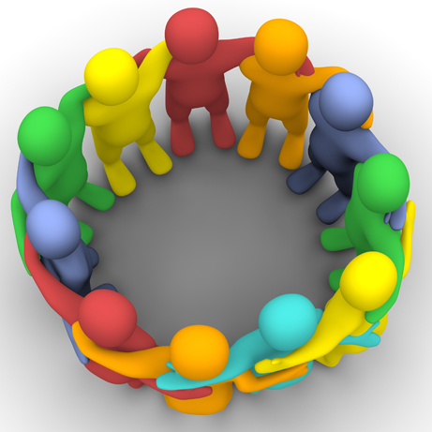
What are we going to do?

Slide 6
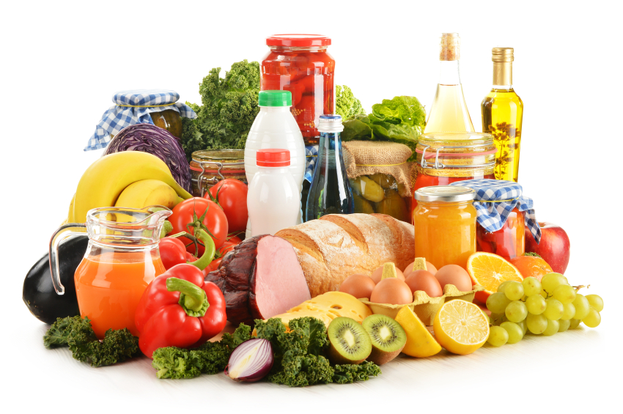
3 words with many
3 words with much
2 words with few
2 words with little
1 sentence with some
1 sentence with any

Slide 7
7 minutes in each zone

Slide 8
Cinquain Poetry Do like the lesson?

Slide 9
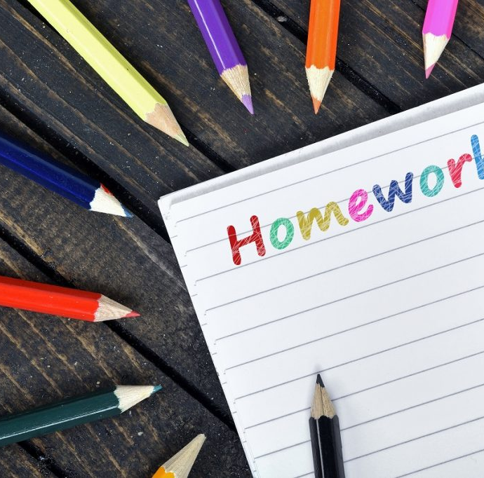
Repeat words «Food»
Repeat Present Simple and Present Continuous

Slide 10
Have a nice day!

