Slide 1
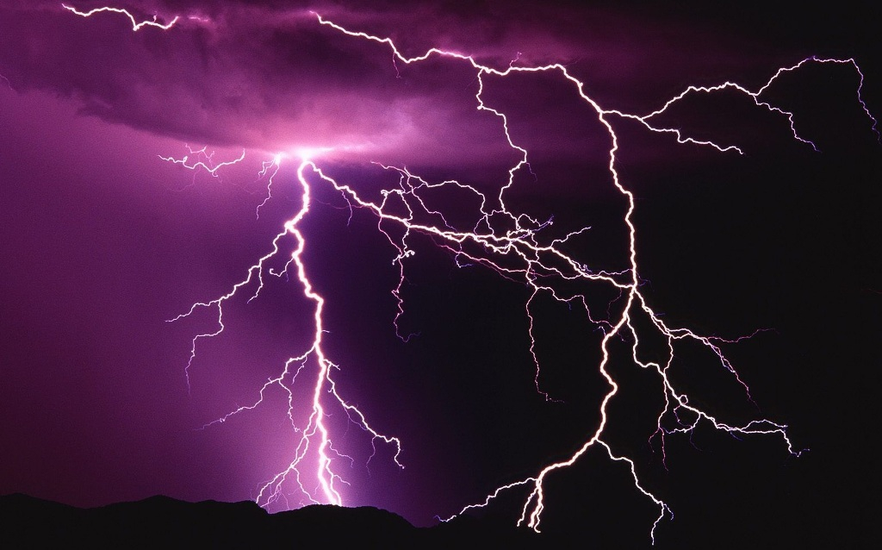
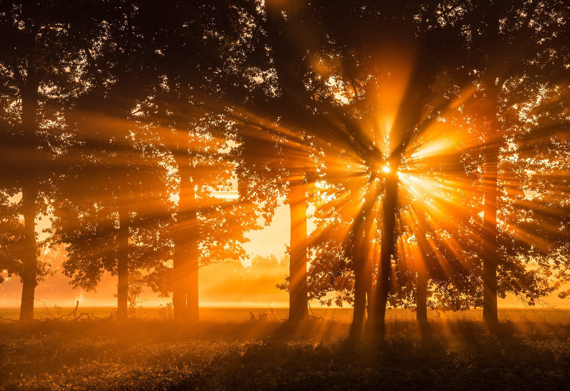
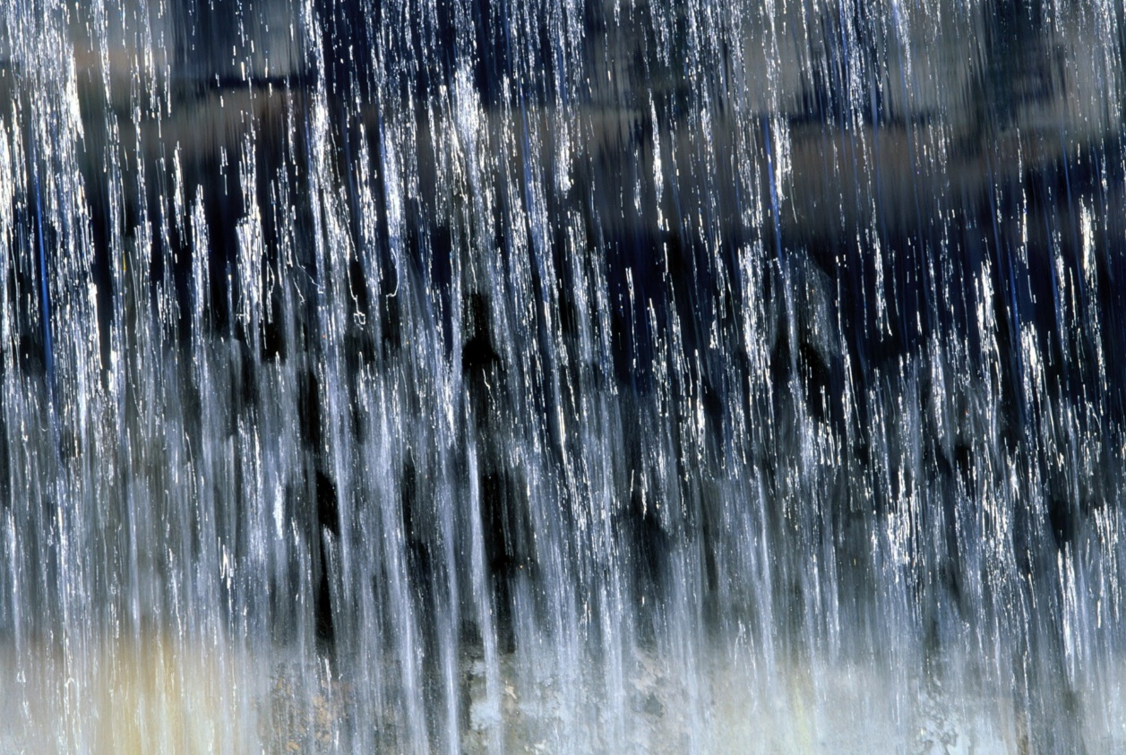

Slide 2
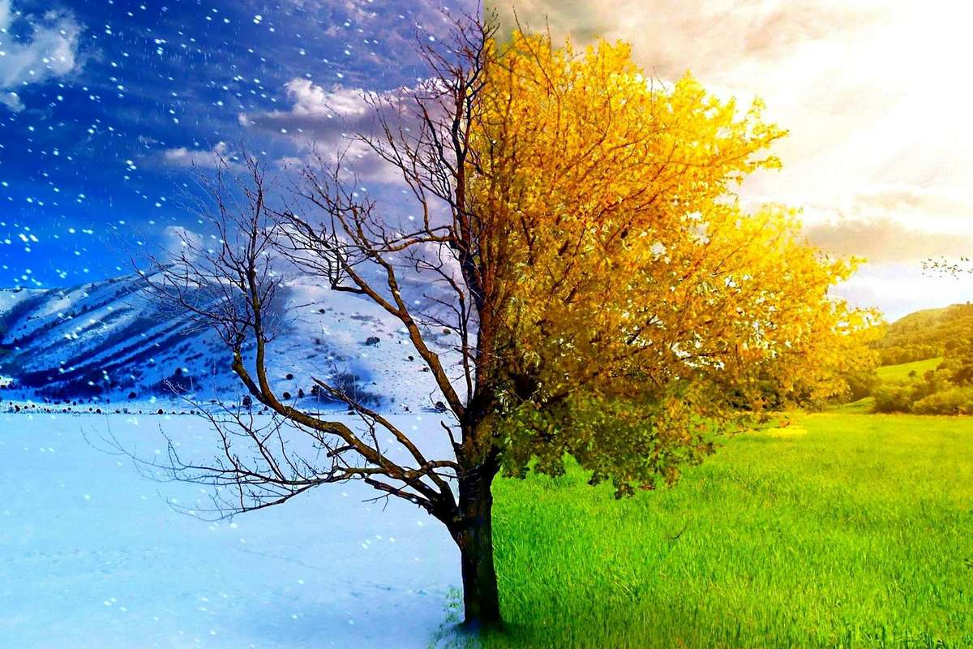
This is the season
When mornings are dark
And birds do not sing
In the forest and park
This is the season
When children ski
And Father Frost
Brings the New Year tree.

Slide 3
What is the weather like?

Slide 4
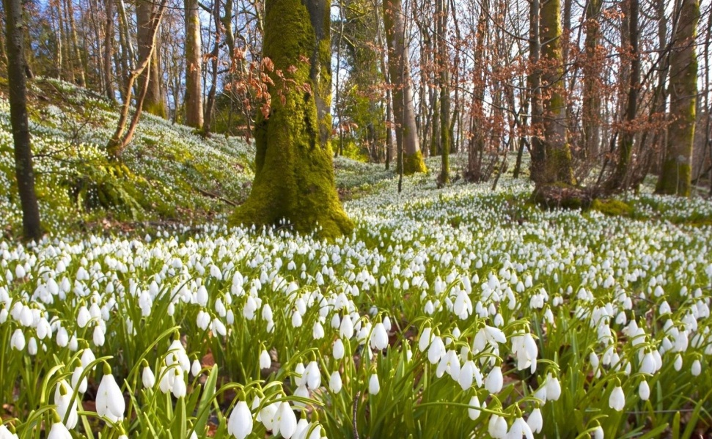
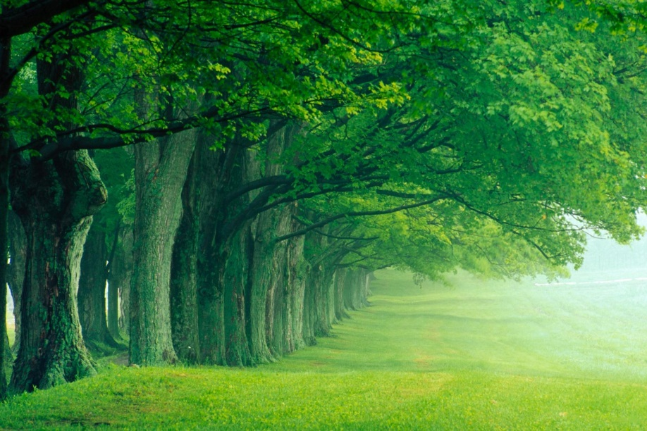
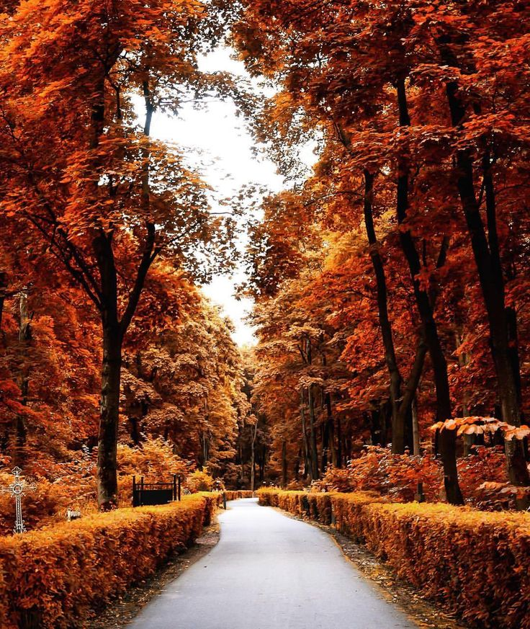
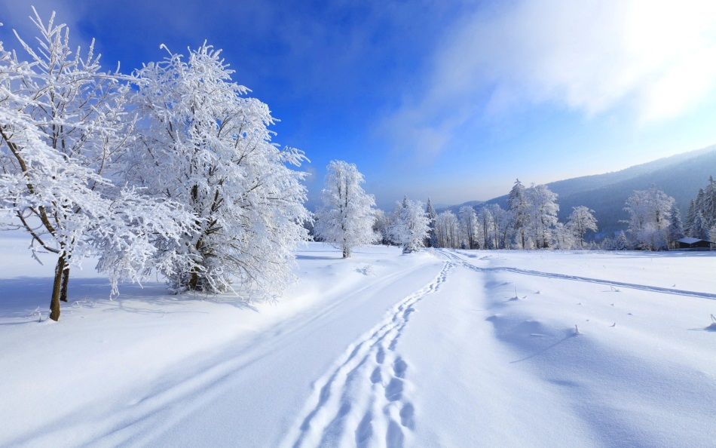
spring
summer
autumn
winter

Slide 5
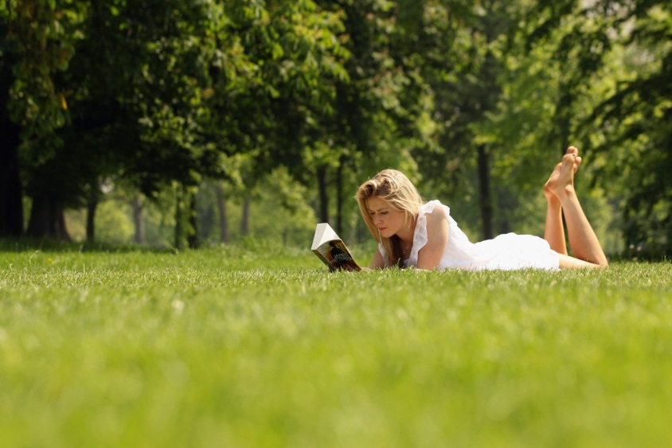
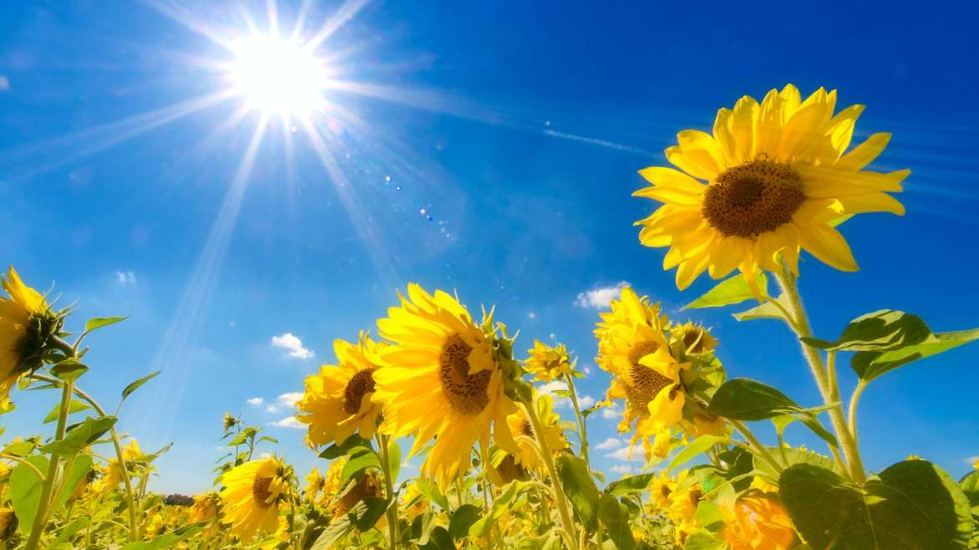
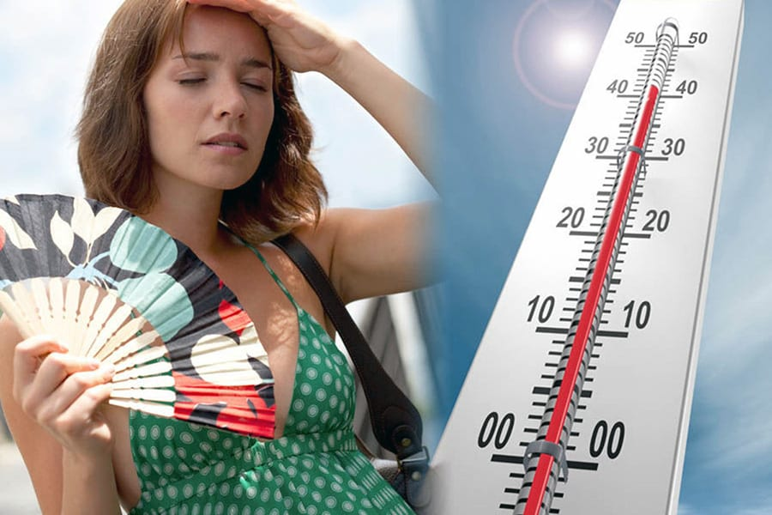
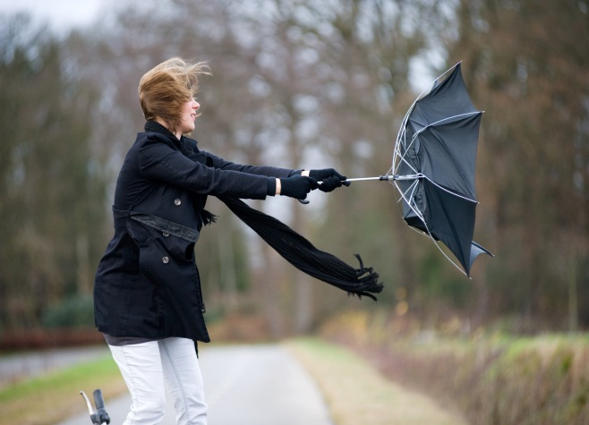
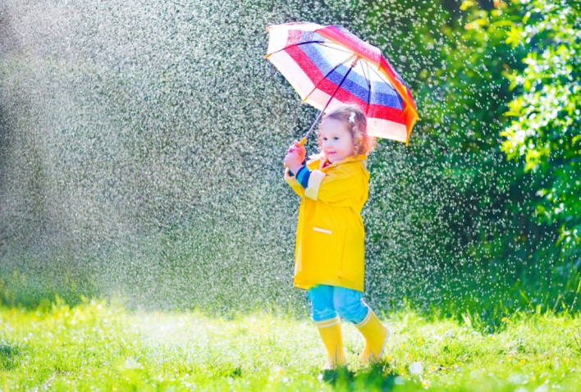
sunny
warm and dry
hot
windy
rainy

Slide 6
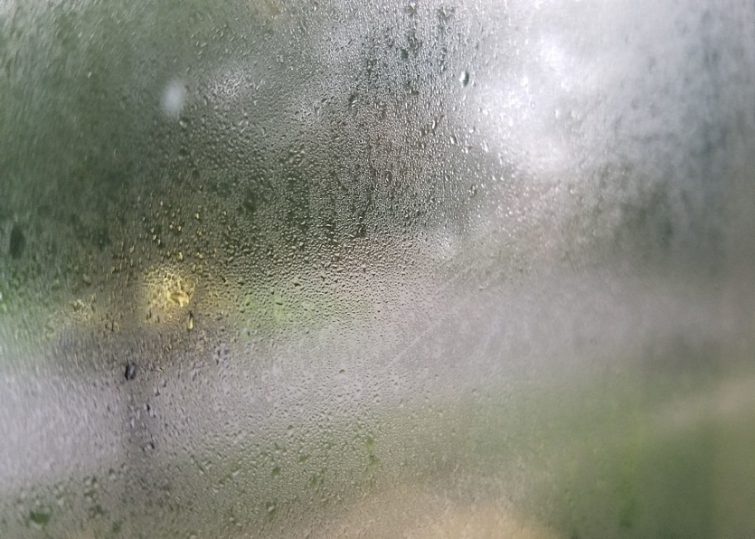
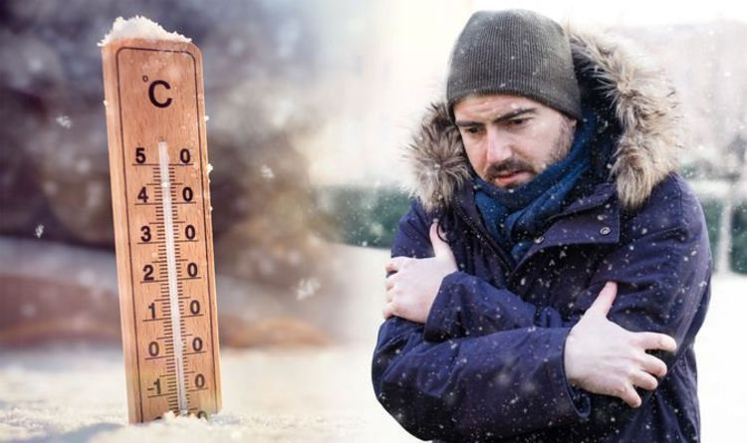
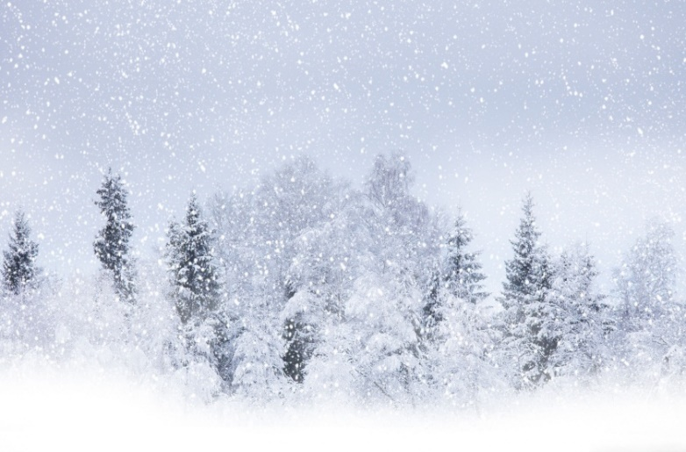
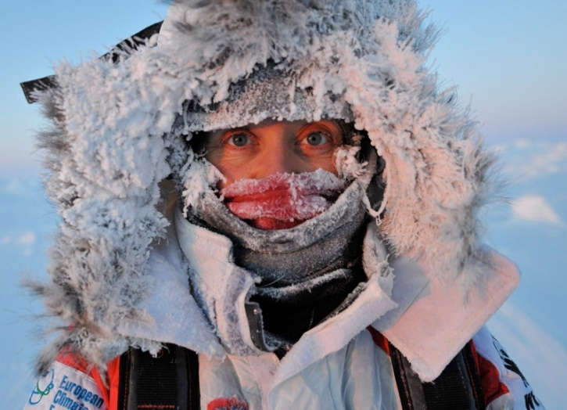
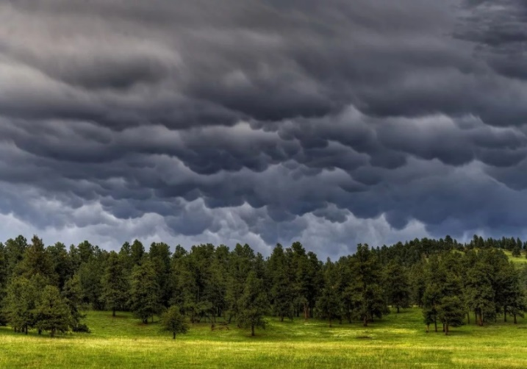
wet/humid
cold
snowy
cloudy
frosty

Slide 7
What is the weather like?
hot
warm
dry сухой
sunny
the
weather
spring
windy
summer
rainy
In
is
the climate
wet/humid
autumn
cold
winter
snowy
frosty
mild мягкий
severe суровый

Slide 8
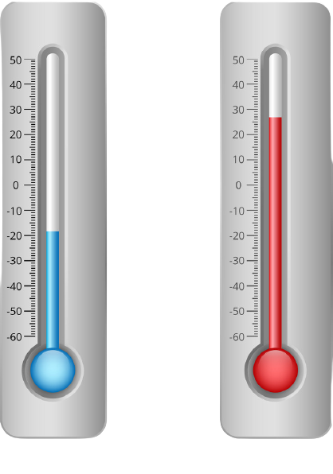
What is the temperature like?
The temperature
is sometimes
30 degrees above zero
выше
The temperature
is often
10 degrees below zero
ниже
degrees
above zero
degrees
below zero

Slide 9
What do you like and dislike about the weather?
rainy
I like /dislike
when the weather
sunny
is
hot and humid
warm and dry
I like / dislike when it
rains
snows
melts тает
freezes морозит
I like / hate when there is
a thunderstorm гроза
a heavy rain сильный
a light frost небольшой

Slide 10
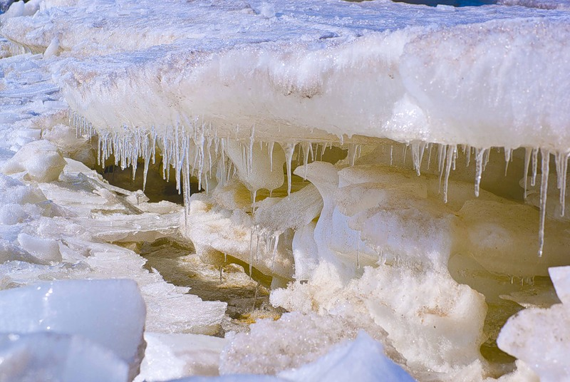
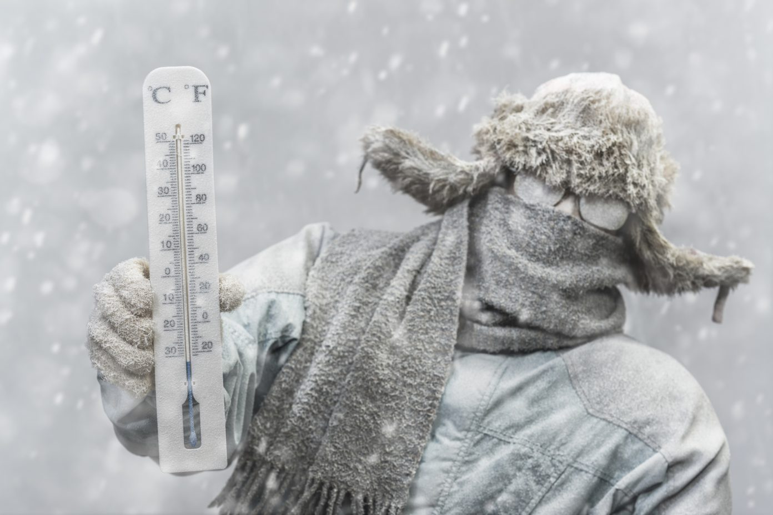
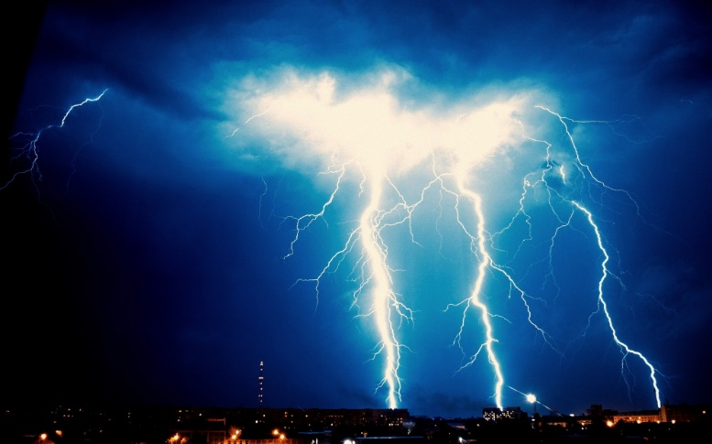
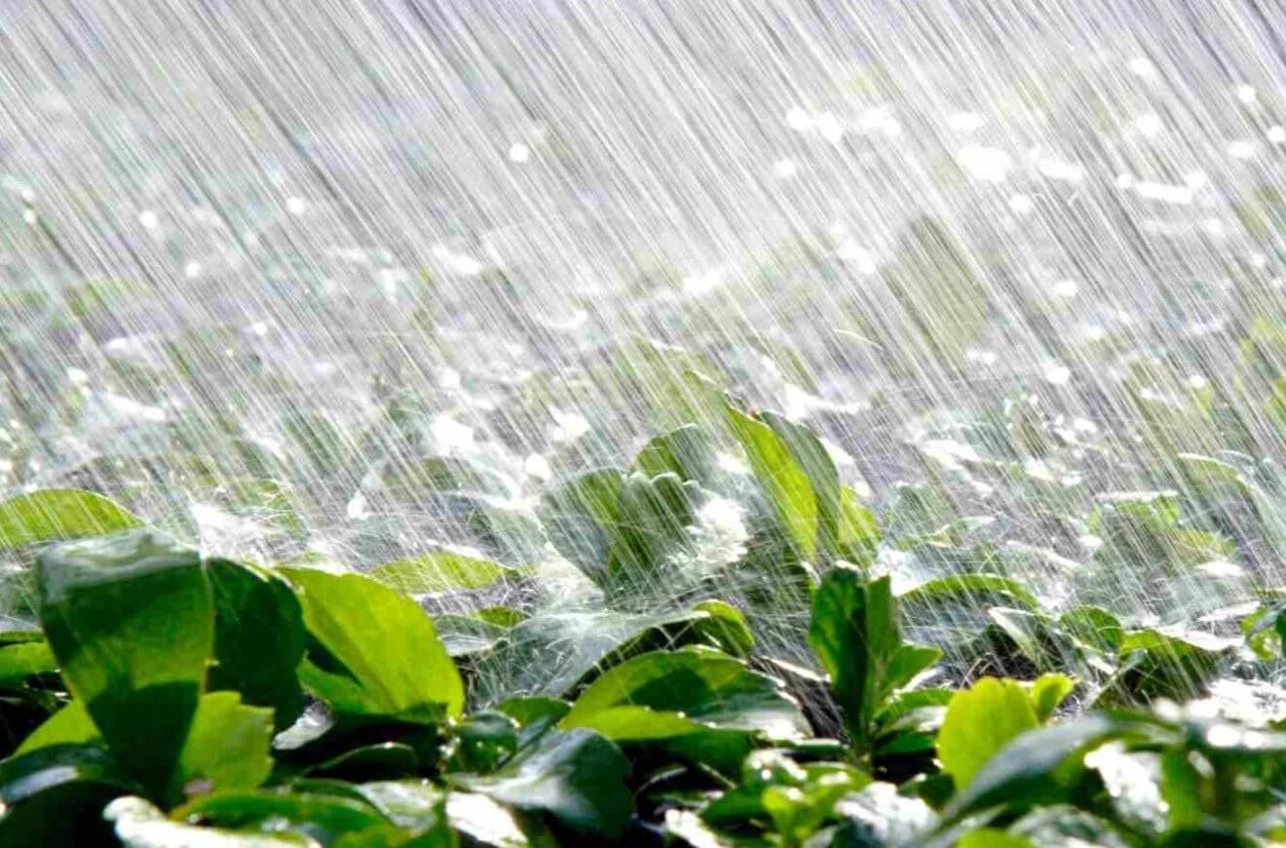
melts
freezes
a thunderstorm
a heavy rain

Slide 11
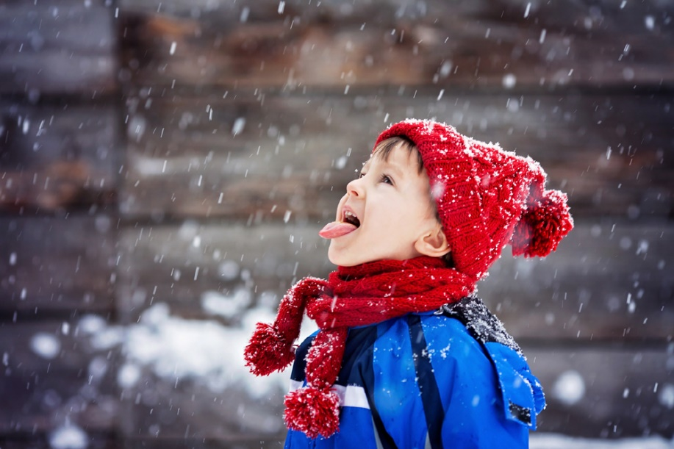
a light frost
sunshine

Slide 12
The temperature is …. degrees below / above zero.

Slide 13
The weather is
snowy
sunny
hot
rainy
windy
cold/frosty
cloudy

Slide 14
Weather

Slide 15
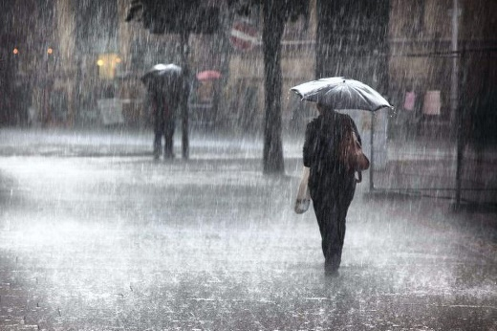
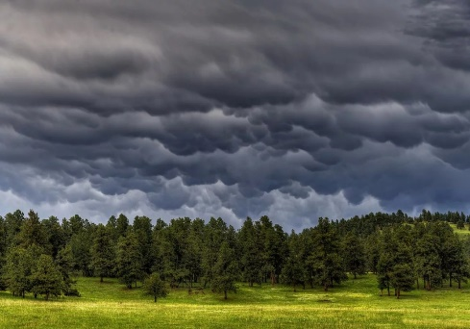
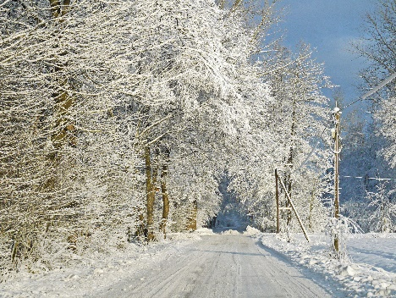
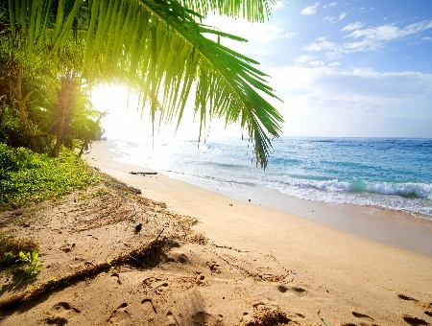
B
D
A
C
A. In the north of Russia the weather will be cold and . snowy. The snow may move to the south.
B. In the west (запад) part of Finland the weather will . be rainy and windy.
C. In the central part of Australia it will be hot, sunny . and wet. In the north the weather will be sunny, too.
D. In the south of Germany the weather will be cloudy . and windy . In the east part of the country the . weather will be cloudy, too.

Slide 16
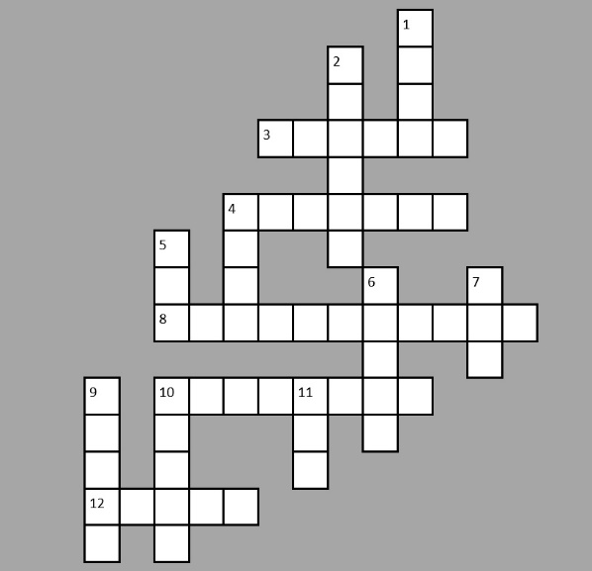
c
1
По горизонтали 3. облачный.
4. погода.
8. температура.
10. солнечный свет.
12. ветреный. По вертикали 1. холодный.
2. морозный.
4. тёплый.
5. влажный.
6. дождливыйй.
7. сухой.
9. снежный.
10. солнечный.
11. жаркий.
f
o
r
l
c
l o u d y
s
4
w
e a t h e r
w
a
y
e
r
r
d
t
e m p e r a t u r e
i
y
11
s
10
s
u n s h i n e
n
u
o
y
o
n
t
12
w
i n d y
y
y

Slide 17
Tony: Hello, Jane! What is the weather like in Rome?
Jane: It is sunny and cloudy. The temperature is +12 .
Tony: What is the climate like in Italy?
Jane: In summer it’s usually hot, with a lot of . sunshine.
Tony: And what is the weather like in winter in Italy?
Jane: I winter it is wet and mild. The temperature . is usually +6 ,+8. And what about Britain?
Tony: In Britain the weather is often warm and . sunny but sometimes rainy in summer.
Jane: And what is the climate like winter?
Tony: In winter the weather is usually snowy and . frosty but also can be rainy.

