Slide 2
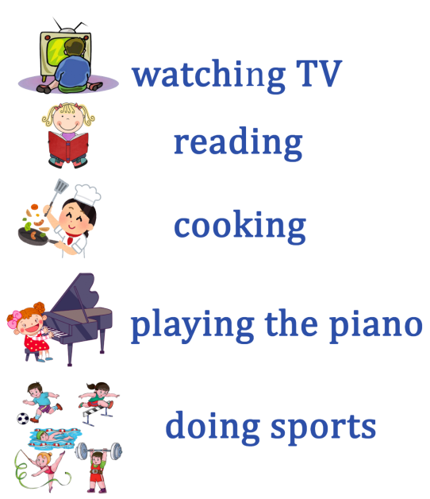
I’m ____________ .
I like __________ .

Slide 4
F
R
E
E
T
I
M
E

Slide 5
Going jogging [ ˈɡəʊɪŋ ˈdʒɒɡɪŋ ]
Going climbing [ ˈɡəʊɪŋ ˈklaɪmɪŋ ]
Hanging out with friends
[ ˈhæŋɪŋ aʊt wɪð frɛndz ]
Relaxing with your family
[ rɪˈlæksɪŋ wɪð jɔː ˈfæmili ]
Taking photos [ teɪkɪŋ ˈfəʊtəʊz ]

Slide 7
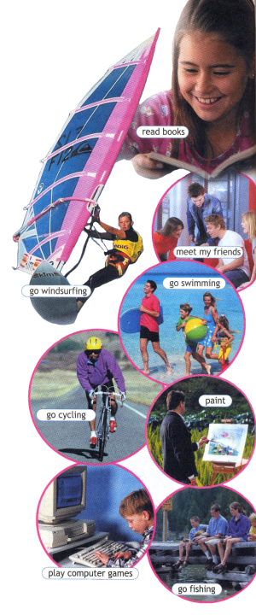
In my free time,
I like _______
like + -ing

Slide 8
I love_____
I enjoy_____
I am keen on ____
I am interested in ______
I am mad about _____
I am fond of ______

Slide 9
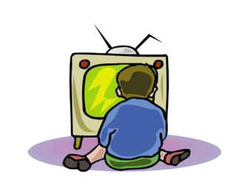
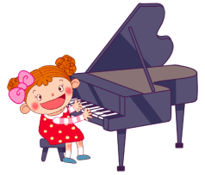
I love going swimming.
I enjoy watching TV.
I am mad about playing the piano.

Slide 10
I love__________
I enjoy________
I’m fond of ______
I’m keen on ______
I’m interested in _______
I’m mad about _________

Slide 11
Do you love_____? Yes, I love____ Do you enjoy____? No, I don’t enjoy ___ Are you keen on____? Yes, I am keen on____ Are you interested in____? Yes, I am interested ____ Are you fond of_____? No, I’m not fond of______

Slide 12
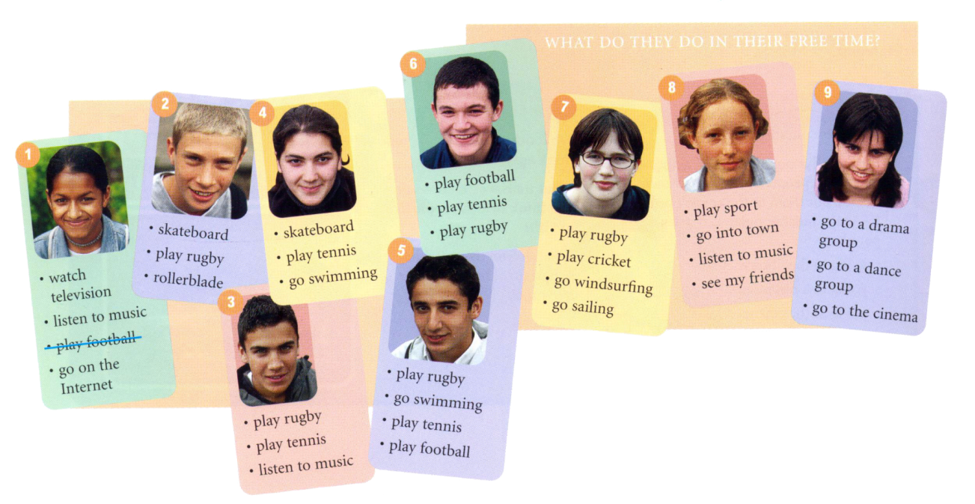

Slide 17
Score
8 - 9 - “5” 6 – 7 - “4” 4 – 5 – “3” < 3 - “2”

Slide 20
2 Min.

Slide 21
01
59
58
57
56
55
54
53
52
51
50
49
48
47
46
45
44
43
42
41
40
39
38
37
36
35
34
33
32
31
30
29
28
27
26
25
24
23
22
21
20
19
18
17
16
15
14
13
12
11
10
09
08
07
06
05
04
03
02
01
00

Slide 22
00
59
58
57
56
55
54
53
52
51
50
49
48
47
46
45
44
43
42
41
40
39
38
37
36
35
34
33
32
31
30
29
28
27
26
25
24
23
22
21
20
19
18
17
16
15
14
13
12
11
10
09
08
07
06
05
04
03
02
01
00

Slide 23
What is the most popular club? The most popular club is … . What is the least popular? The least popular club is … .

Slide 24
Complete the leaflet.
Are you interested in 1)________ ?
2)____________________________
_{(the name of the club)}
invites you to 3)_________ them.
Here’s your chance to:
learn how to 4)________
learn a lot about famous/popular 5) ______
Develop that special talent you already have.
Club meeting: 6)__________________
Call Mrs Smith,
Club President at: 787-5419

Slide 25
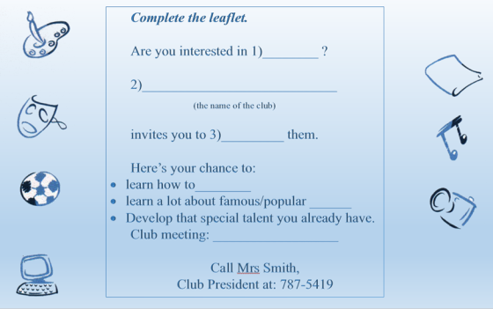

Slide 26
Thank you so much!

