Slide 1
Do the crossword puzzle
http://puzzlecup.com/crossword-ru/?guess=B654E58446BA46AU

Slide 2
Do the crossword puzzle
http://puzzlecup.com/crossword-ru/?guess=B654E58446BA46AU

Slide 3
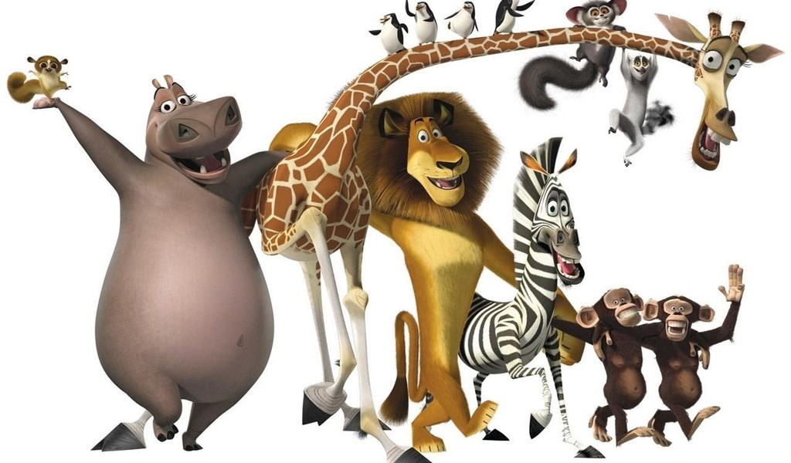
Animals
Today is the 27of April

Slide 4
Today is the 27of April Animals

Slide 5
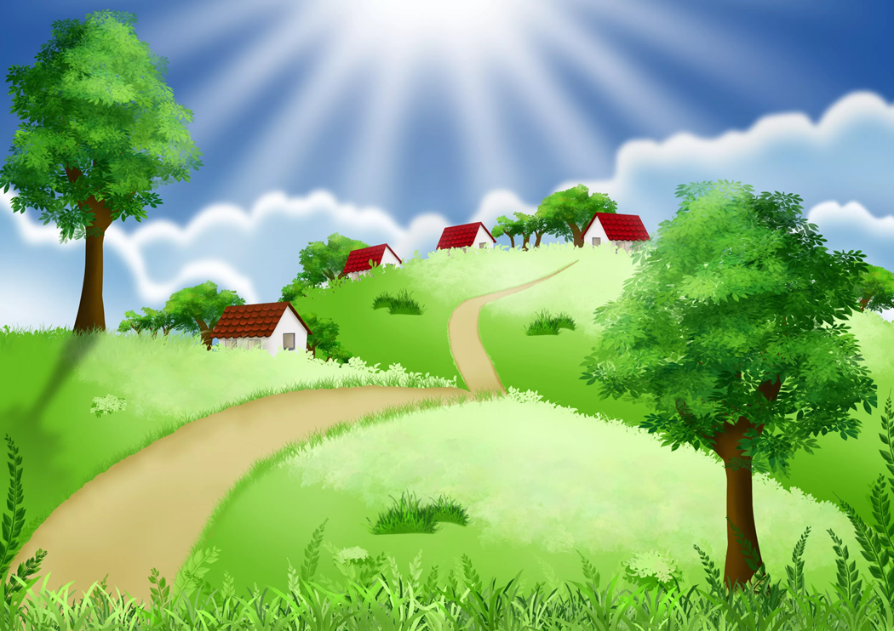
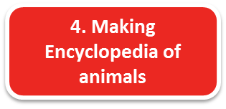
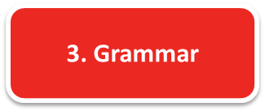
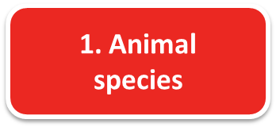
3
Map
Listen, understand and
guess riddles
Revise Grammar
2
1
Classify animals
4
Make a multimedia
Encyclopedia
of animals

Slide 6
Station 1
Animal species
Divide animals into 4 groups
https://jr.brainpop.com/science/animals/classifyinganimals/
Mammals | Fish | Birds | Reptiles
? | ? | ? | ?
a budgie a camel a peacock a crocodile a turtle
a giraffe a penguin a lion an eagle a rabbit
a whale a rhino a cock a seal
a shark a snake a lizard

Slide 7
Map
Listen, understand and
guess riddles
Revise Grammar
Classify animals
Make a multimedia
Encyclopedia
of animals

Slide 8
Riddles
Station 2
https://www.liveworksheets.com/worksheets/en/English_as_a_Second_Language_(ESL)/Animals/Animal_Riddles_ys259183go

Slide 10
Map
Listen, understand and
guess riddles
Revise Grammar
Classify animals
Make a multimedia
Encyclopedia
of animals

Slide 11
Station 3
Grammar
Present Simple

Slide 12
Map
Listen, understand and
guess riddles
Revise Grammar
Classify animals
Make a multimedia
Encyclopedia
of animals

Slide 13
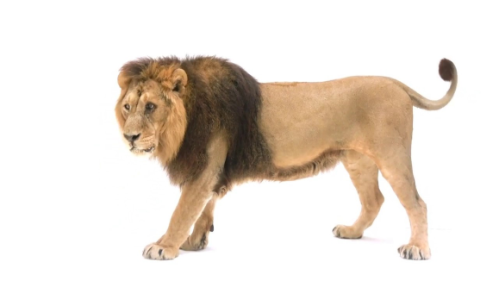
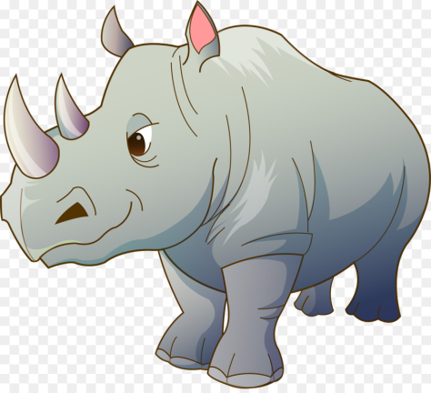
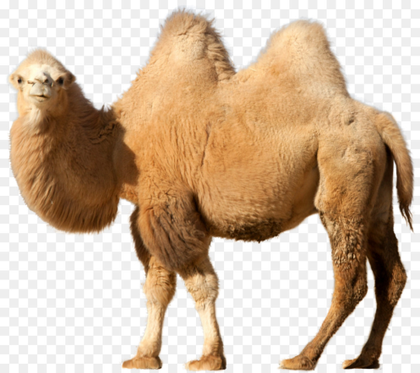
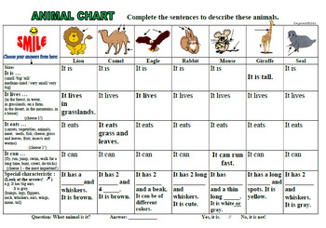
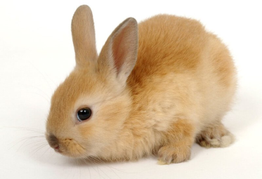
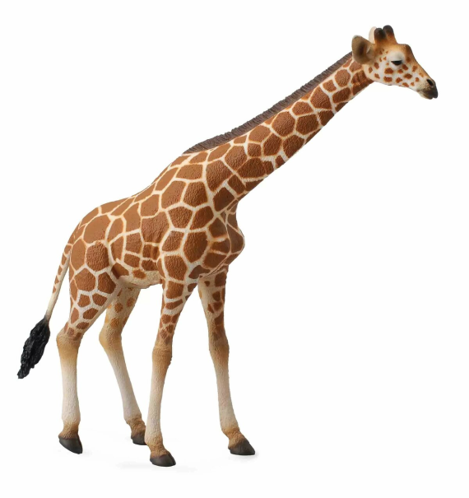
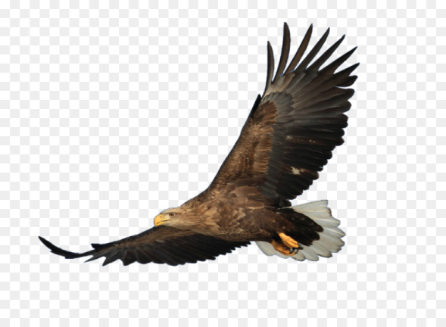
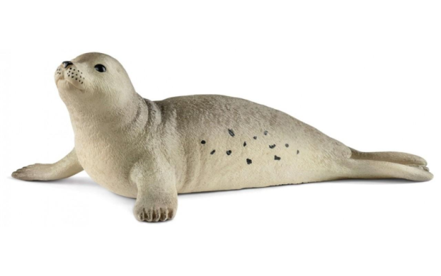
Station 4
Making an Encyclopedia
https://docs.google.com/presentation/d/1CgmJSVFtwuu_m_5Fus4cAx7fMKV0Xbf9xZlgboJX20s/edit?usp=sharing
https://docs.google.com/presentation/d/1un1egGDer1UI1KWxfSF6T81QAigKpxBFkq5nT3HOVEU/edit?usp=sharing

Slide 14
Animal Chart
A lion | A camel | An eagle | A rabbit | A rhino | A giraffe | A seal
is a … (big/small, tall/short, fat/thin, round, long аnimal/bird)
It lives … (in the bushes (в кустах), in the sea, in Africa, at home, in the jungle, in a cave (в пещере), in a cage (в клетке), in the ocean, in the desert, on the farm, in the mountains).
It eats … (meat, fruit, vegetables, grass (трава), leaves (листья), corn (зерно), fish).
It can … (run, jump, swim, crawl, fly, walk, hide, hunt, carry heavy things).
It has got … (4 legs, flippers, whiskers (усики), a beak, a tail, a thick mane, a trunk, a neck, 4 paws, 2 ears, fur, feathers, claws, a horn, a hump).
It can be … (grey, brown, yellow, white, black, blue, green, red, orange, it can be of different colour).
I like it because it is … (smart, clever, loyal (верный), brave (смелый), strong (сильный), nice, cute, beautiful, funny, cool, friendly, kind, noisy, sweet, playful, slow, dangerous, fast (быстрый)).

Slide 15
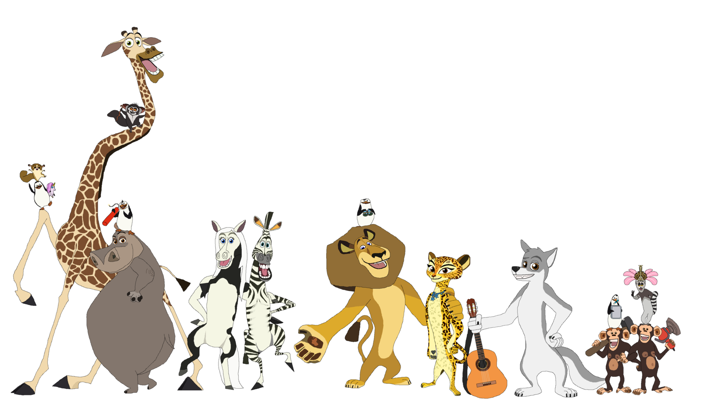

Slide 16
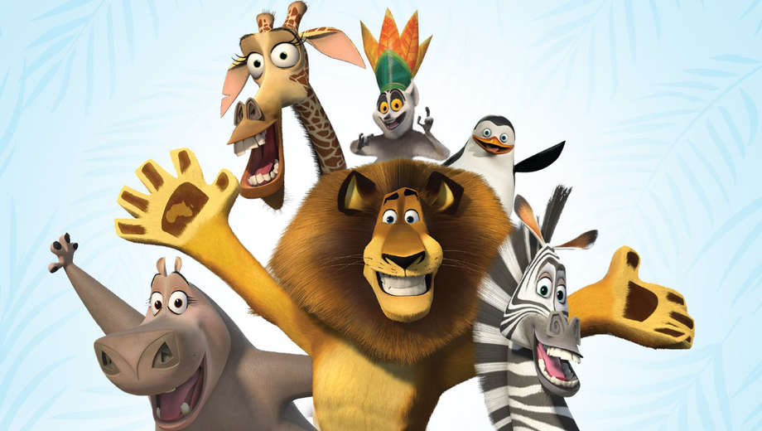
The lesson is over!
Good-bye!

