Slide 1
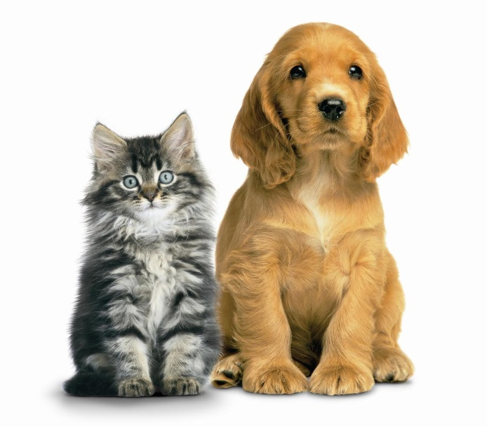
Animals
Иванова А. С.

Slide 2
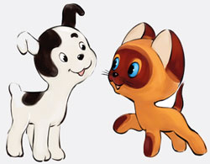
They can be wild and domestic.
They can be big and small.
They can be red, brown or white.
They can live in the forest or in the jungles.
They can be our friends.

Slide 3
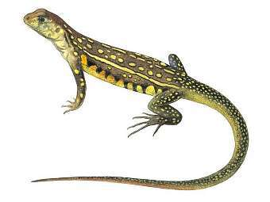
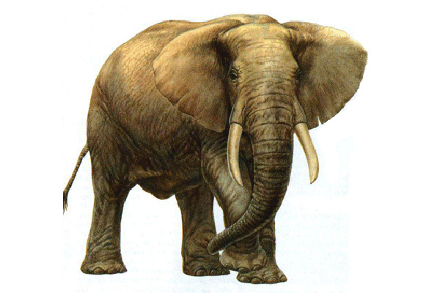
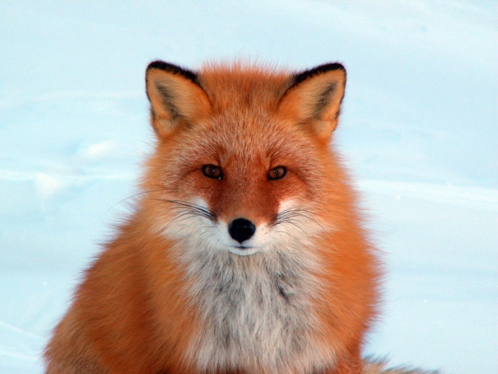
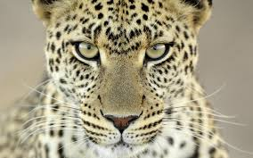
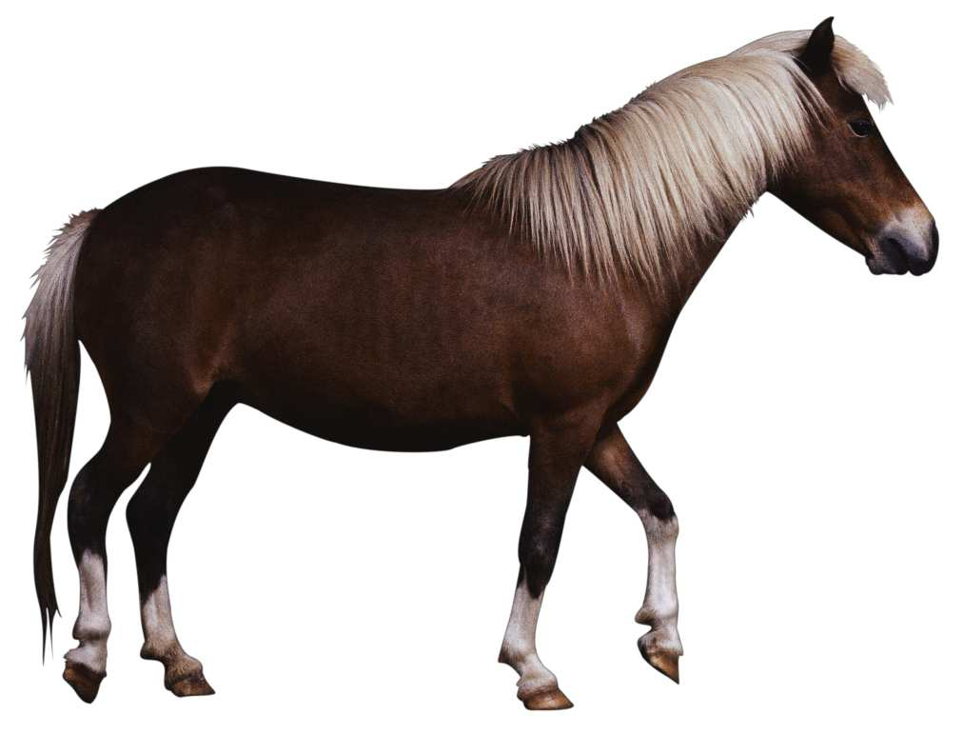

Slide 4
What does it look like?
What can it do?
Where does it live?
What does it eat?

Slide 5
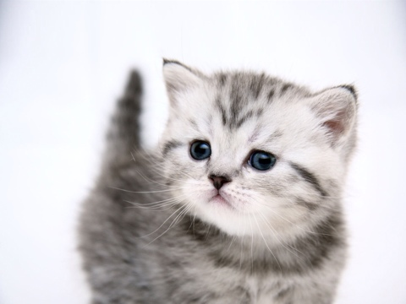
True or False
Jane has got a big cat.
Its name is Pussy.
Pussy is a white cat.
Pussy can’t play football.
Pussy likes meat and fish.

Slide 6
Correct the mistakes
Pussy is a small puppy.
Pussy is five years old.
Pussy likes playing tag.
Pussy eats ice-cream.
Pussy drinks juice.

Slide 7
My pet
I have got a pet.
It is a ……………….
Its name is……….
It is…..years old.
It is……………………
It has got………….
It can………………..
It eats…and drinks…
I love my pet!

Slide 8
Thank you!

