Slide 1
THE MENU
Презентацию подготовили студенты группы О-41 Суханов Никита, Поволоцкий Владислав.

Slide 2
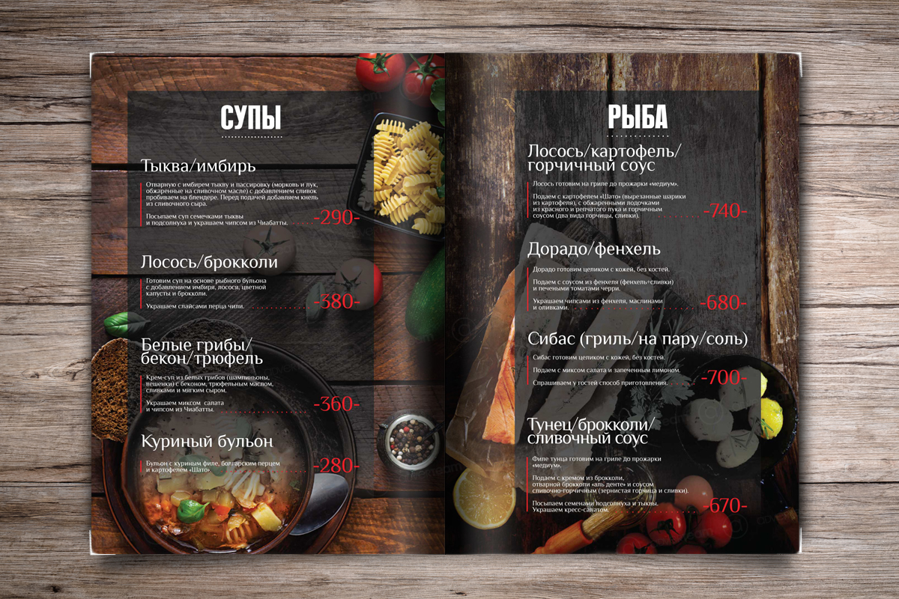
The word menu means: a list of dishes served in this restaurant. The list includs dishes and vines with prices.

Slide 3
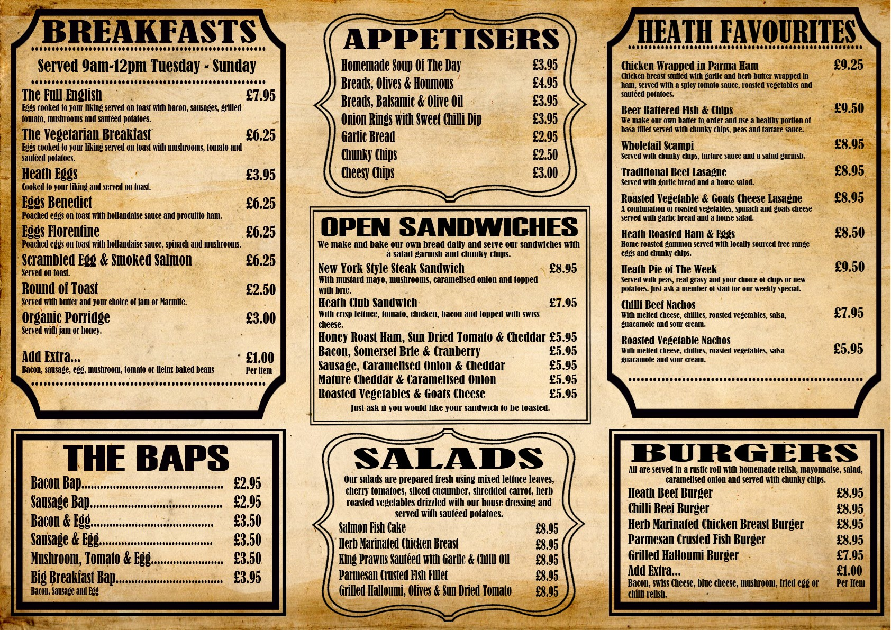
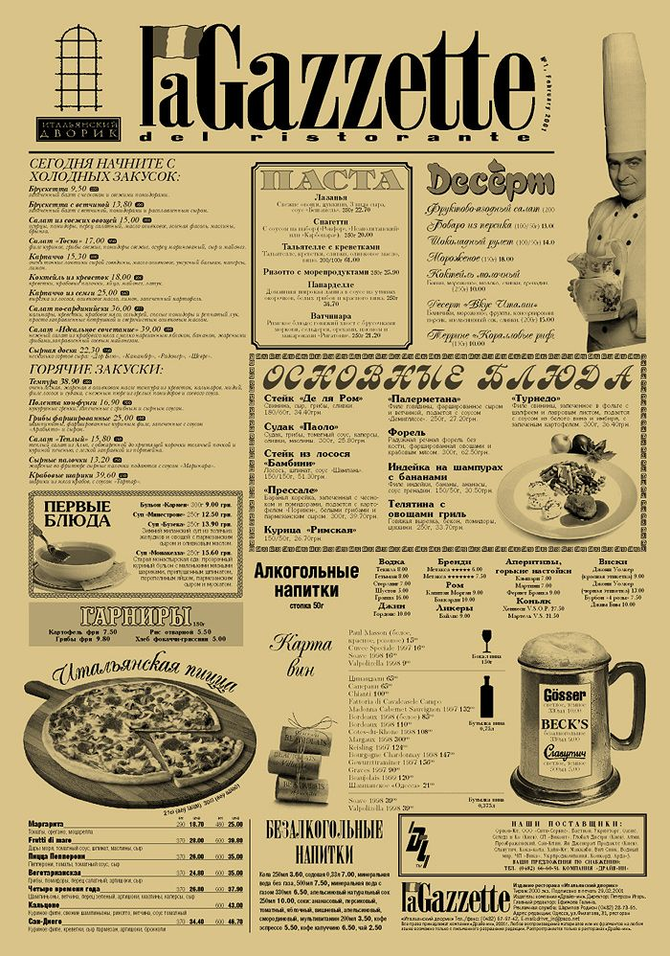
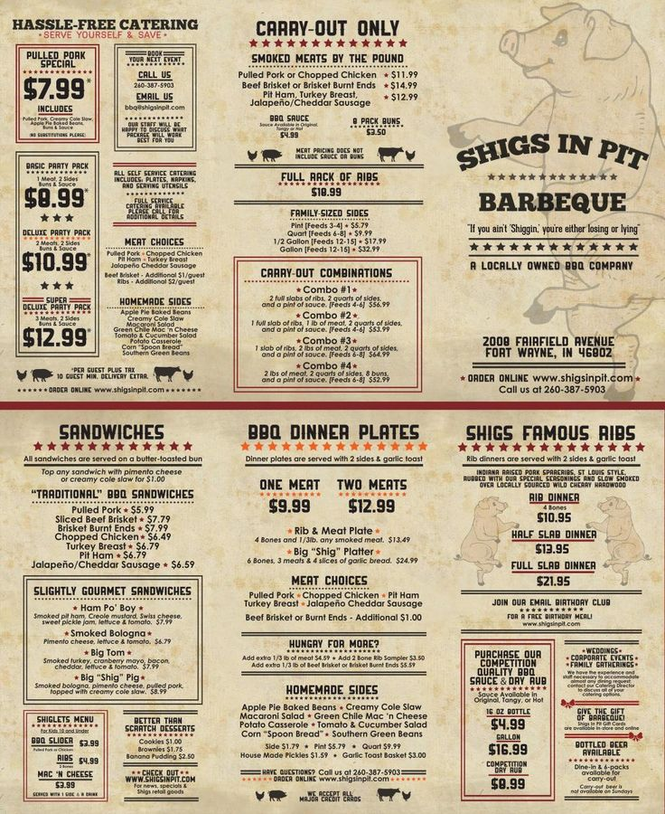
Different tips of menus:

Slide 4
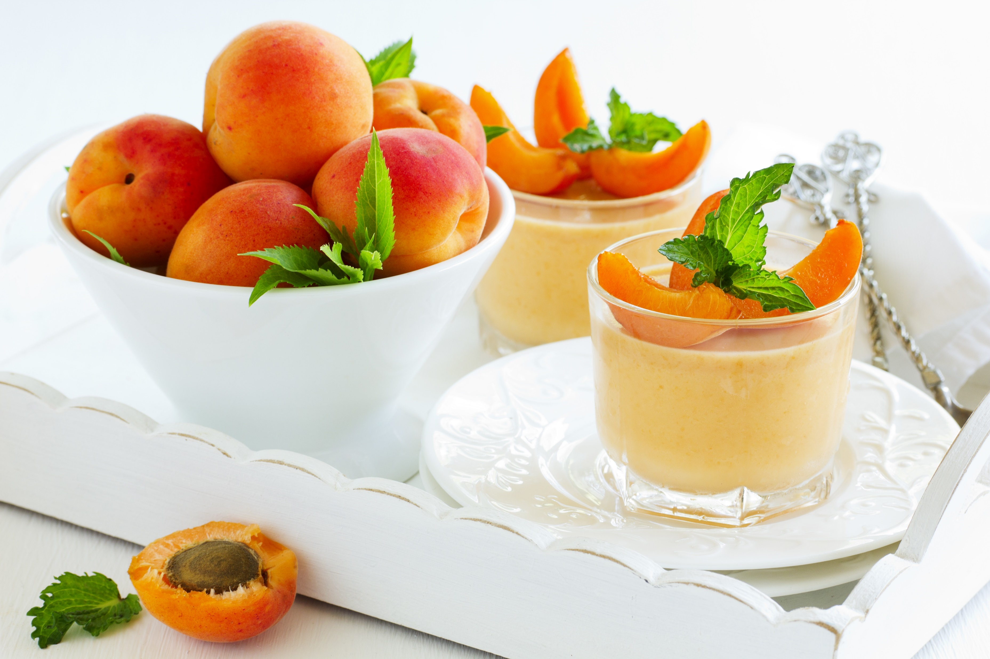
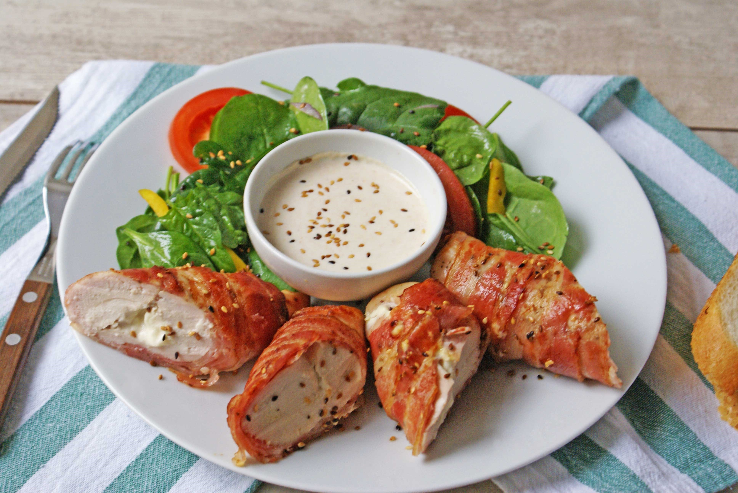
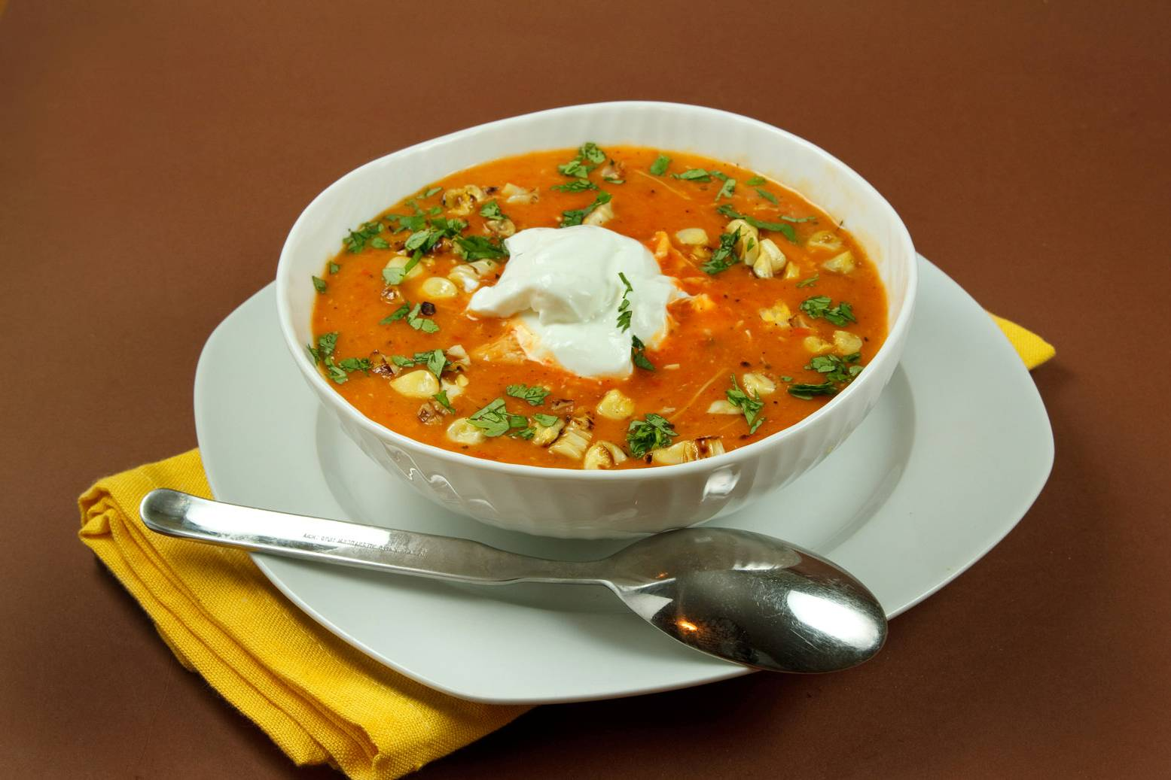
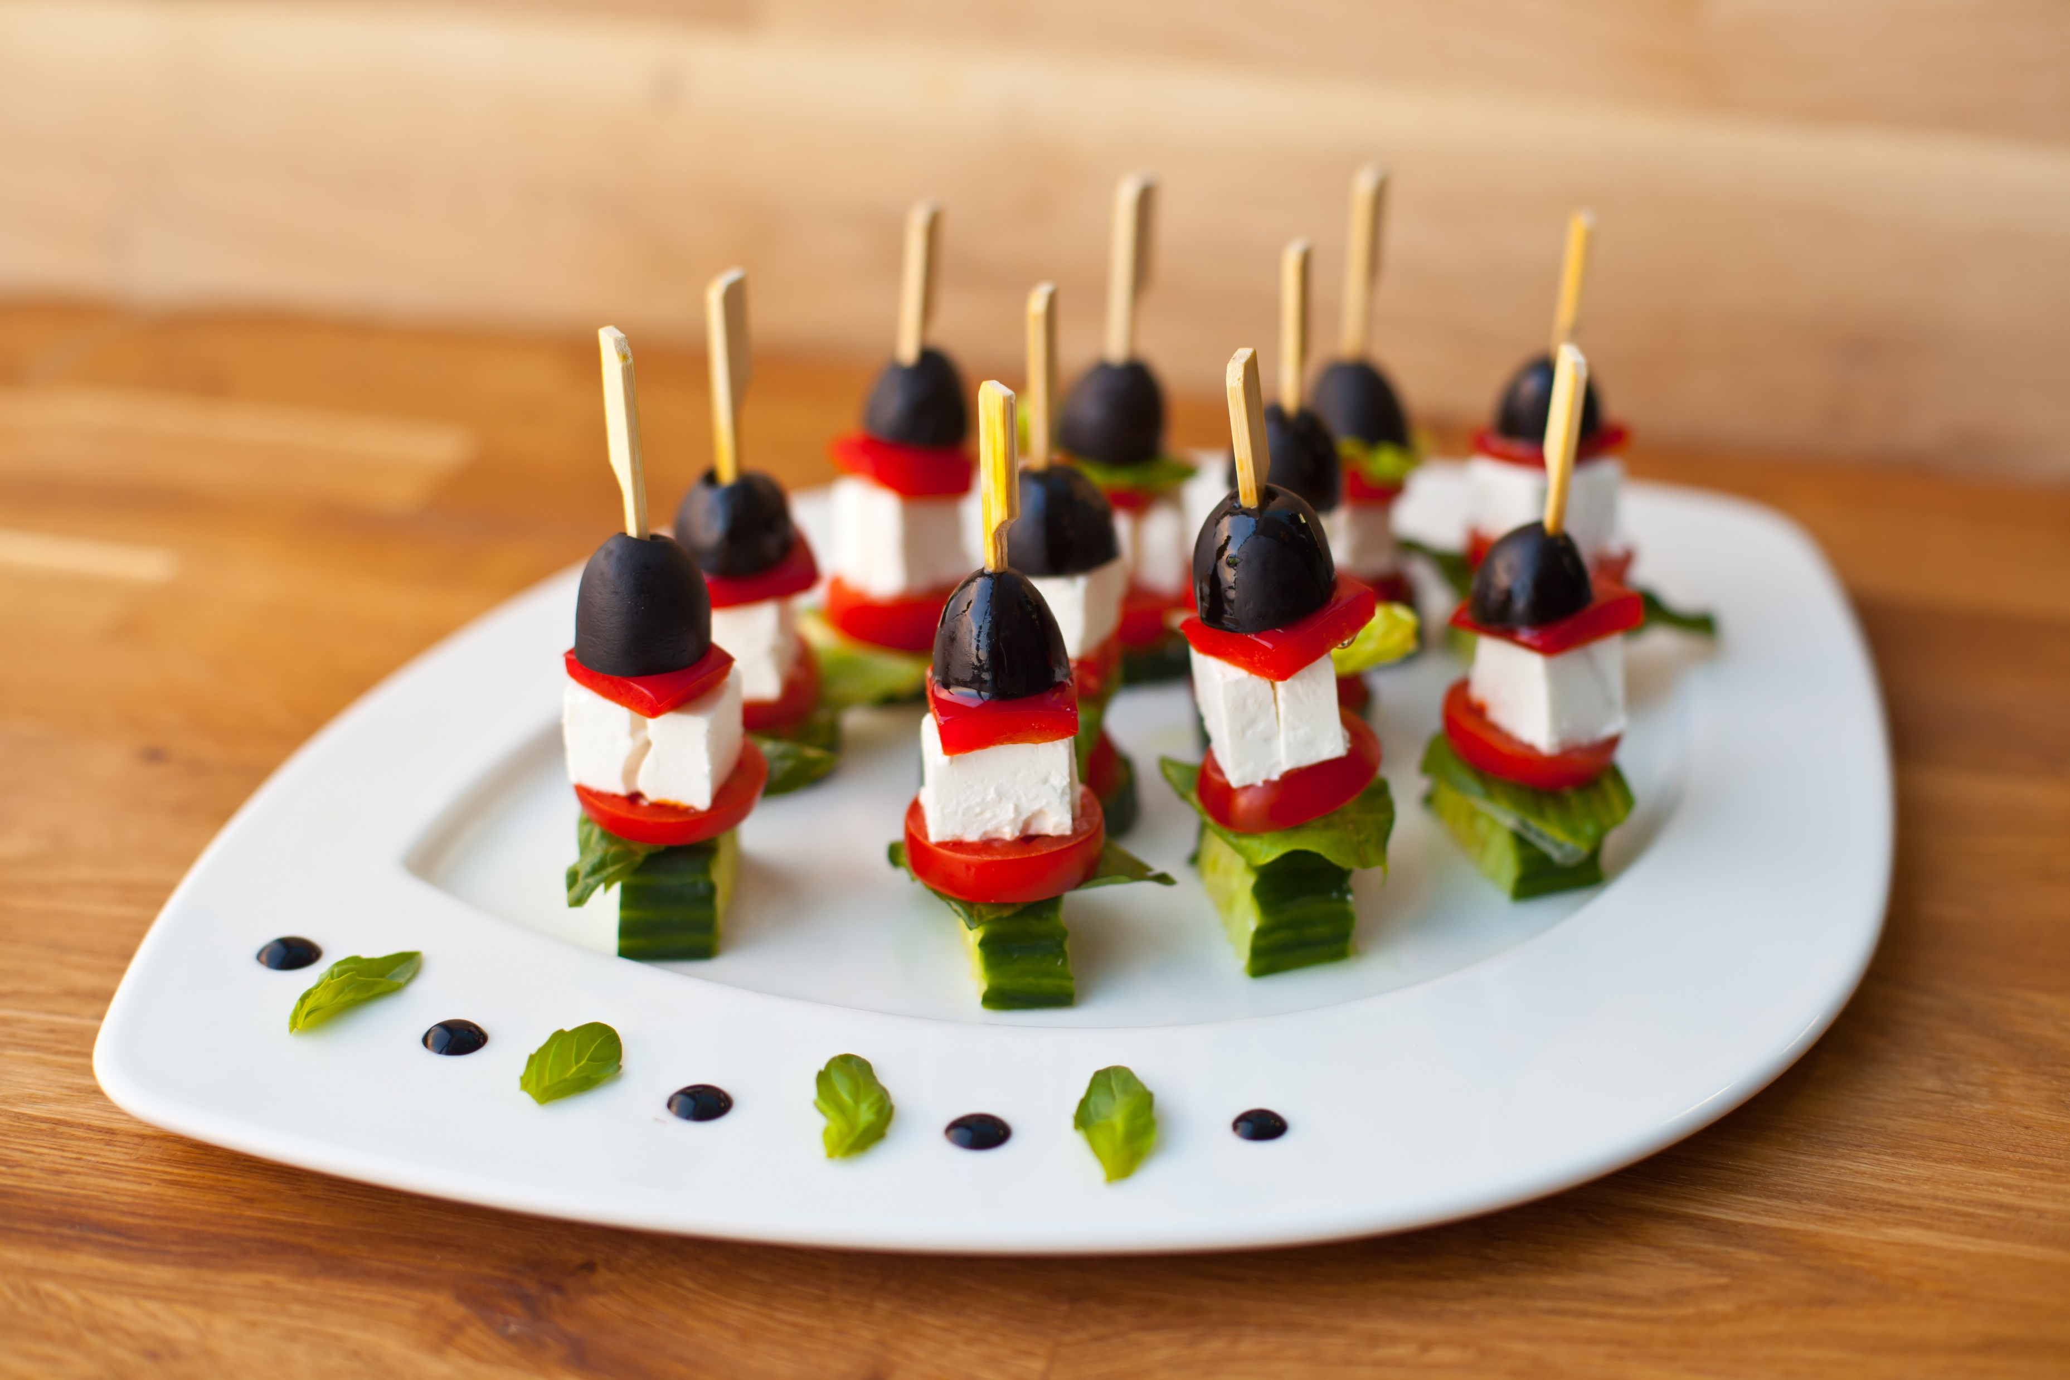
The structure of menu
The classical French menu has more than twelve courses.
Modern menus usually have two or three courses:
Appetizers or snacks
Soups
Entrees
Main courses
Desserts

Slide 5
Many restaurants call the first three courses «starters». 1. Appetizers can be hors-d’oeuvres, pates, or natural oysters. These dishes are usually cold.

Slide 6
2. Soups are usually served hot, but can be served cold.

Slide 7
3. The entrée in the classical French menu is a course served between the fish and the main meat courses. In the modern menu it can be seafood dishes, salads, small fried sausages or fish.

Slide 8
4. The main course is the most substantial course of the meal. Guests usually choose their main courses first and then select other courses.

Slide 9
5. Dessert is the sweet course at the end of a meal or before coffee. Coffee can be served with chocolates, biscuits or fruit.

