Slide 1
QUIZ
Подготовила Буневич Виктория Романовна, учитель английского языка МОУ гимназии №12 г. Тверь

Slide 2
QUESTIONS AND CATEGORIES
Grammar | 100 | 100 | 100 | 100 | 100 | 100 | 100
Where are the robots? | 100 | 200 | 300 | 400 | 500 | 600 | 700
All about the Internet | 100 | 200 | 300 | 400 | 500 | 600 | 700
How to use English | 100 | 200 | 300 | 400 | 500 | 600 | 700
I am better than Google Translate | 100 | 200 | 300 | 400 | 500 | 600 | 700
GENIUS OR NOT | 100 | 200 | 300 | 400 | 500 | 600 | 700

Slide 3
100
BACK
This time next week I ___ (fly) to London.

Slide 4
100
BACK
We ____ (visit) our friends tomorrow evening.

Slide 5
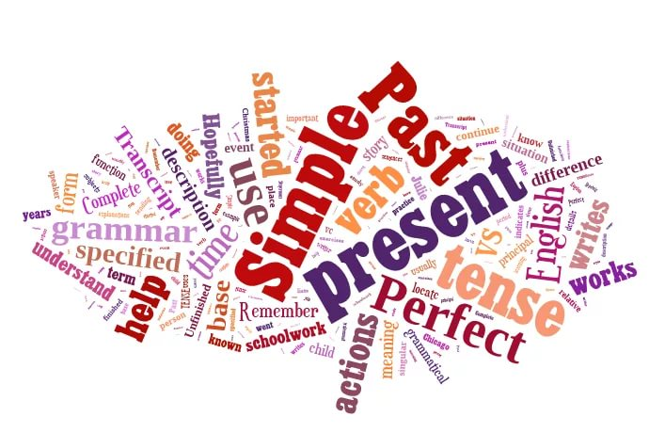
100
BACK
In 2100 we ____ (use) flying cars.

Slide 6
100
BACK
By the end of the next week they ___ (finish) their projects.

Slide 7
100
BACK
It is so slippery… Look! He ___ (fall)!

Slide 8
100
BACK
By the end of the month Jane ___ (work) in this company for 10 years.

Slide 9
100
BACK
The bus ____ (arrive) at 7.15 o’clock.

Slide 10
100
BACK
Translate the sentence: The main problem with creating a robot is how to give it intelligence.

Slide 11
200
BACK
Choose the correct word: The invention/discovery/creation/production of a thinking robot lies in the future.

Slide 12
300
BACK
what does “household robot” mean? Give an explanation.

Slide 13
400
BACK
Say 3 problems related to the computers.

Slide 14
500
BACK
what is not true about robots?
Mobility
Perform different tasks
Understand emotions and gestures
Know lots of information in different spheres
Understand figurative speech
Understand several languages

Slide 15
600
BACK
Say 5 words related to each topic: Hardware and Software

Slide 16
700
BACK
“Computers will replace the human beings in the future”. Do you agree? Give 3 reasons.

Slide 17
100
BACK
What does “www” mean?

Slide 18
200
BACK
what is “the internet”
a way of sending emails
a way of sending emails and watching videos via Youtube
a worldwide system of computers network
a worldwide system of websites’ users.

Slide 19
300
BACK
we are on the same wavelength. What does it mean?

Slide 20
400
BACK
I can not connect to the net, maybe the ___ is busy.
TV
Phone line
Server
Subscription

Slide 21
500
BACK
Name 3 search engines.

Slide 22
600
BACK
Name 3 WEBsites that help you improve your English skills. Say why.

Slide 23
700
BACK
What does “e” stands for in “email / e-book”?

Slide 24
100
BACK
Make a noun from “deliver”

Slide 25
200
BACK
make a noun from “inform”

Slide 26
300
BACK
What is missing? “Every new invention starts ___ a good idea”

Slide 27
400
BACK
What is missing? “Creating a robot is much more difficult __ practice than ___ theory”

Slide 28
500
BACK
Choose the correct answer:
Can I download/access to the Internet from this laptop?

Slide 29
600
BACK
Choose the correct answer:
Digital cameras have dropped in price, which has positively affected/effected the sales.

Slide 30
700
BACK
Make nouns from: invent, create, attach

Slide 31
100
BACK
Translate into English: робот, технологии, компьютер

Slide 32
200
BACK
Translate into English: мозг, экран, клавиатура

Slide 33
300
BACK
Translate into English: мышь, ноутбук, сканнер

Slide 34
400
BACK
Translate into Russian: memory, website, virus

Slide 35
500
BACK
Translate into Russian: memory, website, virus

Slide 36
600
BACK
Translate into Russian: download, delete, frozen screen

Slide 37
700
BACK
Translate into English: препятствие, ссылка, соединение

Slide 38
100
BACK
What is the capital of Great Britain?

Slide 39
200
BACK
In which countries do people speak English?

Slide 40
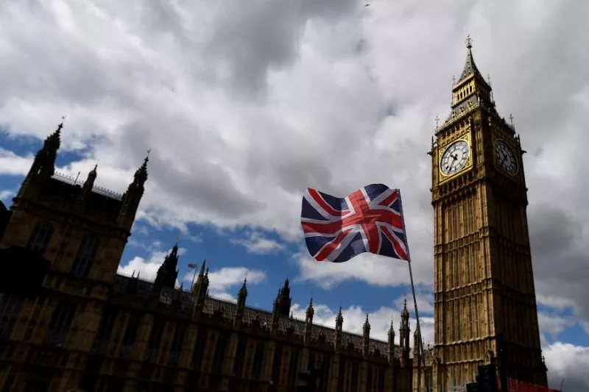
300
BACK
Who rules in the UK? What is his/her name?

Slide 41
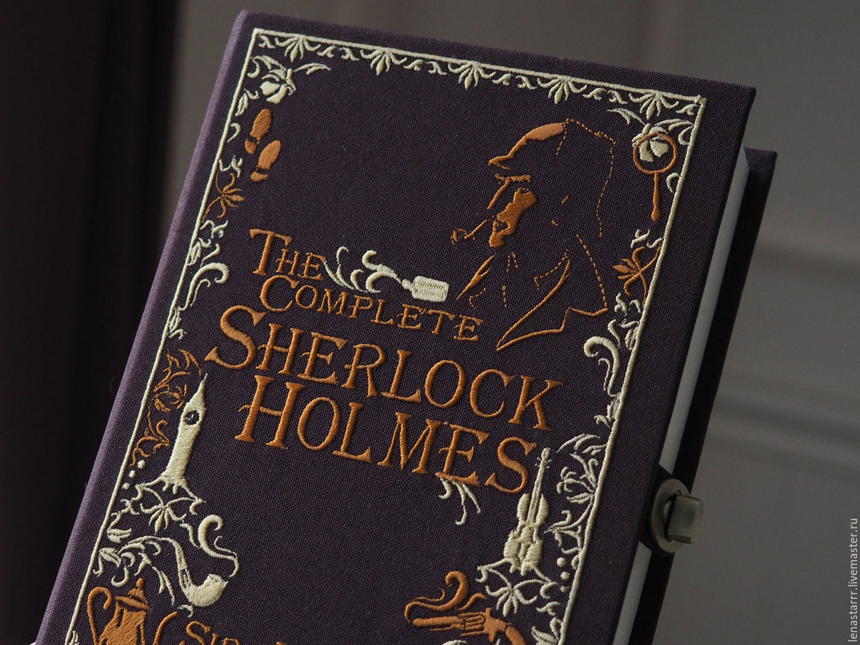
400
BACK
Who is the author of “Sherlock Holmes”?

Slide 42
500
BACK
what can’t you find in Great Britain?
1) Trafalgar square
2) Big Ben
3) Saint Isaac’s Cathedral
4) Westminster Abbey

Slide 43
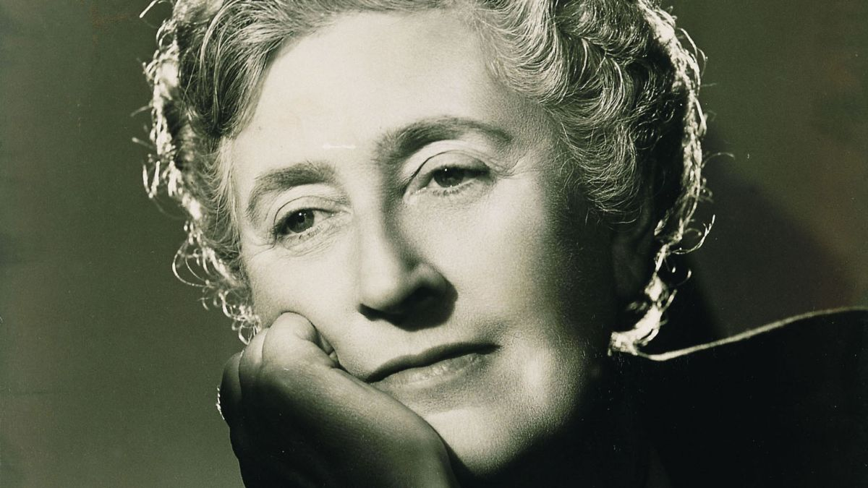
600
BACK
Who is Agatha Christie? What do you know about her works?

Slide 44
700
BACK
Who wrote “The Picture of Dorian Gray”?

Slide 45
Источники
https://ru.wikipedia.org
https://yandex.ru/images/
http://www.newworldencyclopedia.org/entry/Great_Britain
https://alleng.org/engl-top/005.htm
https://www.historic-uk.com/HistoryUK/HistoryofBritain/The-UK-Great-Britain-Whats-the-Difference/

