Slide 1
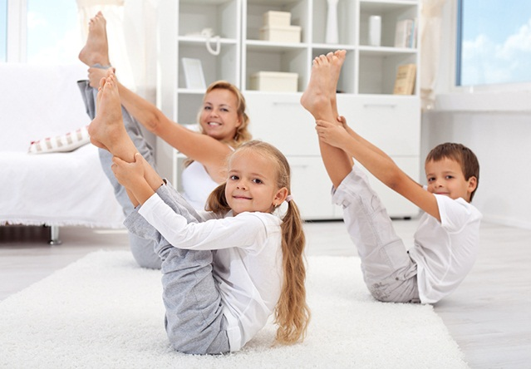
Healthy food and healthy lifestyle

Slide 2
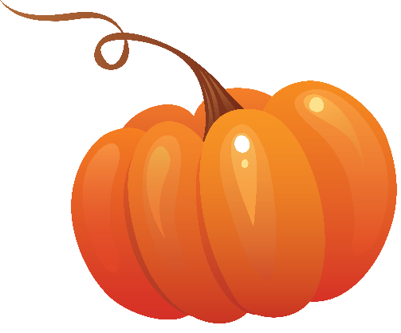
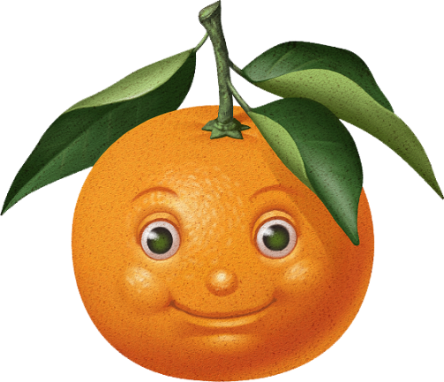
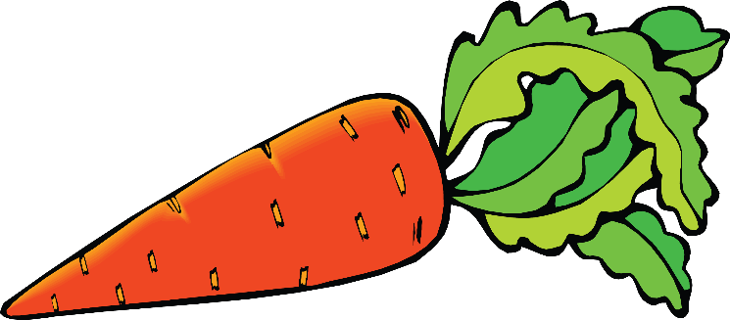
Orange foods
Orange foods are brain food. They help you keep your mind on things and really improve your powers of concentration. On the physical side, foods like mangoes, oranges and peaches have lots of vitamin C. This is important because that's the vitamin that helps your body fight off infections. As everyone knows, carrots are also fantastic for your eyesight. After all, you've never seen a rabbit wearing glasses, have you?

Slide 3
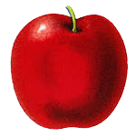
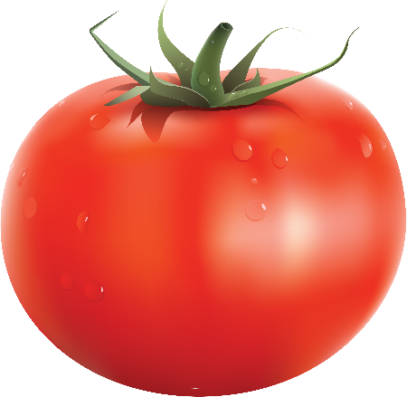
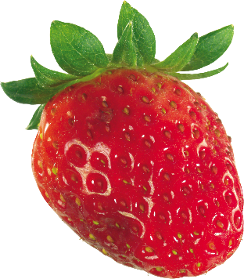
Red foods
Red foods get you moving. They give you that extra boots when you really need it the most. What's more, eating foods in this group will protect you from many serious illnesses and can keep older people active for longer. So, have you got a big game tonight ? is it your turn to do the gardening? Then go ahead and treat yourself to one or even two of your favourite red foods.

Slide 4
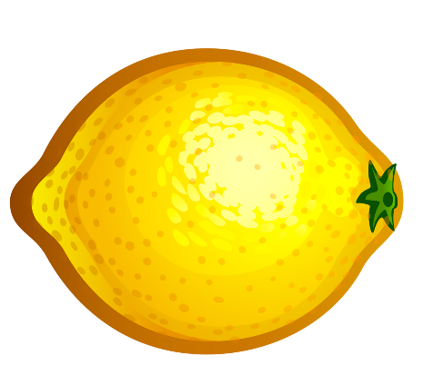
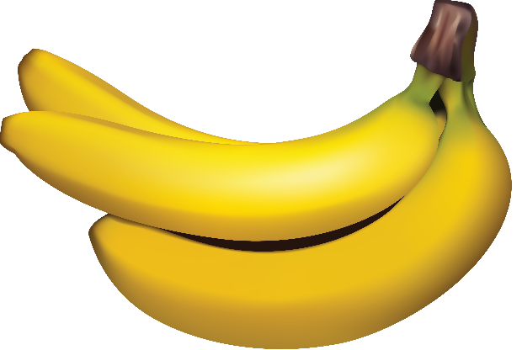
Yellow foods
Yellow foods are nature's way of helping us to stay happy. They make you more optimistic. Imagine that you're feeling a bit down in the dumps. Eat a banana and you'll feel a bit better. Eat a couple of slices of pineapple and you'll feel a smile coming on and by the time you finish your tall glass of lemonade, you'll be grinning from ear to ear! What could be easier? Enjoying yellow foods is better for you, emotionally, than hearing the best jokes in the world.

Slide 5
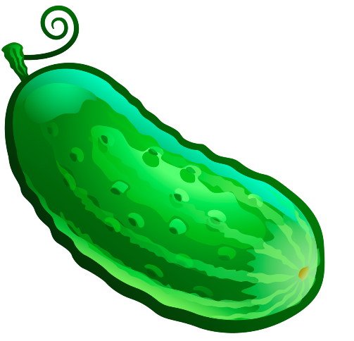
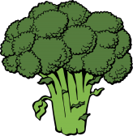
Green foods
Broccoli, lettuce and cucumbers are all green foods. These foods are great when you want to relax, calm yourself down or keep your emotions under control. Green foods are good for you because they contain vitamins and minerals that keep your teeth and bones strong and healthy, so next time your mum tells you to eat all your peas don't complain, just do it. Remember, mums always know what's best for you, no matter how old you are!

Slide 6
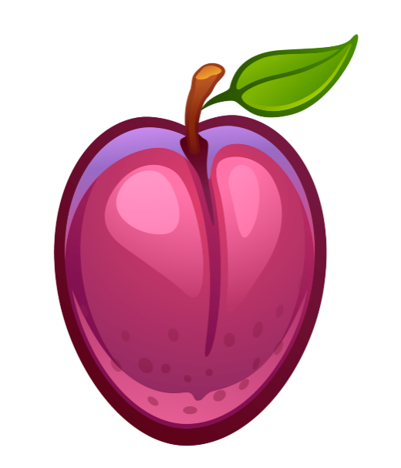
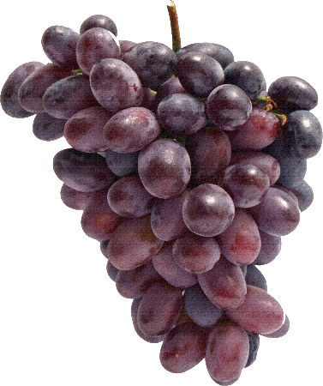
Purple foods
Shakespeare, Da Vinci and Picasso must have all been fans of purple foods. This is because fruits and vegetables like figs, prunes and beetroot make people more creative. If that isn't a good enough reason to eat them, then think about this ... purple foods can keep you looking young! Imagine being eighty years old, but looking as if you're forty and just about to finish writing your second best-selling novel. Bring on the purple foods!

Slide 7
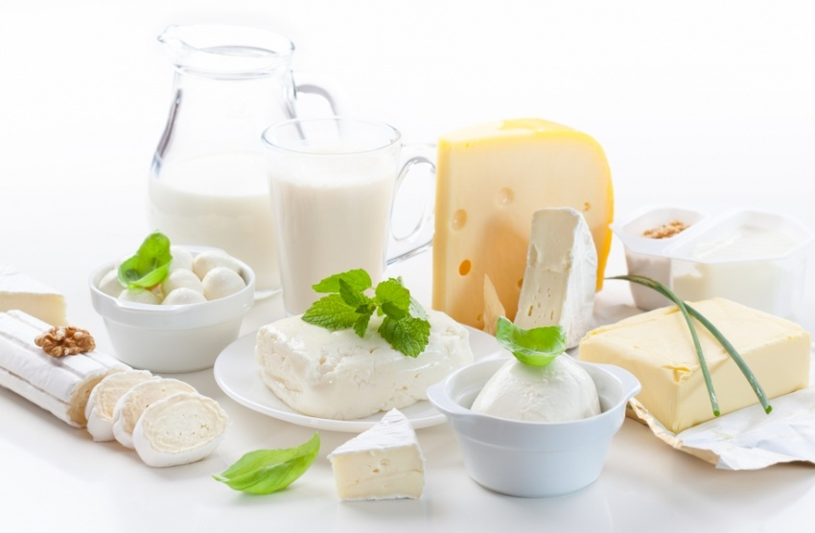
Healthy way of life
1
What dairy products do you know?
2
4

Slide 8
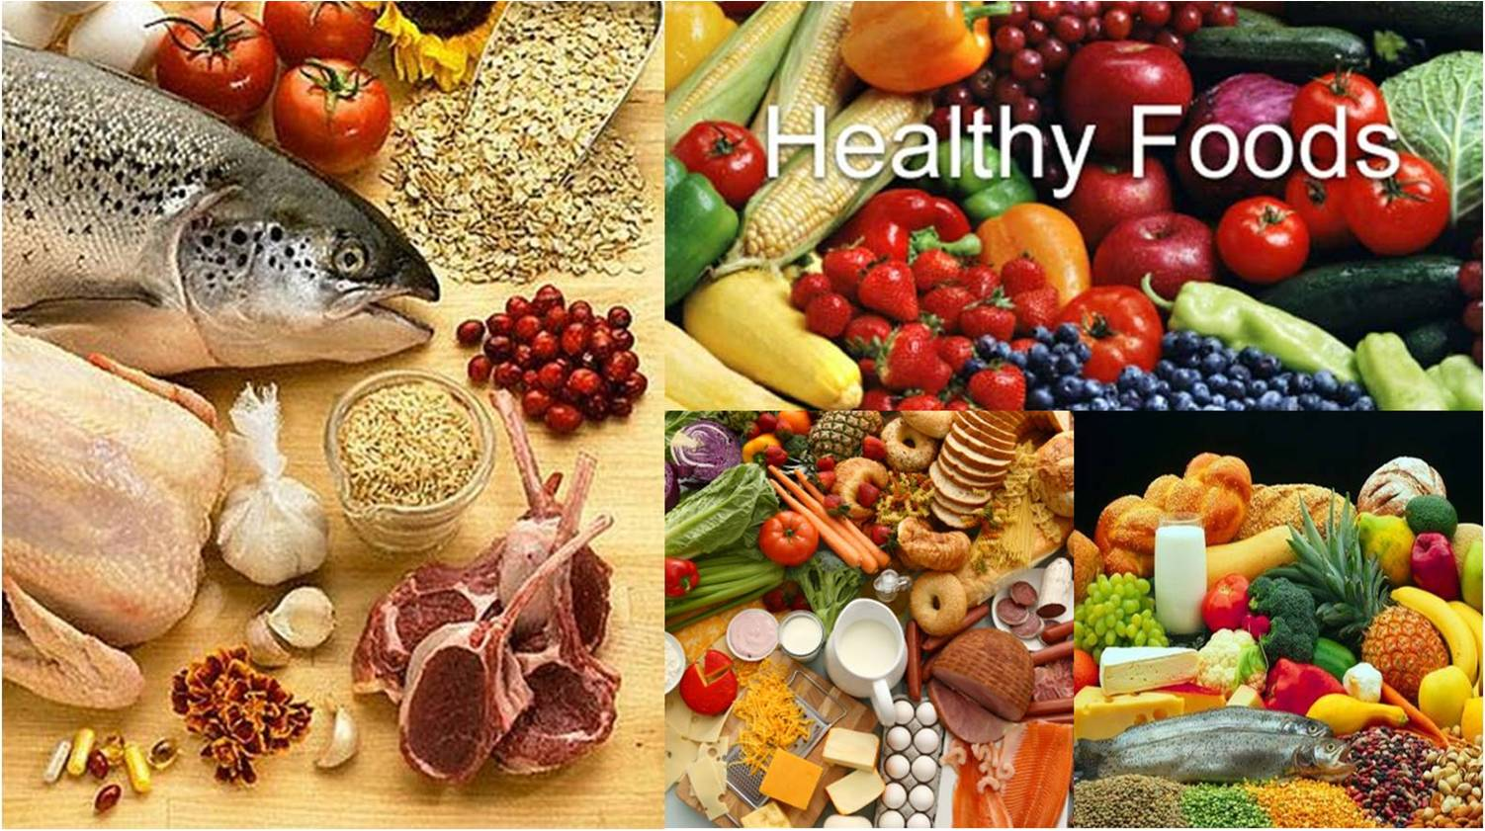
Healthy way of life
2
What food is good for people`s health?

Slide 9
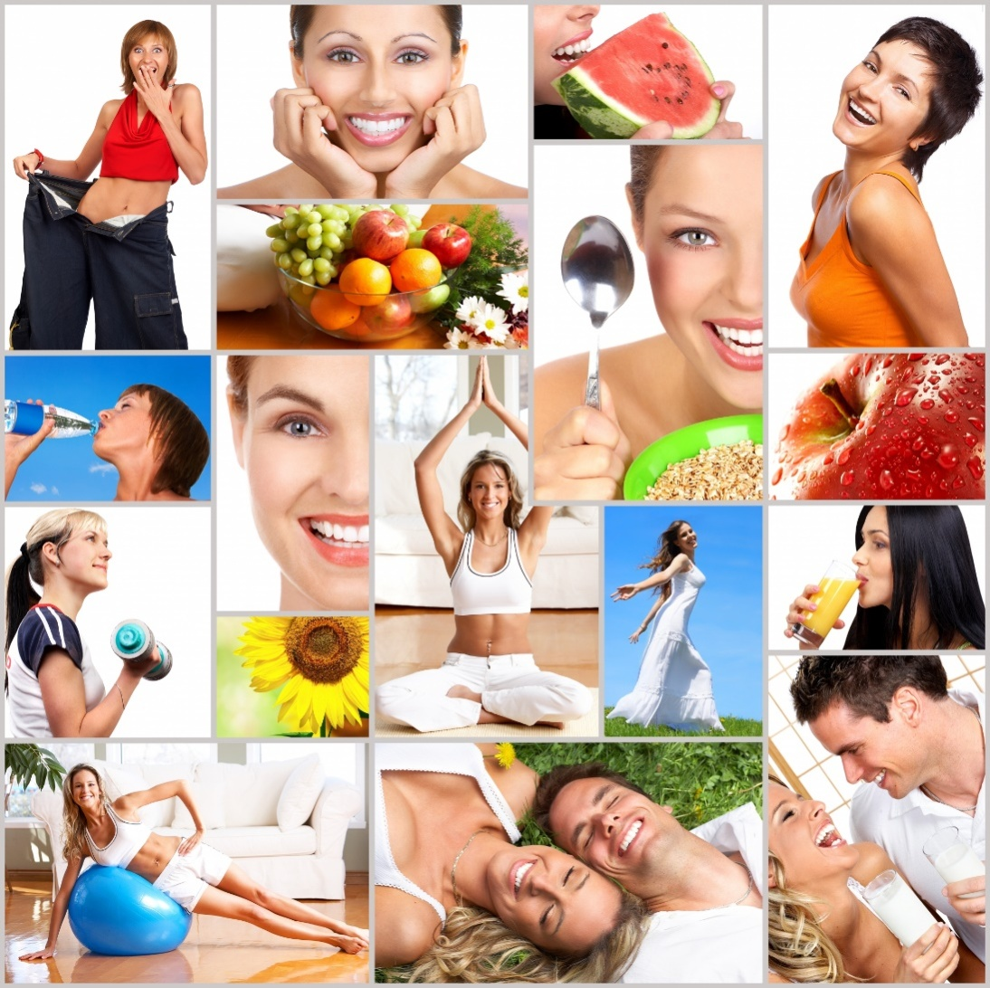
Healthy way of life
3
What can help us to keep fit?

Slide 10
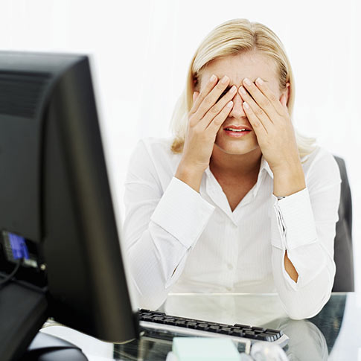
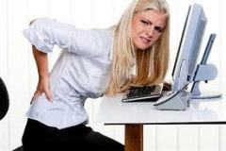
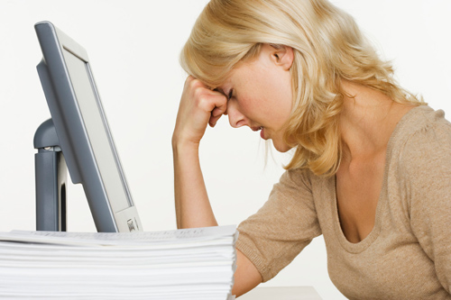
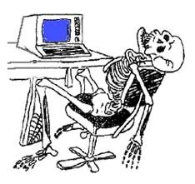
Healthy way of life
4
Which parts of human body can suffer from TV and computer?

Slide 11
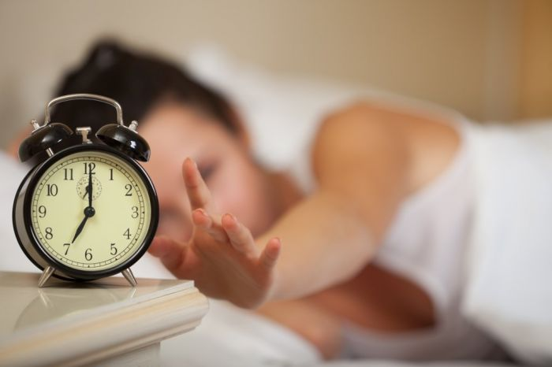
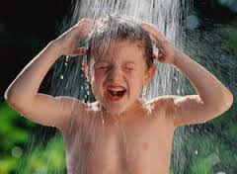
Healthy way of life
5
What should we start our day with to be healthy?
3

Slide 12
Grammar practice Complete the sentence using some/any/much/many
To make this dish you need some tomatoes, some eggs and some olive oil.
We need to go to the supermarket; we haven`t got any bread.
Are there any tomatoes in the fridge?
We have got some potatoes. Don`t buy many .
Do we need much olive oil?

Slide 13
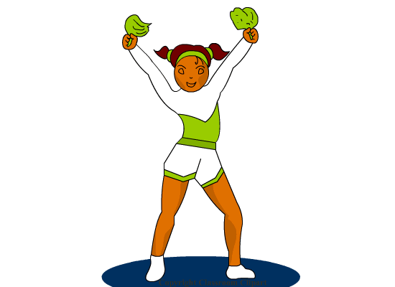
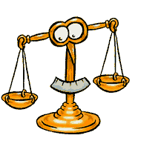
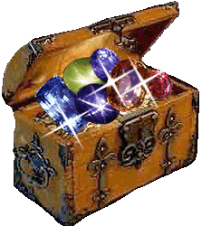
Put the words in the logical order
wealth, is, good, above, health
Good health is above wealth.

Slide 14
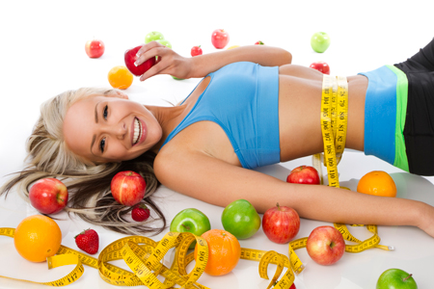
Put the words in the logical order
healthy, fit, food, to, eat, keep
Eat healthy food to keep fit

Slide 15
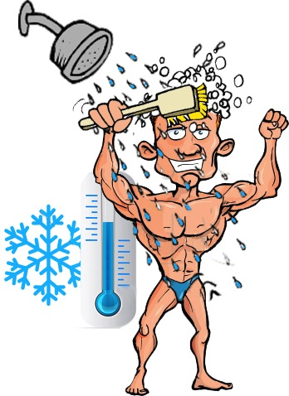
Put the words in the logical order
be, take, a, shower, cool, to, healthy
Take a cool shower to be healthy

Slide 16
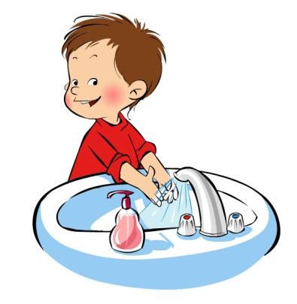
Put the words in the logical order
Your, eat, wash, hands, before, you
Wash your hands before you eat

Slide 17
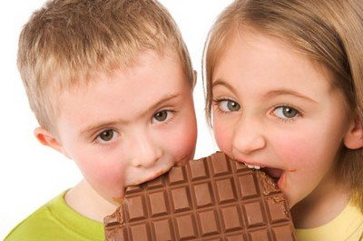
Put the words in the logical order
Sweets, are, too, bad, many, teeth, for, your
Too many sweets are bad for your teeth

Slide 18
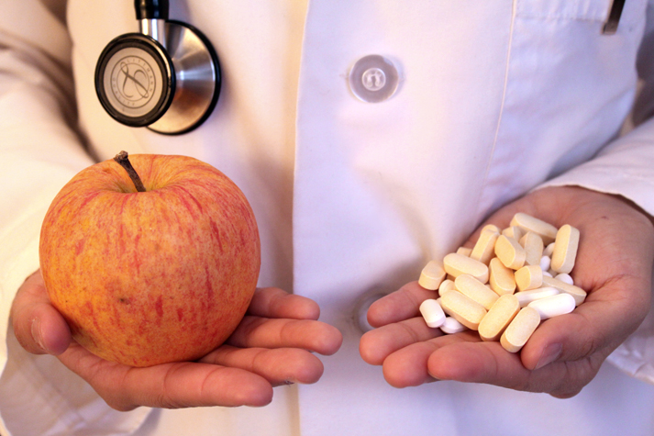
Put the words in the logical order
A, away, apple, an, keeps, a doctor, day
An apple a day keeps a doctor away

Slide 19
Healthy food will make you smile

Slide 20
Put the letters in a logical order
UMUCCREB
SUMHOMOR
MAOOTT
GEABVELTE
COHLOTAEC
TAPOTO
WADNSCIH
RACROT
CENHCIK
CUCUMBER
MUSHROOM
TOMATO
VEGETABLE
CHOCOLATE
POTATO
SANDWICH
CARROT
CHICKEN

Slide 21
Answer the questions
And find out the secret word

Slide 22
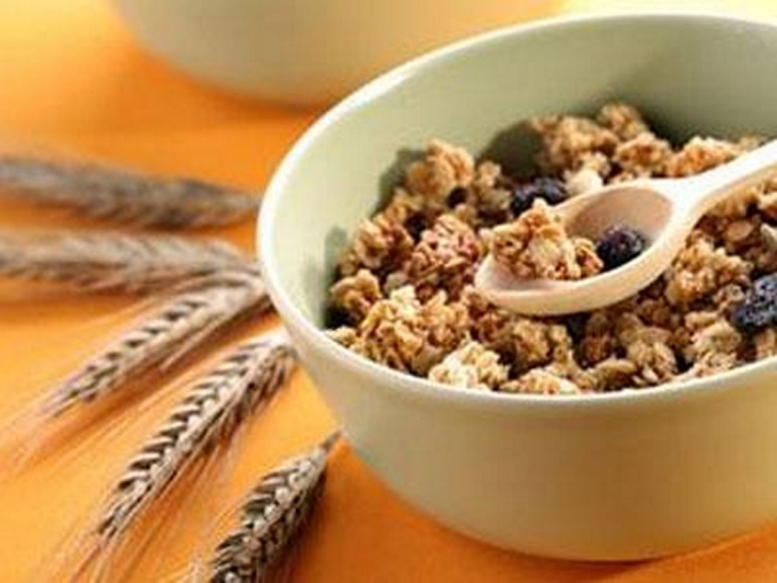
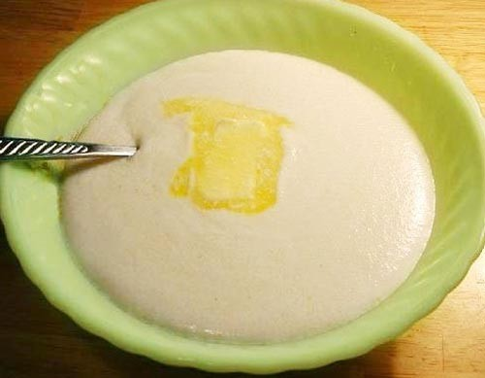
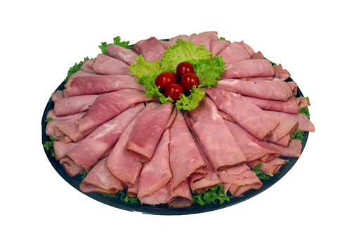
1. Choose the wrong kind of food for breakfast.
Porridge
Ham
Muesli

Slide 23
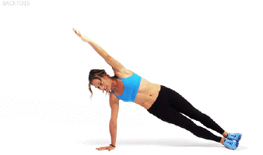
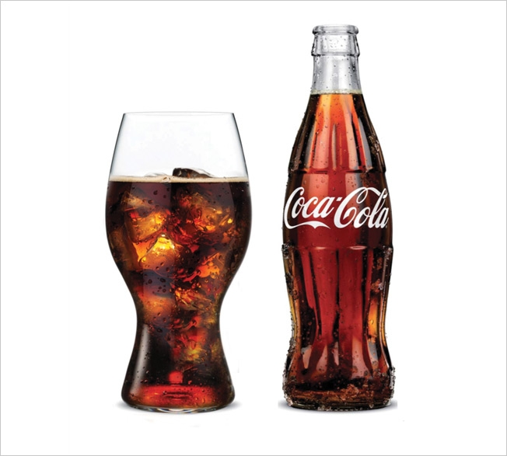
2. Do it every morning to keep fit
Exercise
Drink Coca-Cola
Smoke

Slide 24
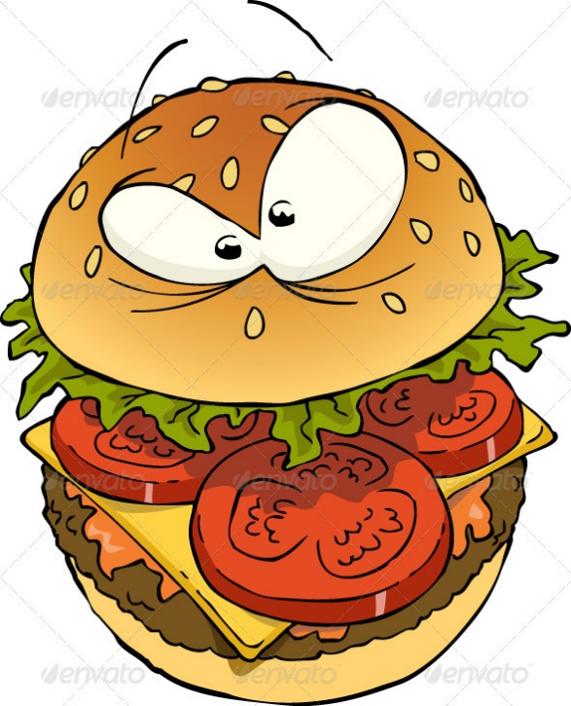
3. ….. a day keeps doctor away
Apple
Lemon
Hamburger

Slide 25
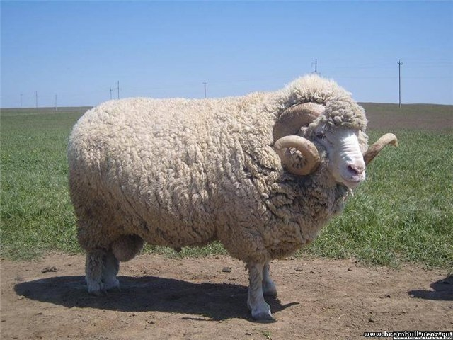
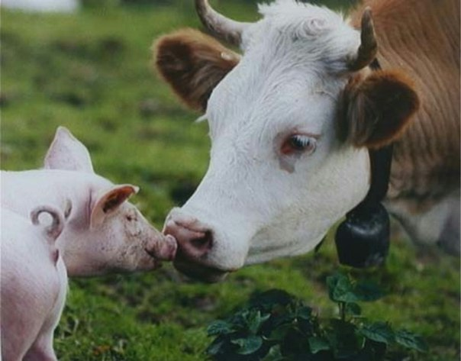
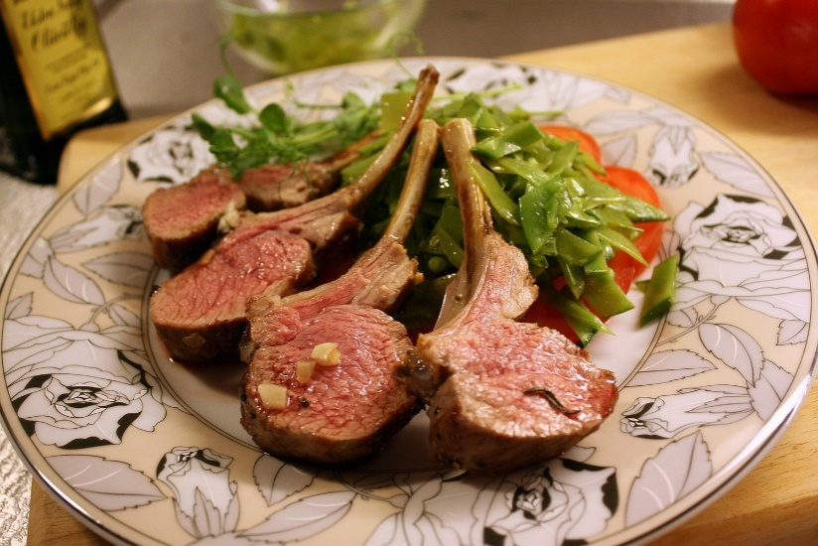
4. How do we call sheep`s meat?
Pork
Beef
Lamb

Slide 26
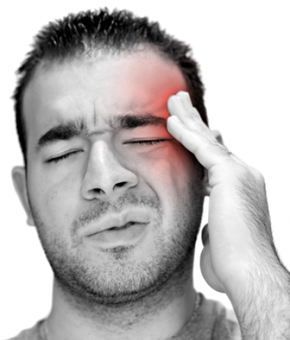
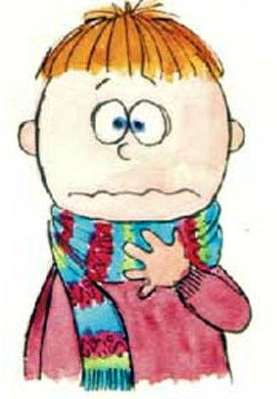
5. It will hurt after eating a lot of ice-cream.
Head
Chest
Throat

Slide 27
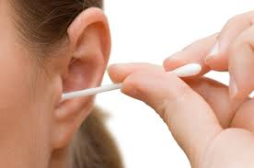
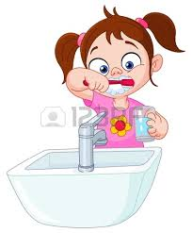
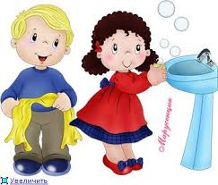
6. You should wash them before you eat
Teeth
Hands
Ears

Slide 28
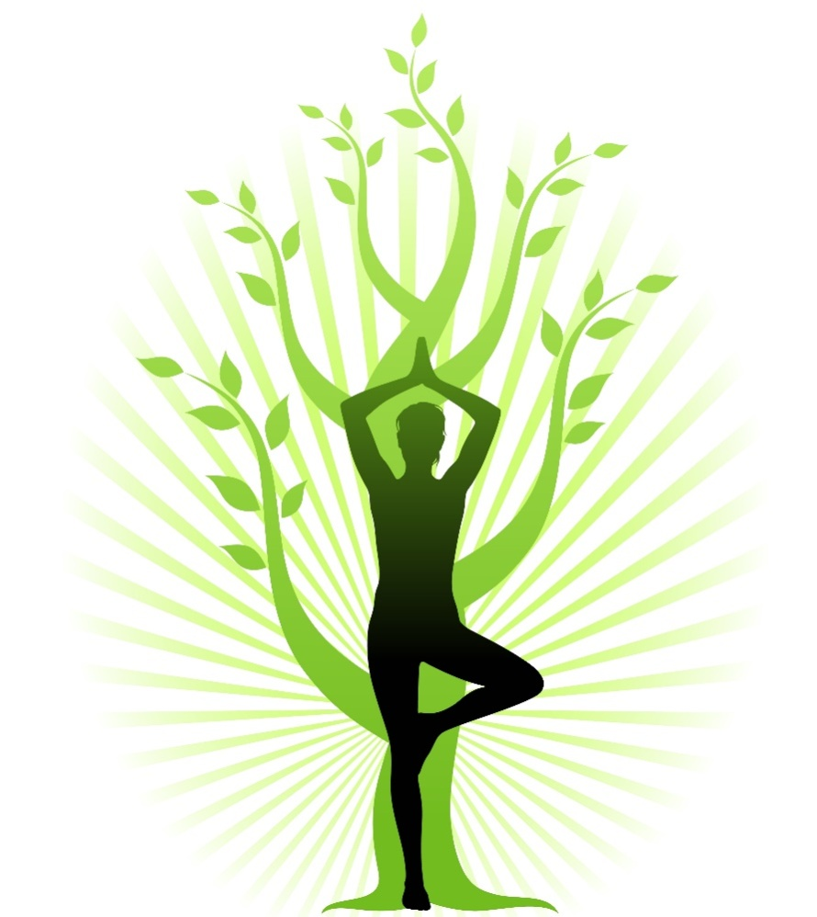
The secret word is
HEALTH

Slide 29
Thank You! Have a nice day and be in a good health!

