Slide 1
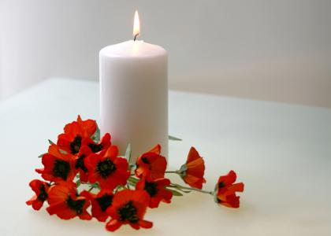
Remembrance Day

Slide 2
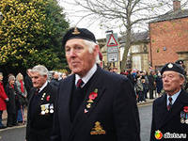
Special Day to Remember War Veterans
After World War II,
the name of the holiday
was changed to:
Veterans Day
in the USA;
Remembrance Day
in Britain and countries of the British Commonwealth of Nations

Slide 3
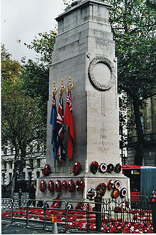
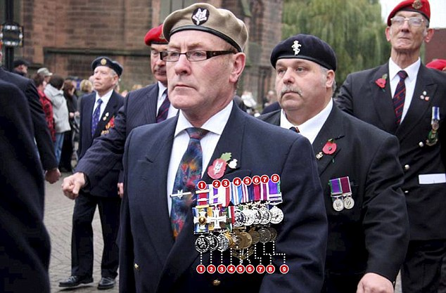
Where it happens
The 11a.m.ceremony takes place at the Cenotaph, in London

Slide 4
Paying Tribute The Queen, the Duke of Edinburg, the Duke of Cambridge

Slide 5
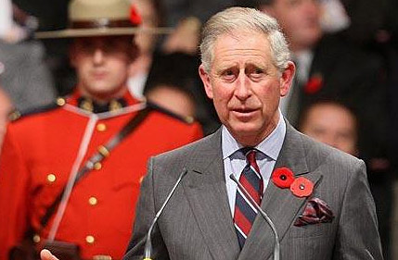
The Royal Family on Remembrance Day

Slide 6
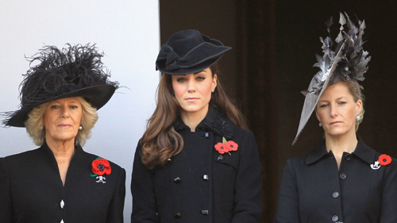
The Royal Family on Remembrance Day

Slide 7
Political Leaders Prime Minister David Cameron, Deputy Prime Minister Nick Clegg hold wreaths

Slide 8
Watching on Thousands of people gathered in central London to commemorate the sacrifices of the Armed Force

Slide 9
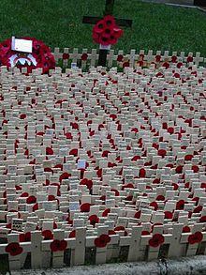
Memorials on the fields of Remembrance outside London’s Westminster Abbey

Slide 10
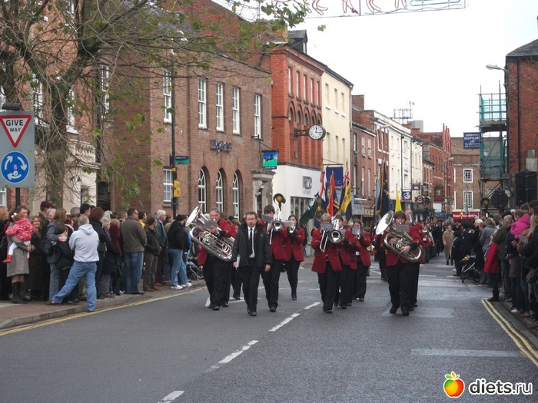
How the British commemorate Remembrance Day

Slide 11
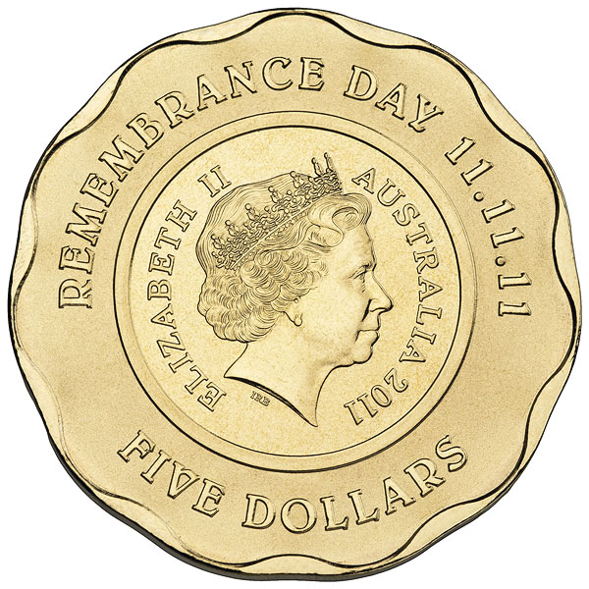
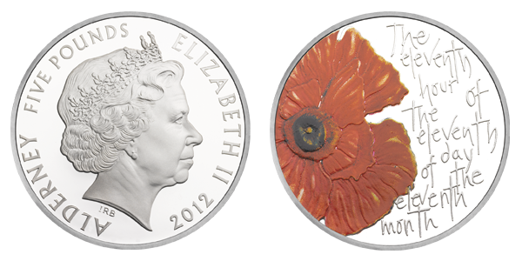

Slide 12
Thank you for your attention!

