Slide 1
Living in Space
Teacher: V. I. Porechnaia
Notes:
http://masyamba.ru/Космос/58%20(Галактика,%20звезды,%20планеты).jpg

Slide 2
1 Working on the vocabulary
2 Listening
3 Answering the questions
4 Discussing
5 Voting
Notes:
https://www.remontnik.ru/media/OrderPicture/99/163144__c7477d30e83f208e2df89001962e7f8c.jpg
https://aclanguages.com/wp-content/uploads/2016/03/the-vocabulary-book_block_1-300x182.png
http://9.news.img.orsha.eu/479/preview.315.jpg
http://pathworksohio.com/wp-content/uploads/2014/09/checked-boxes.jpg
https://thumbs.dreamstime.com/t/бесе-ы-круг-ого-сто-а-установ-енной-ю-группа-в-составе-коман-ы-72086404.jpg
https://www.ourgateshead.org/sites/default/files/styles/thumbnail/public/images/resources/thank-you-volunteer-clip-art-volunteer-hands-large.jpg?itok=4E2FfCqv

Slide 3
Airless
Space
Vacuum
Hose
Space
Station
Muscles go
Soft
Lack
of Gravity
Household
Chores
Sleeping
Bag
Football
Pitch
Zero
Gravity
Do
Experiments

Slide 4
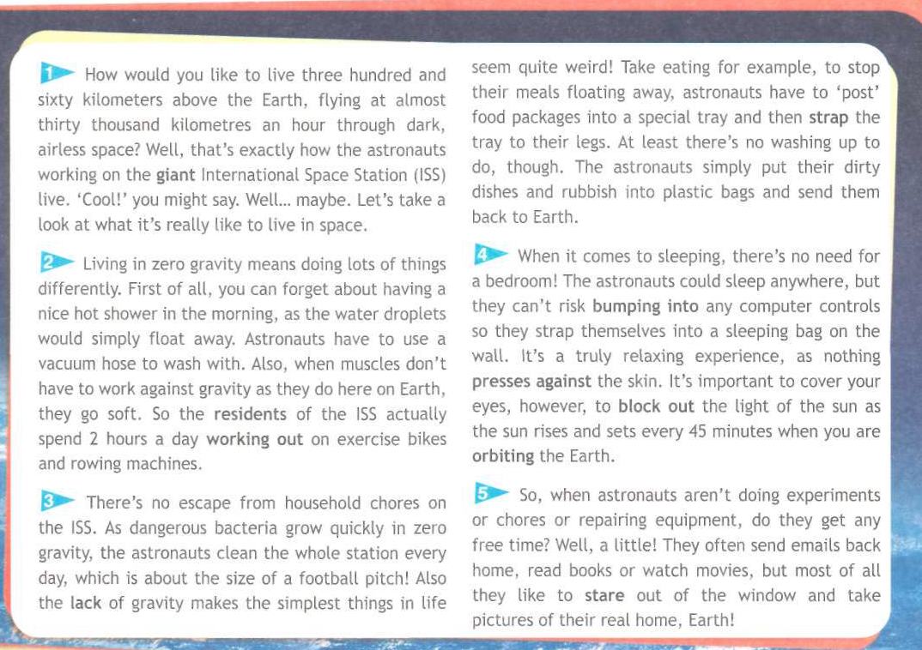
1
2
8
3
4
5
9
6
7

Slide 5
Where do the astronauts work?
What does living in zero gravity mean? Give examples.
What does eating in Space look like?
What does sleeping in Space look like?
How do the astronauts spend their free time in Space?

Slide 6
1st group: We should never live and work in zero gravity.
2nd group: We should definitely live and work in zero gravity but only in Space.
3rd group: It would be great to have zero gravity on Earth, live and work in zero gravity here.

Slide 7
Thank you for your attention!

