Slide 1
My holidays! It’s windy!

Slide 2
Warming up
Rain on the green grass. Rain on the tree. Rain on the house top, But not on me!

Slide 3
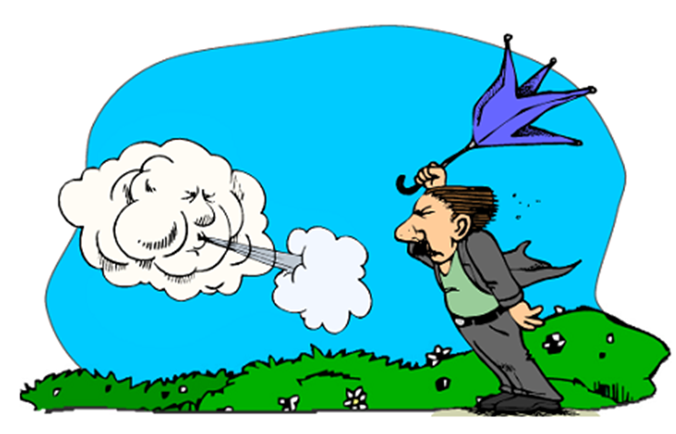
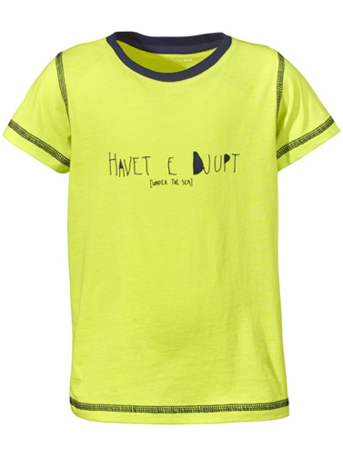
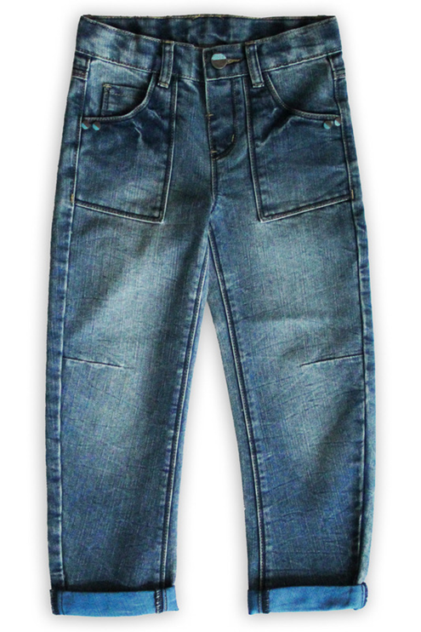
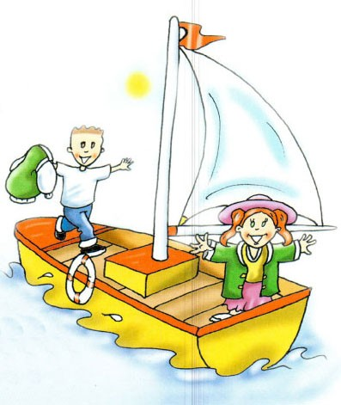
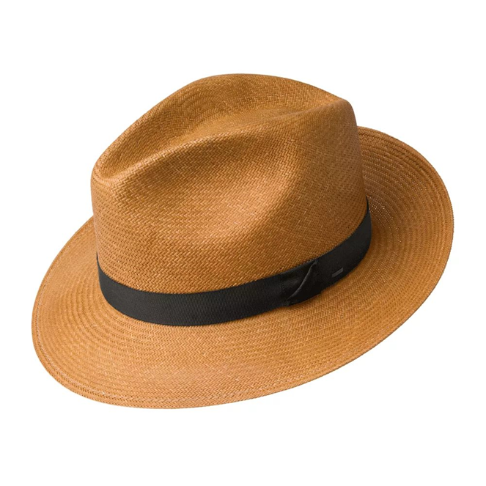
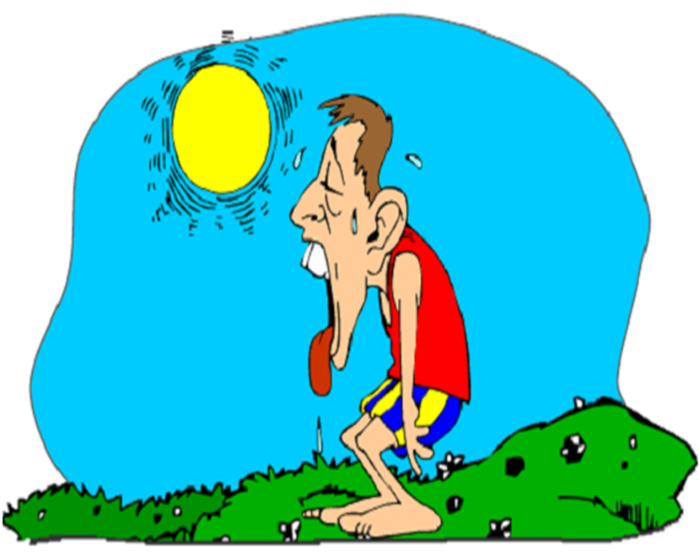
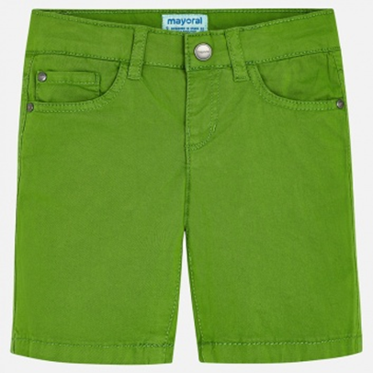
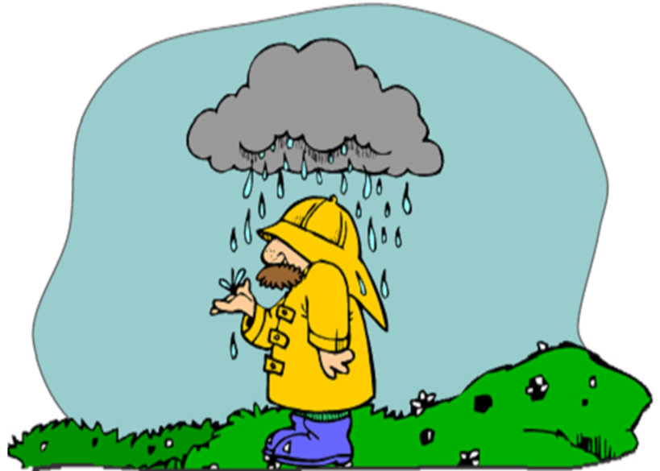
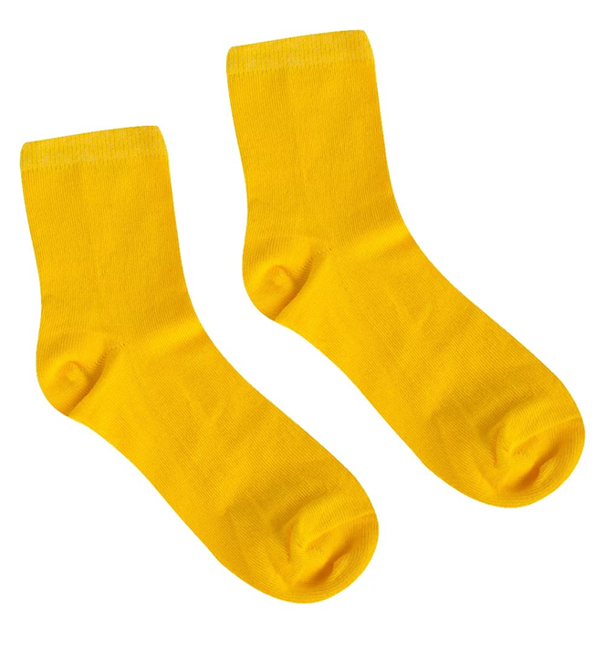
HOLIDAYS !

Slide 4
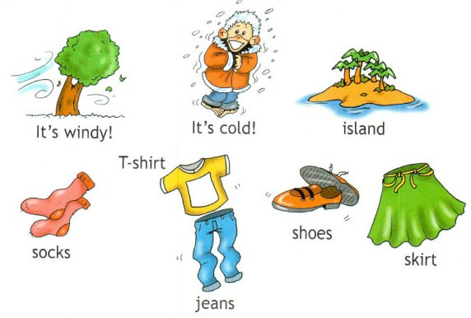

Slide 6
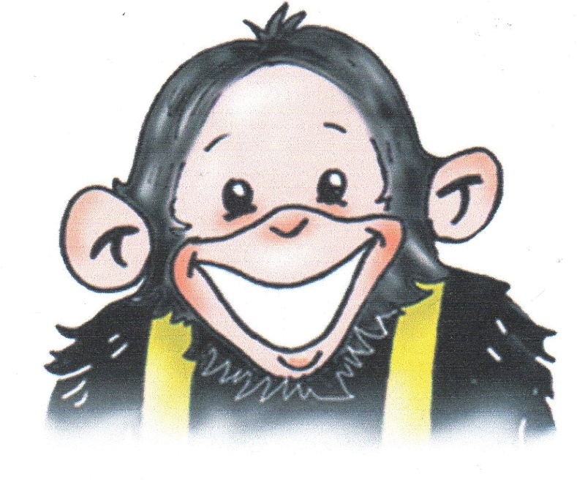
ВСТАВЬТЕ TAKE OFF, PUT ON.
It’s hot! ….. your hat!

Slide 7
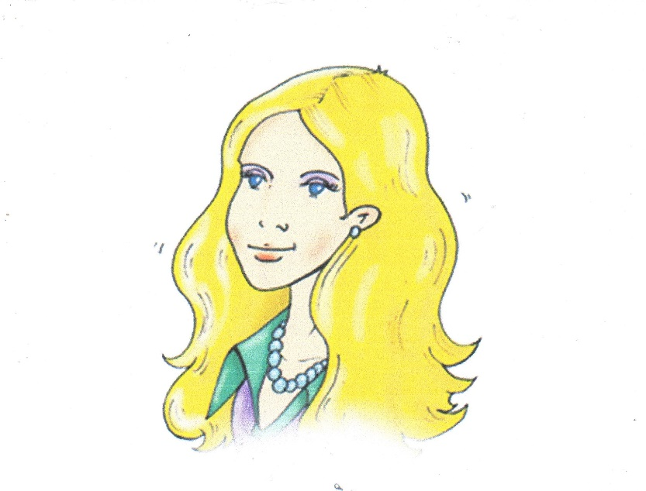
ВСТАВЬТЕ TAKE OFF, PUT ON.
It’s hot! Put on your hat!

Slide 8
ВСТАВЬТЕ TAKE OFF, PUT ON.
It’s cold! … your coat!

Slide 9
ВСТАВЬТЕ TAKE OFF, PUT ON.
It’s cold! Put on your coat!

Slide 10
ВСТАВЬТЕ TAKE OFF, PUT ON.
It’s raining! … your raincoat!

Slide 11
ВСТАВЬТЕ TAKE OFF, PUT ON.
It’s raining! Put on your raincoat!

Slide 12
ВСТАВЬТЕ TAKE OFF, PUT ON.
It’s windy! … your shorts and … your jeans!

Slide 13
ВСТАВЬТЕ TAKE OFF, PUT ON.
It’s windy! Take off your shorts and put on your jeans!

Slide 14
ВСТАВЬТЕ TAKE OFF, PUT ON.
It’s hot! … your jacket!

Slide 15
ВСТАВЬТЕ TAKE OFF, PUT ON.
It’s hot! Take off your jacket!

Slide 16
MAP

Slide 17
CLOTHES LIST
coat
skirt
jeans
shoes
hat
shorts
T-shirt
jacket
9. socks

Slide 18
MAP

Slide 19
It’s sunny!

Slide 20
It’s hot!

Slide 21
It’s windy!

Slide 22
It’s windy!

Slide 23
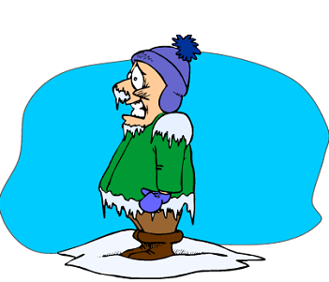
It’s cold!

Slide 24
It’s a boat!

Slide 25
It’s an island!

Slide 26
MAP

Slide 27
She’s wearing her … He’s wearing his …

Slide 28
Find the words
skirt
holidays
coat
socks
jeans
shoeshat

Slide 29
Good bye!

