Slide 1
Learn English through movies and cartoons

Slide 2
Do you like watching movies, cartoons or TV-shows?
Do you watch them in English or in Russian?
Do you think it’s useful to watch films in English or it’s just a waste of time?

Slide 3
When you learn English with movies, you’re taking a wild adventure.

Slide 4
Watching Movies Is a Great Way to Learn English

Slide 5
Speaking skills
1
Hearing natives helps our speaking skills, especially our fluency in speaking.

Slide 6
Pronunciation and listening skills
2
Hearing how certain words are pronounced will help you to remember and memorize the sounds. Besides you are able to hear and understand spoken English fully.

Slide 7
Vocabulary
3
Watching English movies is a great way to learn a lot of new words and expressions.

Slide 8
Learning and having lots of fun!
4
After all, watching movies is supposed to be fun, right? =)

Slide 9
Practice Tips to Really Learn English with Movies

Slide 10
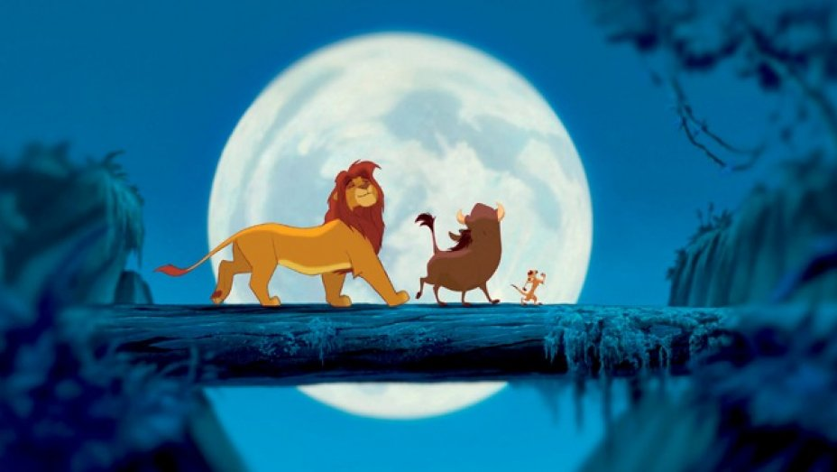
1. Choose an interesting movie
This probably sounds obvious, but if you choose a boring movie, you’ll be bored.

Slide 11
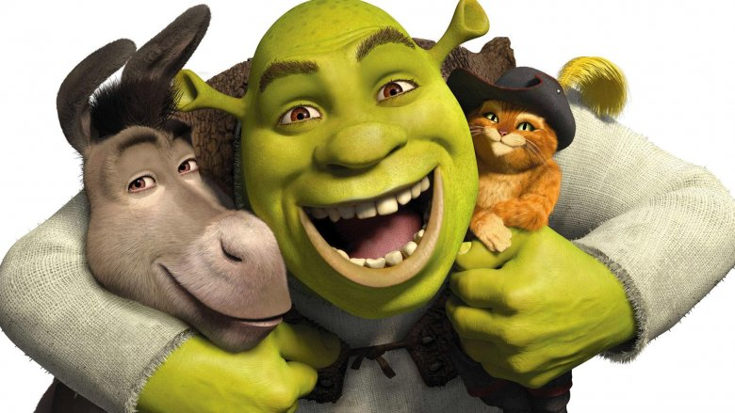
2. Choose a movie that matches your current English level
Learning English through animations would be great for begginers. The main reason is because the English is usually very friendly, nice and easy to understand.

Slide 12
3. Use your dictionary
Choose a film with subtitles! So when you hear a word you’re interested in, check it up!
But DO NOT check up ALL WORDS!!!

Slide 13
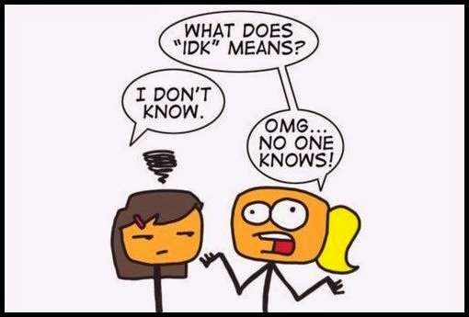
4. Repeat short phrases!
Sometimes, you might hear something cool in the movie. For example, some short phrases, or slang like, “sure thing” or “you betcha!” that are commonly used in English. If you like how it sounds, it really helps to repeat it!

Slide 14
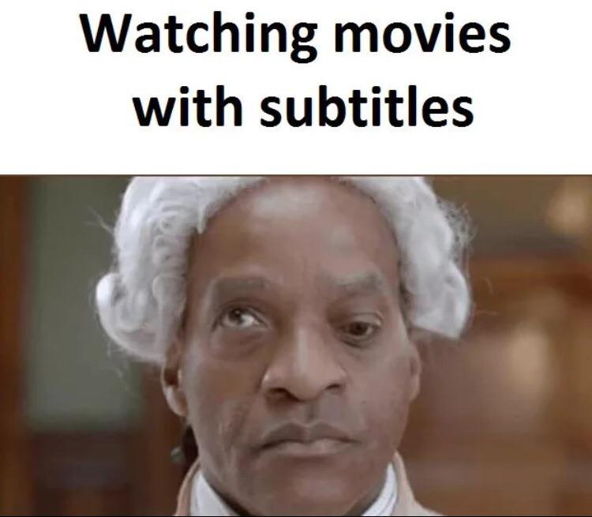
5. Watch with and without subtitles.
When you watch a film the first time, just turn on subtitles.
But if you get the chance to watch it a second time, try turning off subtitles.

Slide 15
6. It’s okay to miss words… just let it go
Watching movies should be fun… so if you miss a word, a phrase, or even many sentences, that’s okay!
Don’t feel bad… watching films is supposed to be fun!

