Slide 1
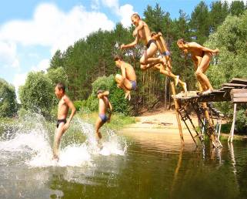
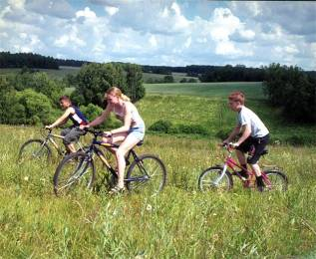
Good Health is Above Wealth.
Презентация к уроку по учебному предмету «Английский язык»
в 5-ом классе на тему
« Здоровье ».
Выполнили:
учителя английского языка МБОУ Хотьковской СОШ №1
Кочергин Сергей Петрович и Гусейнова Елена Закировна

Slide 2
Fonetic exeсises
[p] [k ] [d] [ei] An apple a day keeps a doctor
away.
[θ] [w] [e ] Good health is above wealth.
[З:] [ r] [ h] [ θ] Early to bed,
early to rise –
Makes a man healthy,
wealthy and wise.

Slide 3
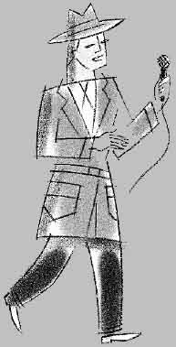
I am a reporter from a famous TV programme “Health”. I would like to answer some questions about your health and health habits.
How often do you brush your teeth?
How often do you wash your hands?
Do you often go to the swimming pool?
How often do you visit a dentist?
Do you like to visit a doctors?
Thank you very much. Don’t forget to watch our programme.

Slide 4
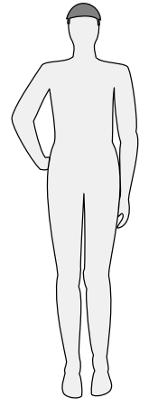
Write the parts of the body.

Slide 5
Let’s sing this song and do that I’ll show you.
Head and shoulders,
knees and toes, knees and toes, knees and toes!
Head and shoulders,
knees and toes, , knees and toes, knees and toes!
Eyes and ears, and mouth and nose!
Head and shoulders,
knees ad toes, knees and toes,
knees and toes!
Arms and legs, feet and hands,
feet and hands!
Arms and legs, feet and hands,
feet and hands!
Eyes and ears, and mouth and nose!
Arms and legs, feet and hands,
feet and hands.

Slide 6
Thank you.
Clap you hands!

Slide 7
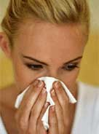
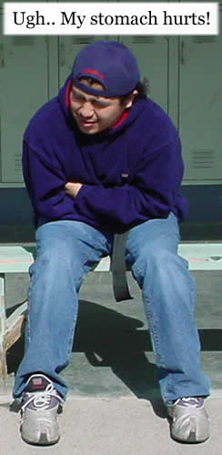
Say what problems they have and give them some pieces of advice
Ruth Kelly
Ron Bill
Peter Dan

Slide 8
Sing this song.
Ruth has a toothache,
Teddy has a cold.
Fred has a headache.
Eddie’s getting old.
Sam has a stomachache.
Frankie has the flu.
Jack has a backache.
Tony has one, too.
Ruth has a toothache,
Teddy has a cold.
Fred has a headache.
Eddie’s getting old.
Great! Clap your hands!

Slide 9
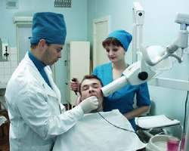
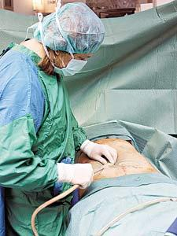
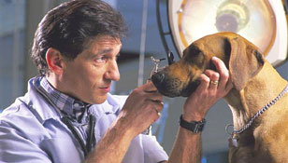
Match the photos and the doctors.
a) a veterinarian b) a surgeon c) a dentist

Slide 10
Which proverb you have chosen as a title of our lesson?
An apple a day keeps a doctor away
Good health is above wealth.
Early to bed, early to rise – Makes a man healthy, wealthy and wise.

Slide 11
Don’t forget that “Good Health is above Wealth”
Thank you very much for your work.
Good bye!

