Slide 1
The 21 of November
st
Class work

Slide 2
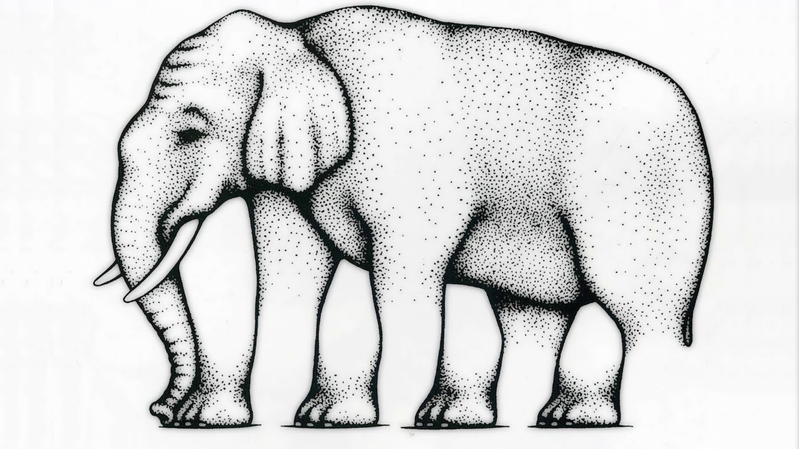

Slide 3
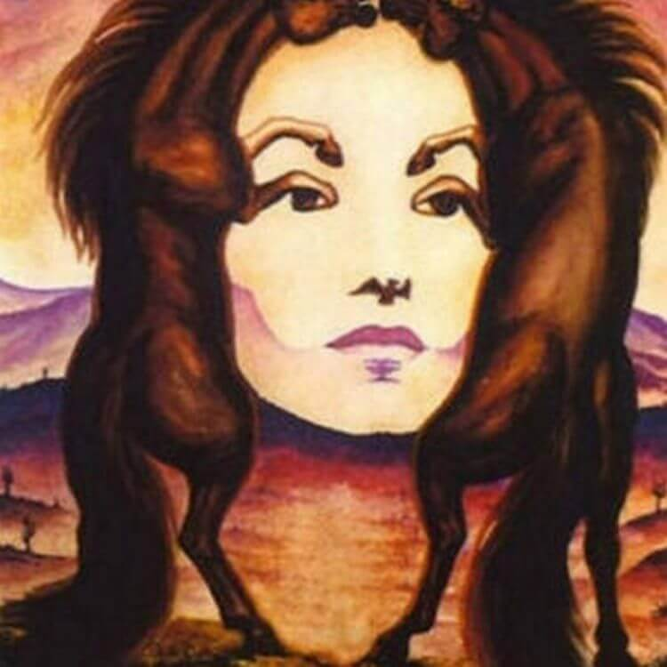

Slide 4
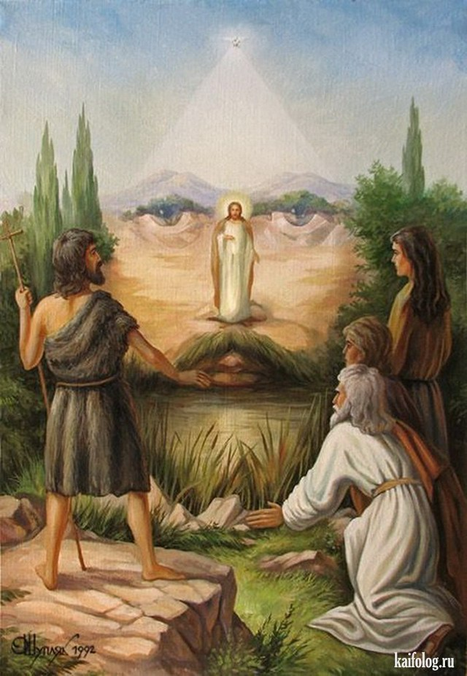

Slide 5
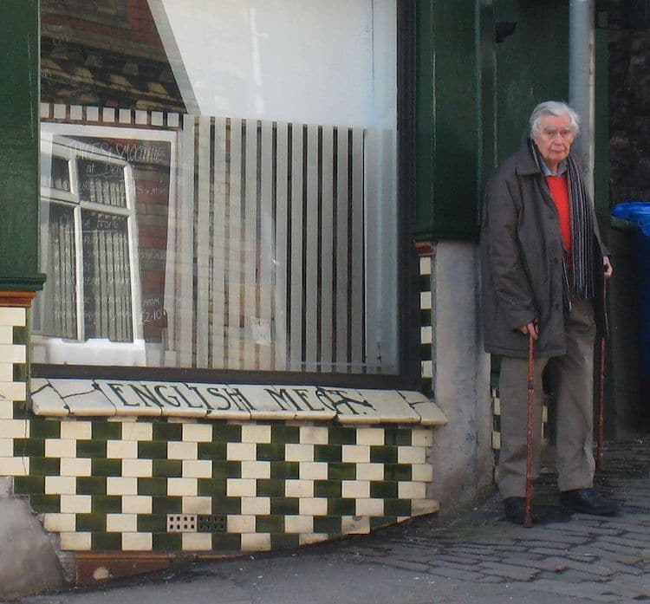
rediscovered
century
pattern
created
parallel
diagonally
evident
squares
perceives
react
brightness
wedges
interpreting

Slide 6
Your hometask will be:
1. to speak about illusions;
2. describe the picture with optical illusion.

