Slide 1
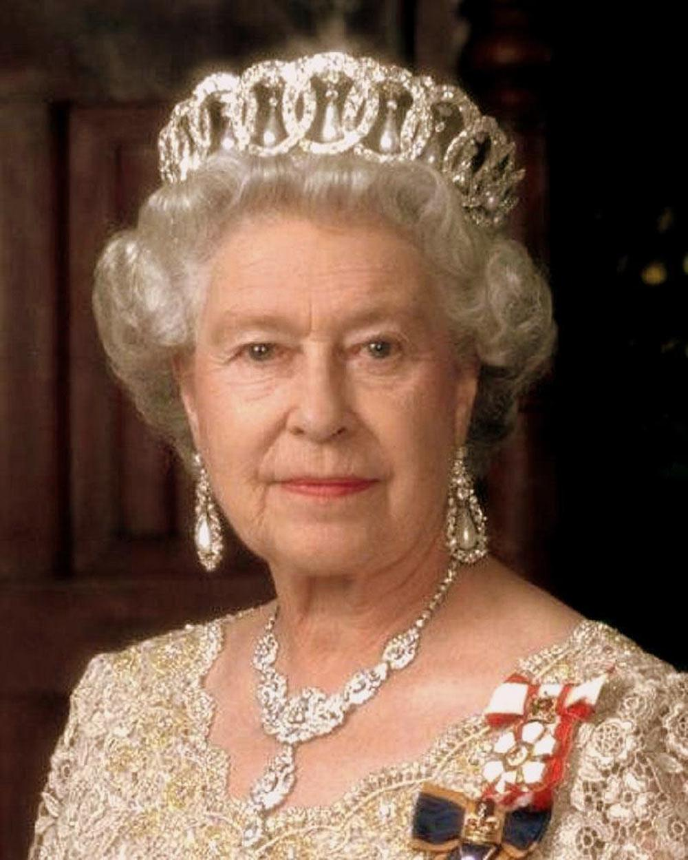
Elisabeth ii
Выполнила
учитель английского языка
Иванова Наталия Евгеньевна

Slide 2
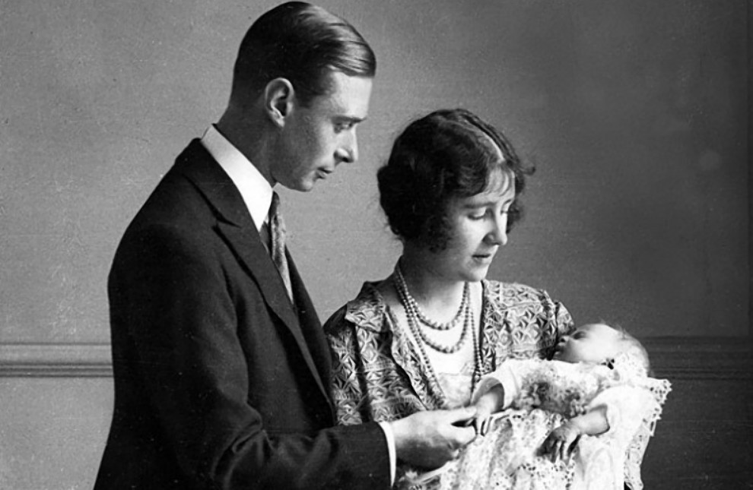
Elisabeth II
The full name is Elisabeth Alexandra Maria.
She was born in April, 21 1926 in London, Great Britain.
Her father was the King of England George VI, her mother was Elisabeth Bows Lyon.

Slide 3
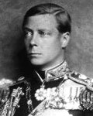
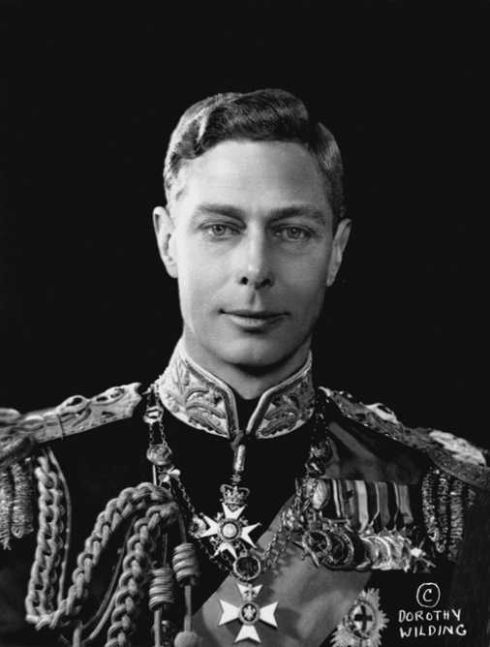
George VI И Edward viii
Elisabeth’s father George VI was the second in the line to the throne
after his elder brother Edward VIII.
Edward VIII George VI

Slide 4
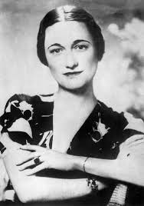
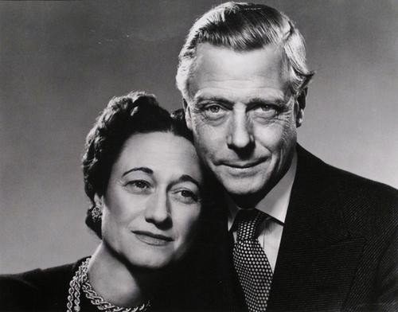
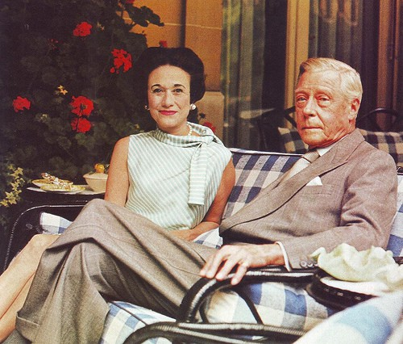
edward and wallis simpson
Edward VIII had been the King of the UK for only one month (since January till December 1936). He abdicated to marry divorced Wallis Simpson, but the Government of the UK didn’t agree with it. He declared: «I found it impossible… to fulfill the duties of a king without the help and support of the woman whom I love». But no matter what they married and lived long time.

Slide 5
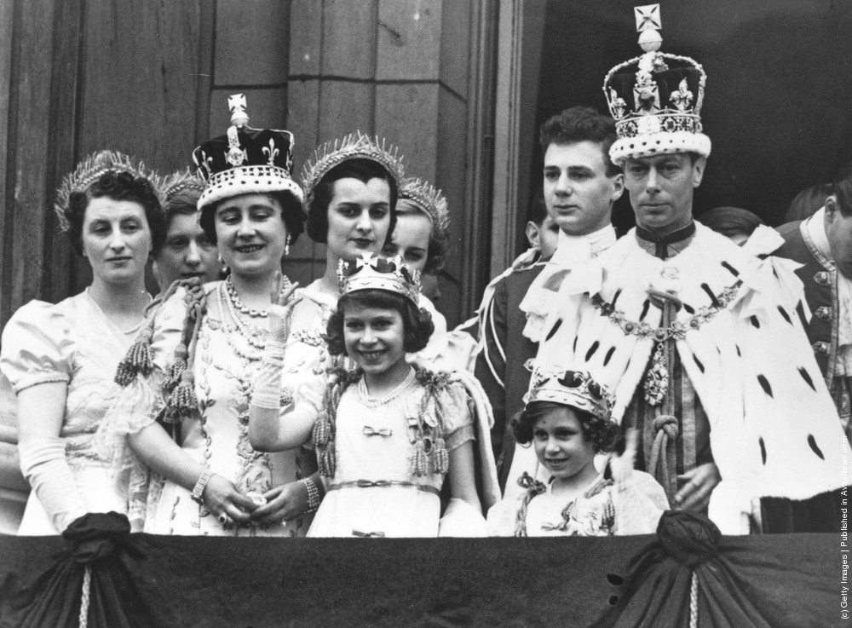
The coronation of george VI
So the throne passed to his younger brother George VI 11 in December 1936 .
He was crowned in May, 12 1937.

Slide 6
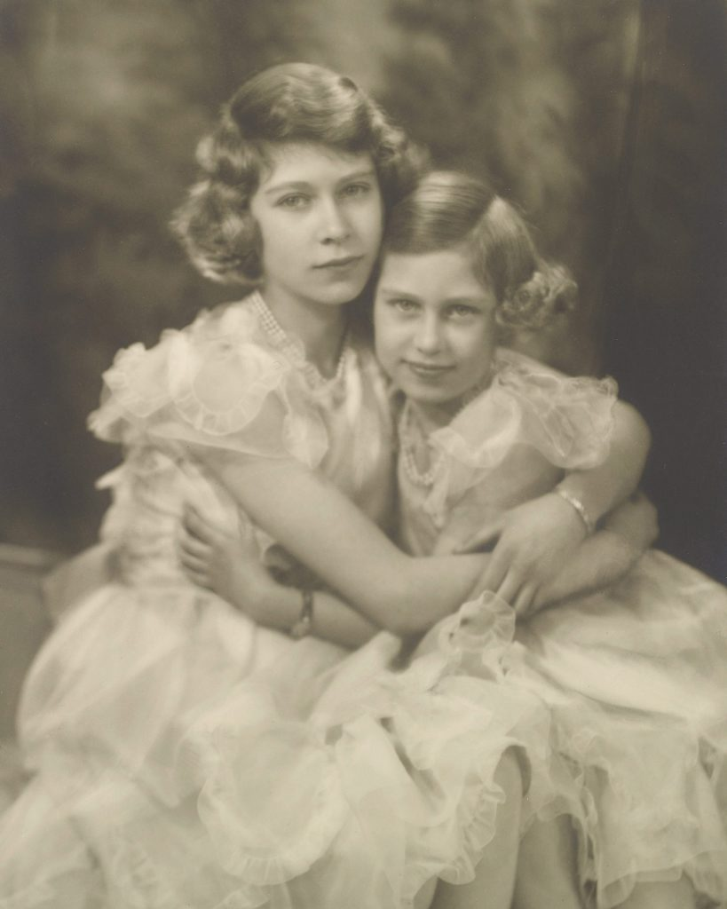
elisabeth and margaret
The eldest daughter of George VI - Elisabeth and the youngest daughter Margaret became the candidates for the throne.

Slide 7
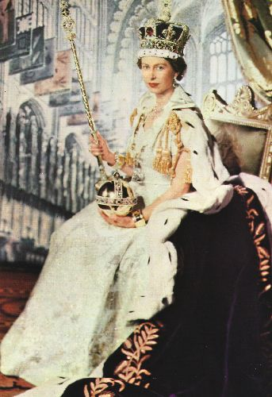
The coronation of elisbeth II
After the death of George VI in 1952 his eldest daughter Elisabeth II became the Queen of the UK.
The coronation was in June, 2 1953.

Slide 8
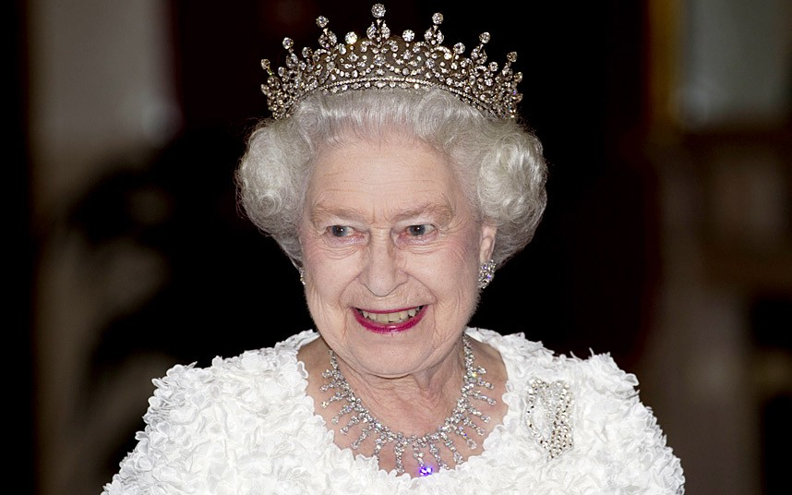
Elisabeth II today
Elisabeth II is the longest reigning queen of England. She broke Queen Victoria’s record who ruled 63 years.
In 2016 Elisabeth II celebrated her 90th anniversary!

