Slide 1
Color wheel or Colour circle

Slide 2
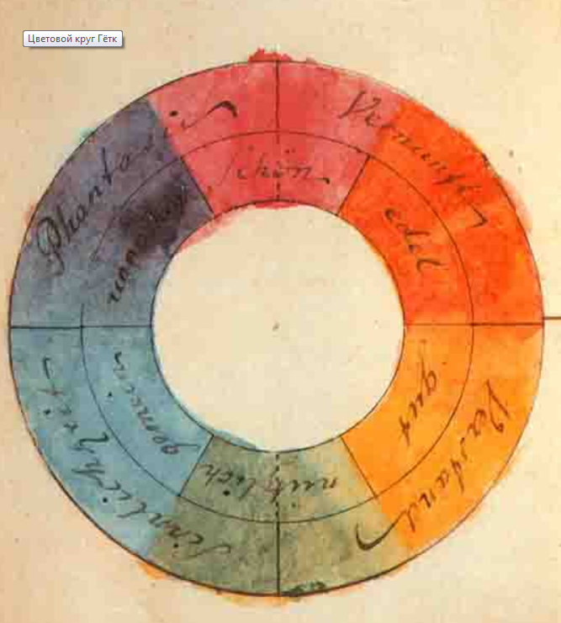
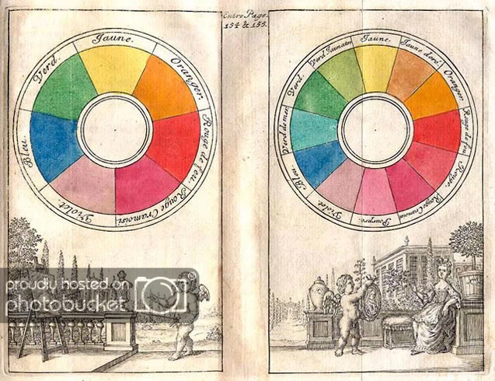
Goethe's Theory of Colours & Color circle of Isaac Newton

Slide 3
Video
Sessions - Color Theory: Color Wheel

Slide 4
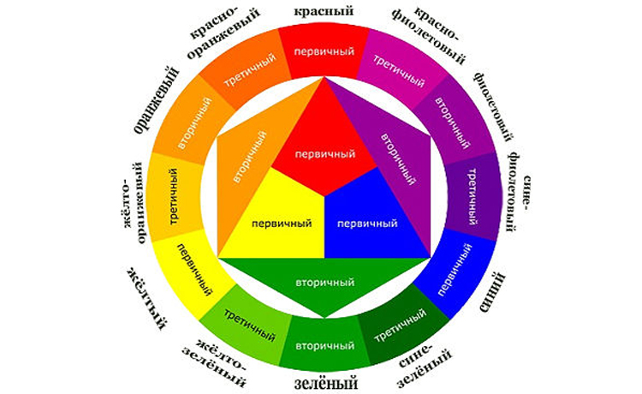

Slide 5
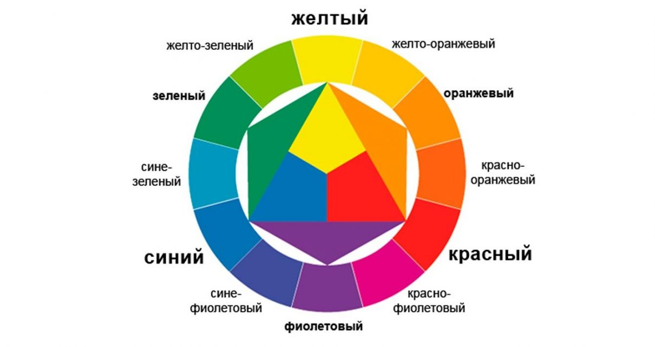
primary colors
secondary colors
tertiary colors

Slide 6
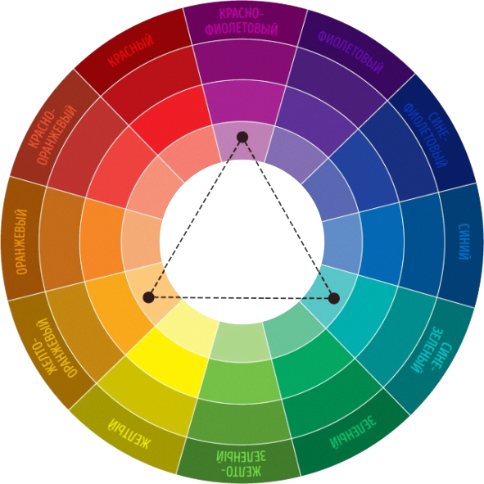
Triadic - Классическая триада

Slide 7
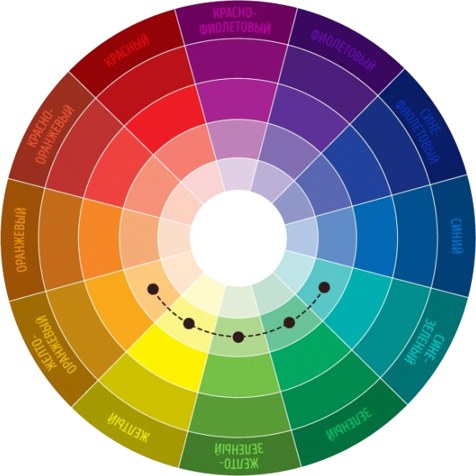
Analogous - Аналоговая триада

Slide 8
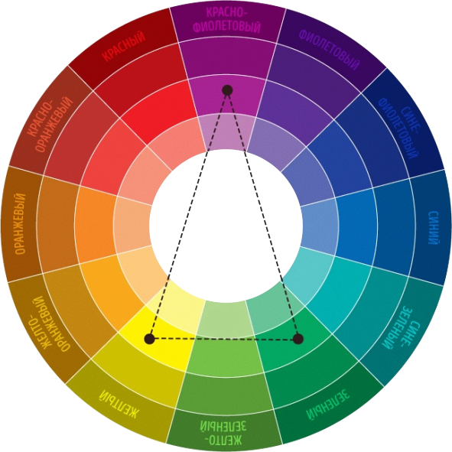
Split complementary- Контрастная триада

Slide 9
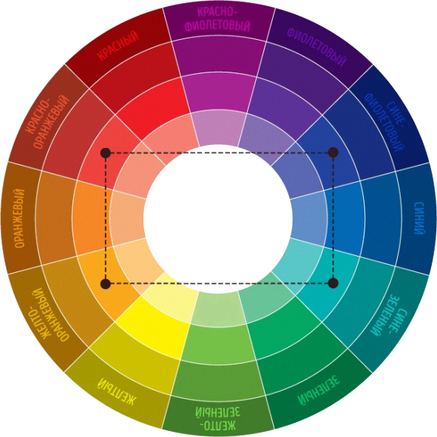
Tetradic - Тетрада

Slide 10
Practice-10 min
Choose tertiary colors to create the schema using color circle

Slide 11
Color Calculator
Adobe Color
Цветовой круг

