Slide 1
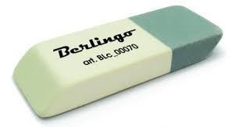
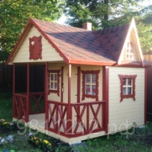
Complete the crossword
 |  |  |  |  |  | 13
 |  | 1
 |  | 2
 |  |  |  | 3
 |  |  |  | 4
 |  |  |  | 5
 |  |  |  |  | 6
 |  |  |  |  | 7
 |  |  |  |  | 8
 |  |  |  |  | 9
 |  |  |  | 10
 |  | 11
12
6. I … my family.
1.
7. My he - parent
2.
8. School subject
9. My she-parent
3.
10. My parents’
child
4.
11. Our lesson
5.
12. 30

Slide 2
Complete the crossword
6. I … my family.
 |  |  |  |  |  | 13)
 |  | 1) | E | r | a | S | e | r
 |  | 2) | P | e | n | c | i | l
 |  |  |  | 3) | S | h | a | r | p | e | n | e | r
 |  |  |  | 4) | H | o | u | s | e
 |  |  |  | 5) | B | o | o | k
 |  |  |  |  | 6) | l | o | v | e
 |  |  |  |  | 7) | f | a | t | h | e | r
 |  |  |  |  | 8) | a | r | t
 |  |  |  |  | 9) | m | o | t | h | e | r
 |  |  |  | 10) | S | i | s | t | e | r
 |  | 11) | E | n | g | l | i | s | h
12) | T | h | i | r | t | y
1.
7. My he - parent
2.
8. School subject
9. My she-parent
3.
10. My parents’
child
4.
11. Our lesson
5.
12. 30

Slide 3
We are going to speak about:
School family

Slide 4
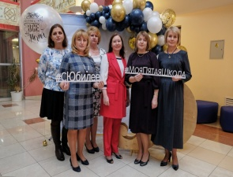
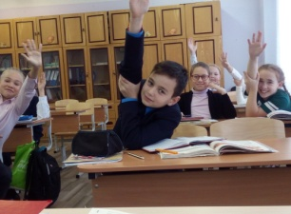
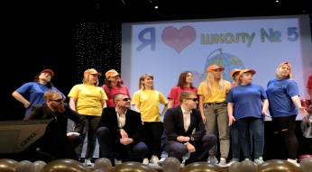
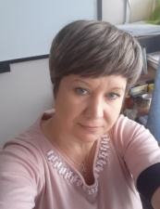
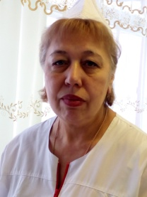
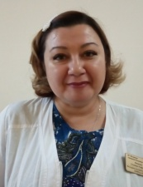
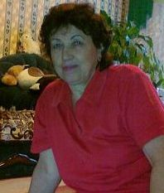
School family

Slide 5
Teachers
Students
Parents
Head teacher
School family
Dining room workers
Medical worker
Security guard
Technical staff

Slide 6
Missing words
Are
Old
Class
Clever
Play
Teachers
They
Love
Workers
Guard
Family

Slide 7
Cinquain (синквейн)
One noun (одно существительное – главная тема)
_____________________________________________________
Two adjectives (два прилагательных)
_____________________________________________________
Three verbs (три глагола)
_____________________________________________________
A sentence (фраза, предложение - отношение к теме)
_____________________________________________________
One word (дно слово – синоним темы)
_____________________________________________________

Slide 8
Cinquain (синквейн)
One noun (существительное – главная тема)
SCHOOL FAMILY
Two adjectives (два прилагательных)
DIFFERENT, FRIENDLY
Three verbs (три глагола)
PROTECT, STUDY, HELP
A sentence (фраза, предложение - отношение к теме)
MY SCHOOL IS MY HOME
One word (дно слово – синоним темы)
FRIENDSHIP

Slide 9
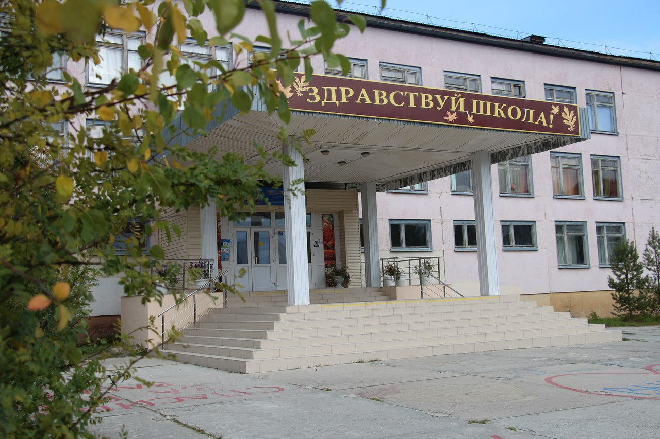
Your homework
Take Card 6. Here you can see your home task:
Read the letter and tell the class about your school family.

Slide 10
Thank you for your work

