Slide 1
Outstanding Men of England and America

Slide 2
William Shakespeare

Slide 5
Sonnet XOI
Some glory in their birth, some in their skill,
Some in their wealth, some in their bodies’ force,
Some in their garments, though new-fangled ill.
Some in their hawks and hounds, some in their horse;
And every humour hath his adjunct pleasure,
Wherein it finds a joy above the rest:
But these particulars are not my measure;
All these I better in one general best,
Thy love is better than high birth to me,
Richer than wealth, prouder than garments’ cost,
Of more delight than hawks or horses be;
And having thee, of all men’s pride I boast.
Wretched in this alone, that thou mayst take
All this away and me most wretched make.

Slide 6
The famous Liverpool four // the Beatles

Slide 11
mark twain

Slide 13
Walt Disney

Slide 14
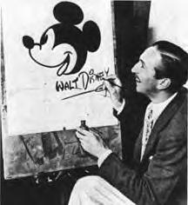

Slide 15
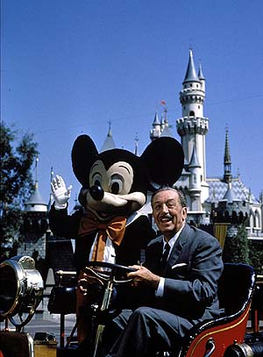
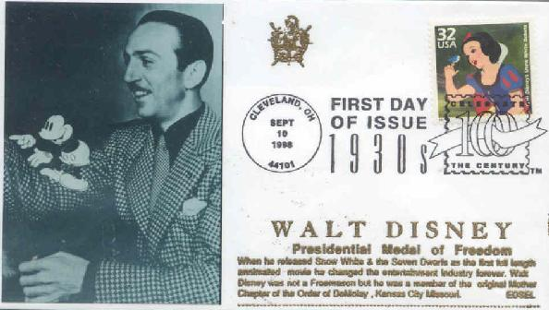
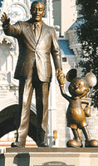
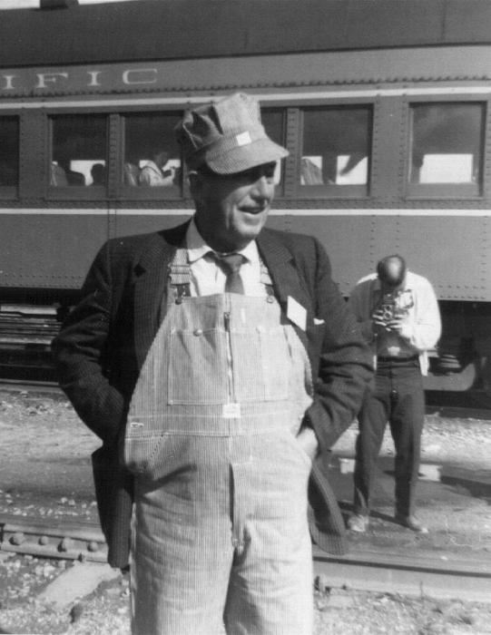

Slide 16
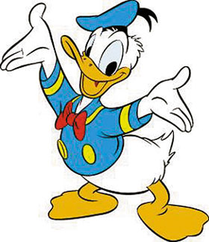
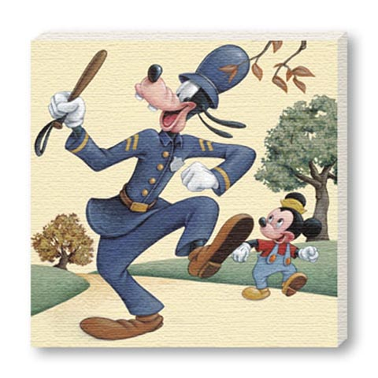
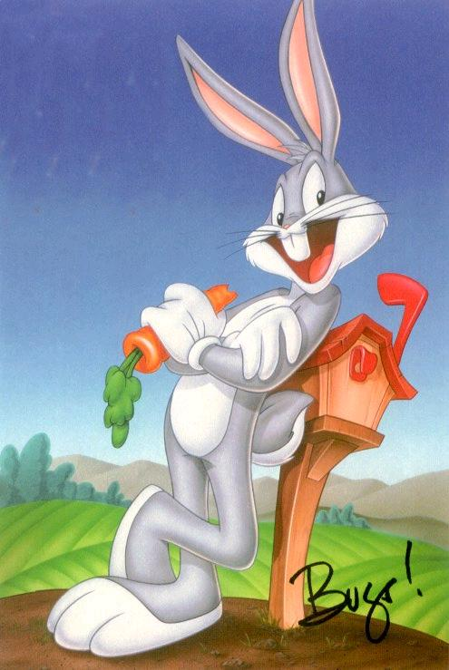
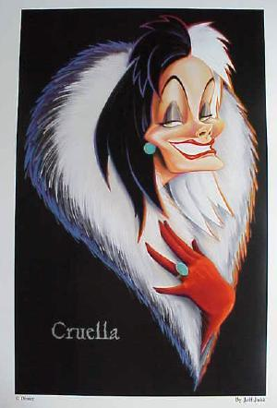
Walt Disney's characters

Slide 17
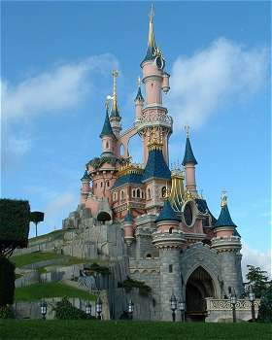
Disney’s parks are all over the world

Slide 18
Jack London

Slide 20
Elvis Presley

Slide 22
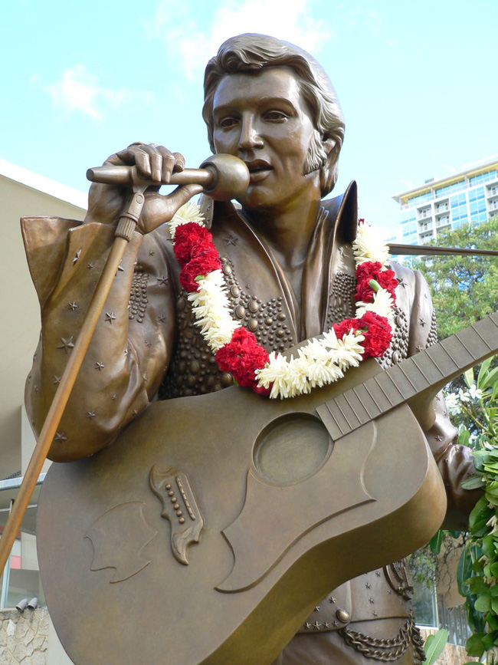

Slide 24
Henry ford

Slide 29
Louis Armstrong

Slide 31
The song

Slide 32
See you and good luck!!!!!!

