Slide 1
SCHOOLING in the UNITED STATES of AMERICA Школьное образование в Соединенных Штатах Америки
Выполнила студентка 2 «А» группы Зерноградского педагогического колледжа: Черкесова Маргарита

Slide 2
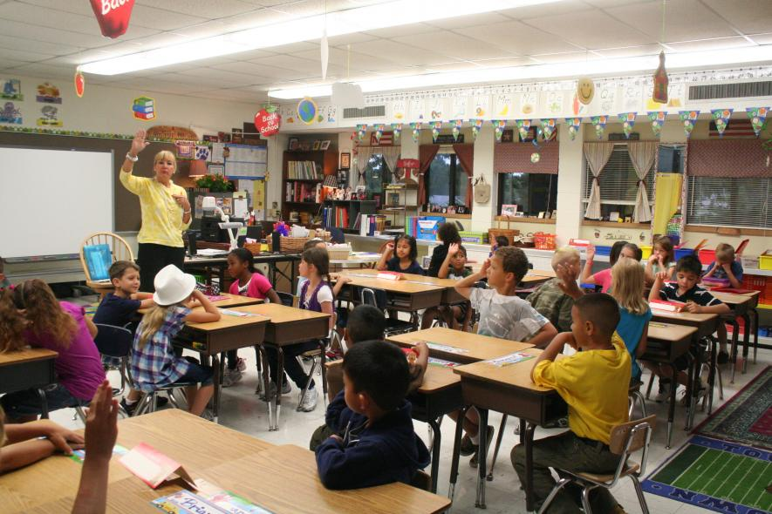
What kind of schools are there in the U. S. A.? Какие школы существуют в США?

Slide 3
There are two kinds of schools in the United States of America: public schools and private schools.

Slide 4
In which schools is education free? В каких школах бесплатное образование?

Slide 5
The money for public schools is given by each state, so education in these schools is free
Деньги для общественных школ дает каждое государство, поэтому обучение в этих школах бесплатное

Slide 6
From what children age is education compulsory in the U. S. A.? С какого возраста в США образование является обязательным?

Slide 8
What general patterns of school education are there in America? Какие общие модели школьного образования существуют в Америке?

Slide 9
The general pattern of education is an 8-year elementary school, followed by a 4-year high school.

Slide 10
What do you know about pre schooling education? Что вы знаете о дошкольном образовании?

Slide 11
Preschooling is optional. There is a network of nursery schools and daycare centres where children are looked after while their parents are at work.

Slide 12
What knowledge do elementary schools give children? Какие знания дают детям начальные школы?

Slide 13
Elementary schools give the basic knowledge about the world around us and people who live in it. Pupils are taught to count, read and write, to draw, sing and dance.

Slide 14
How are secondary schools named in America? Как называются средние школы в Америке?

Slide 15
Secondary schools are usually named high schools and their pupils are called students.

Slide 16
What grades do students get for their work at school? Какие оценки получают ученики за свою работу в школе?

Slide 17
Marks given to students for their work are called grades. Pupils get A, B, C, D. A - for excellent work. D for poor work.

Slide 18
What skills can pupils acquire at school? Какие навыки могут приобрести ученики в школе?

Slide 19
Students study a wide range of subjects which cover exact, natural sciences and humanities.

Slide 20
In what extracurricular activities can students be engaged at school? Какими внеклассными мероприятиями могут заниматься учащиеся в школе?

Slide 21
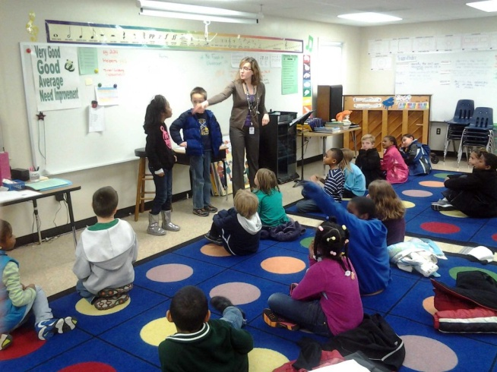
Most schools, for instance, publish their own student newspapers, and some have their own radio stations.
Almost all have student orchestras, bands and choirs, which give public performances
There are theatre and drama groups, chess and debating clubs, foreign languages clubs, groups which meet after school to discuss computers, or chemistry, or amateur radio. Students can learn flying, diving and mountain-climbing

