Slide 1
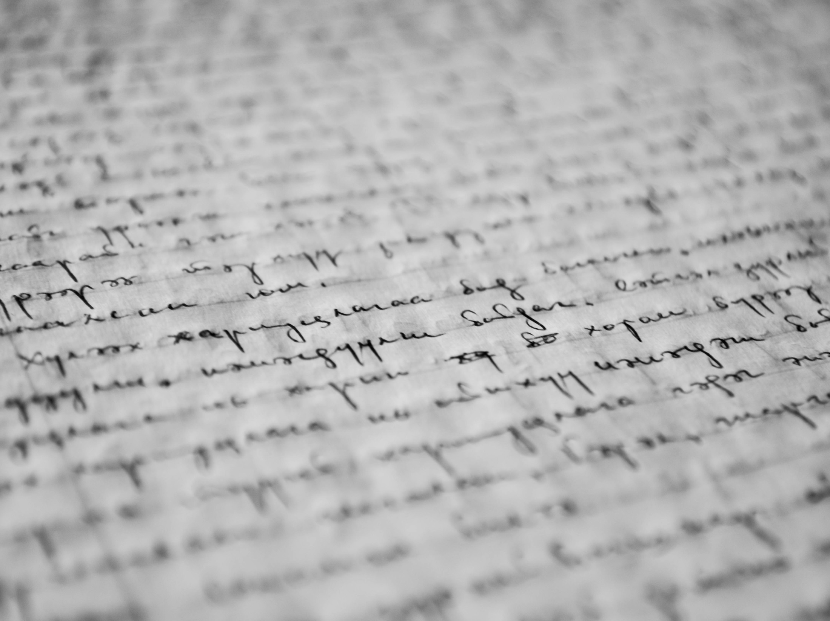
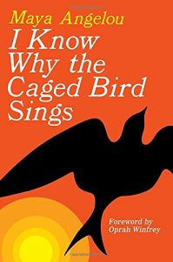
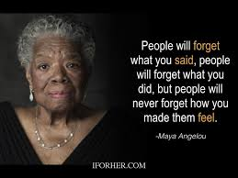
Maya Angelou (1928- 2014)

Slide 3
SYMBOL | EPITHET | METAPHOR | PERSONIFICATION
The free bird- a person who is not restrained The caged bird- a person who is restrained Distant hill- future | Orange rays Narrow cage Fearful thrill Things longed for Sighing trees Fat worms Dawn-bright lawn | Back of the wind Bars of rage Wings are clipped Feet are tied Grave of dreams | The free bird leaps Floats downstream Dares to claim Dips his wings Fat worms waiting Names the sky Shadow shouts Worms waiting

Slide 5
1. bird | 1.bird
2. free, delighted | 2. caged, miserable
3. flying, enjoying, having fun | 3. singing, crying, missing
4. claims the sky | 4. sings of freedom
5. owner | 5. prisoner

Slide 6
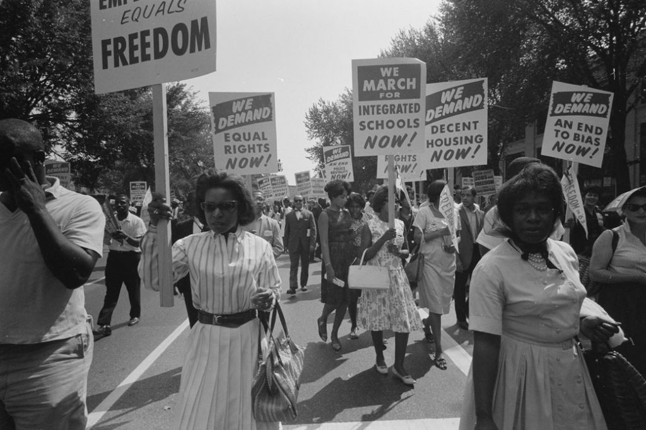
Inequality in the rights of Black and white Americans

Slide 8
Homework assignment
Translate any part of the poem
2. Learn by heart any part of the poem

