Slide 1
1 а School

Slide 4
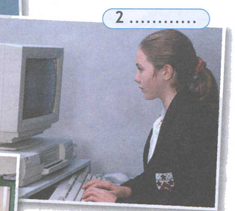
Maths
Information Technology

Slide 5
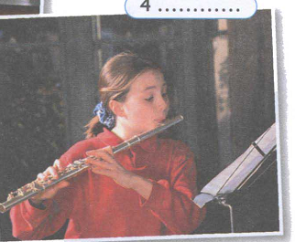
Science
Music

Slide 7
a
a
an
a
a
a
an
a
a

Slide 8
