Slide 1
Cartoons

Slide 2
Составила:
Мелешко О.Г.
Учитель английского языка
МБОУ «Лицей Сигма»
г.Барнаул

Slide 3
Contest №1
Who is who?
Guess the heroes.

Slide 4
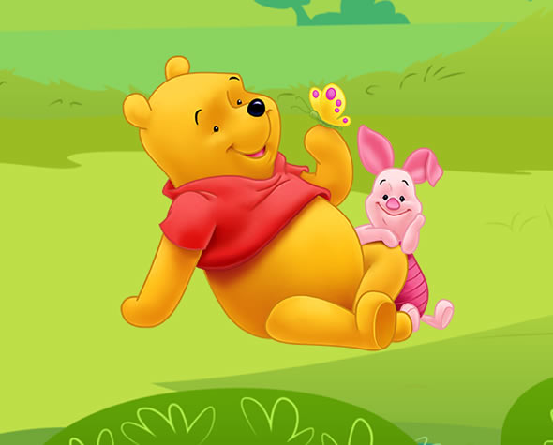
Who is who?
He is a very kind and funny teddy bear created by English author A. A. Milne.
He loves to eat honey very much.
His best friend is a little pig called piglet

Slide 5
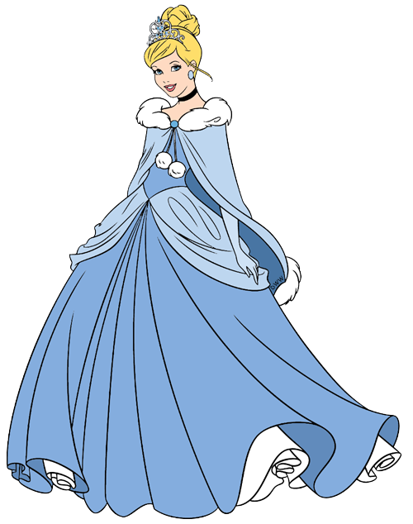
Who is who?
She lost her mother.
She lived with evil stepmother who used her as servant for her own daughters.
She had a fairy godmother
The prince fell in love.
He could find his love.

Slide 6
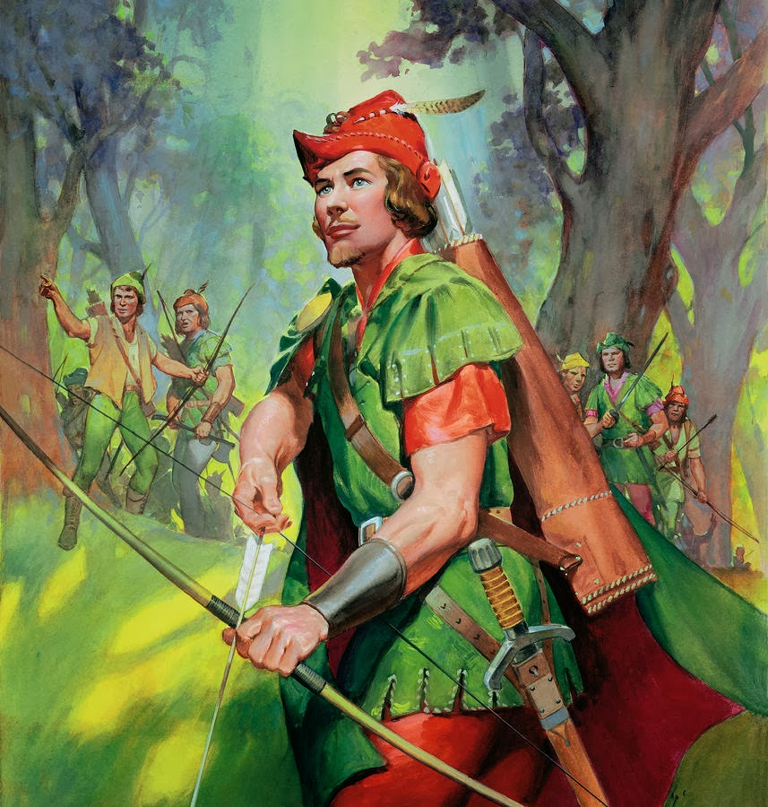
Who is who?
He is an English folk hero of the Middle Ages.
According to most legends, he lived and worked out of the Sherwood Forest in Nottinghamshire with his band of Merry Men.
He helped the poor.

Slide 7
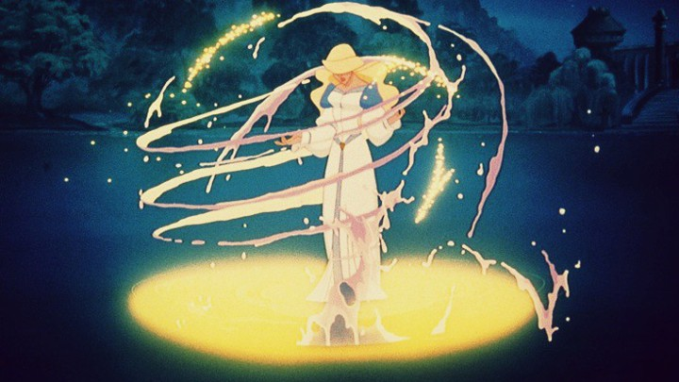
Who is who?
She is very beautiful and kind.
The evil wizard Rothbart wants to marry her to make her kingdom his own.
She spends most of the film under his spell.
When the moonlight hits the lake she turns a human.
When the moonlight leaves the lake she turns into a bird.

Slide 8
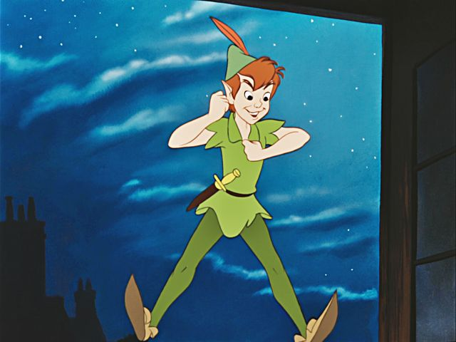
Who is who?
He is the only boy who never grows up.
He has got a lot of talents.
He is very brave and friendly.
He misses his mother but would never let anyone else know.

Slide 9
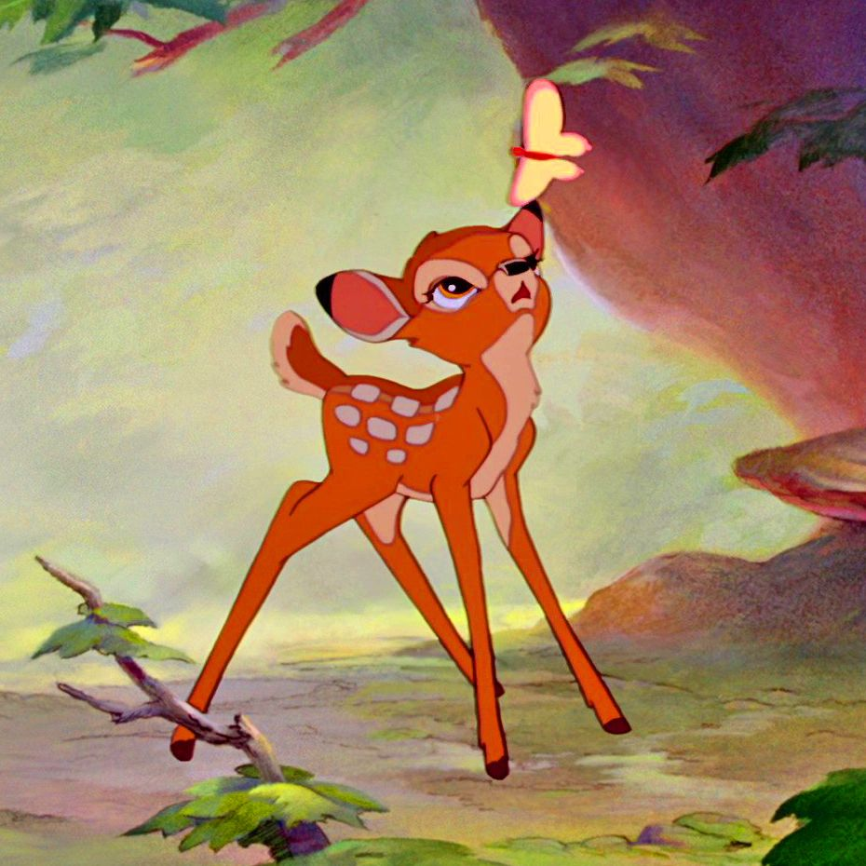
Who is who?
His mother is killed by hunters early on in the film.
He makes a friend named Thumper, who is a rabbit.
He falls in love with his old childhood friend Faline.

Slide 10
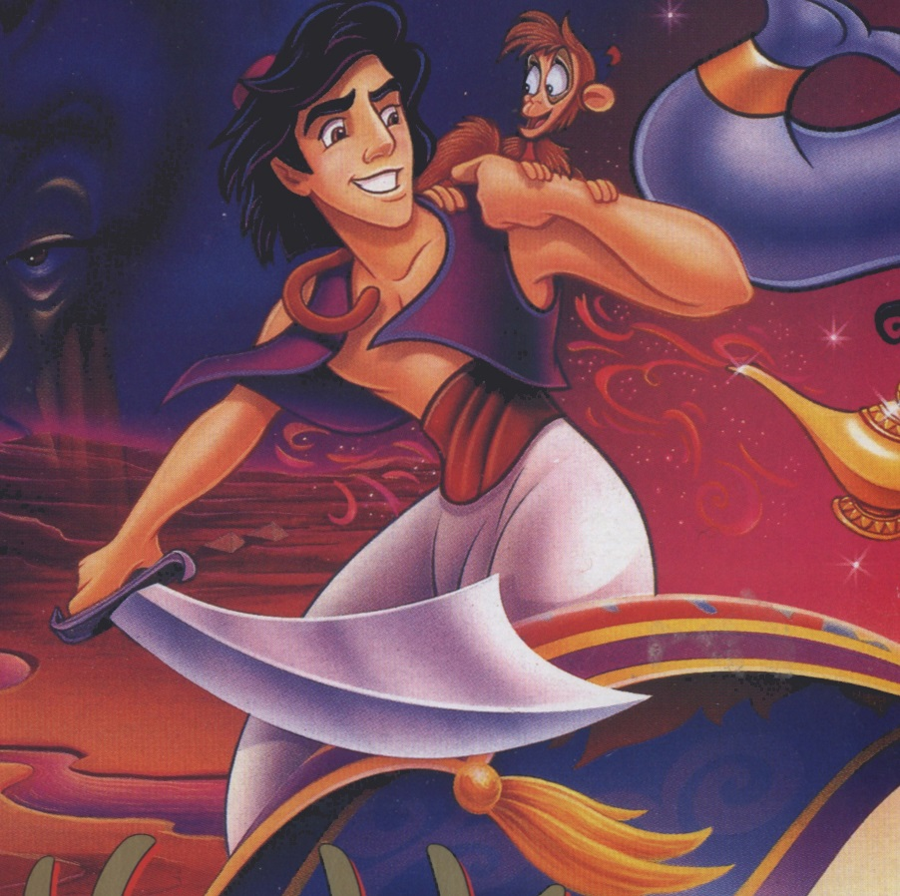
Who is who?
He is a very careless and idle fellow.
Once he falls in love with a beautiful princess.
He uses a genie's magic power to marry her.
He has got a monkey.

Slide 11
Contest №2
Each team has got a letter from a cartoon character. You should do all the tasks.
You have got only 2 minutes.

Slide 12
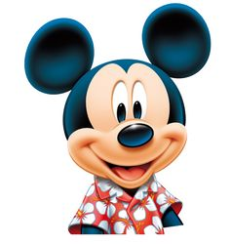
the first letter
Fill in the gaps with
Task 1
Have, get up, best, breakfast, make, usually, tired
Hello! I’m Mickey Mouse. I want to tell you about my routine.
In the morning
I usually … at 7 o’clock and get dressed. Then I have … and goes for a walk.
In the afternoon
After lunch I … go to school. I always … five lessons a day. After school I like to meet my friends.
In the evening
My … friend Goofy and I like to cook. We often … something special for dinner. In the evening I’m very … and I prefer to go to sleep at 10 o'clock.

Slide 13
have get up best breakfast make usually tired
Hello! I’m Mickey Mouse. I want to tell you about my routine.
In the morning
I usually at 7 o’clock, and get dressed. Then I have and go for a walk. At 9 o'clock I have breakfast. I like to do my homework in the morning.
In the afternoon
After lunch I go to school. I always five lessons a day. After school I sometimes meet my friends.We play basketball and football.
In the evening
My friend Goofy and I are mad of cooking. We often something special for dinner. In the evening I’m very and I prefer to go to sleep at 10 o'clock.

Slide 14
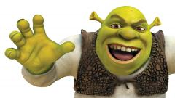
the second letter
Fill in the gaps with
before, usually, come, jogging, usually, have, work.
Hello! I’m an ogr. My name is Shrek. I want to tell you about my routine.
In the morning
I ...... at 10 o’clock and go.... and I do all this .... brealfast!
In the afternoon
After lunch I … go to the forest and ..... there.
In the evening
I ....home at 9 o'clock and .... dinner. After dinner my wife, children and I .... read fairy tales. I go to bed at 11.30.

Slide 15
before usually come jogging usually have work
Hello! I’m an ogr. My name is Shrek. I want to tell you about my routine.
In the morning
I ...... at 10 o’clock and go.... and I do all this .... brealfast!
In the afternoon
After lunch I … go to the forest and ..... there.
In the evening
I ....home at 9 o'clock and .... dinner. After dinner my wife, children and I .... read fairy tales. I go to bed at 11.30.

Slide 16
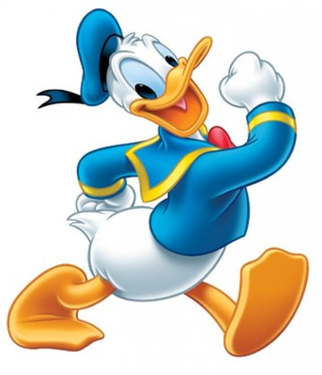
the third letter
Fill in the gaps with
o’clock , shower, lunch, friendly, dressed, a lot, dinner
Hello! I’m Donald Duck. I will tell you about my routine.
In the morning
I'm an early bird. I get up at 5...... and get ...... . I like to jogging. After breakfast I take a ...... .
In the afternoon
I have ...... at 1 o'clock. I work ...... till the evening.
In the evening
When I come home, my ...... is always ready. My relatives are good cooks. I like to watch TV with my nephews. We are a ....... family.

Slide 17
o’clock shower lunch friendly dressed a lot dinner
Hello! I’m Donald Duck. I will tell you about my routine.
In the morning
I'm an early bird. I get up at 5 and get . I like to jogging. After breakfast I take a .
In the afternoon
I have at 1 o'clock. I work till the evening.
In the evening
When I come home, my is always ready. My relatives are good cooks. I like to watch TV with my nephews. We are a friendly family.

Slide 18
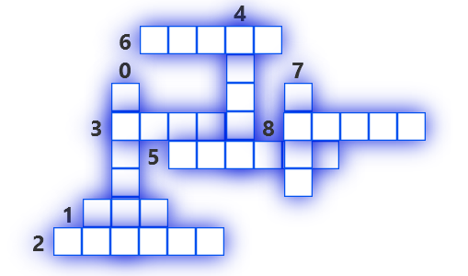
Contest №3
Solve a puzzle.

Slide 19
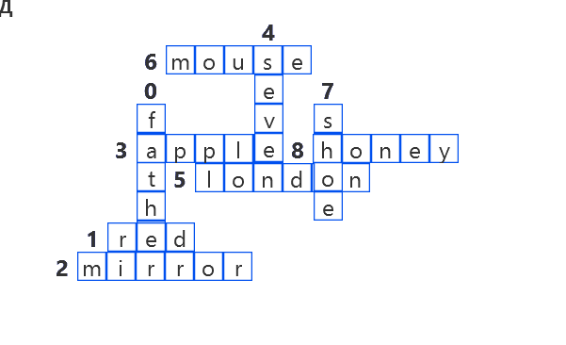
Let's check.

Slide 20

Let's see who is the winner.

Slide 21
Список используемых ссылок
Изображение Винни Пуха
http://poplembrancinhas.com.br/wp-content/uploads/2018/09/caixinha-ursinho-pooh-para-imprimir-tamanho-capa-2.jpg
Изображение Золушки
https://dumielauxepices.net/sites/default/files/winter-snow-clipart-winter-outfit-824910-8499762.png
Изображение Робин Гуда
http://3.bp.blogspot.com/-a2zz9ZlHdHI/UlV2YdGvkcI/AAAAAAAABsE/aZFHfIf0x_k/s1600/robin-hood-james-edwin-mcconnell.jpg
Изображение Принцессы Лебедь
https://cdn.theatlantic.com/assets/media/img/mt/2014/11/swanprincess-1/lead_720_405.jpg?mod=1533691715

Slide 22
Изображение Питера Пена
http://cdn.playbuzz.com/cdn/e54af8bc-683d-4d3a-b531-3271c8a4840a/b04701f8-24f5-405e-bc92-1b6e020e3f47.jpg
Изображение Бэмби
https://i.pinimg.com/originals/4b/9a/d6/4b9ad6eff8cb420a111c9b1c362df619.jpg
Изображение Алладина
http://webgames.host/uploads/2016/05/aladdin.jpg

Slide 23
Изображение Микки Макуса
https://i.pinimg.com/236x/e6/a6/59/e6a659259313f28a45b0a95f5a7fa661--mickey-mouse-png-disney-characters.jpg
Изображение Дональда Дака
https://b.kisscc0.com/20180730/ybe/kisscc0-aku-ankka-daisy-duck-mickey-mouse-pluto-goofy-donald-duck-5b5faa8df00a45.8900421415329962379832.jpg
Изображение Шрека
https://hdwallsource.com/img/2014/4/thumb/shrek-15232-15703-hd-wallpapers-thumb.jpg
Изображение Кубков
https://politeka.net/wp-content/uploads/2017/07/1-45.jpg

