Slide 1
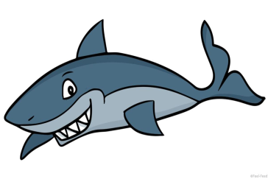
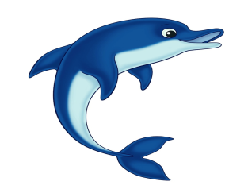
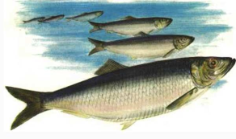
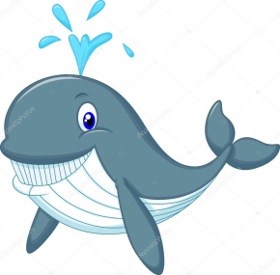
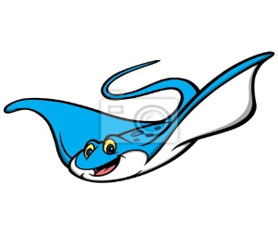
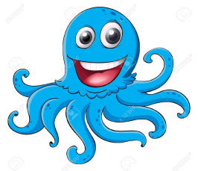
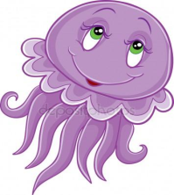
a shark a dolphin herrings a whale a ray an octopus a jellyfish

Slide 2
Under the sea
Many different plants and creatures live in the sea. Jellyfish float near the surface of the sea, whales and dolphins must come to the surface to breath. The blue whale is the largest creature on earth, and the great white shark is the most dangerous shark. It can swim very quickly and it has got sharp teeth. Rays and octopuses live on the bottom of the sea. They swim lazily along the sea bed. But herrings travel together in large number. Fishermen can easily catch them.

Slide 3
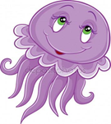
Under the sea
Many different plants and creatures live in the sea. float near the surface of the sea, and must come to the surface to breath. The blue is the largest creature on earth, and the great white is the most dangerous .It can swim very quickly and it has got sharp teeth. and live on the bottom of the sea. They swim lazily along the sea bed. But travel together in large number. Fishermen can easily catch them.

Slide 4
Many different plants and creatures live in the sea.
come to the surface
to breath
the largest creature
near the surface
float
sharp teeth
the most dangerous
on the bottom of the sea
travel together
Fishermen can easily catch them.

Slide 5
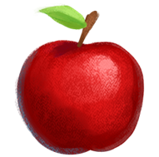
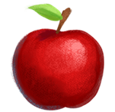
Степени сравнения прилагательных (The degrees of comparison of adjectives)
This apple is small.
er
This apple is small
This apple is the small
est
Notes:
the

Slide 6
Степени сравнения прилагательных (The degrees of comparison of adjectives) Правила присоединения окончаний
big -
bigger -
the biggest
large -
larger -
the largest
happy -
happier -
the happiest
Notes:
the happiest

Slide 7
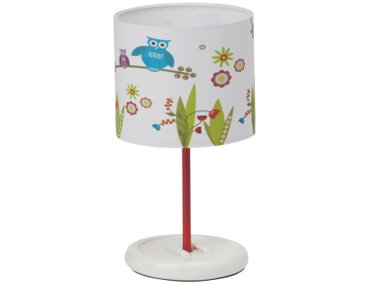
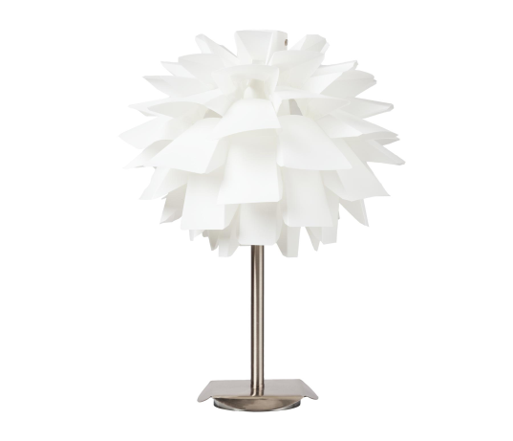
Степени сравнения прилагательных (The degrees of comparison of adjectives)
This lamp is
expensive
This lamp is
more
expensive
This lamp is
the most
expensive
Notes:
the most

Slide 8
Under the sea
Many different plants and creatures live in the sea. Jellyfish float near the surface of the sea, whales and dolphins must come to the surface to breath. The blue whale is the largest creature on earth, and the great white shark is the most dangerous shark. It can swim very quickly and it has got sharp teeth. Rays and octopuses live on the bottom of the sea. They swim lazily along the sea bed. But herrings travel together in large number. Fishermen can easily catch them.

Slide 9
Under the sea
Many different plants and creatures live in the sea. Jellyfish float near the surface of the sea, whales and dolphins must come to the surface to breath. The blue whale is the largest creature on earth, and the great white shark is the most dangerous shark. It can swim very quickly and it has got sharp teeth. Rays and octopuses live on the bottom of the sea. They swim lazily along the sea bed. But herrings travel together in large number. Fishermen can easily catch them.

Slide 10
Образуйте сравнительную и превосходную степень от данных прилагательных
hot
warm
old
happy
expensive
small
beautifull
easy

Slide 11
Образуйте сравнительную и превосходную степень от данных прилагательных
hot – hotter – the hottest
warm – warmer – the warmest
old – old – the oldest
happy – happier – the happiest
expensive –more expensive –the most expensive
small – smaller – the smallest
beautiful – more beautiful – the most beautiful
easy – easier – the easiest

Slide 12
Make up sentences using the names of sea animals and the degrees of comparison of given adjectives
large
dangerous
clever
lazy
beautiful
funny

Slide 13
HOMETASK
Для всех: правило учить
1 уровень – текст читать, переводить, найти главные предложения в каждом абзаце.
2 уровень - текст читать, составить план текста, выписать ключевые слова, составить 10 вопросов по содержанию текста.
3 уровень – составить 10 вопросов по содержанию текста, пересказать текст с опорой на вопросы.

