Slide 1

[b]

Slide 2

[d]

Slide 3

[k]

Slide 4

[l]

Slide 5

[m]

Slide 6

[n]

Slide 7
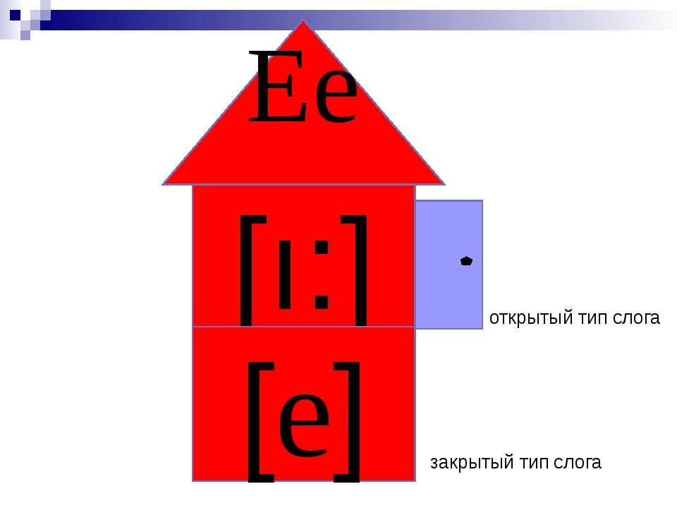
[e]

Slide 8

[t]

Slide 9

[s]

Slide 10

[g]

Slide 11

[i]
В конце слова

Slide 12

[f]

Slide 13

[p]

Slide 14

[v]

Slide 15

[w]

Slide 16

[h]

Slide 17



Slide 18

[z]

Slide 19

[i]

Slide 20

[r]

Slide 21

[k]

Slide 22

[ks]

Slide 23



Slide 24



Slide 25

Tree
Street
Bee
Sweet
Meet

Slide 26
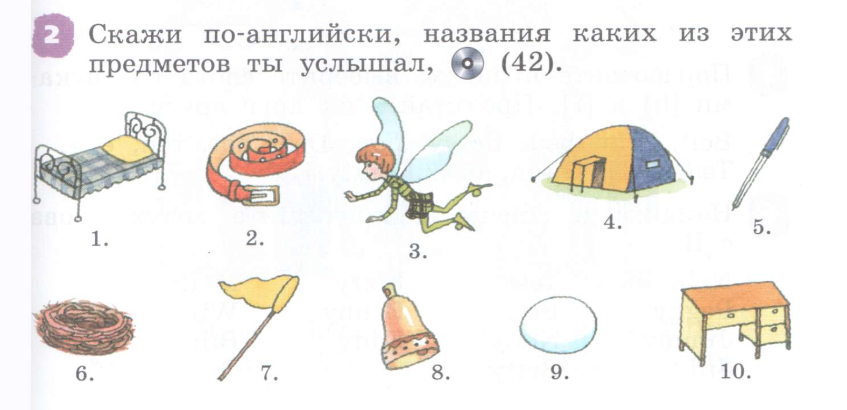
РТ стр 14 упр 2,3

Slide 27
РТ с 15 упр 1,4

Slide 31
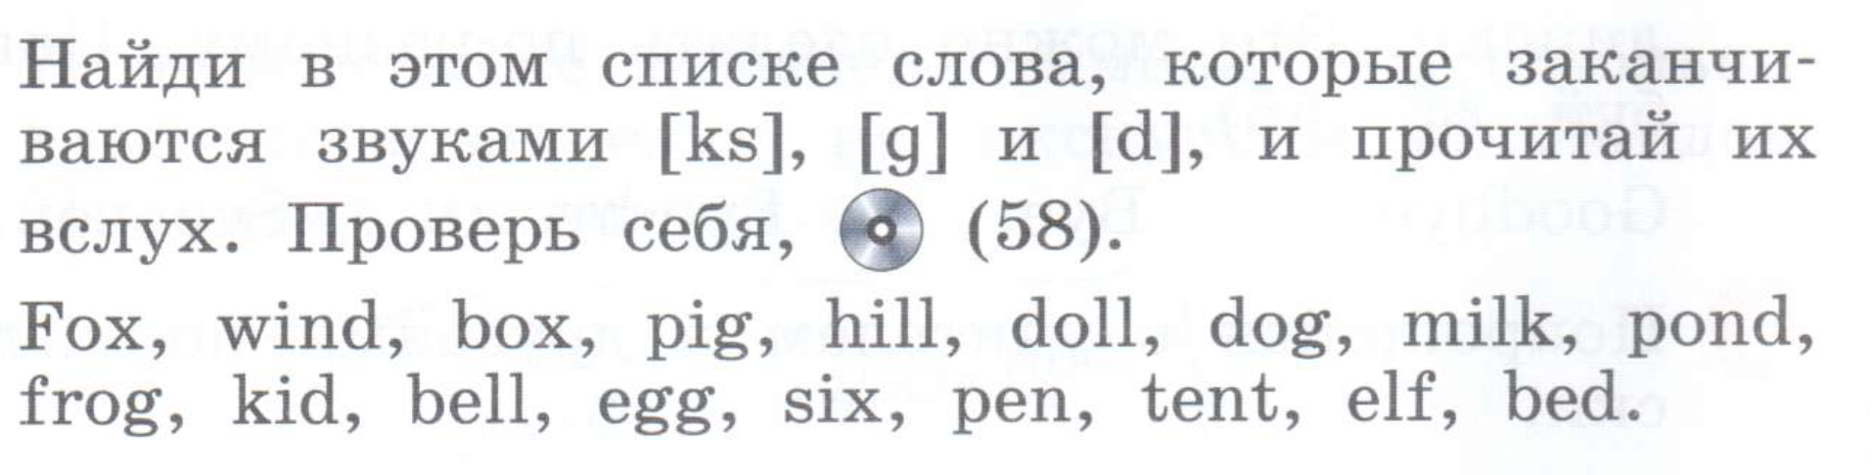

Slide 34
1
5
Glen Finn
7
Tim Lindy
Lizzy Cripps
3
2
9
Kitty Griffin
Ed Webb
Vic Wilks
6
8
Gregg Tenby
Cliff Perry
4
Gwen Webb

Slide 35
Hi
What’s your name?
Hello!
My name is_______
What’s your name?
My name is _____
Nice to meet you!
Nice to meet you!
Good bye
Good bye!

Slide 38
Д/з стр 17 упр 4
РТ стр 17 упр 1-3

Slide 43
РТ стр 20 упр 1

Slide 44
I can see …. Я вижу

Slide 45
I can see a….

Slide 46


Slide 48


