Slide 1
Автор: Кинцель Александр Евгеньевич
Республика Казахстан, Акмолинская область, г.Степногорск
КГУ «Школа-гимназия № 6 имени Абая Кунанбаева»
8 класс
Урок «The structure of plant and animal cells»

Slide 3
The topic «STRUCTURE OF ANIMAL AND PLANT CELLS»

Slide 4
THE AIM OF THE LESSON IS TO COMPARE THE STRUCTURE OF A PLANT AND ANIMAL CELLS

Slide 5
Human body has about 75 trillion cells. There are more than 75 trillion bacteria living in and on our body. How is this possible that we have more bacterial cells than our own cells?

Slide 6
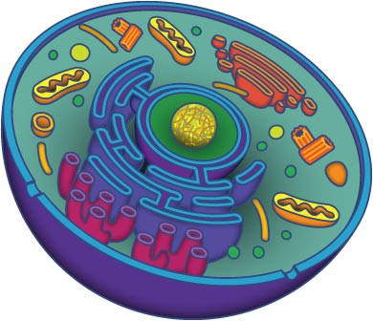
Cell structure and types
Жасуша құрылысы және түрлері

Slide 7
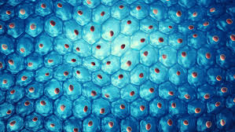
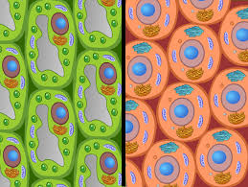
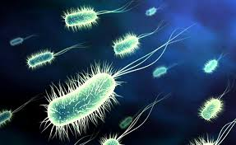
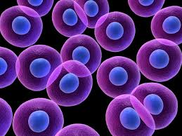
Aim:
You will compare structures of different types of cells

Slide 8
What is cell?
The questions for the lesson
What do we know about cell?
Which cell types do you know?
What is in the cell?

Slide 9
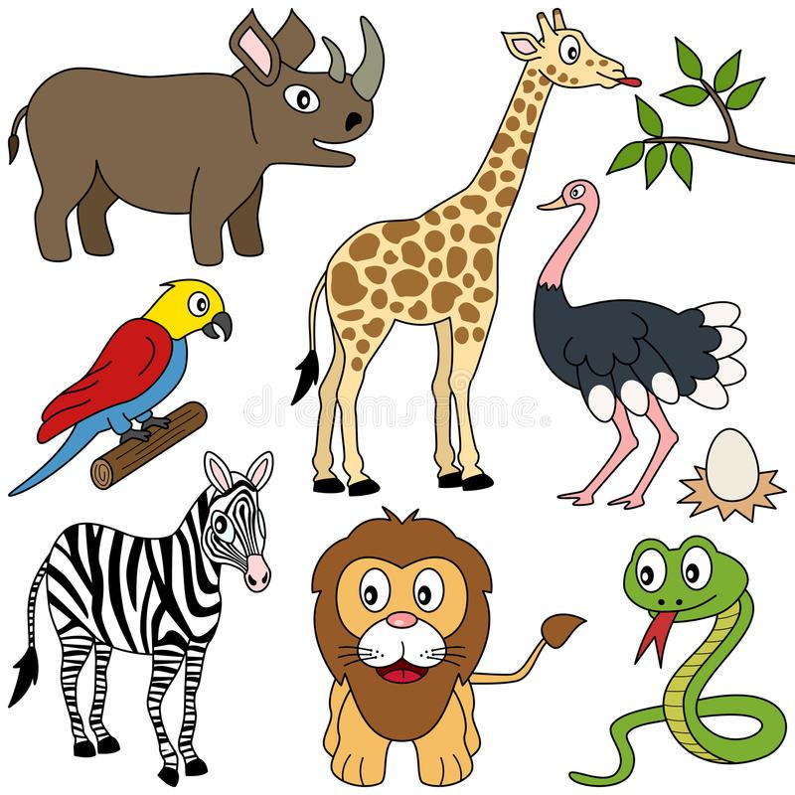
CELL - ЖАСУША
LIVING ORGANISMS – ТІРІ АҒЗАЛАР
All living organisms are made of one or more cells.

Slide 10
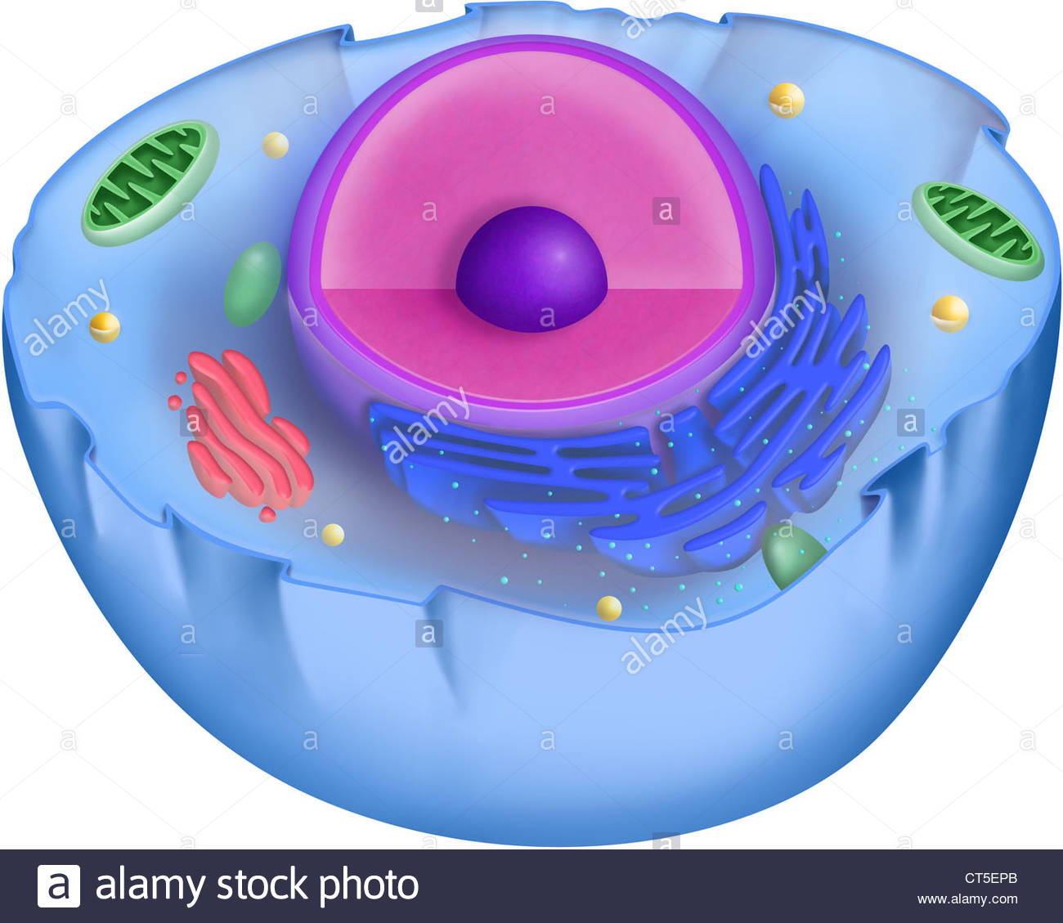
Structure of eukaryotic cell
Cell membrane covers the cell.
controls transport of substances in or out of the cell.
Plant, fungi and some protista cells have cell wall
-Cytoplasm includes liquid part and cell organelles.

Slide 11
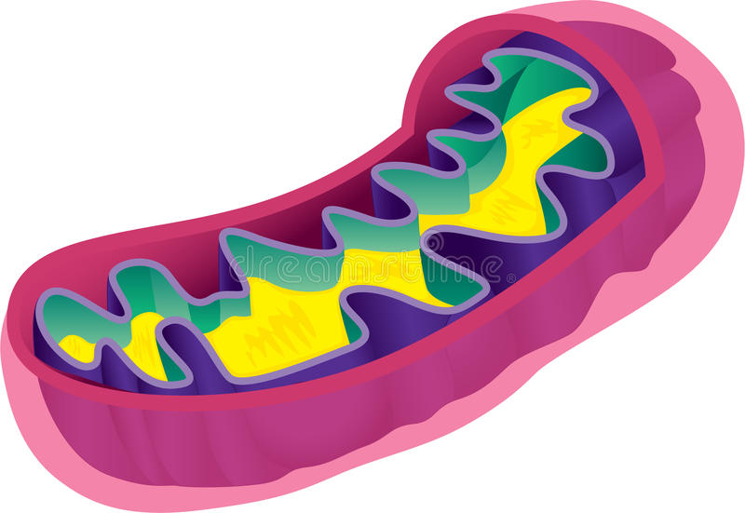
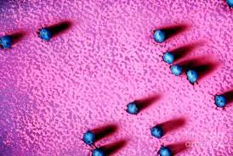
Every organelle has its own function.
-Mitochondria: it produces energy for the cell life
-Ribosomes: they produce protein

Slide 12
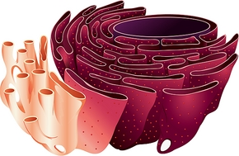
-Endoplasmic reticulum: it makes and transports proteins and lipids within the cell;

Slide 13
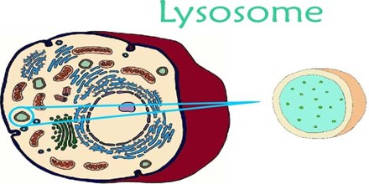
-Golgi apparatus: it receives, modifies and packs substances produced by endoplasmic reticulum; then it transports them to cytoplasm or outside the cell
-Lysosomes: small organelles with digestive enzymes, make intracellular digestion

Slide 14
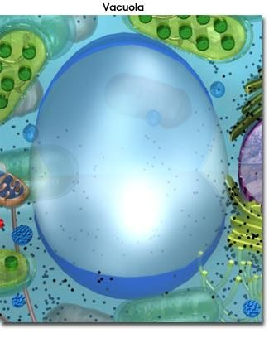
Chloroplast is a plant organelle which is in charge of photosynthesis
Vacuole: it stores substances

Slide 15
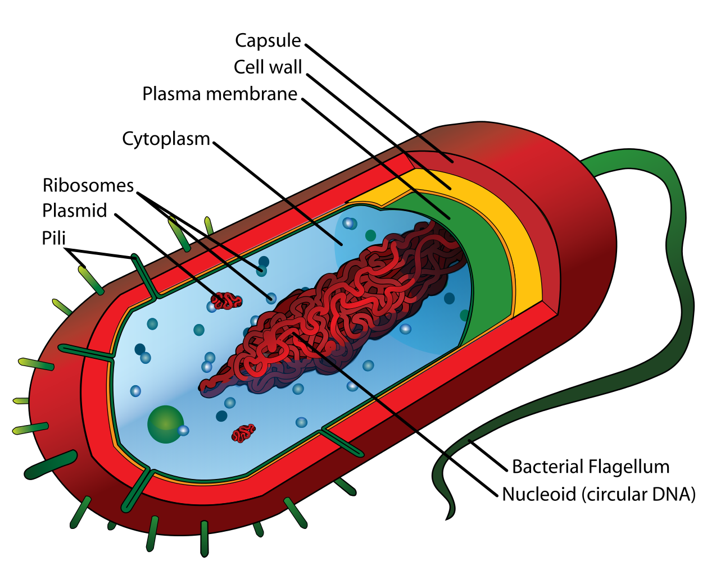
CELL

Slide 16
NUCLEUS

Slide 17
CELL MEMBRANE

Slide 18
CYTOPLASM

Slide 19
SMOOTH ER

Slide 20
ROUGH ER

Slide 21
GOLGI BODY

Slide 22
LYSOSOME

Slide 23
MITOCHONDRIA

Slide 24
RIBOSOME

Slide 25
PLASTIDS

Slide 26
VACUOLE

Slide 27
FLUID

Slide 28
BILAYER

Slide 29
PERMEABLE

Slide 30
CELL WALL

Slide 31
WELL DONE

