Slide 1
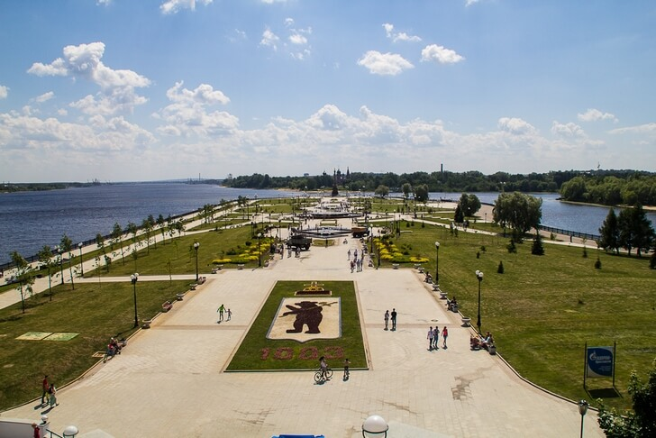
A quiz about Yaroslavl

Slide 2
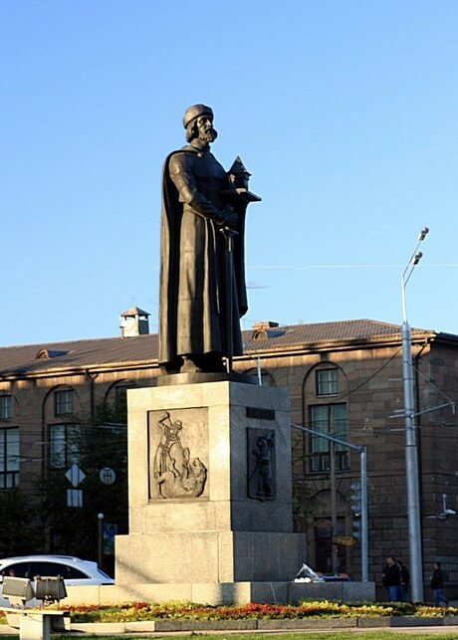
1. Who was founded Yaroslavl?
Yuri Dolgoruky
Vladimir Monomakh
Yaroslav the Wise

Slide 3
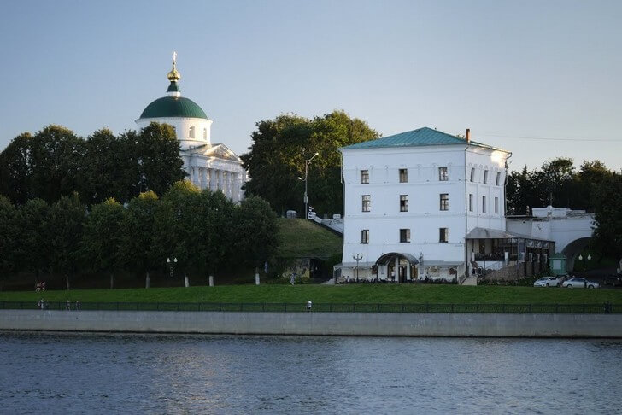
2. When was Yaroslavl founded?
In 1485
In 1010
In 1123

Slide 4
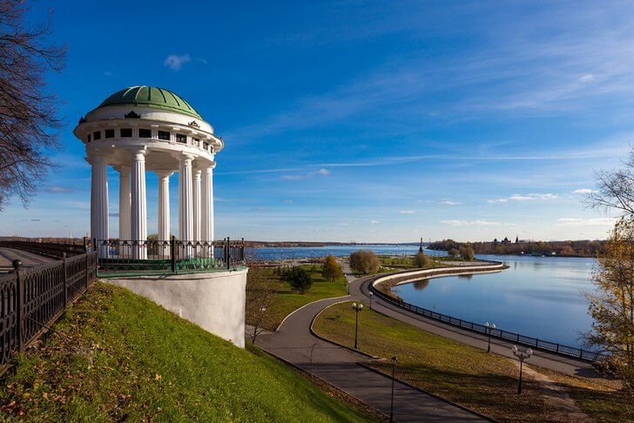
3. How was the emblem of Yaroslavl created?
It was connected with the legend about an owl and a mouse
It was connected with the legend about a dog and fish
It was connected with the legend about a bear and a prince

Slide 5
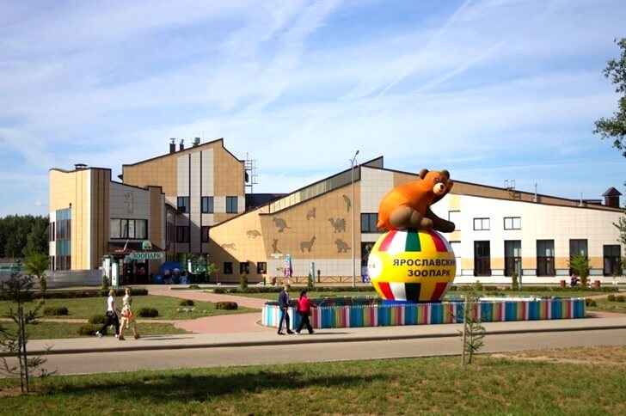
4. When was founded the Yaroslavl zoo?
In 2008
In 2010

Slide 6
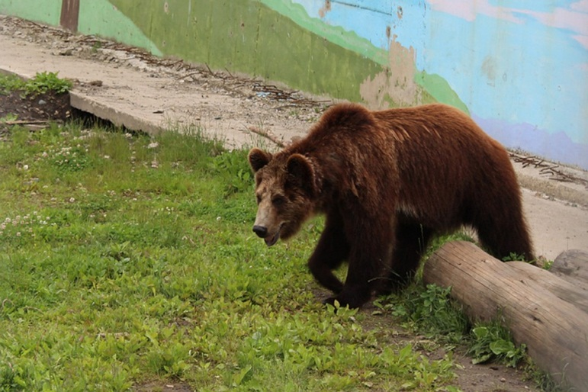
5. How many animals live there?
more than 3000 creatures
more than 5000 creatures

Slide 7
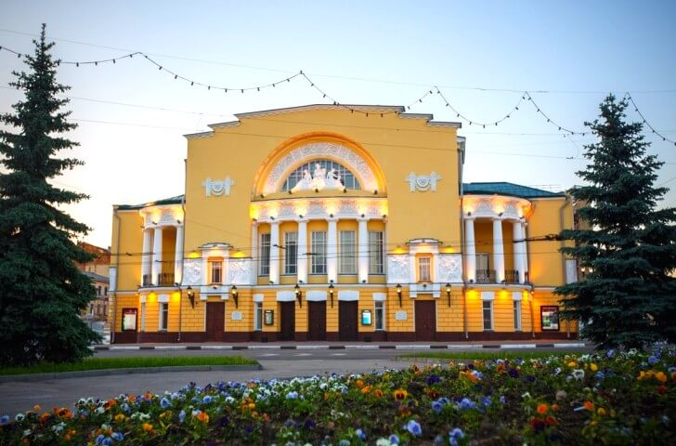
6. Who founded the Volkov`s Theater (the first theatre in Russia)?
Michail Volkov founded it in 1850
Fedor Volkov founded it in 1769
Fedor Volkov founded it in 1750

Slide 8
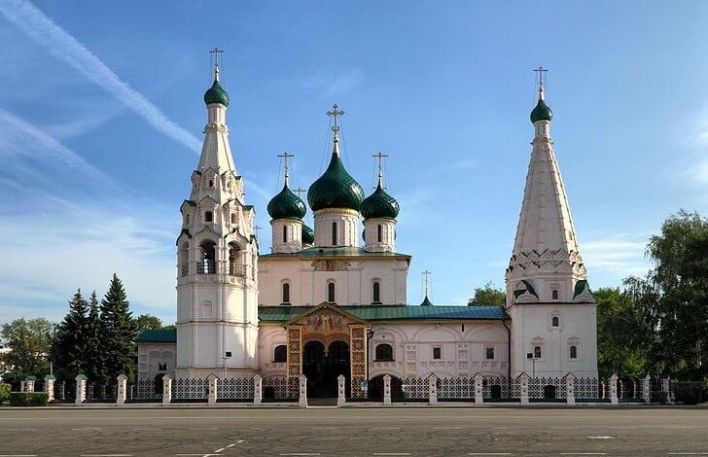
7. Where is the church of the Saint Elijah situated?
On Komsomolskaya Square
On Soviet Square
On Labor Square

Slide 9
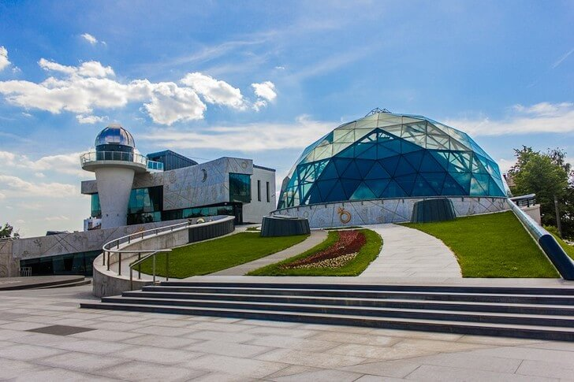
8. What is the name of the Yaroslavl’s planetarium?
It was built in honour of Valentina Tereshkova
It was built in honour of Yuri Gagarin

