Slide 1
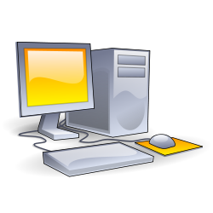
Personal computer
A personal computer (PC) is any general-purpose computer whose size, capabilities, and original sales price make it useful for individuals, and which is intended to be operated directly by an end-user with no intervening computer operator.
Computers of different types and sizes are used by modern society.
Modern personal computers often have connections to the Internet, allowing access to the World Wide Web and a wide range of other resources. Personal computers may be connected to a local area network (LAN), either by a cable or a wireless connection. A personal computer may be a desktop computer or a laptop, tablet, or a handheld PC.

Slide 2
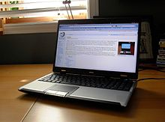
Laptop
A laptop computer or simply laptop, also called a notebook computer, is a small personal computer designed for portability. Laptops contain high capacity batteries that can power the device for extensive periods of time.
The laptop has the same access as the desktop to the wide variety of devices, such as external displays, mice, cameras, storage devices and keyboards, which may be attached externally through USB ports and other less common ports such as external video.
A subtype of notebooks, called subnotebooks, are computers with most of the features of a standard laptop computer but smaller. They are larger than hand-held computers.

Slide 3
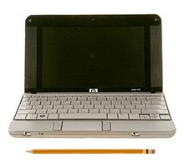
Netbook
Netbooks are a rapidly evolving category of small, light and inexpensive laptop computers. They are often called a "relatively new category of small, light and cheap laptops”.

Slide 4
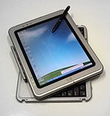
Tablet PC
A tablet PC is a notebook or slate-shaped mobile computer. Its touchscreen or graphics tablet/screen hybrid technology allows the user to operate the computer with a digital pen, or a fingertip, instead of a keyboard or mouse.
Tablet PC with rotating/removable keyboard.
The form factor offers a more mobile way to interact with a computer. Tablet PCs are often used where normal notebooks are impractical.
Recently, tablet PCs have been given operating systems normally used on phones, like Android or iOS. This gives them many of the same uses as a phone, but with more power and functionality.

