Slide 1
COMPARATIVE ADJECTIVES

Slide 2
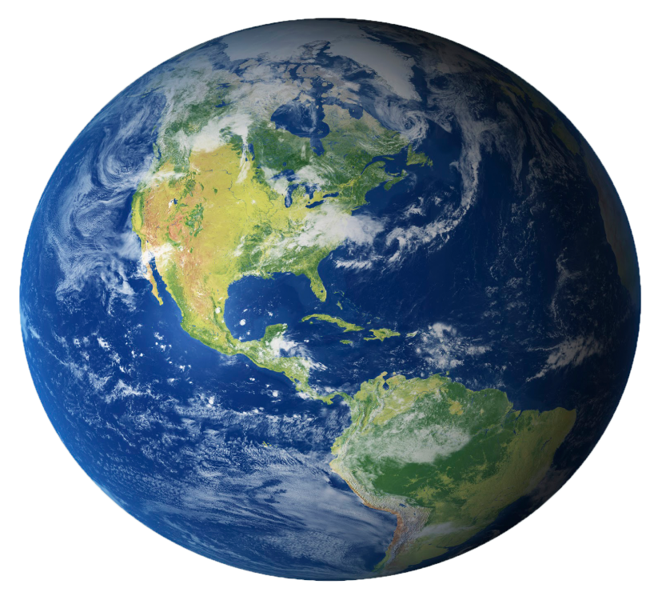
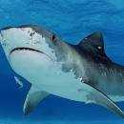
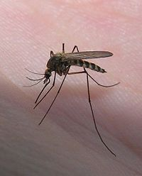
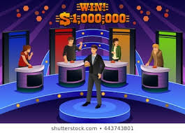
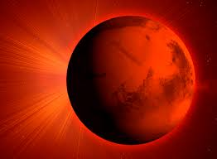
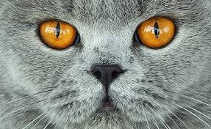
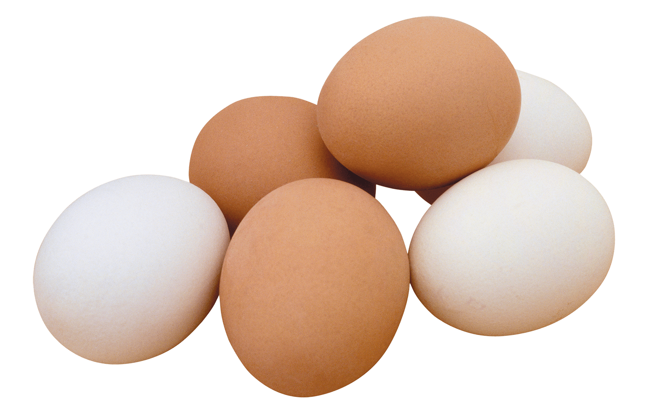
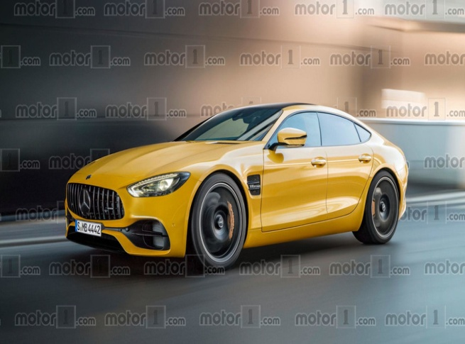
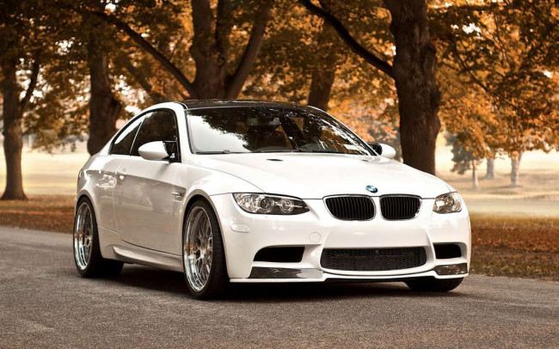

Slide 3
THE TRUE FALSE SHOW
Mosquitoes are more dangerous than sharks.
Brown eggs are healthier than white eggs.
The Earth is hotter than Mars.
Coffee is more popular than tea in the UK.
Tigers are better swimmers than cats.
An adult is shorter in the morning than in the evening.
White cars are safer than yellow cars.
The word “yes” is more common than the word “no”.

Slide 4
China is bigger _______ Japan.

Slide 5
THANK YOU
and
GOOD LUCK

