Slide 1
So early in the morning | On a cold and frosty morning
This is the way wash our face | This is the way comb our hair
wash our face, wash our face | comb our hair, comb our hair
On a cold and frosty morning | On a cold and frosty morning
This is the way brush our teeth | This is the way we go to school,
brush our teeth, brush our teeth | we go to school, we go to school…

Slide 2
Daily routine

Slide 3
Match the words and pictures
do homework
brush your teeth
wake up
have breakfast
go to work
go home
have dinner
go to school
have lunch
go to bed
have a shower
get up

Slide 4
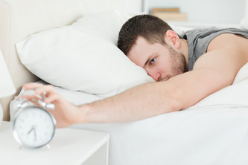
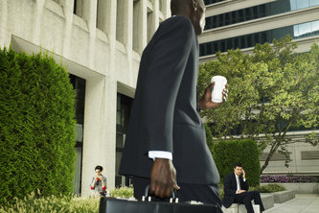
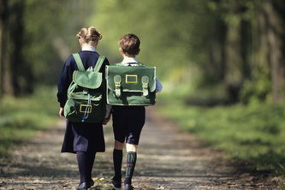
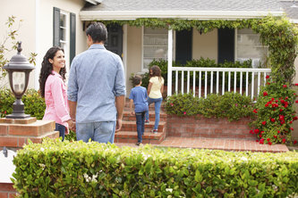
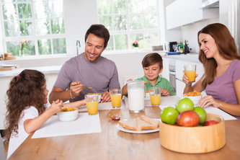
wake up
get up
go to work
go to school
go home
have breakfast

Slide 5
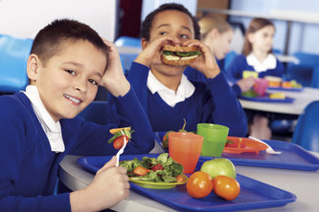
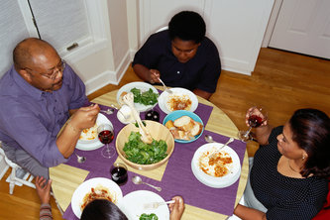
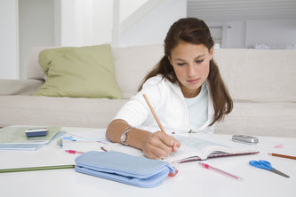
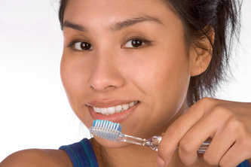
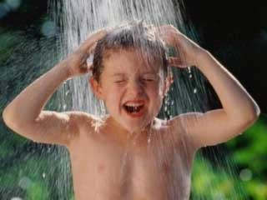
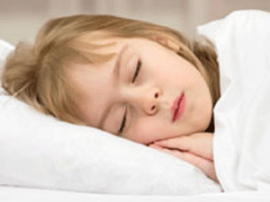
have lunch
have dinner
do homework
brush your teeth
have a shower
go to bed

Slide 6
Read the definitions and find the meanings
You do this in the afternoon when your classes at school have finished.
go home
You do this in the morning because it is the most important meal of the day.
have breakfast
You do this at the dinner table with your family.
have dinner
You do this to make your body and hair clean.
have a shower
You do this after you wake up.
get up
You do this so you can meet your friends and learn new things.
go to school
You do this after school because your teacher will get angry if you don't.
do homework
brush your teeth
Your dentist will be pleased if you do this twice a day.

Slide 7
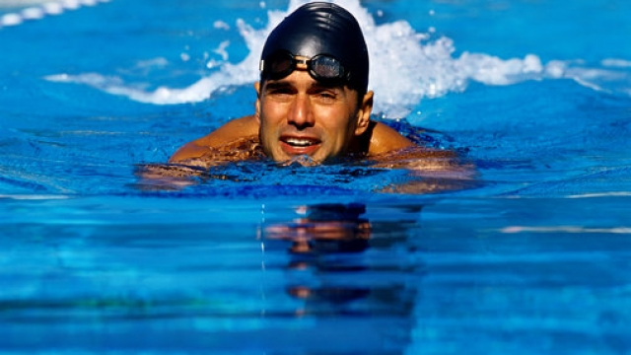

Slide 8
Interview with a swimmer Are the sentences true or false?
1. Dan gets up early.
2. He has a small breakfast.
3. He's a student.
4. Dan has lunch at home.
True
False
5. He goes swimming after classes.
False
False
6. Dan watches TV or goes on the internet before bed
True
True

Slide 9
Fill in the gaps with the correct activity to complete Dan's diary.
5 a.m.
6 a.m.
8 a.m.
11 a.m.
get up
2 p.m.
have lunch
go swimming
meet friends
5 p.m
have breakfast
have dinner
7 p.m
go to university

Slide 10
Discussion
What’s your daily routine like?
What time do you get up?
What time do you start and finish school?
Do you do any activities after school? What do you do?
What time do you go to bed?

Slide 11
Now I can…
Talk and write about daily routine
Tell the time

