Slide 1
The Greatest Philosophers

Slide 2
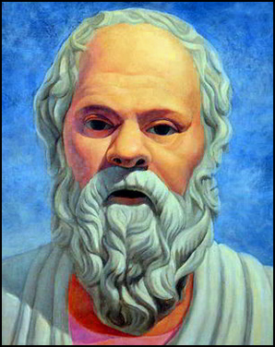
SOCRATES ( C.470 – 399 BC)

Slide 3
Socrates wanted to show people how to live wisely and happily, and to convince them that wisdom and honesty are more important than riches and fame. His guiding rule was “ know thyself “
Socrates had many followers. The most important of them was Plato. He wrote down Socrates’ ideas in his book “ Dialogues”

Slide 4
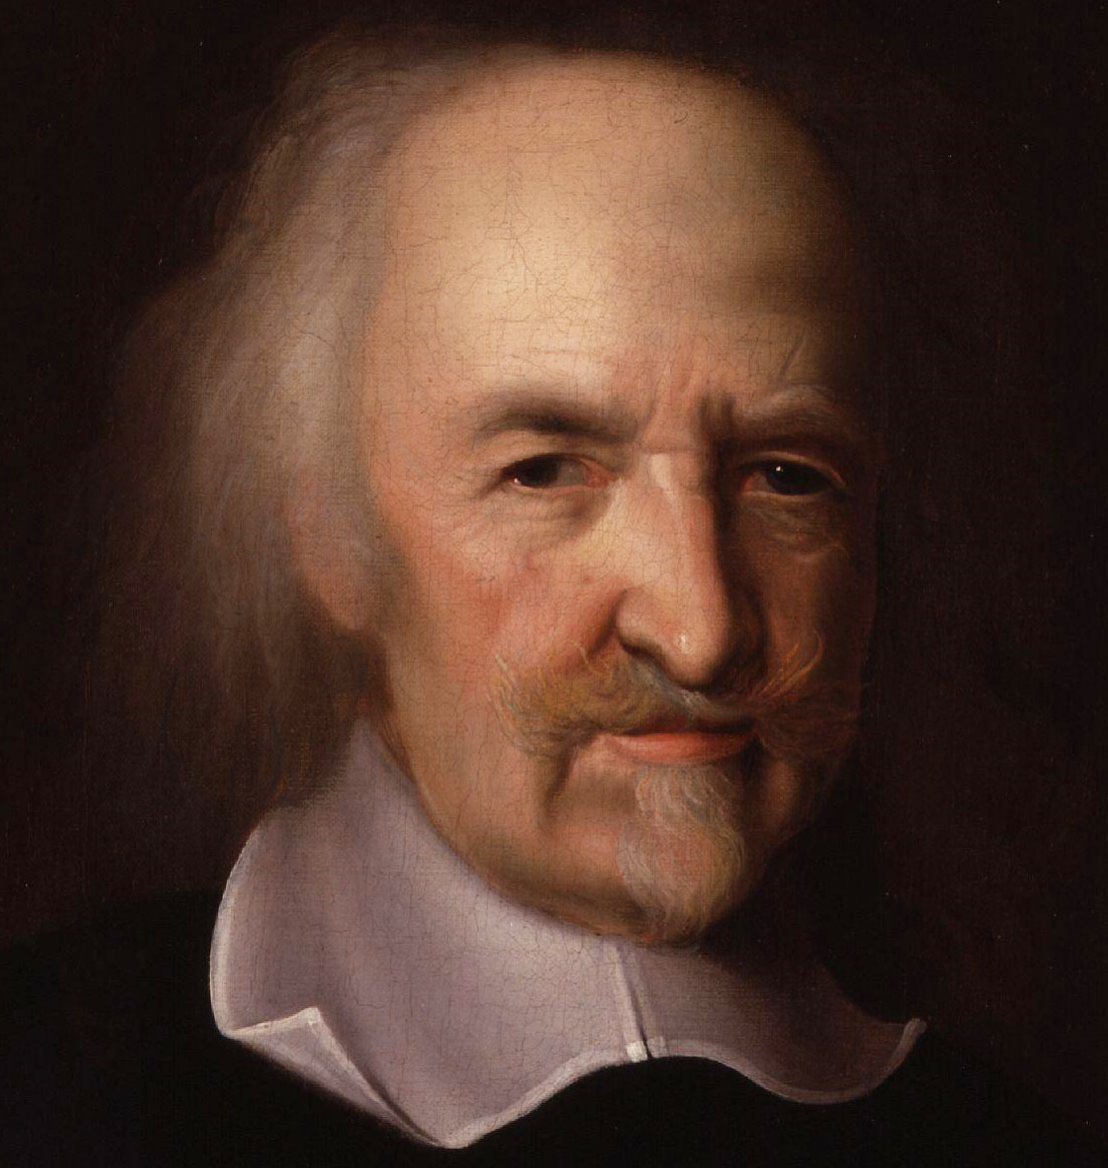
Thomas Hobbes ( 1588 – 1679 )

Slide 5
One of the greatest English philosophers believed that every man had the right to live in peace and safety. His greatest work is “ Leviathan”, in which he explained his ideas about government and also attacked the Church.

Slide 6
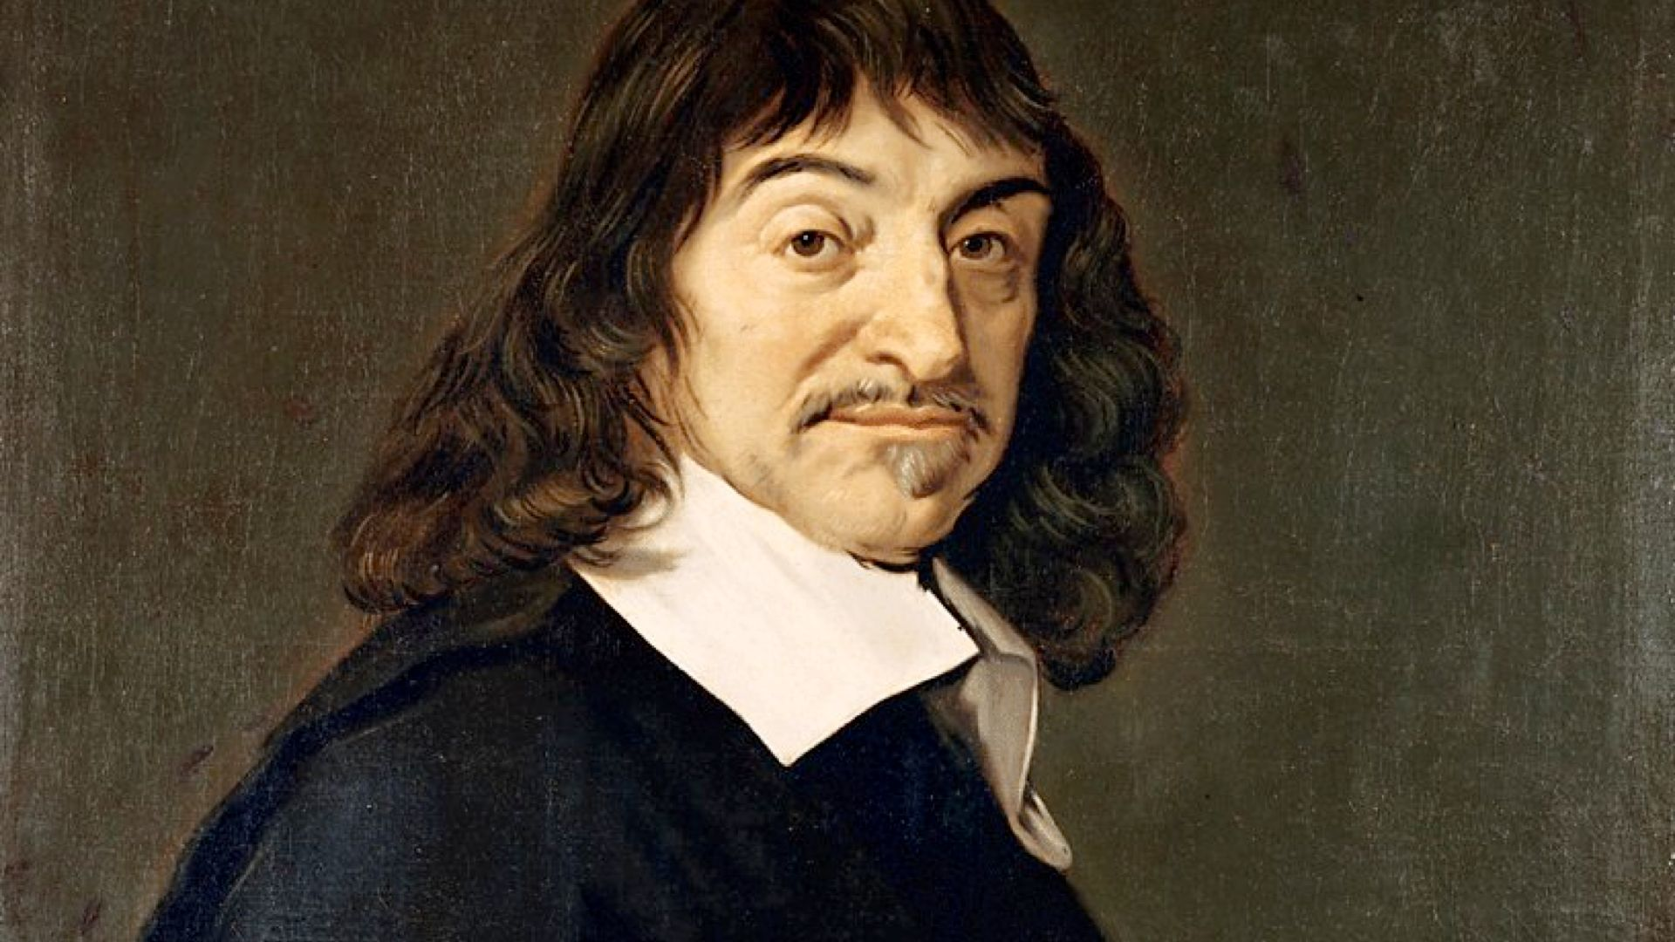
Rene Descartes (1596 – 1650 )

Slide 7
The greatest of all French philosophers set out rules for analyzing problems and attempted to find a single system that would link together all the knowledge.
Descartes’ ideas were the foundation of modern scientific investigation, of the philosophy of mind, of mathematical physics, and of analytic geometry, in which algebra is applied to geometrical problems.

Slide 8
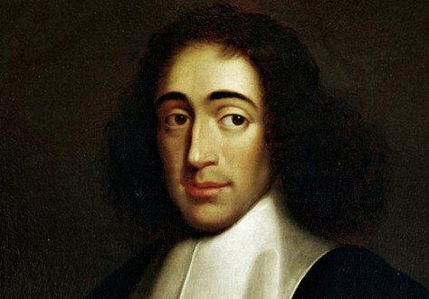
Benedict Spinoza ( 1632 – 1677 )

Slide 9
A Dutch philosopher believed that everything in the world , including human being, is part of God. He also believed that one cannot separate body from mind.

Slide 10
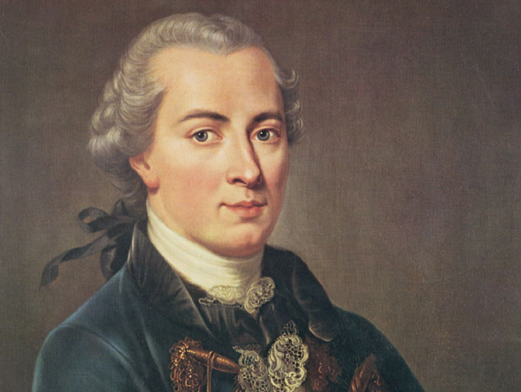
Immanuel Kant ( 1724 – 1804 )

Slide 11
A German philosopher is most famous for his writings on the “ theory of knowledge ” Kant believed that the laws of physics do not exist independently of human beings. The things that exist in the outside world are real, but the human mind is needed to give them order and form, and to see the relationships that exist between them.

Slide 12
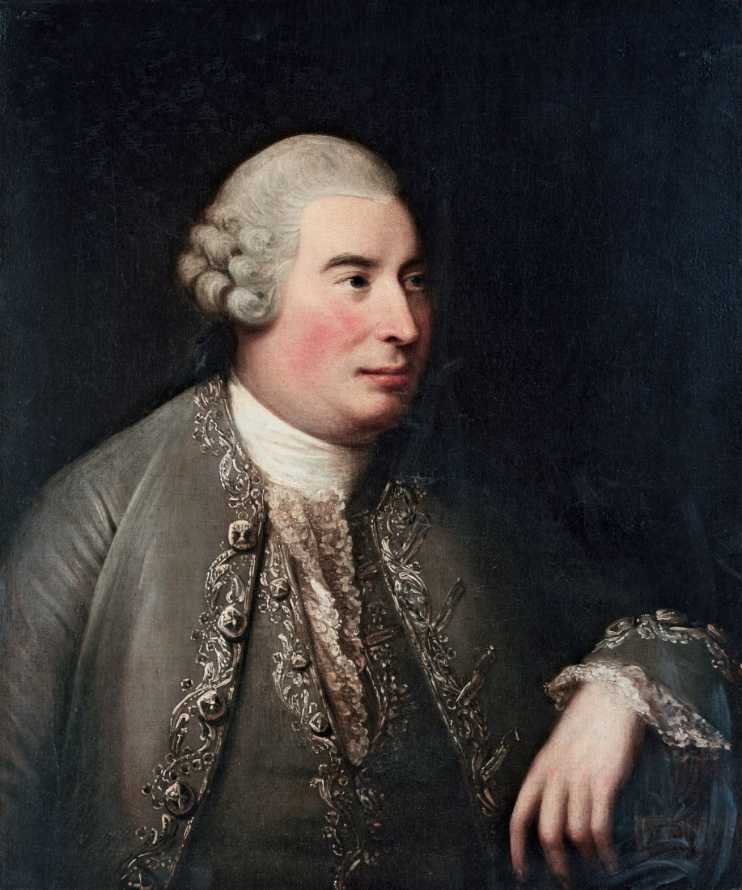
David Hume ( 1711 – 1776 )

Slide 13
A Scottish philosopher believed that man can discover the nature of the world only through his senses. Hume maintained that sense impressions are not a basis for establishing scientific laws.

