Slide 2
“How to Write a Friendly Letter”
n
l
s
E
g
i
h
http://aida.ucoz.ru

Slide 3
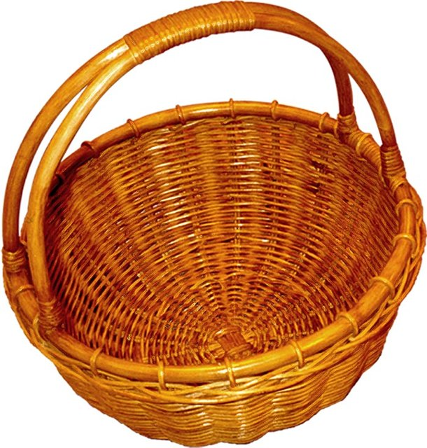

Slide 4
The Principal Parts of a Letter:
Your address
A date
The Greeting
The Body of the Letter/Text
The Ending
The Sign off

Slide 5
Fill the table:
Parts of a letter | Location
Address
Date
The Greeting
The Body of the Letter/Text
The Ending
The Sign off

