Slide 1
W
A
T
E
R
Лущик Марина Александровна,
учитель МБОУ №14 г. Хабаровска

Slide 2
Water is great wealth

Slide 3
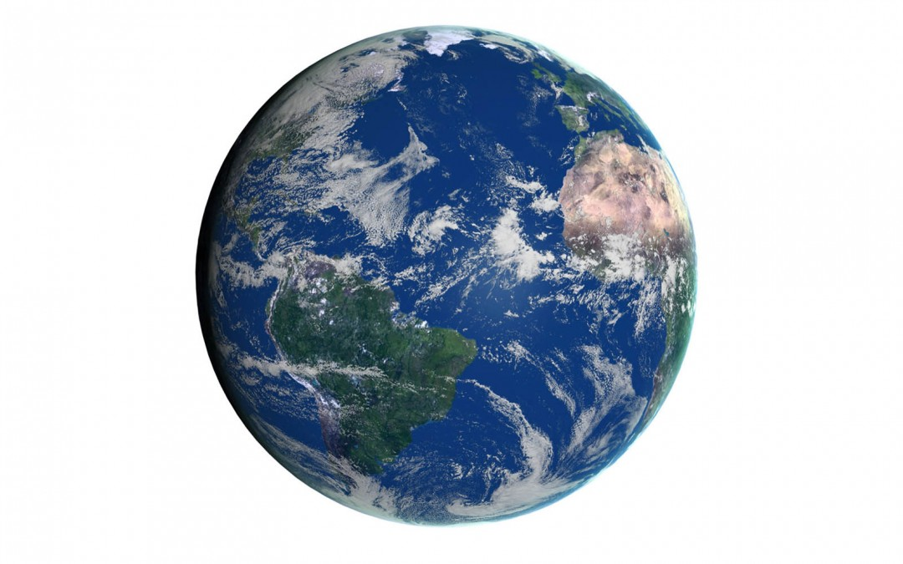
The planet Earth is mostly water. Oceans cover the biggest part of it – and there are lakes, rivers, streams, and even water underground.

Slide 4
Ocean
Sea
River
Lake
Pond
Bog
Rain
Snow
Море
Океан
Болото
Река
Снег
Озеро
Пруд
Дождь

Slide 5
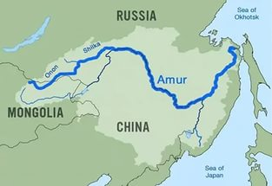
Clean water is great wealth. We must keep the water clean. That’s why we have World Day for Water. It is observed on the 22nd of March.

Slide 6
Are the sentences T(true), F(false) according the text
1. People cannot live without water.
2. People pollute water
3. Fish cannot live in the clean rivers and lakes.
4. We mustn’t keep the water clean.
5. Water makes us healthy.
True
1. People cannot live without water.
2. People pollute water
5. Water makes us healthy.

Slide 7
Home task
Water

Slide 8
Источники:
Земной шар с надписью - http://allfestivals2016.com/wp-content/uploads/2017/03/World-Water-Day-Earth-Globe-Clipart.jpg
Земной шар - http://static9.depositphotos.com/1682899/1155/i/450/depositphotos_11557656-Earth-globe.jpg
Карта - http://3.bp.blogspot.com/-ipZRohr-i3I/UVfYrgu7SmI/AAAAAAAAGvM/WUOOxrMIP20/s1600/amurmap2-960x661.jpg
Шаблон презентации -
http://climat-webmarket.ru/id/imgs/56213cd3af15b.jpg

