Slide 1

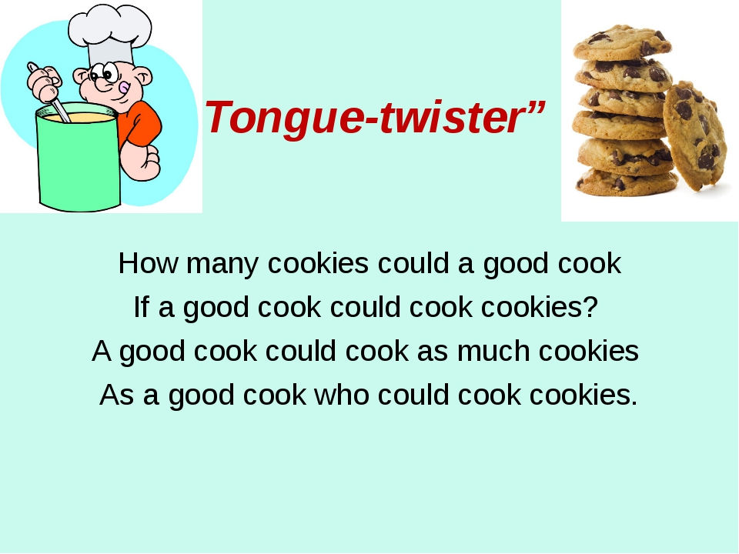

Slide 2
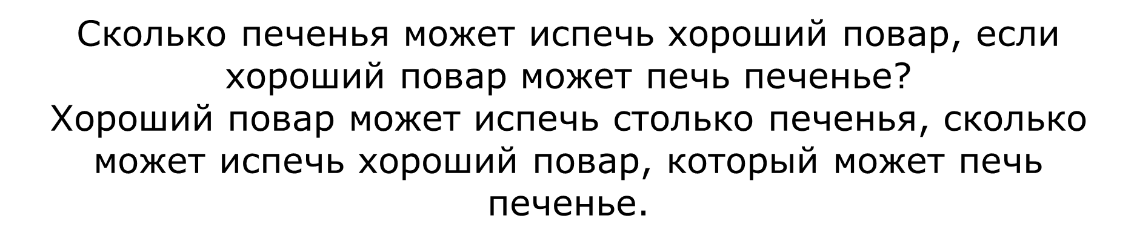

Slide 3
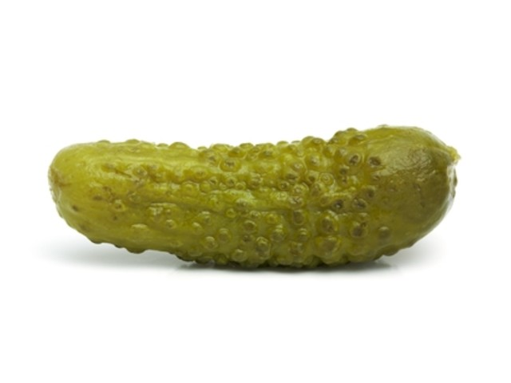
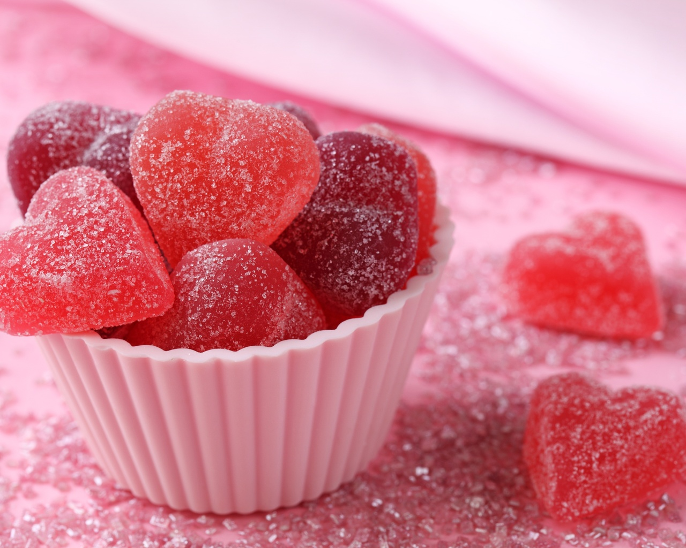
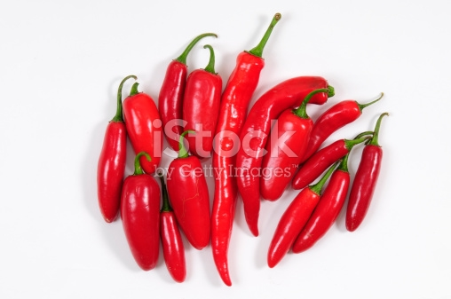
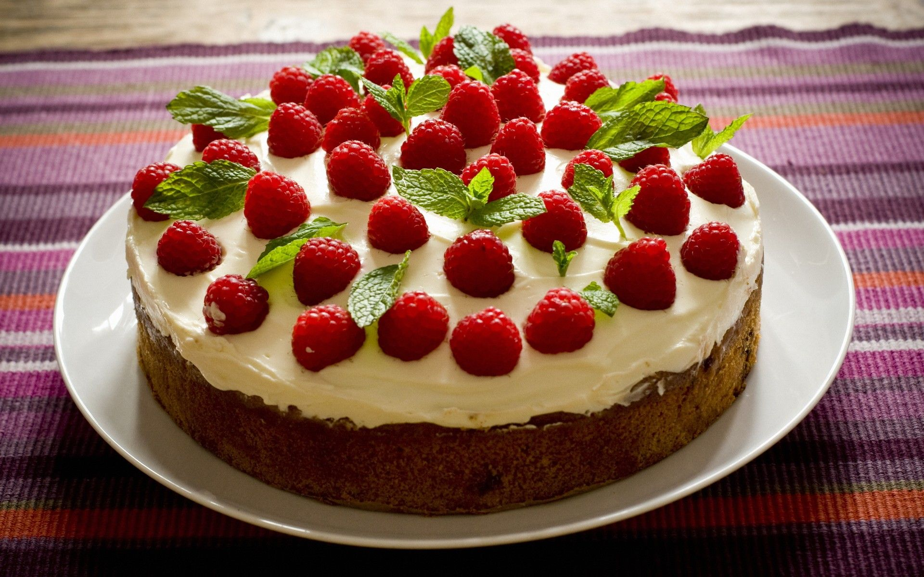
Salty – ____________
Sweet – ____________
Hot and spicy – ____________________ Delicious – _______________

Slide 4
1.
A: Let’s go to the Chinese restaurant!
B: Do you want to see me crying again?
A: Why? Are there any reasons?
B: Their cuisine is so _________________________
2.
A: Oh, this baked fish is extremely ________________! Thank you, mom!!!
B: I am happy you like it!

Slide 5
3.
A: Mum, are you in love?
B: Why? A: The soup is too ____________.
4.
A: Do you like candyfloss?
B: I love it! It’s so ____________.

Slide 6
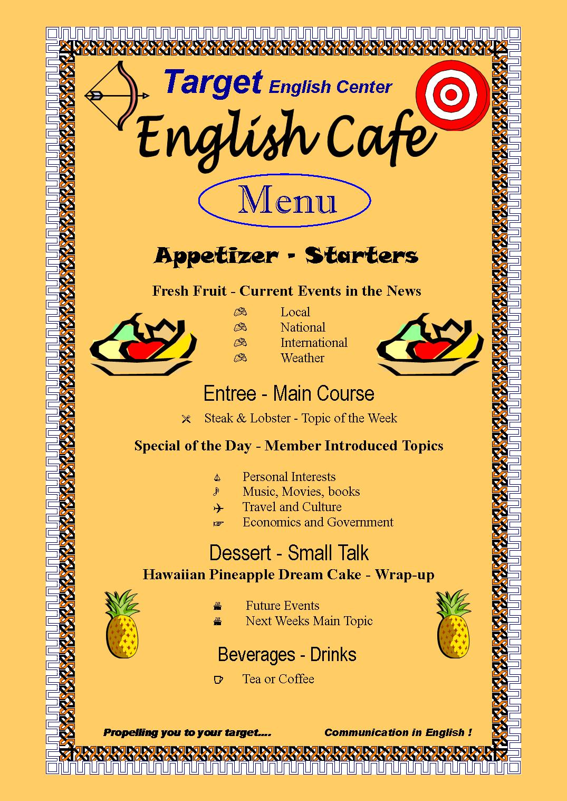

Slide 9
Ex. 4b p. 88-89
dialogue

Slide 10


Slide 11
My mum and dad (to go) to the restaurant on Fridays.
I (to cook) with my friend at the moment.
My mum and dad go to the restaurant on Fridays.
Present Simple
2. I am cooking with my friend at the moment.
Present Continuous
• a daily routine/habit? • an action happening now?

Slide 12
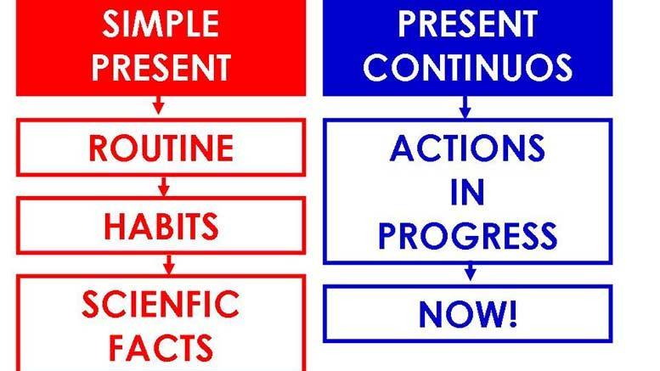

Slide 13
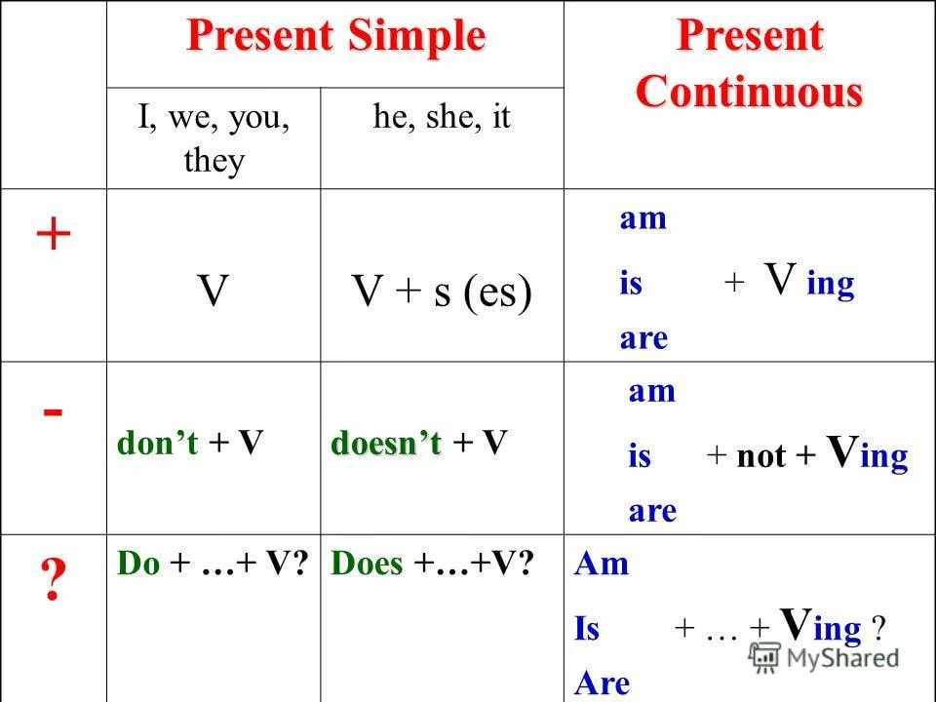

Slide 14
Workbook p. 54 ex 4
3. We always buy/ are buying fresh fruit from the market.
4. She is having/ has breakfast at 7 a.m. every day.
5. She makes/is making some fresh orange juice.
Would anyone like some?

Slide 15
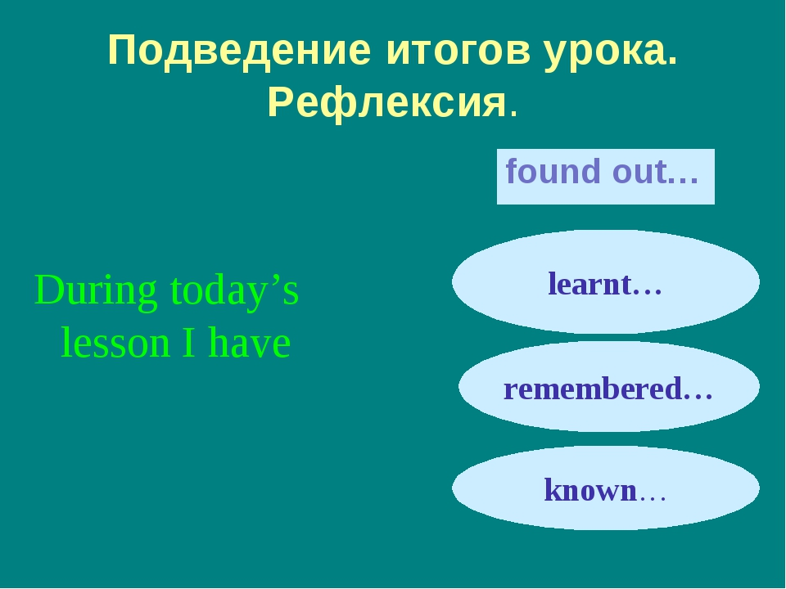

Slide 16
Hometask
Wb p. 54 ex. 1,2
Sb p.89 ex.7
Thank you for the lesson

