Slide 1
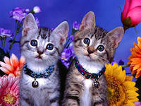
СATS
My cat is black.
My cat is fat.
I like my cat.
It is my pet.

Slide 2
Dogs
My dog can run.
My dog can jump.
My dog likes chocolate.
It’s fun!

Slide 3
Rabbits
I have got a rabbit.
He is pink and white.
His favorite food is carrot.
He likes it very much!

Slide 4
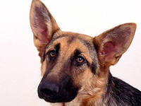
«Буквы спрятались»
A
T Z
Q N G X
M E K Y D W
H S C J U V P
B F L O I R

Slide 5
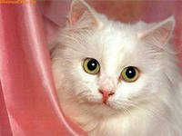
«Буквы спрятались»
B
I R
MQ WX
ENYGKD
PVSHUCO
A J T Z F L

Slide 6
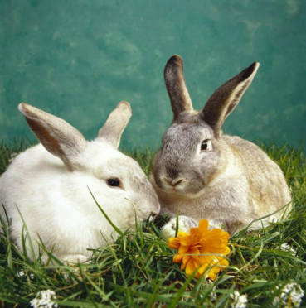
«Буквы спрятались»
B
I R
MQ WX
ENYGKD
PVSHUCO
A J T Z F L

Slide 7
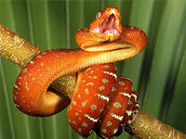
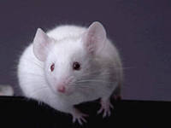
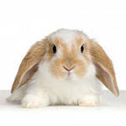
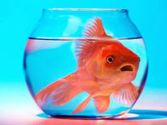
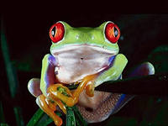
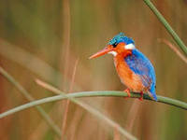
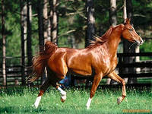
Do you know these animals?

Slide 8
Check yourself, please!
a chimp----
a mouse-------
a bird---------
a rabbit-------
a horse-------
a frog--------
a snake ----------
a fish------------

Slide 9
What can these animals do?
Swim
Dance
Climb
Jump
Run
Fly
Sing songs
Летать
Прыгать
Танцевать
Петь песни
Бегать
Лазать
Плавать

Slide 10
Make up sentences with the words!
1. can, dog, fly, a, not.
----------------------------------
2. likes, cat, my, fish .
----------------------------------
3. I, swim, like, fish, a, can.
----------------------------------
4. has, Tom, got, rabbits, six.
----------------------------------

Slide 11
Check yourself, please!
1. A dog can not fly.
2. My cat likes fish.
3. I can swim like a fish.
4. Tom has got six rabbits.

Slide 12
My favourite animal.
My favourite animal is………..
It likes………..
It can ……...
It can’t ………

