Slide 1
Министерство образования Московской области Государственное образовательное учреждение Высшего образования Московской области «Государственный социально-гуманитарный университет»
Family in the modern world
Зарайск 2017г.

Slide 2
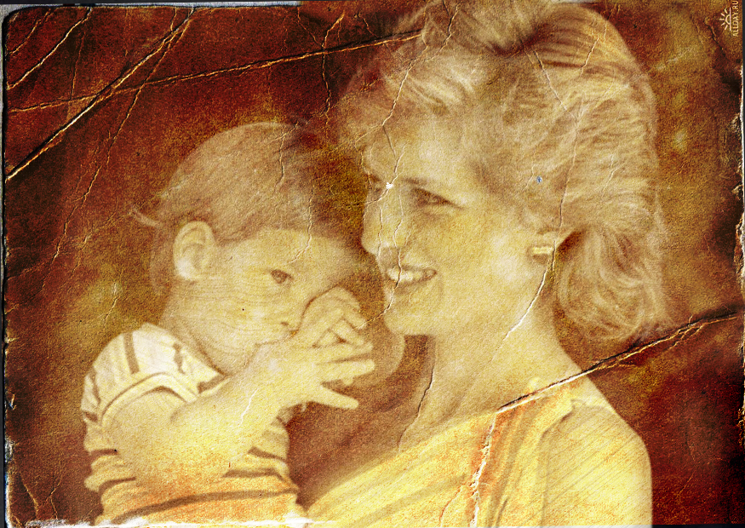
«Family is the most important thing in the world»
Diana, princess of wales, 1961-1997

Slide 3
Warm-up activities
Express your opinions on the following terms.
Divorce
Working mothers
Two-career families
Single-parent family

Slide 4
Express your ideas on the statements below and back up your opinion.
Healthy families are our greatest nationals resource
The great advantage of living in a large family is that early lesson of life s essential
Every family is a «normal» family – no matter whether it has one parent? Two or no children at all

Slide 5
Pre-reading
Look at the words and phrases and try to explain their meaning
Industrialized societies
Irretrievable breakdown of marriage
Proposed laws
Welfare
Adultery
Socially acceptable
The rise in the divorce rate
Break-up of a marriage

Slide 6
The history or divorce in the 20-th century
Read the text and list two possible reasons for the divorce rate rising sharply since the Second World War

Slide 7
After you read
Was there a «golden age» of the family in Russia ?
What role do discipline and moral standards have in Russia?
Does our country have an equivalent of British «Victorian values» ?
How does «traditional» family life differ from Russian family life in the present ?

Slide 8
After you read
Divide the text above into logical parts and give each part a title.
Prepare a summary of the text.
Give a direct translation of the underlined parts of the text.

Slide 9
Express your ideas on the following situations
A man and a woman living together without getting married
A man or a woman living alone and never getting married
People marrying two or three times during their lifetime
How acceptable are these ways of life in your country?

Slide 10
Reading
The Whiniest Generation (from: Newsweek. February 17/20)
Discussion
Discuss the relationship between different generations in Russia.

Slide 11
Vocabulary practice
Stigma
Breadwinner
Petition
Latch key kids
Permissive society
Cohabiting
An application for legal action to be taken
Children who have their own key to their home because there is no one to let them after school
Living together as husband and wife without being married
A reputation of shame or dishonor
A person supporting a family financially by earning money
A term given to a society which allows people a great deal of freedom, especially sexual freedom

Slide 12
Keys
D
E
A
B
F
C

Slide 13
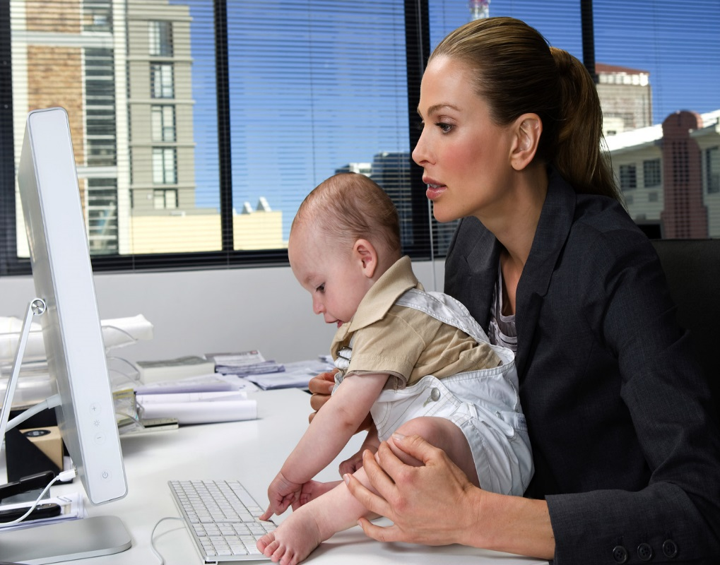
Discussion
Working mothers – guilty mothers?

Slide 14
Sinquan
Noun
Two adjectives
Three verbs (-ing)
Sentence
Synonym

Slide 15
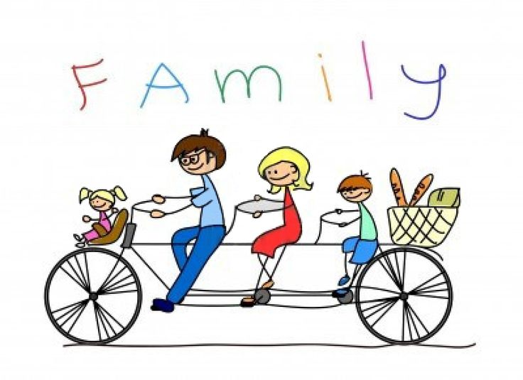
Sinquan
Family
Favorite, priceless
Loving, understanding, protecting
The most important thing in the world
Riches

Slide 16
Home work:
Student book “New headway. Intermediate” p. 108 ex. 1,5.

Slide 17
Sources:
Агафонова Л.И., Вакурина Н.А., Верхотурова В.В. Social work: what is it? Учебное пособие. – 2-е изд., испр. – Томск: Изд – во Томского политехнического университета, 2007. – 99 с.

