Slide 1
The name bringing fame and glory to others
Презентация подготовлена Пахомовой С.Н.,
учителем английского языка
Гимназии г. Раменское

Slide 2
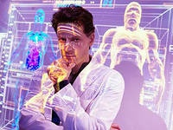
“Modern civilization is everything that has been achieved thanks to science”
. Why do people become scientists?
Do you think it is difficult to be a scientist? Why? Why not?

Slide 3
it is fun
feel thrilled when they learn new things
want to have unique knowledge
scientist
like to create order out of chaos
want to have freedom
like working for the benefit of society

Slide 4
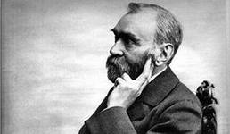
The name bringing fame and glory to others

Slide 5
Writing a sinkwein poem .
Alfred Nobel
Two adjectives
Three verbs
The name bringing fame and glory to others
One noun ( may be with an adjective)

Slide 6
Russian Nobel Prize winners in Physics and Chemistry
How many Nobel Prize winners were members of the Academy?
Which scientists were among those who founded the Moscow Institute of Physics and Techology?
Which scientists left the country to continue their studies?
Who was the director of the Academy’s Physics Institute
before Vitaly Ginsburg?

Slide 7
1. All but one= ten
2.Semyonov, Landau and Kapitsa
3.Kapitsa and Landau
4. Igor Tamm

