Slide 1
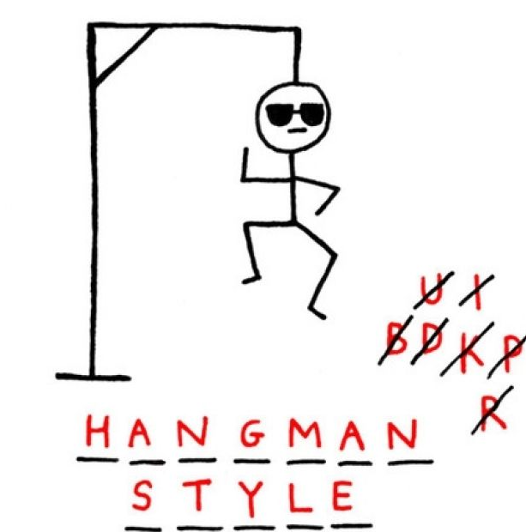
Hangman game

Slide 2
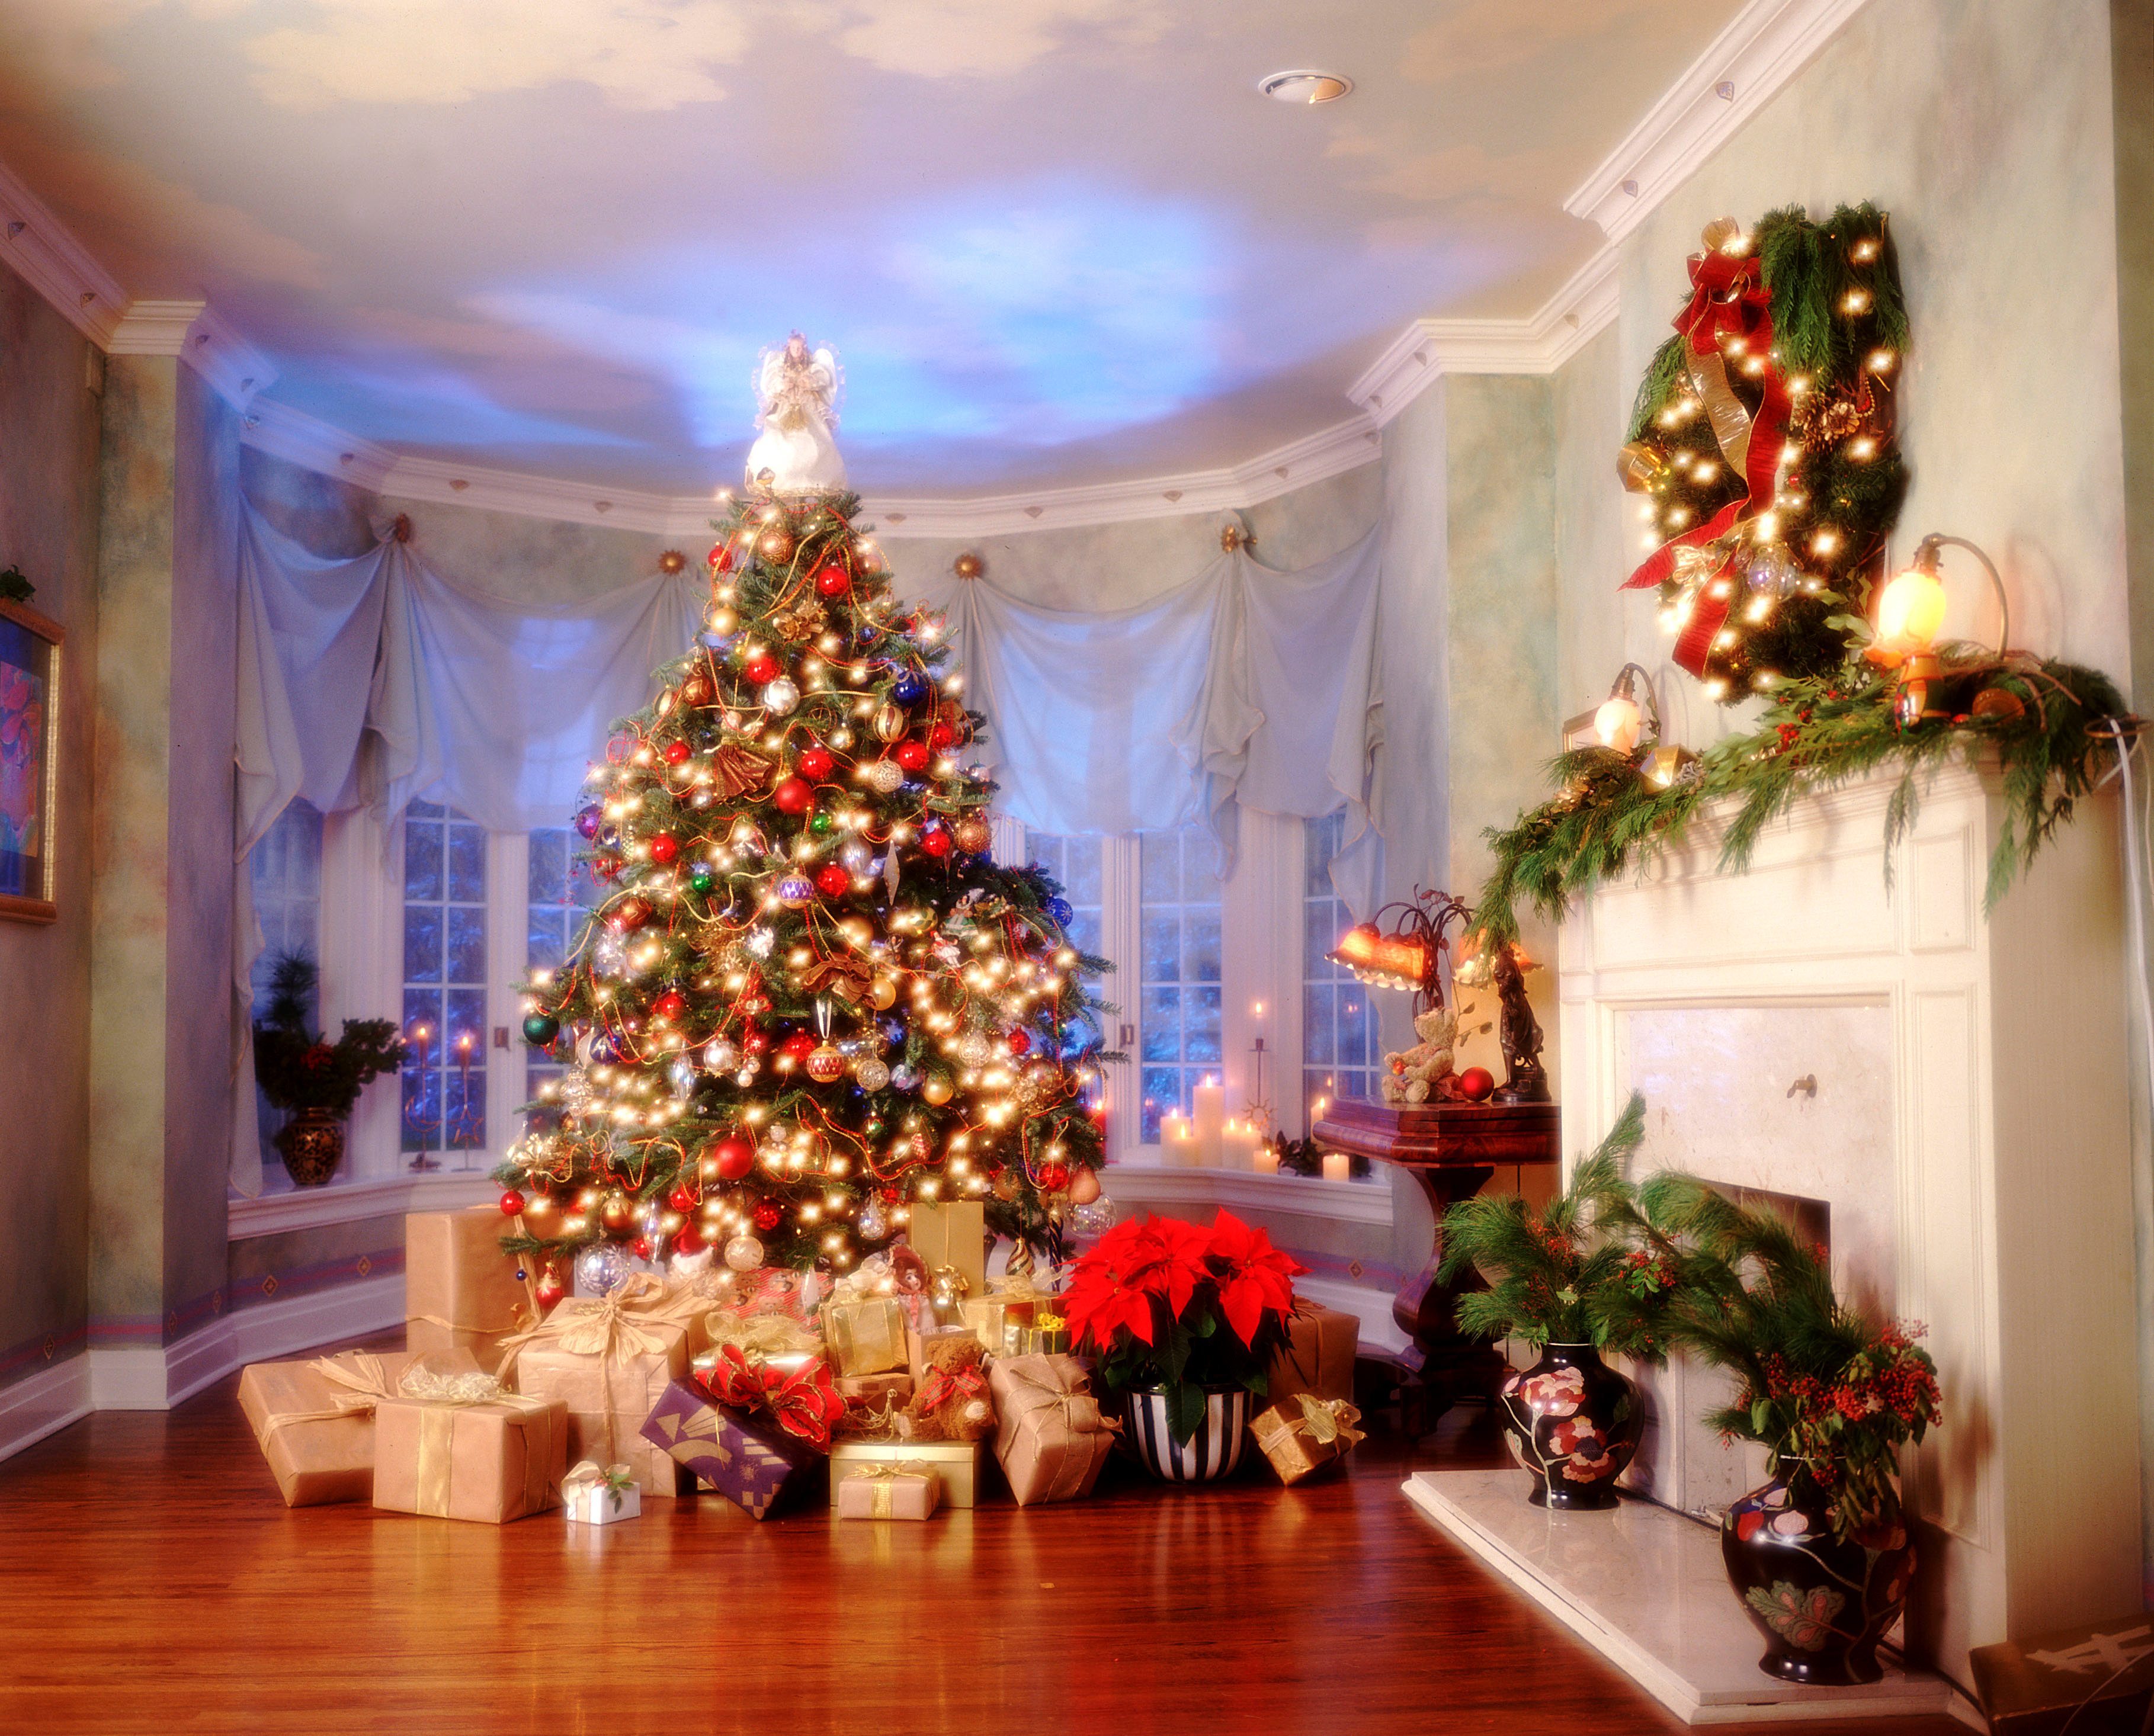
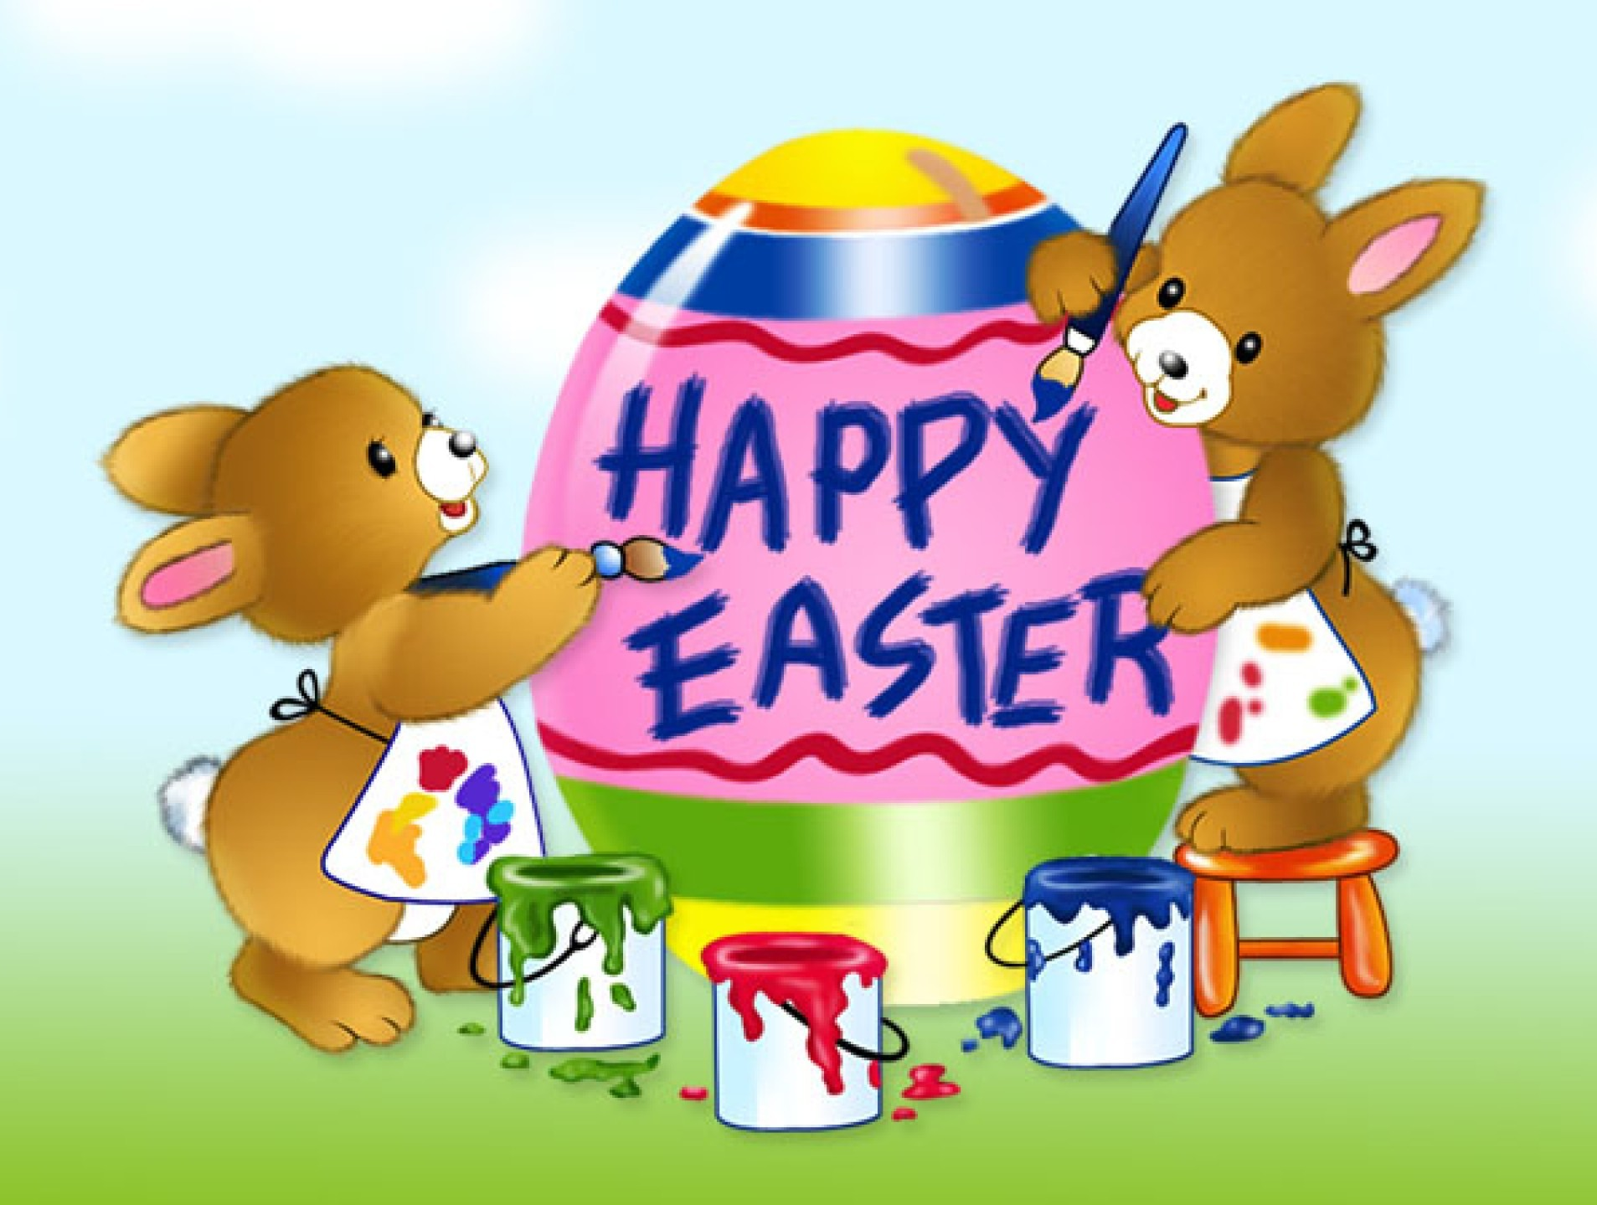
Holidays
Feasts -
it’s time
to celebrate some special occasions

Slide 3
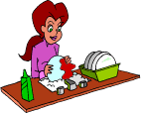
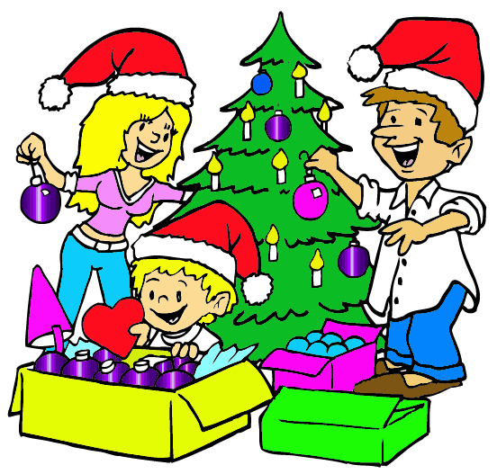
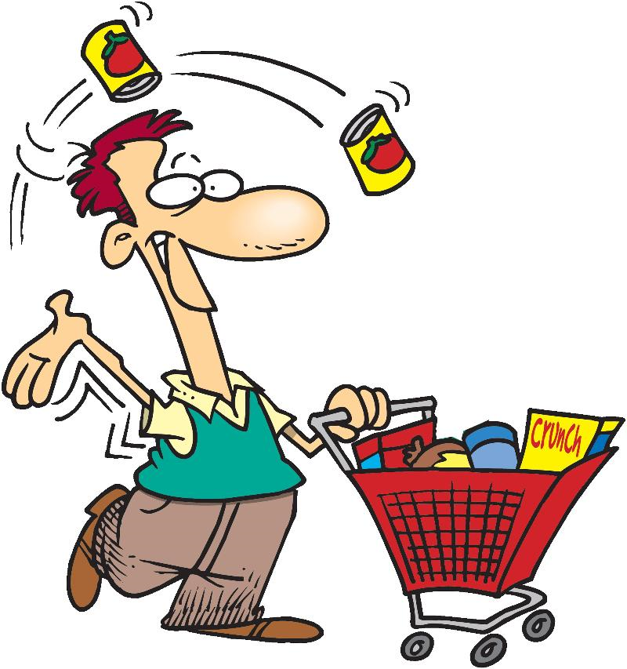
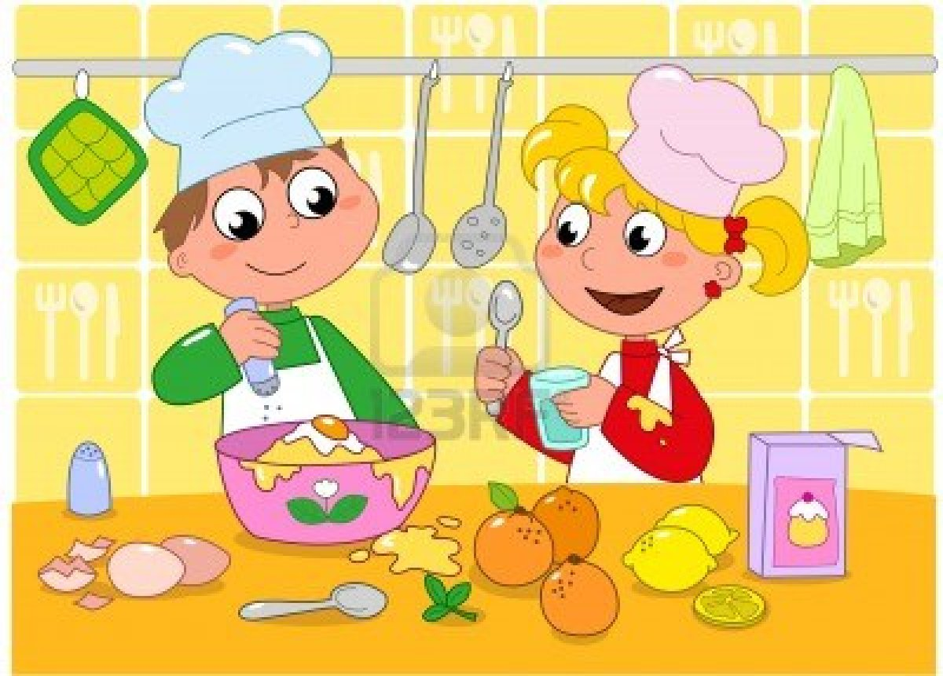
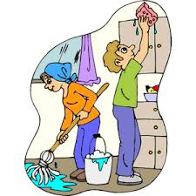
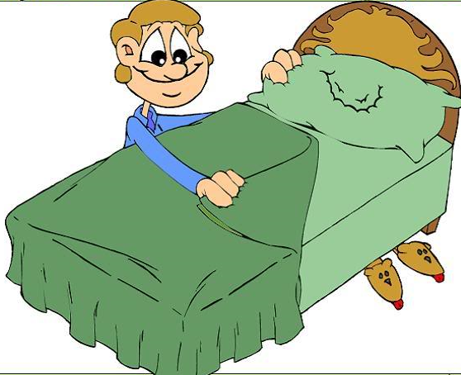
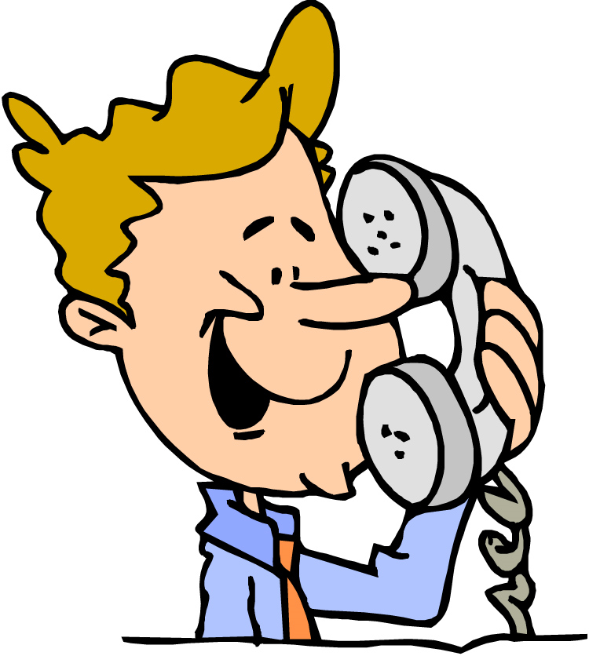
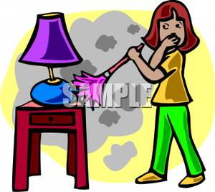
making preparations
Before Feasts -

Slide 4
make
do
make the decorations
make tea
make a special dish
make a cake
do the dusting
do my/your homework
do the gardening
do the washing-up
do the shopping
to make means to produce something
(изготавливать, создавать) ;
to do means to perform an action
(выполнять действие, выполнять работу).

Slide 5
make
do
make the decorations
make tea
make a special dish
make a cake
do the dusting
do my/your homework
do the gardening
do the washing-up
do the shopping
fixed expressions
make a phone call
make the bed
make a mistake
make a fire

Slide 6
What are the people doing?
The woman
The man in picture …. is making ….
The man& the woman are doing ….
The children

Slide 7
1.How often do you ….?
1.How often do you ….?
How often do you …? | A/ S / N | points
1. do the washing-up | S
2.
…..
SCORE
A – for always/ often
S –for sometimes
N – for never

Slide 8
How to score
Write in your paper
Points
A – for always/ often
S –for sometimes
N – for never
2 points
1 point
0 point

Slide 9
What your score means
13 -18
I think, …. really helps his/her parents because he/she has … points. His/her parents can be proud of him/her.
7 – 12
I think, …. helps his/her parents because he/she has … points. But he/she should help more.
0 – 6
I think, …. doesn’t help his/her parents because he/she has … points. His/her poor parents work hard, like slaves, and he/she doesn’t think about them.

Slide 10
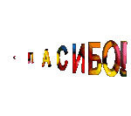
Thanks everybody !
I hope you’ve enjoyed our lesson.
Goodbye. Have a nice day!

