Slide 1
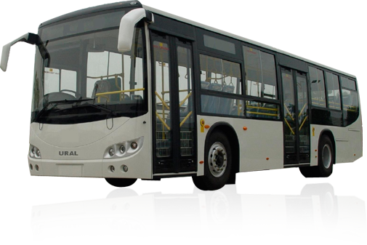
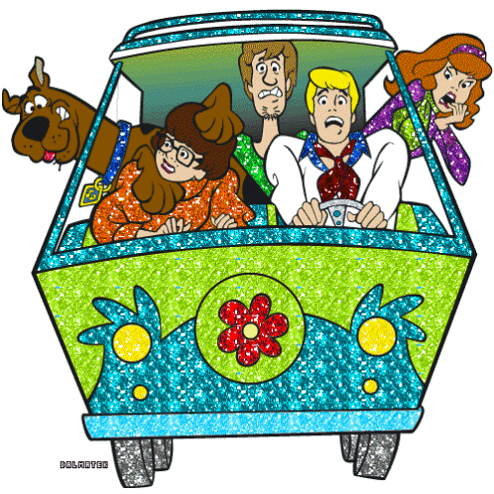
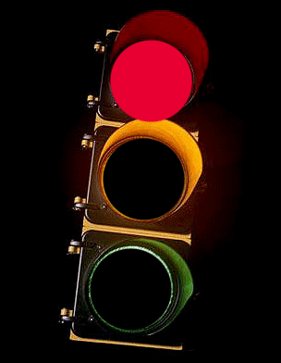
Road safety

Slide 2
What are we going to do in our lesson?
We’ll read about road safety
Learn how to give instructions
Learn new words
Sing a song
Play games
Write some words
Practise grammar
Speak about safety rules

Slide 3
Фонетическая зарядка
[æ] traffic, back, stand
[ai] light, driver, bike, line, sign
[i:] lean, seat, zebra
[ei] pavement, way, plane, train
[o] walk, talk, crossing, across, both

Slide 4
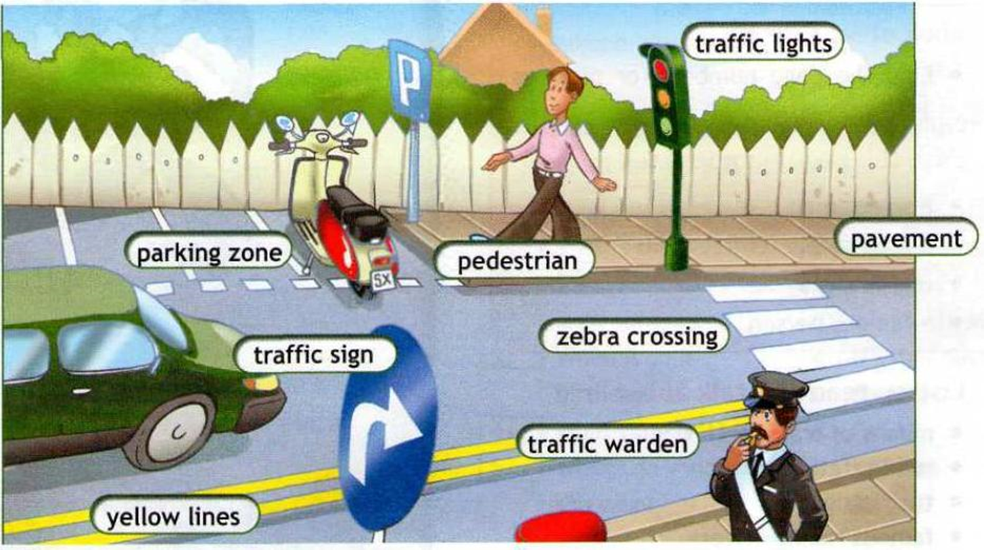
What can you see in our town?

Slide 5
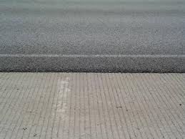
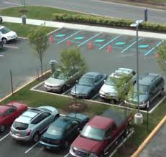
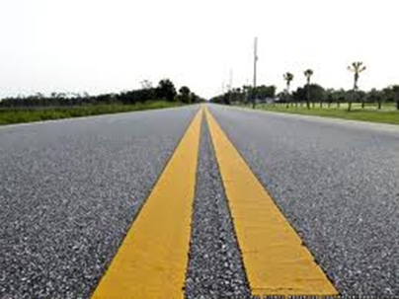
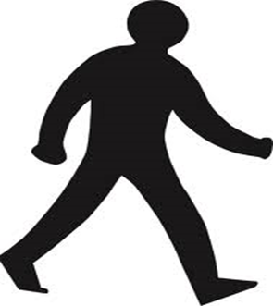
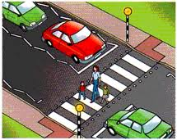
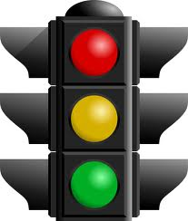
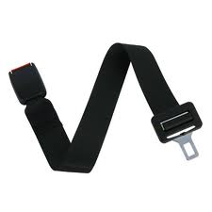
Match the words and the pictures

Slide 6
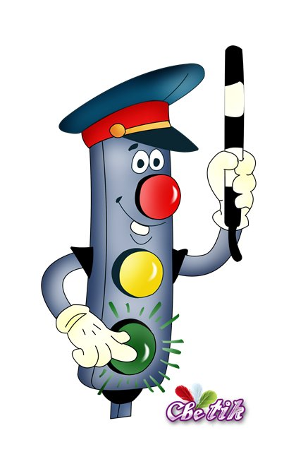
Match the words to make phrases:
Wear
the window
Walk straight
the pavement
Look
the driver
Run onto
the road
Talk to
both ways
Walk on
across the road
Lean out of
a seat belt

Slide 7
It’s safe
It’s dangerous
Run onto the road
Look both ways
Walk straight across the road
Talk to the driver
Walk on the pavement
Wear a seat belt
Lean out of the window

Slide 8
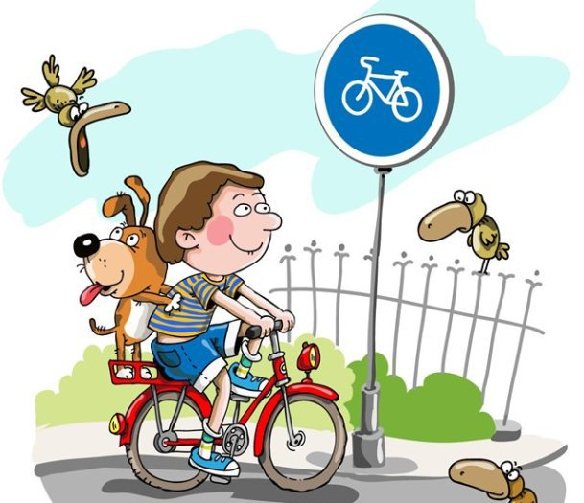
Повелительное наклонение
I wear my seatbelt.
Wear your seatbelt!
I don’t talk to the driver.
Don’t talk to the driver!

Slide 9
Give instructions on road safety
When you travel in a car,
When you ride a bike,
When you cross the street on foot,
When you travel in a bus,

Slide 10
Complete the spidergrams with the words
bicycle
car
bus

Slide 11
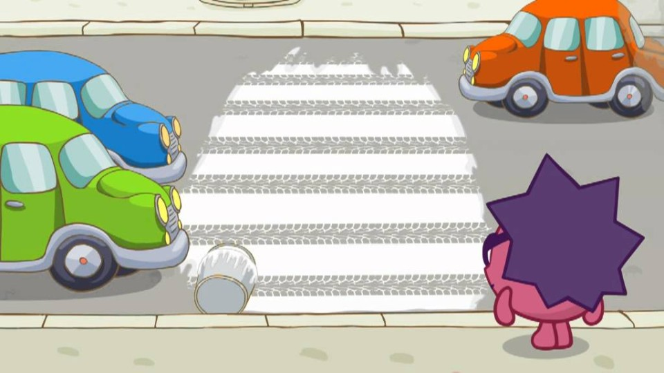
RULES OF SAFETY ON THE ROAD
DON’T
Lean out of the window
DON’T
Run onto the road
Look both ways
DON’T
Walk straight across the road
DON’T
Talk to the driver
Walk on the pavement
Wear a seat belt

Slide 12
Самооценка результатов своей учебной деятельности

