Slide 1
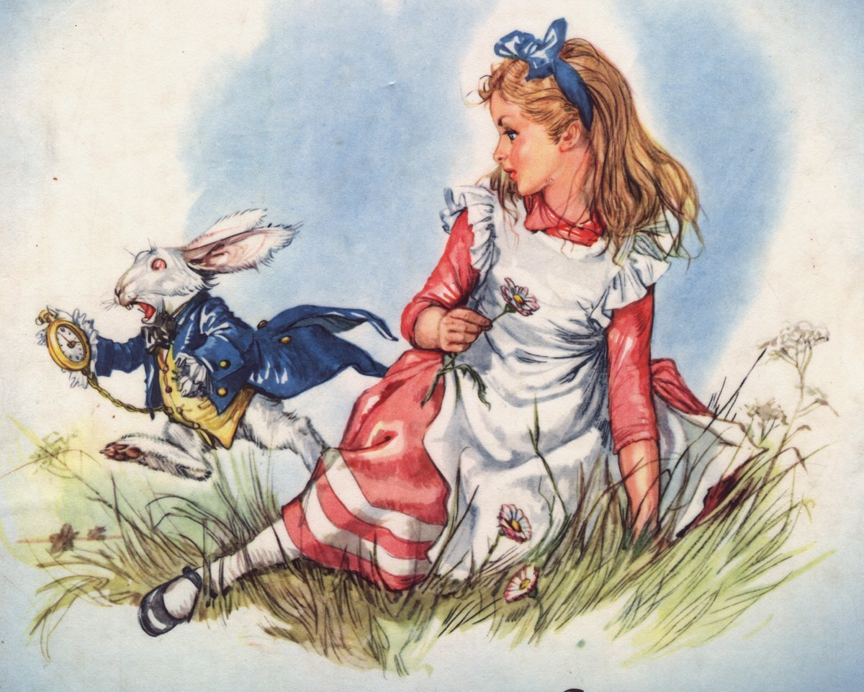

Slide 2
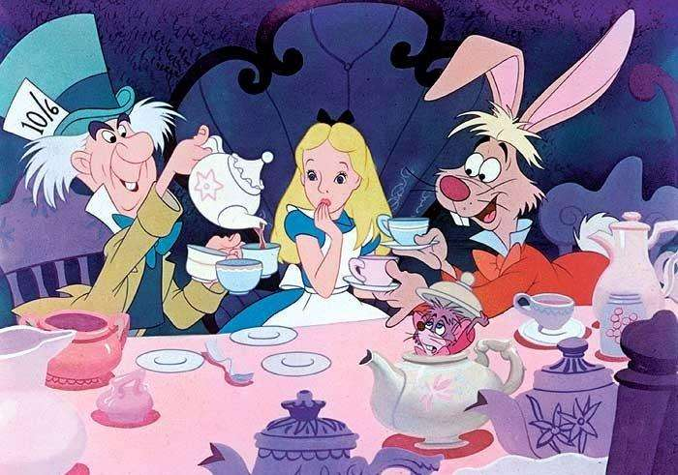

Slide 3
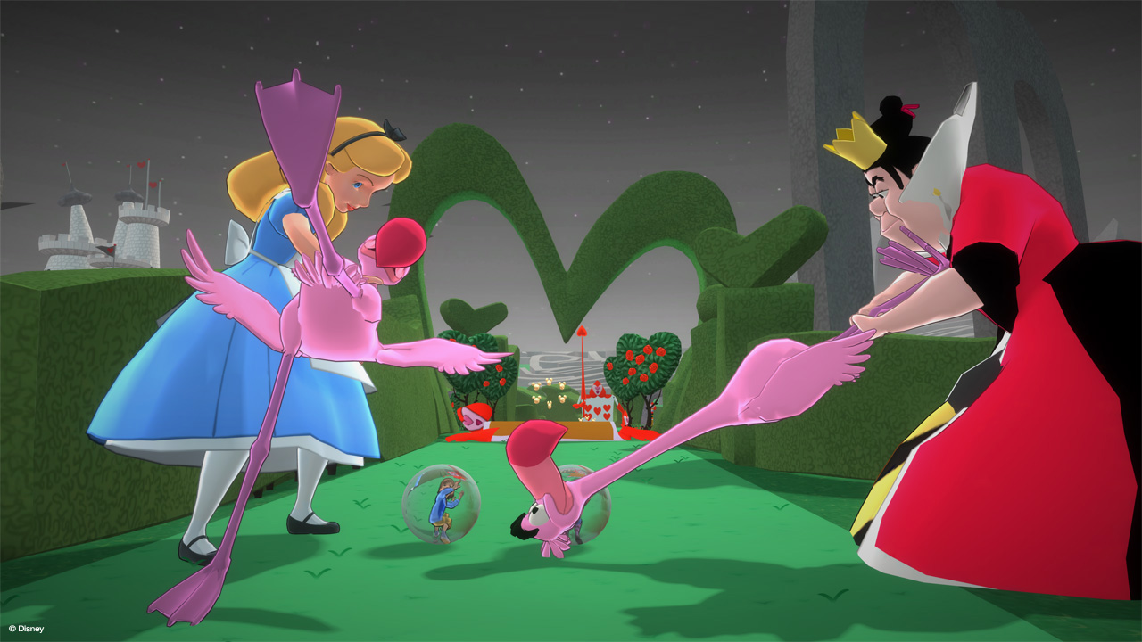

Slide 4
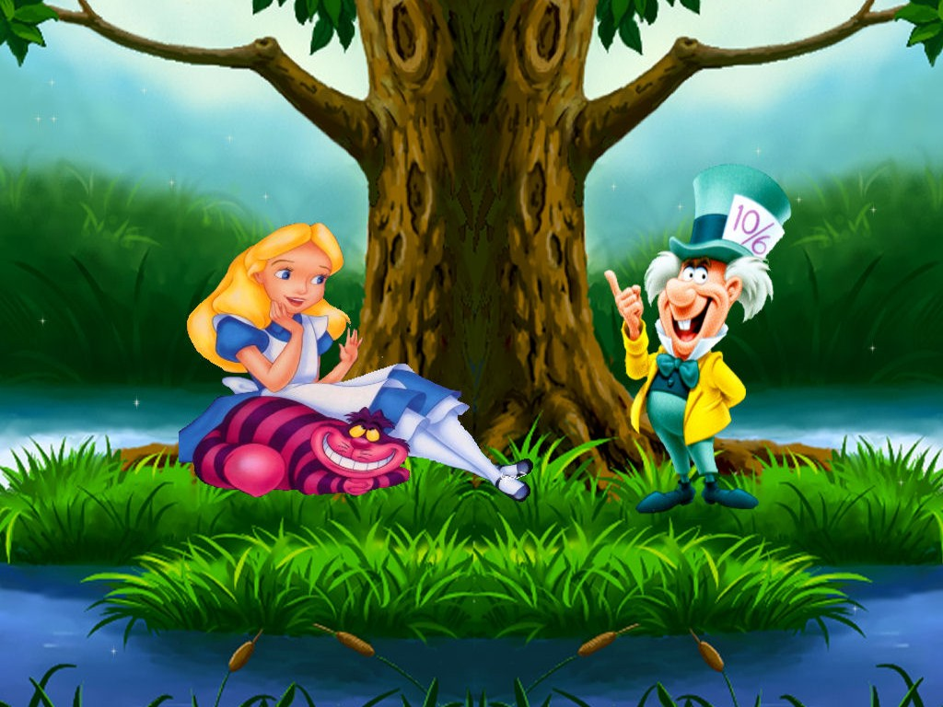

Slide 5
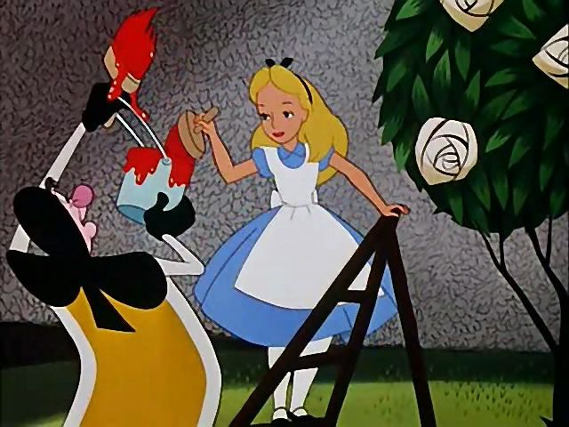

Slide 6
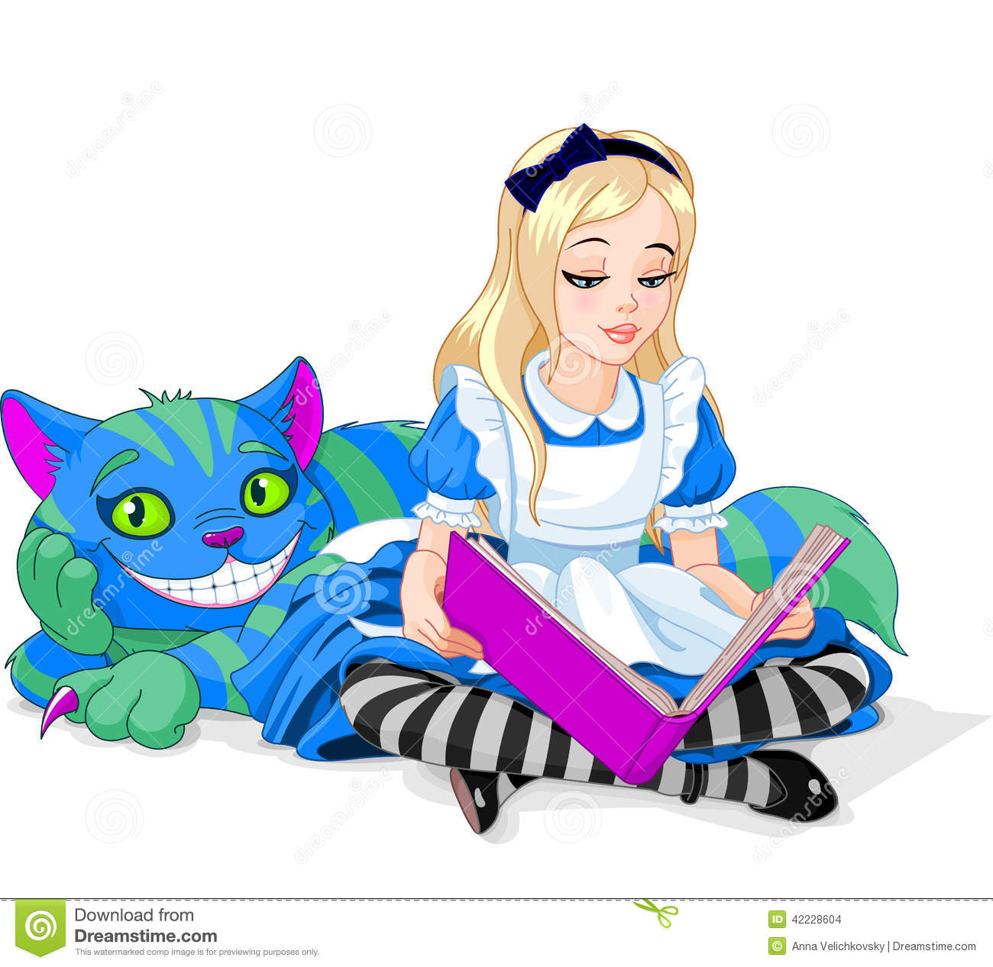

Slide 8
W
H
A
T
I
S
ALICE’S DAY LIKE?

Slide 9
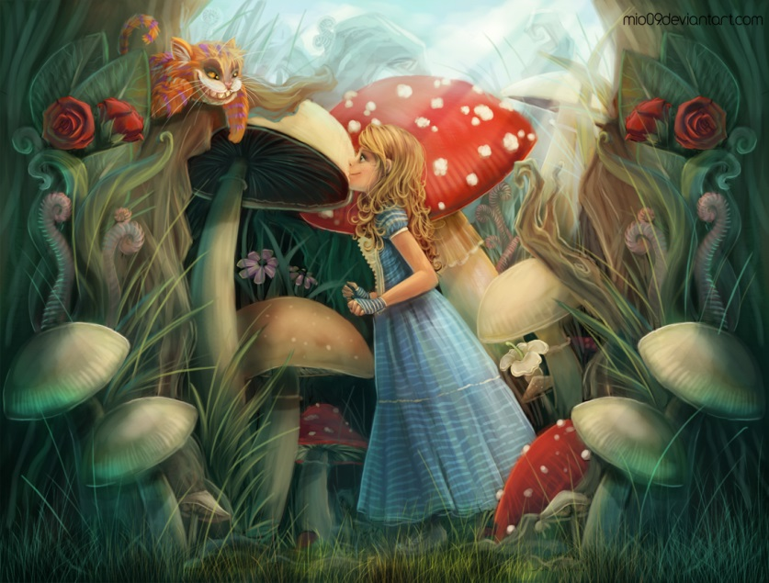
WHERE SHOULD I GO?
WHERE DO YOU WANT TO COME?
I DON’T KNOW
THEN THAT DOESN’T MATTER WHERE TO GO

Slide 10
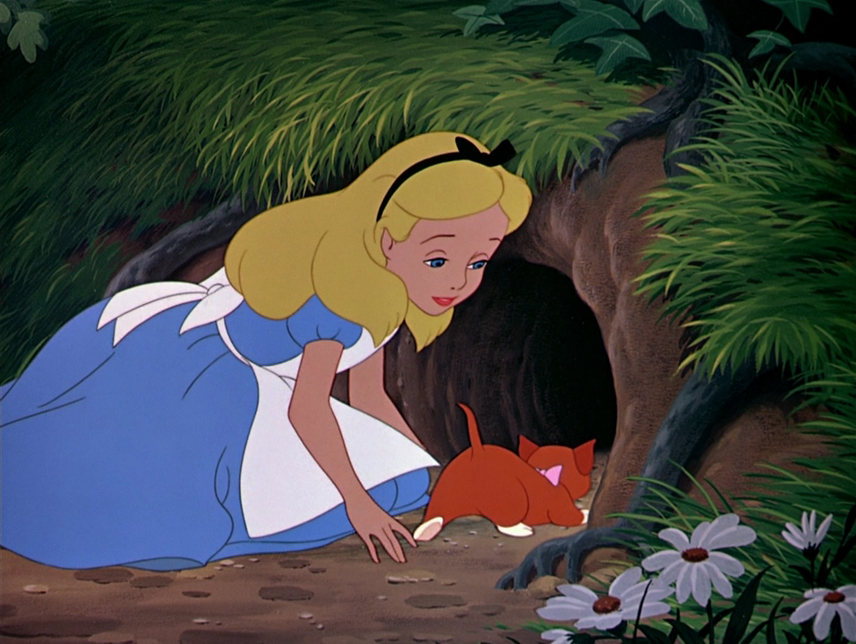
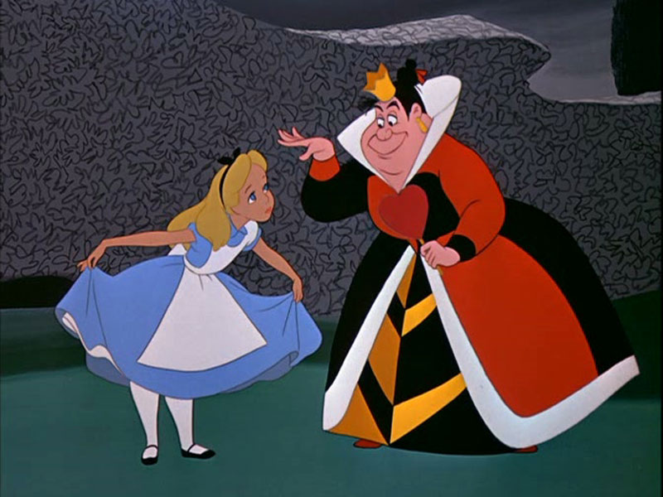

Slide 11
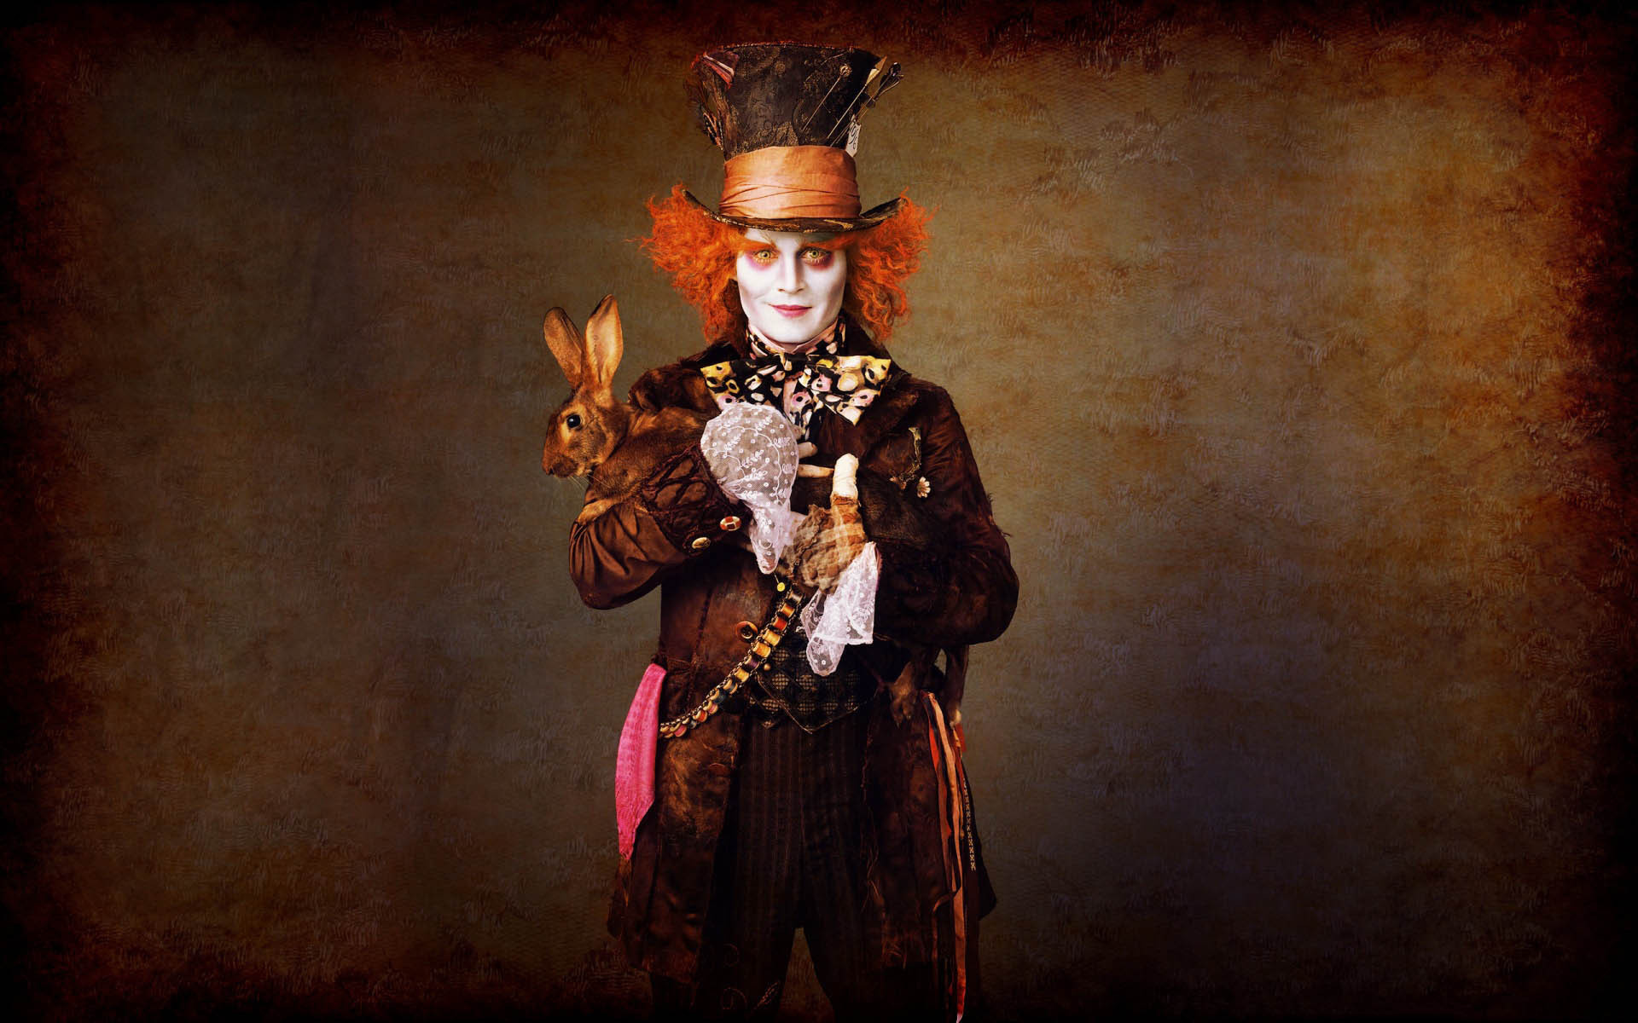

Slide 13
A ………
L ………
I ………
C ……...
E’ ……...
S ………
D ………
A ………
Y ………

Slide 14
DRINK TEA
HAVE BREAKFAST
PLAY CRICKET
PLAY WHITH A CAT
TALK TO THE RABBIT
GO TO THE GARDEN
RUN AFTER THE RABBIT
GO TO SCHOOL

Slide 15
DRINK TEA | ПИТЬ ЧАЙ
HAVE BREAKFAST
PLAY CRICKET
PLAY WHITH A CAT
TALK TO THE RABBIT
GO TO THE GARDEN
RUN AFTER THE RABBIT
GO TO SCHOOL

Slide 16
DRINK TEA | ПИТЬ ЧАЙ
HAVE BREAKFAST | ЗАВТРАКАТЬ
PLAY CRICKET
PLAY WHITH A CAT
TALK TO THE RABBIT
GO TO THE GARDEN
RUN AFTER THE RABBIT
GO TO SCHOOL

Slide 17
DRINK TEA | ПИТЬ ЧАЙ
HAVE BREAKFAST | ЗАВТРАКАТЬ
PLAY CRICKET | ИГРАТЬ В КРИКЕТ
PLAY WHITH A CAT
TALK TO THE RABBIT
GO TO THE GARDEN
RUN AFTER THE RABBIT
GO TO SCHOOL

Slide 18
DRINK TEA | ПИТЬ ЧАЙ
HAVE BREAKFAST | ЗАВТРАКАТЬ
PLAY CRICKET | ИГРАТЬ В КРИКЕТ
PLAY WHITH A CAT | ИГРАТЬ С КОТОМ
TALK TO THE RABBIT
GO TO THE GARDEN
RUN AFTER THE RABBIT
GO TO SCHOOL

Slide 19
DRINK TEA | ПИТЬ ЧАЙ
HAVE BREAKFAST | ЗАВТРАКАТЬ
PLAY CRICKET | ИГРАТЬ В КРИКЕТ
PLAY WHITH A CAT | ИГРАТЬ С КОТОМ
TALK TO THE RABBIT | РАЗГОВАРИВАТЬ С КРОЛИКОМ
GO TO THE GARDEN
RUN AFTER THE RABBIT
GO TO SCHOOL

Slide 20
DRINK TEA | ПИТЬ ЧАЙ
HAVE BREAKFAST | ЗАВТРАКАТЬ
PLAY CRICKET | ИГРАТЬ В КРИКЕТ
PLAY WHITH A CAT | ИГРАТЬ С КОТОМ
TALK TO THE RABBIT | РАЗГОВАРИВАТЬ С КРОЛИКОМ
GO TO THE GARDEN | ИДТИ В САД
RUN AFTER THE RABBIT
GO TO SCHOOL

Slide 21
DRINK TEA | ПИТЬ ЧАЙ
HAVE BREAKFAST | ЗАВТРАКАТЬ
PLAY CRICKET | ИГРАТЬ В КРИКЕТ
PLAY WHITH A CAT | ИГРАТЬ С КОТОМ
TALK TO THE RABBIT | РАЗГОВАРИВАТЬ С КРОЛИКОМ
GO TO THE GARDEN | ИДТИ В САД
RUN AFTER THE RABBIT | БЕЖАТЬ ЗА КРОЛИКОМ
GO TO SCHOOL

Slide 22
DRINK TEA | ПИТЬ ЧАЙ
HAVE BREAKFAST | ЗАВТРАКАТЬ
PLAY CRICKET | ИГРАТЬ В КРИКЕТ
PLAY WITH A CAT | ИГРАТЬ С КОТОМ
TALK TO THE RABBIT | РАЗГОВАРИВАТЬ С КРОЛИКОМ
GO TO THE GARDEN | ИДТИ В САД
RUN AFTER THE RABBIT | БЕЖАТЬ ЗА КРОЛИКОМ
GO TO SCHOOL | ИДТИ В ШКОЛУ

Slide 23
HAVE LUNCH
HAVE SUPPER
GO FOR A WALK
GO TO BED
WATCH TV
CRY
EAT CAKES
ASK THE WAY

Slide 24
HAVE LUNCH | ОБЕДАТЬ
HAVE SUPPER
GO FOR A WALK
GO TO BED
WATCH TV
CRY
EAT CAKES
ASK THE WAY

Slide 25
HAVE LUNCH | ОБЕДАТЬ
HAVE SUPPER | УЖИНАТЬ
GO FOR A WALK
GO TO BED
WATCH TV
CRY
EAT CAKES
ASK THE WAY

Slide 26
HAVE LUNCH | ОБЕДАТЬ
HAVE SUPPER | УЖИНАТЬ
GO FOR A WALK | ИДТИ НА ПРОГУЛКУ
GO TO BED
WATCH TV
CRY
EAT CAKES
ASK THE WAY

Slide 27
HAVE LUNCH | ОБЕДАТЬ
HAVE SUPPER | УЖИНАТЬ
GO FOR A WALK | ИДТИ НА ПРОГУЛКУ
GO TO BED | ИДТИ СПАТЬ
WATCH TV
CRY
EAT CAKES
ASK THE WAY

Slide 28
HAVE LUNCH | ОБЕДАТЬ
HAVE SUPPER | УЖИНАТЬ
GO FOR A WALK | ИДТИ НА ПРОГУЛКУ
GO TO BED | ИДТИ СПАТЬ
WATCH TV | СМОТРЕТЬ ТЕЛЕВИЗОР
CRY
EAT CAKES
ASK THE WAY

Slide 29
HAVE LUNCH | ОБЕДАТЬ
HAVE SUPPER | УЖИНАТЬ
GO FOR A WALK | ИДТИ НА ПРОГУЛКУ
GO TO BED | ИДТИ СПАТЬ
WATCH TV | СМОТРЕТЬ ТЕЛЕВИЗОР
CRY | ПЛАКАТЬ
EAT CAKES
ASK THE WAY

Slide 30
HAVE LUNCH | ОБЕДАТЬ
HAVE SUPPER | УЖИНАТЬ
GO FOR A WALK | ИДТИ НА ПРОГУЛКУ
GO TO BED | ИДТИ СПАТЬ
WATCH TV | СМОТРЕТЬ ТЕЛЕВИЗОР
CRY | ПЛАКАТЬ
EAT CAKES | ЕСТЬ ТОРТЫ
ASK THE WAY

Slide 31
HAVE LUNCH | ОБЕДАТЬ
HAVE SUPPER | УЖИНАТЬ
GO FOR A WALK | ИДТИ НА ПРОГУЛКУ
GO TO BED | ИДТИ СПАТЬ
WATCH TV | СМОТРЕТЬ ТЕЛЕВИЗОР
CRY | ПЛАКАТЬ
EAT CAKES | ЕСТЬ ТОРТЫ
ASK THE WAY | СПРАШИВАТЬ ПУТЬ

Slide 32
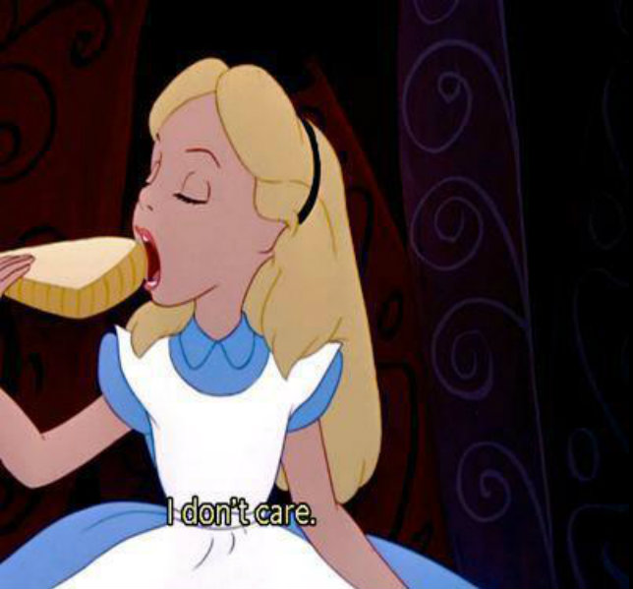
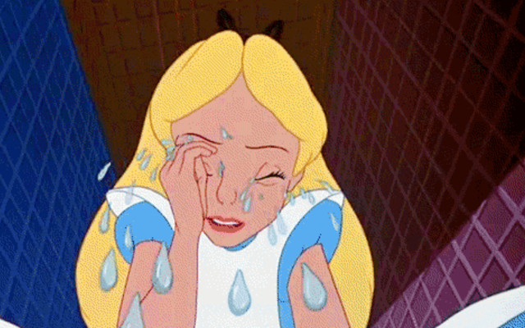
WHAT DOES ALICE LIKE?
WHAT DOESN’T ALICE LIKE?

Slide 33
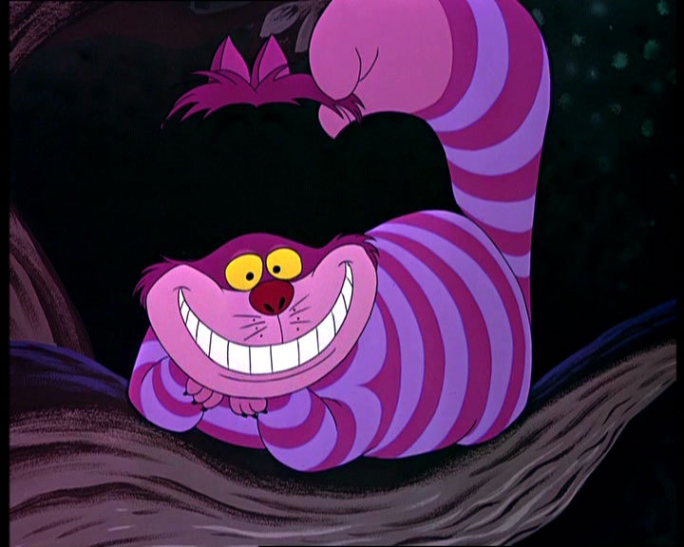
MAKE THE SENTENCES

Slide 34
SHE DON’T GO TO SCHOOL ON SUNDAY.
THEY DRINKS COFFEE IN THE MORNING.
THE CAT EAT MICE AND DRINK MILK.
DO YOUR SISTER HAVE BREAKFAST EARLY?
DOES YOU LIKE TO READ BOOKS?

Slide 35
SHE DON’T GO TO SCHOOL ON SUNDAY.
SHE DOESN’T GO TO SCHOOL ON SUNDAY.
THEY DRINKS COFFEE IN THE MORNING.
THE CAT EAT MICE AND DRINK MILK.
DO YOUR SISTER HAVE BREAKFAST EARLY?
DOES YOU LIKE TO READ BOOKS?

Slide 36
SHE DON’T GO TO SCHOOL ON SUNDAY.
SHE DOESN’T GO TO SCHOOL ON SUNDAY.
THEY DRINKS COFFEE IN THE MORNING.
THEY DRINK COFFEE IN THE MORNING.
THE CAT EAT MICE AND DRINK MILK.
DO YOUR SISTER HAVE BREAKFAST EARLY?
DOES YOU LIKE TO READ BOOKS?

Slide 37
SHE DON’T GO TO SCHOOL ON SUNDAY.
SHE DOESN’T GO TO SCHOOL ON SUNDAY.
THEY DRINKS COFFEE IN THE MORNING.
THEY DRINK COFFEE IN THE MORNING.
THE CAT EAT MICE AND DRINK MILK.
THE CAT EATS MICE AND DRINKS MILK.
DO YOUR SISTER HAVE BREAKFAST EARLY?
DOES YOU LIKE TO READ BOOKS?

Slide 38
SHE DON’T GO TO SCHOOL ON SUNDAY.
SHE DOESN’T GO TO SCHOOL ON SUNDAY.
THEY DRINKS COFFEE IN THE MORNING.
THEY DRINK COFFEE IN THE MORNING.
THE CAT EAT MICE AND DRINK MILK.
THE CAT EATS MICE AND DRINKS MILK.
DO YOUR SISTER HAVE BREAKFAST EARLY?
DOES YOUR SISTER HAVE BREAKFAST EARLY?
DOES YOU LIKE TO READ BOOKS?

Slide 39
SHE DON’T GO TO SCHOOL ON SUNDAY.
SHE DOESN’T GO TO SCHOOL ON SUNDAY.
THEY DRINKS COFFEE IN THE MORNING.
THEY DRINK COFFEE IN THE MORNING.
THE CAT EAT MICE AND DRINK MILK.
THE CAT EATS MICE AND DRINKS MILK.
DO YOUR SISTER HAVE BREAKFAST EARLY?
DOES YOUR SISTER HAVE BREAKFAST EARLY?
DOES YOU LIKE TO READ BOOKS?
DO YOU LIKE TO READ BOOKS?

Slide 40
ALICE COMES TO SCHOOL EVERY DAY.
THE CATS DO NOT EAT CAKES IN THE MORNING.
DOES THE HATTER DRINK TEA IN THE AFTERNOON?

Slide 41
THE RABBIT RUNS TO THE HOLE IN THE MORNING.
ALICE DOES NOT READ A BOOK IN THE EVENING.
DO PEOPLE PLAY CRICKET IN THE GARDEN?

Slide 42
MONDAY | TEUSDAY | WEDNESDAY | THURSDAY | FRIDAY | SATURDAY | SUNDAY

Slide 43
MONDAY | TEUSDAY | WEDNESDAY | THURSDAY | FRIDAY | SATURDAY | SUNDAY
WATCH TV | PLAY BASKETBALL | SWIM | GO CYCLING | GO TO THE CINEMA | GO SHOPPING | READ

Slide 44
 | In the afternoon we have lunch.
 | After supper we watch TV or go for a walk.
 | The day starts at 7 o’clock.
 | Then at 10 p.m. we go to bed.
 | We usually have a big breakfast.
 | After lunch we have to do our homework.
 | At 8.30 we go to school and meet our friends.
 | We usually have supper at 6 or 7 o’clock.

Slide 45
4 | In the afternoon we have lunch.
7 | After supper we watch TV or go for a walk.
1 | The day starts at 7 o’clock.
8 | Then at 10 p.m. we go to bed.
2 | We usually have a big breakfast.
5 | After lunch we have to do our homework.
3 | At 8.30 we go to school and meet our friends.
6 | We usually have supper at 6 or 7 o’clock.

Slide 46
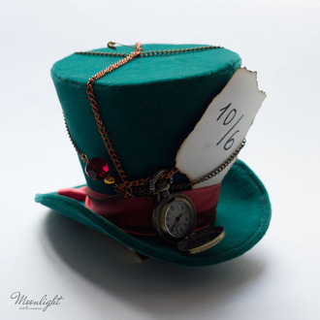

Slide 47
ALICE
………, ………
………, ………, ………
………, ………, ………, ………
………

Slide 48
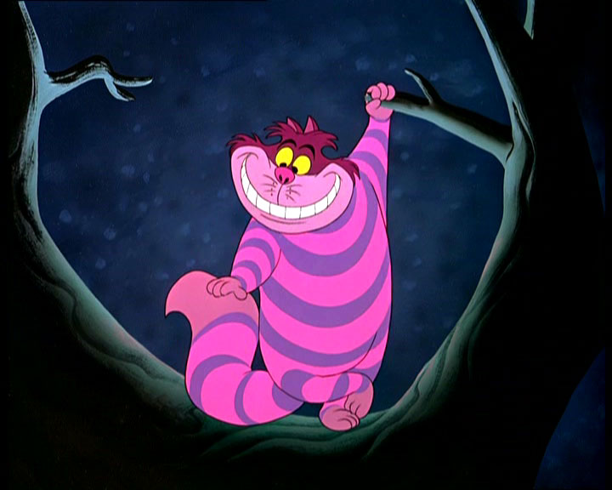
HOMETASK
WRITE A STORY ABOUT ALICE’S DAY AND DRAW A PICTURE

