Slide 1
Sports for everybody

Slide 2
Ball games
Water sports
Adventure sports
Individual sports
Next

Slide 3
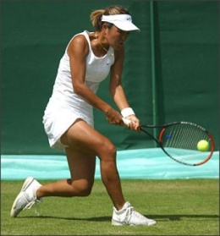
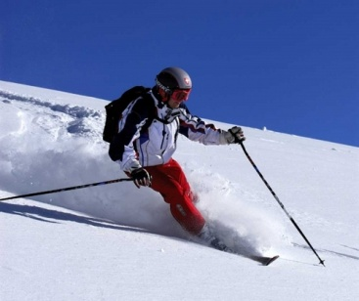
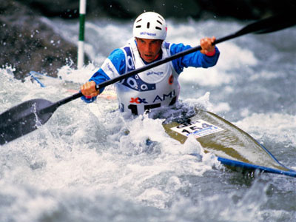
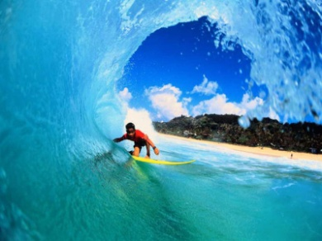
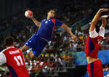
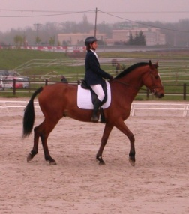
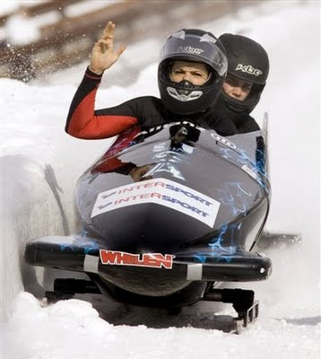
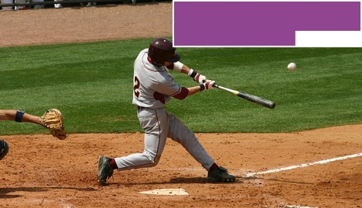
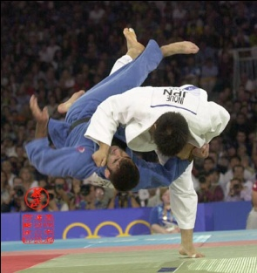
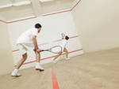
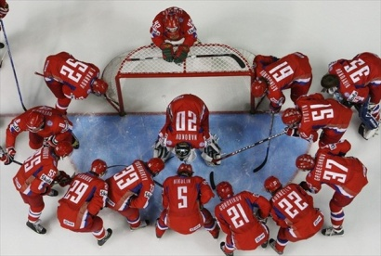
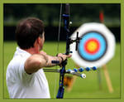
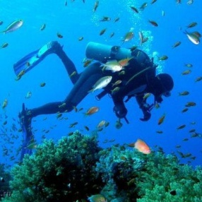

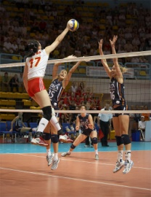
Sailing
Downhill skiing
Surfing
Bobsledding
Baseball
Squash
Diving
Bowling
Tennis
Rowing
Handball
Horse-racing
Wrestling
Ice hockey
Archery
Volleyball

Slide 4
Group these activities into indoor and outdoor sports
Sailing
Downhill skiing
Surfing
Bobsledding
Baseball
Squash
Diving
Bowling
Tennis
Rowing
Handball
Horse-racing
Wrestling
Ice hockey
Archery
Volleyball
Outdoor
sports
Indoor
sports

Slide 5
Indoor
sports
Bowling
Tennis
Handball
Ice Hockey
Volleyball
Squash

Slide 6
Sailing
Downhill skiing
Surfing
Bobsledding
Baseball
Diving
Rowing
Horse-racing
Archery
Outdoor
sports

Slide 7
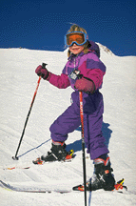
Match the words in English and in Russian
1. Roller-skating
Катание на роликах A
2. Skiing
Плавание B
3. Swimming
Вероятно C
4. Hiking
Гибкий D
5. Cycling
Велоспорт E
6. Skating
Катание на коньках F
7. Tournament
Катание на лыжах G
8. Suddenly
Горный туризм H
9. Improve
Мускулы I
10. Keep fit
Улучшать J
11. Muscles
Турнир K
12. Flexible
Внезапно L
13. Probably
Быть в хорошей форме M

Slide 8
Keys
1. Roller-skating
Катание на роликах
2. Skiing
Катание на лыжах
3. Swimming
Плавание
4. Hiking
Горный туризм
5. Cycling
Велоспорт
6. Skating
Катание на коньках
7. Tournament
Турнир
8. Suddenly
Внезапно
9. Improve
Улучшать
10. Keep fit
Быть в хорошей форме
11. Muscles
Мускулы
12. Flexible
Гибкий
13. Probably
Вероятно

Slide 9
Guess what sport or game it is.

Slide 10
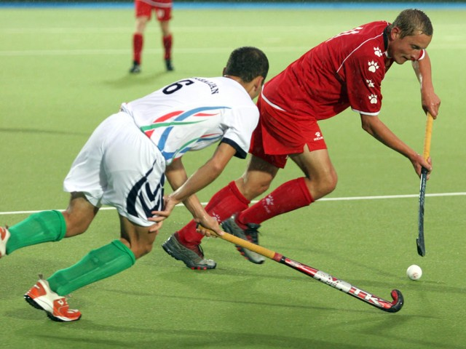
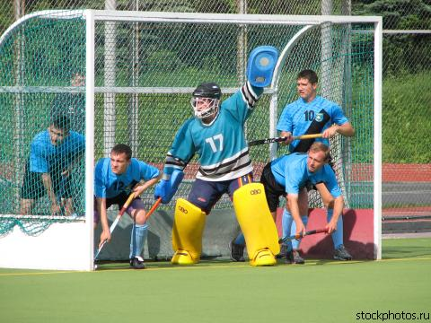
1. A game played on a field by two teams of eleven players with curved sticks and a ball.

Slide 11

2. A sport in which one balances oneself on a long narrow board while being carried along by heavy waves.

Slide 12
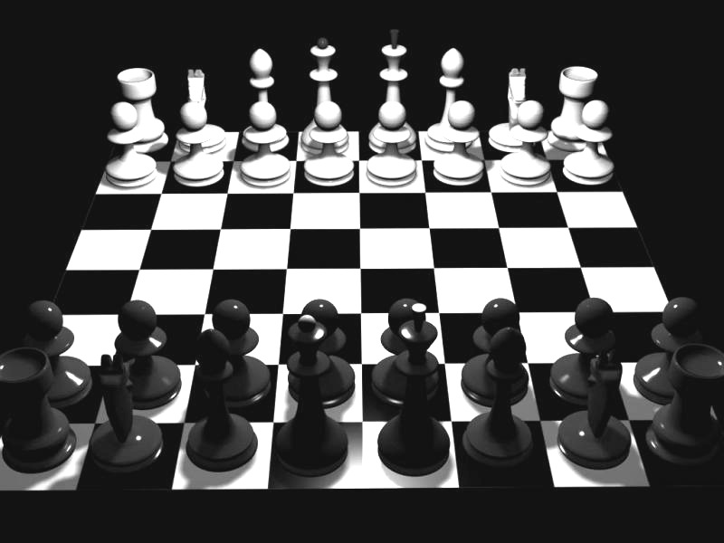
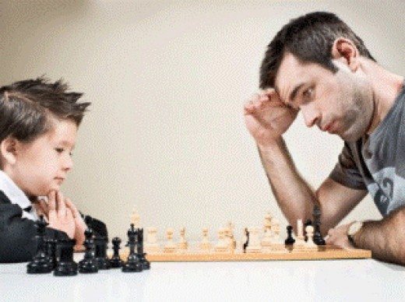
3. A game for two players with sixteen pieces each on a board with sixty-four squares.

Slide 13
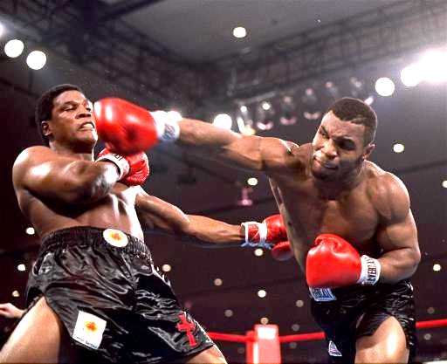
4. A sport in which two people fight with fists in thick gloves.

Slide 14
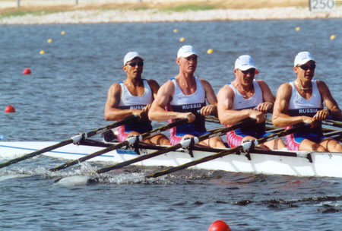
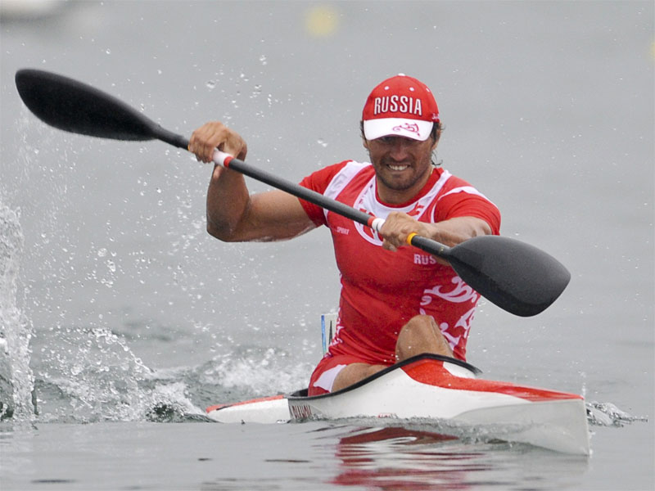
5. A sport in which one or several people move a boat by using oars.

Slide 15
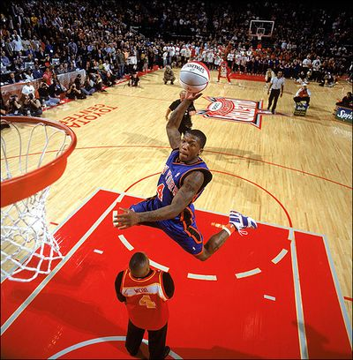
6. A game played by two teams five players each .who try to throw a large ball into a ring with a net 10 feet above the ground.

Slide 16
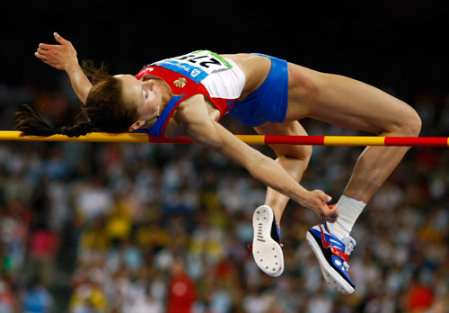
7. Part of athletics in which an athlete makes a jump over a bar which is raised higher and higher.

Slide 17
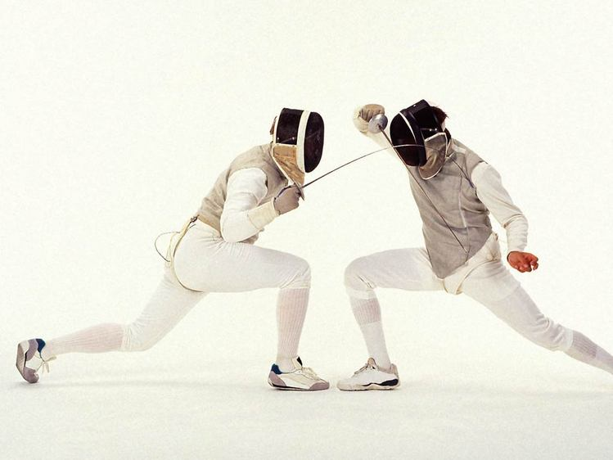
8. A sport in which two people fight with long slender swords.

Slide 18
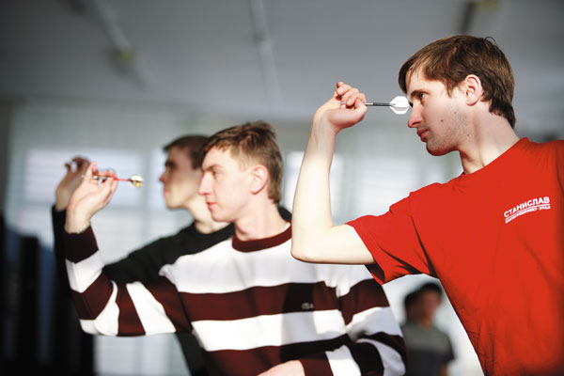
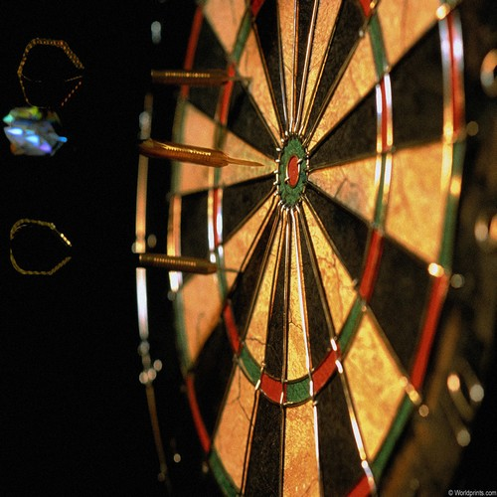
9. A game in which small sharp-pointed objects are thrown at a circular board.

Slide 19
Read the text and fill in the gaps. Choose the words from the box.
Fans net rackets outdoors matches exercise
Tournaments score doubles court clubs
Tennis is a game in which players use __________ to hit a ball over a net. The game is played on a flat surface called a ___________. Each player tries to ______ points by hitting the ball so that the opposing player cannot return it over the______ and inside the court. Tennis may be played indoors and ________. If two people play, the game is called singles. If four people play, it is called ________. In most _______, men play against men and women against women. In mixed doubles, a man and a women play on each side. Millions of people throughout the word play tennis for _____ and recreation. They play it on courts in public parks and in private tennis _________. Players of almost any age can enjoy the sport. Tennis is one of the world’s most popular spectator sports as well as a favourite participant sport. Thousands of _______ attend many _________ held each year. Millions more watch important matches on TV.

Slide 20
Tennis is a very old game, it was played in France in the 14th century. The French called it jeu de paume, a game played with the palm of the hand. The players hit the ball over a net without rackets. Louis XII of France liked it so much that he built 40 tennis courts in his home town, Orleans. Another royal tennis lover was Henry VIII of England. A version of tennis that is similar to the modern sport was introduced in 1873. Rules were invented for playing "lawn tennis" on grass courts. People started to invent
rubber balls and new types of rackets. However, tennis at that time was very different from today's game. Men played it in their best suits while women wore long dresses and smart shoes. Tennis became one of England's most popular outdoor sports. In 1877, the first major tennis tournament was held in Wimbledon, a suburb of London. This competition became the unofficial world championship for men's and women's singles and doubles matches. It is still held every year in June and July.
When | Major events | Where
14th century | Played with the palm of the hand | France
19th century
19th century
20th century

Slide 21
Do this riddle.
You can read a popular saying if you cross out in the boxes:
3 sports
3 weather words
4 colours
2 things that fly
3 words that rhyme with "eight
soccer | scarlet | straight | cloudy | rain
weight | baseball | no | pink | like
jet | grate | beige | purple | tennis
sunny | there’s | place | bluebird | home

Slide 22
Keys
 |  | no |  | like
 | There’s | place |  | home.

Slide 23
Surfing
Rhythmic Gymnastics
Badminton
Swimming
Figure skating
Badminton 2
Bobsleigh
Football
Biathlon

Slide 24
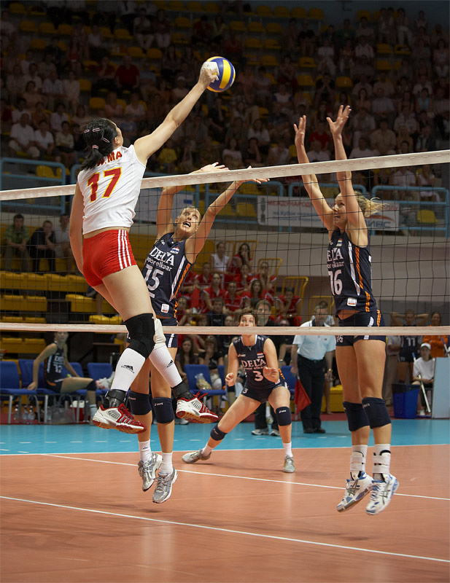
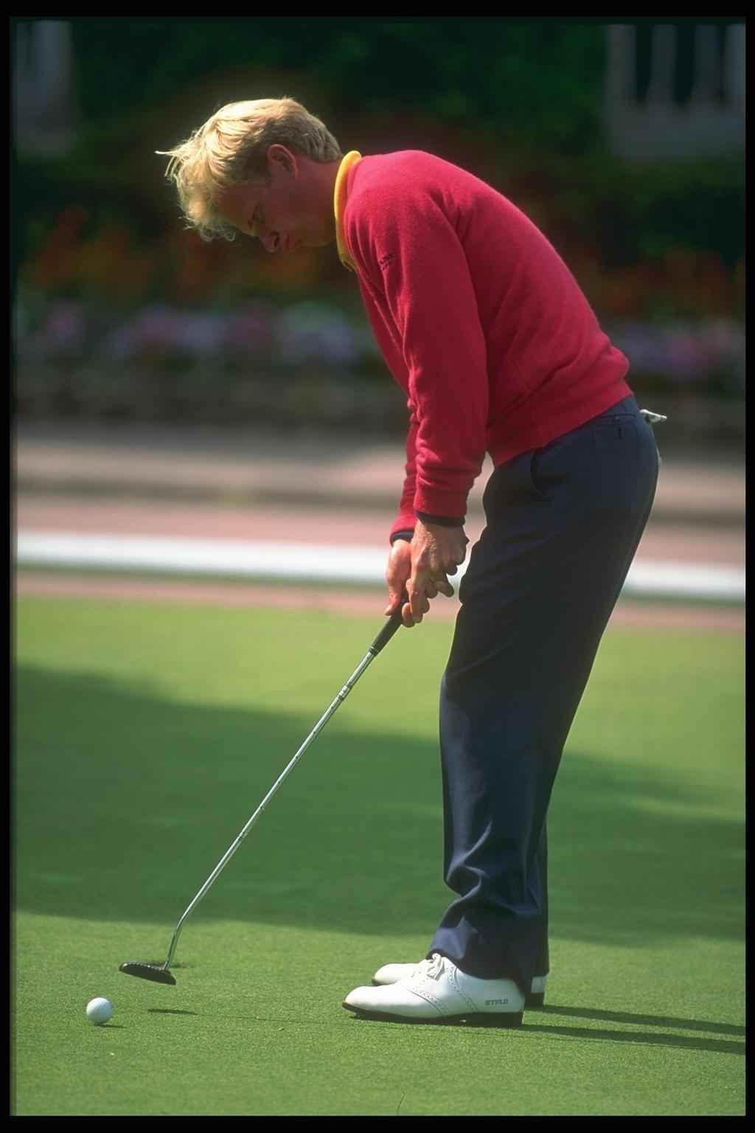

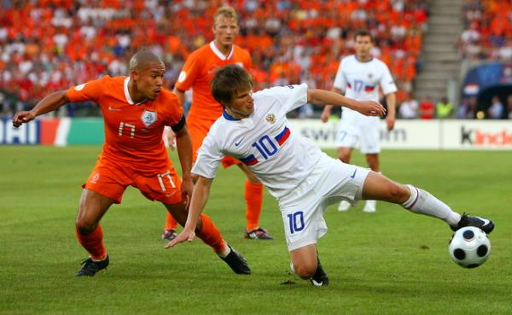

Slide 25
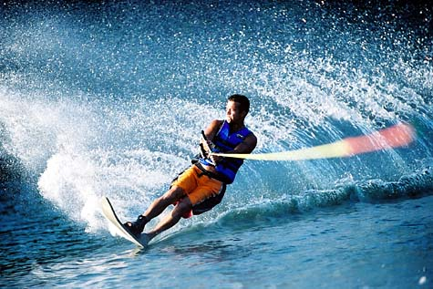
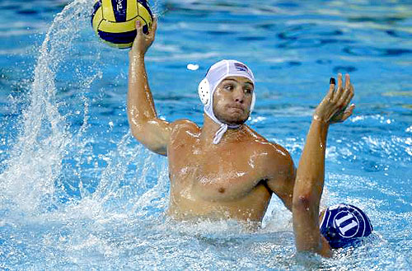

Slide 26
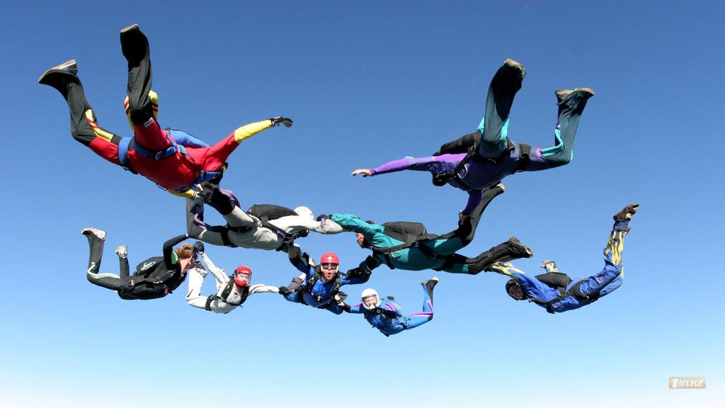
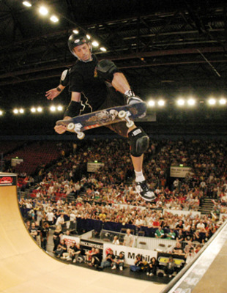
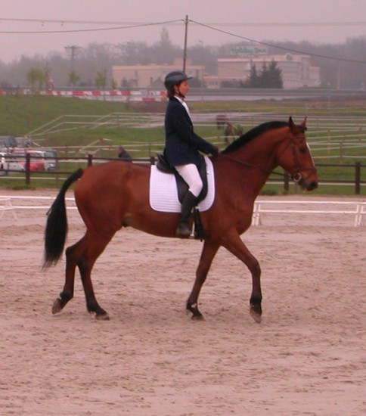
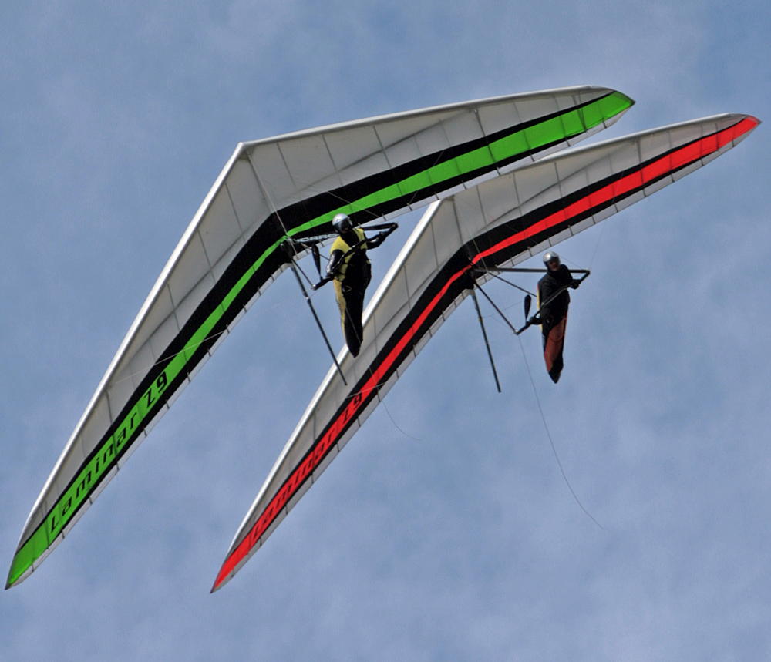

Slide 27
