Slide 1
IN AN EMERGENCY CALL
Открытый урок в 9 классе
Модуль 7
Учебник Spotlight 9

Slide 2
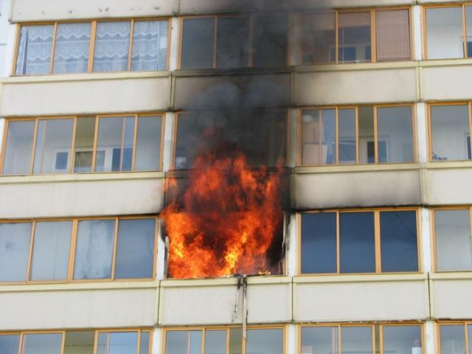
Water leakage
Gas leakage
Injury
Crime
Fire
Power cut
Road accident

Slide 3
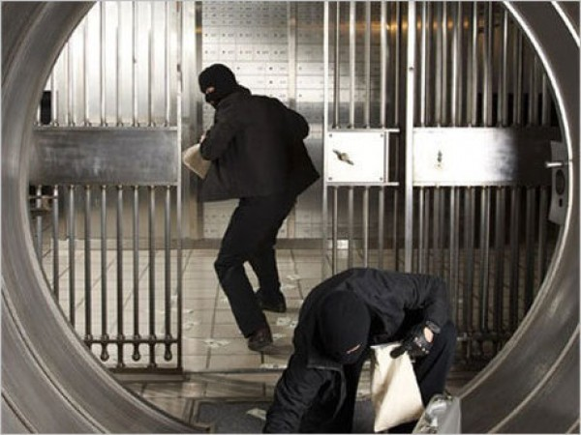
Water leakage
Gas leakage
Injury
Crime
Fire
Power cut
Road accident

Slide 4
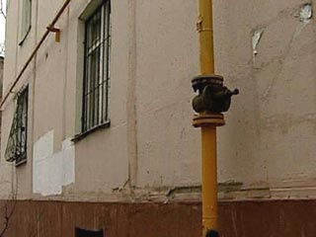
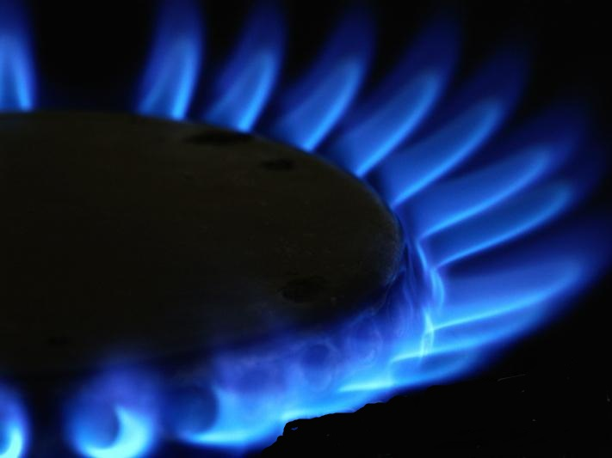
Water leakage
Gas leakage
Injury
Crime
Fire
Power cut
Road accident

Slide 5
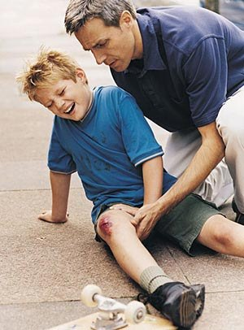
Water leakage
Gas leakage
Injury
Crime
Fire
Power cut
Road accident

Slide 6
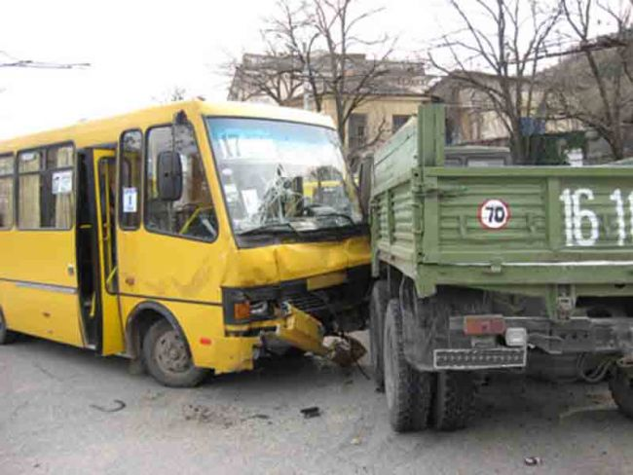
Water leakage
Gas leakage
Injury
Crime
Fire
Power cut
Road accident

Slide 7
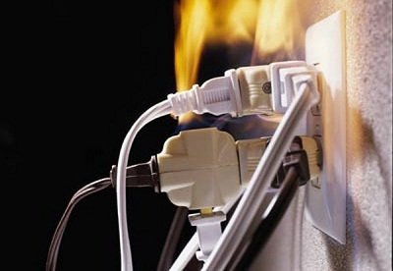
Water leakage
Gas leakage
Injury
Crime
Fire
Power cut
Road accident

Slide 8
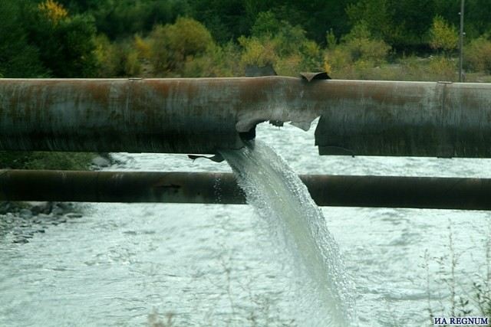
Water leakage
Gas leakage
Injury
Crime
Fire
Power cut
Road accident

Slide 9
The aims of the lesson:
to learn more about emergency services in Russia and abroad, improve your listening and speaking skills,
enrich your vocabulary, learn to work with different types of media resources present the most important details of the given information,
cooperate
speak in public

Slide 10
Cause of emergency call | Emergency service | Dial |  | How to ask for help
 |  | In Great Britain | In Russia
Fire Crime Road accident Gas leak Bad injury Being lost in the forest…

Slide 11
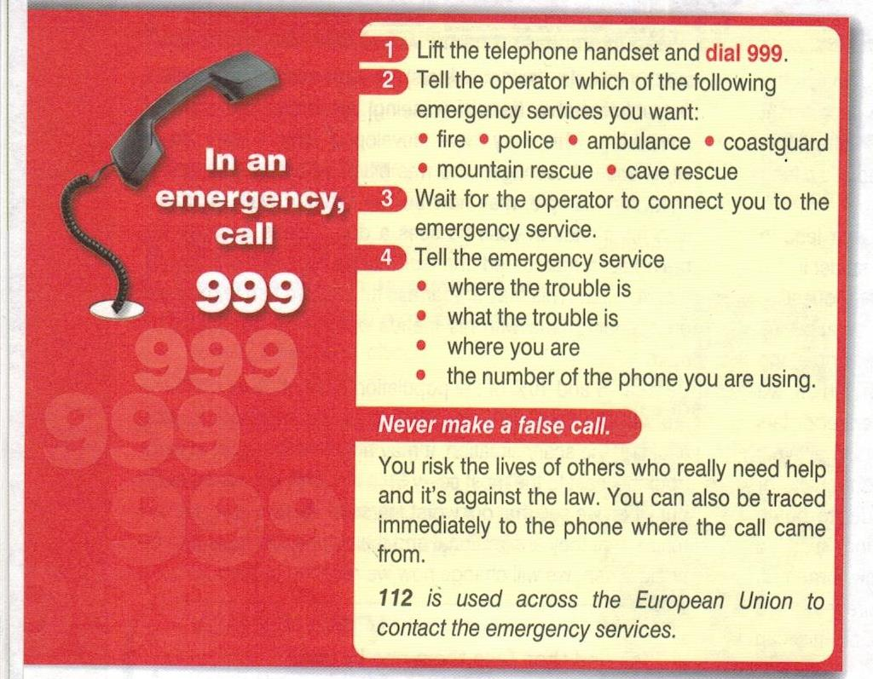
«v» | «+» | «-» | «?»
You should put a tick if you knew this fact before. (то, что вы читаете, соответствует тому, что вы знаете или думали, что знаете) | New information (то, что вы читаете является для вас новым) | Thought differently (то, что вы читаете противоречит тому, что вы уже знали или думали, что знаете) | Don’t understand, have questions (то, что вы читаете, непонятно, или вы хотели бы получить более подробные сведения по данному вопросу)

Slide 12
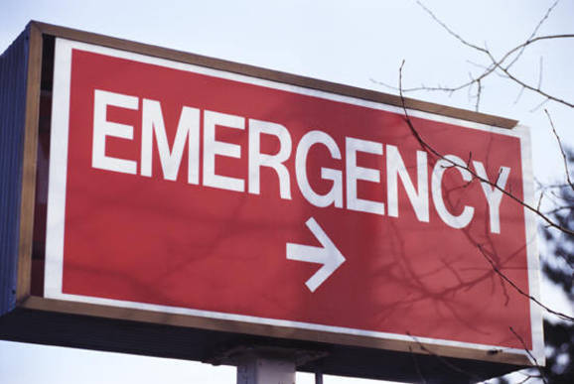
Fire Department: fire fighter
fire engine
house on fire
burn
fire alarm system
Ambulance: doctor
nurse
surgeon injection
hospital
Public Utilities: plumber
mechanic engineer
electrician gas leakage
Police:
crime
detective
police officer robber
coroner

Slide 13
Police

Slide 14
Fire Department

Slide 15
Public Utilities

Slide 16
Ambulance

Slide 17
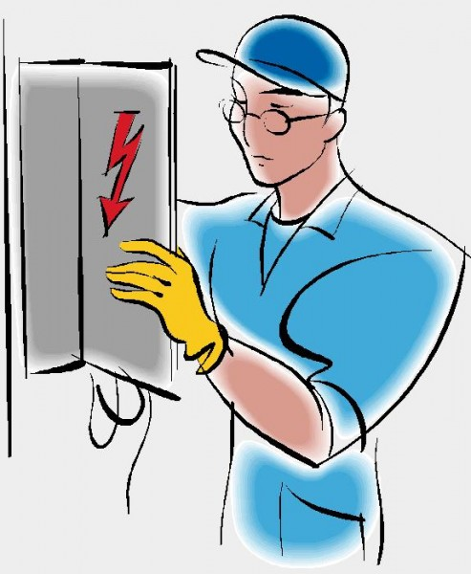
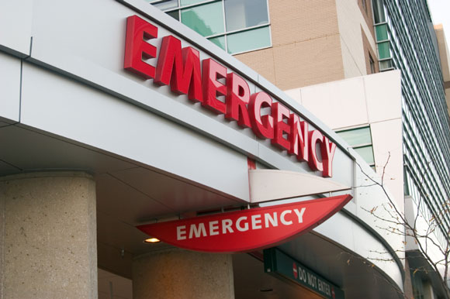
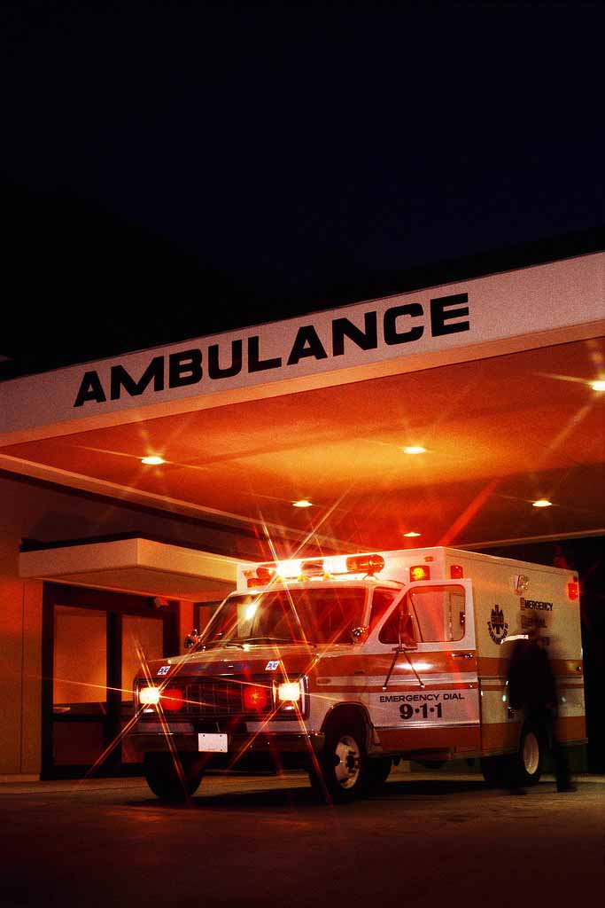
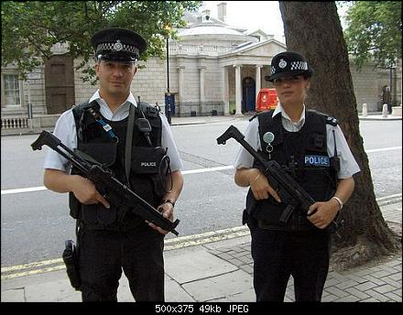
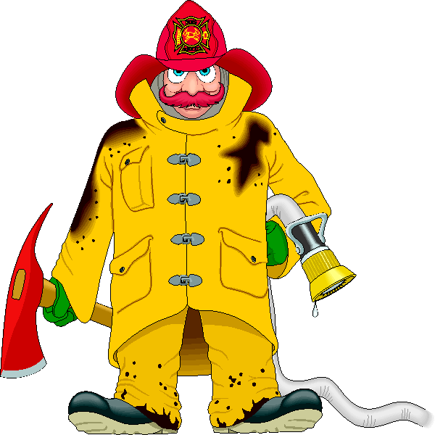

Slide 18
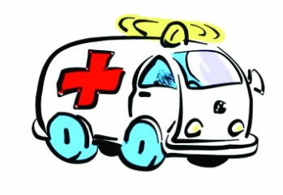
Argument | Yes. Why? | No. Why?
1.An engineer’s help is required.
2.A pedestrian was knocked down by a car.
3.Other people didn’t suffer.
4.The injured man called the Emergency service by himself.
5.The accident took place outside the town.
6.The emergency service car was not available at the moment.
7. The operator found out the name of the calling person.

Slide 19
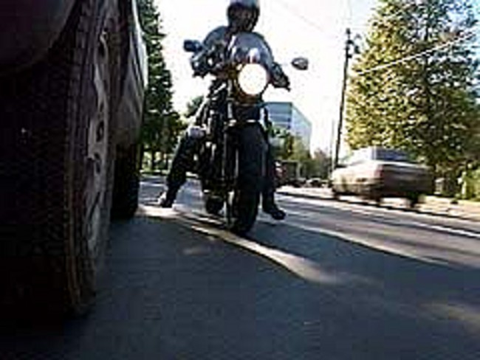
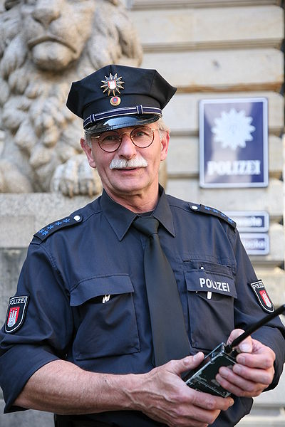
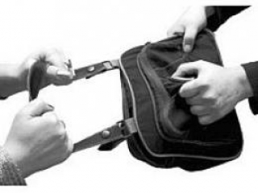

Slide 20
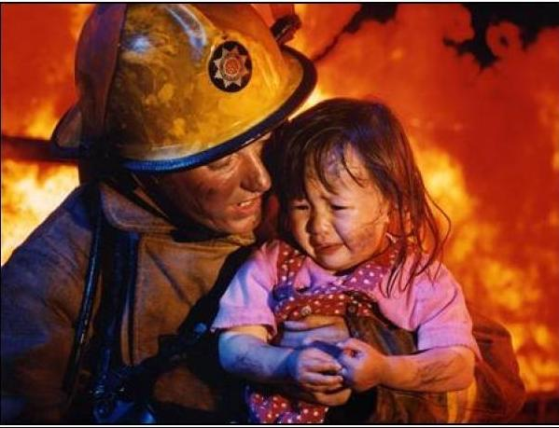

Slide 21
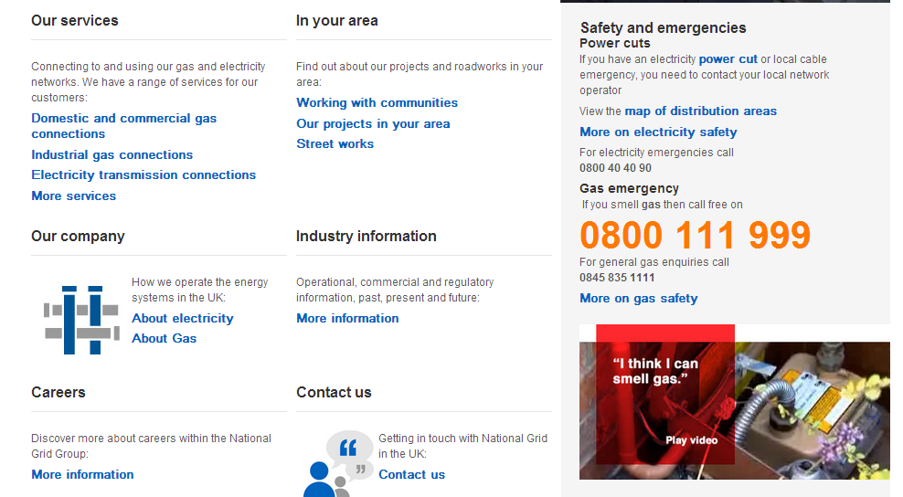
Is there an emergency service in the UK that you can call if you’ve got problems with electricity, gas, the central heating and the running water in the house?
Is there a state gas or electricity emergency service in the UK? Or are there only private companies in charge of these cases?
Do they work all day long?

Slide 22
Cause of emergency call | Emergency service | Dial |  | How to ask for help
 |  | In Great Britain | In Russia
Fire Crime Road accident Gas leak Bad injury Being lost in the forest…

Slide 23
Cinquain
Emergency
…
…
…
…

Slide 24
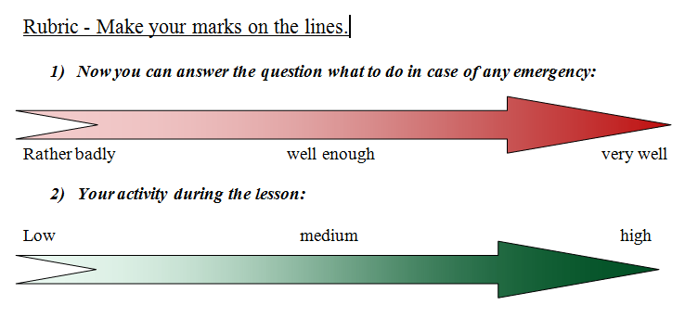

Slide 25
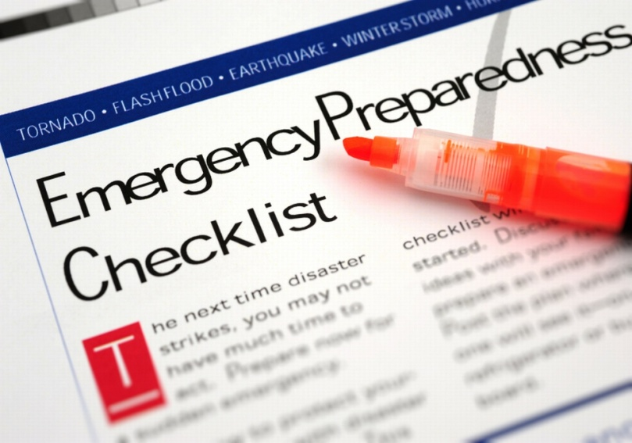
S – satisfied
A – awful
F – fantastic
E - enthusiastic

Slide 26
Home Assignment: Make a Power Safety poster.

Slide 27
Thank you!

