Slide 1
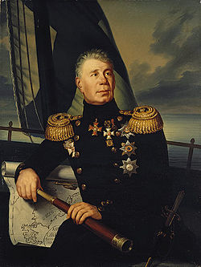
«Great Russian Cadets. The service for the glory of our Fatherland»
Adam Johann von Krusenstern
The project is done by
cadets from 6 “A” class
Naval Cadet School:
Vlasov Nikolai, Artemenko Artem, Eremenko Pavel.

Slide 2
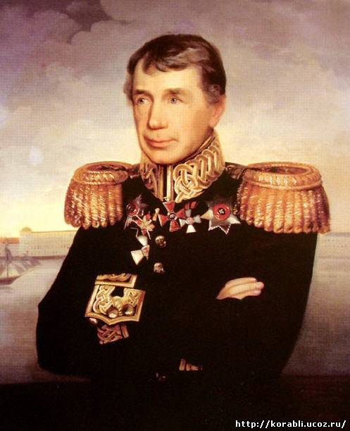
1.Name. Famous for.
2.Early years.
3.Later years
4.Date and place of death

Slide 3
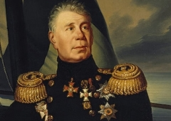
Name. Famous for.
Adam Johann Ritter von Krusenstern((1770 –1846) Ivan Fyodorovich Kruzenshtern), was an admiral and explorer, who led the first Russian circumnavigation of the globe.

Slide 4
Early years.
Krusenstern was born in Estonia, into a Baltic German family descended from the Swedish aristocratic family von Krusenstjerna. He has been studying at Church school for three years in Reval (Tallinn) and then he was a cadet of the Naval Cadet Corps in Kronshtadt.

Slide 5
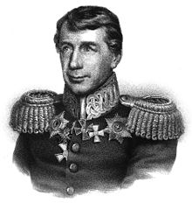
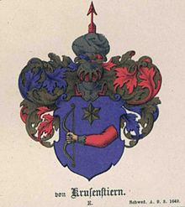
Early years.
After graduating from the Naval Cadet Corpsin 1787, he joined the Russian Imperial Navy, and served in the war against Sweden.

Slide 6
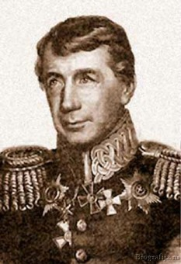
Later years
When he returned, Krusenstern wrote a detailed report, published in Saint Petersburg in 1810. It was published in 1811-1812 in Berlin; this was followed by an English translation, French, Dutch, Danish, Swedish, and Italian. His scientific work, which includes an atlas of the Pacific, was published in 1827 in Saint Petersburg and won him an honorary membership in the Russian Academy of Sciences.

Slide 7
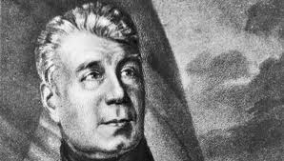
Later years
In 1816, he was elected a foreign member of the Royal Swedish Academy of Sciences. In 1827 he became the director of the Russian Naval Cadet Corps. Krusenstern became an admiral in 1841.

Slide 8
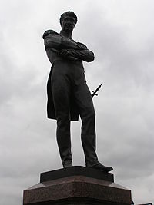
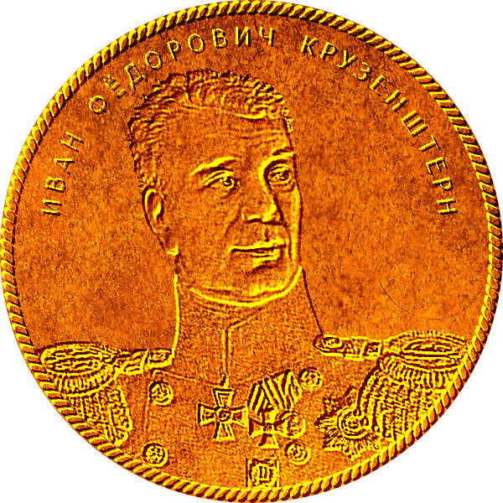
Date and place of death
He died in 1846 and was buried in the Tallinn Cathedral.
Named after him:
The Russian training tall ship Kruzenshtern
Russian icebreaker Ivan Kruzenshtern.
The crater Krusenstern on the Moon
There is Krusenstern Island in the Bering Strait
Krusenstern Strait
A small group of islands in the Kara Sea

Slide 9
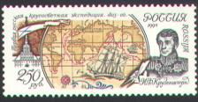
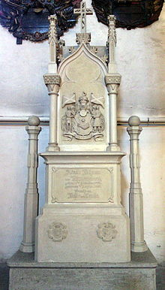
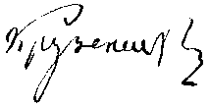

Slide 10
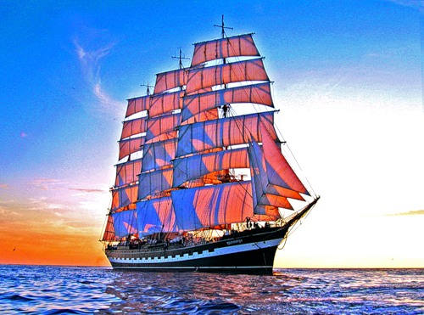
Thank you for your attention!

