Slide 1
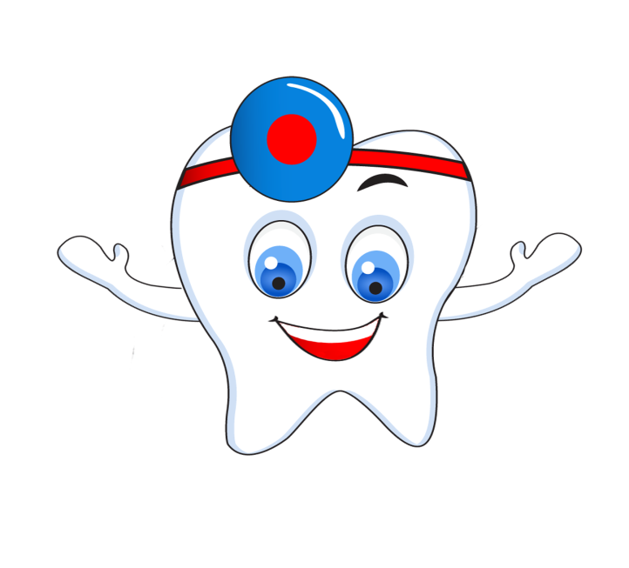
DENTISTRY

Slide 2
teeth
whitening
dental diet
dental hygiene
dental diseases
rules of tooth
brushing
structure of tooth

Slide 3
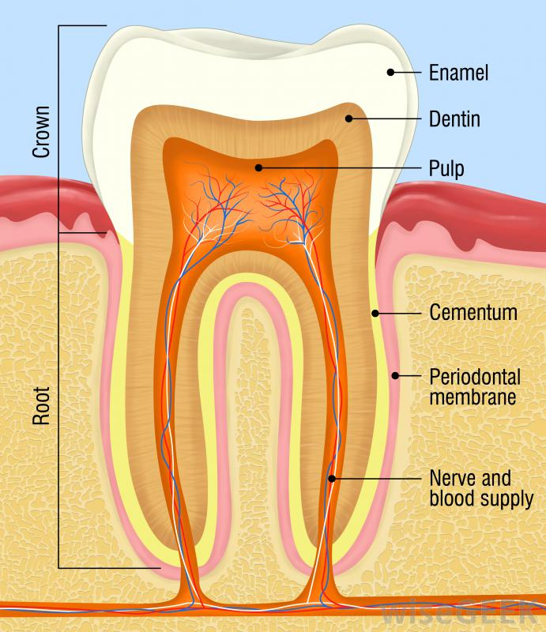

Slide 4
Enamel is the outer covering of the crown and is the hardest substance in the body.
Cementum is the outer covering of the root and is structure to bone. Cementum meets enamel at the neck of the tooth.
Dentine occupies the interior of the crown and root, and is very sensitive to pain.
Pulp. Unlike enamel, dentine and cementum, the pulp is purely soft tissue. In contains blood vessels and nerves, and occupies the centre of the dentine.
A tooth is attached to its socket in the jaw by a soft fibrous tissue called the periodontal membrane.

Slide 5
1. __________is purely soft tissue. It contains blood vessels and nerves, and occupies the centre of the dentine.
2.________ is the outer covering of the root and is structure to bone. It meets enamel at the neck of the tooth.
3 . A tooth is attached to its socket in the jaw by a soft fibrous tissue called the____________.
4 .________ is the outer covering of the crown and is the hardest substance in the body.
5._______occupies the interior of the crown and root, and is very sensitive to pain.
Dentine, periodontal membrane, enamel, pulp, cementum

Slide 6
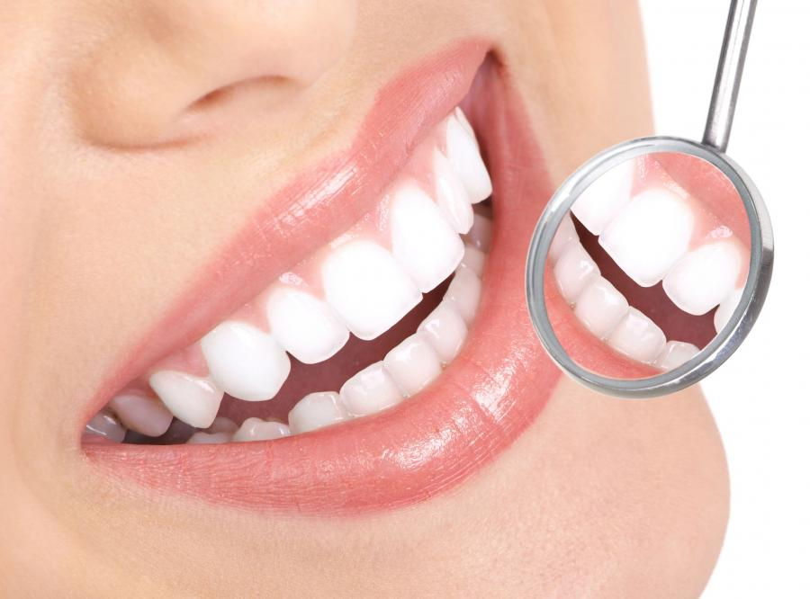
hygiene of teeth

Slide 7
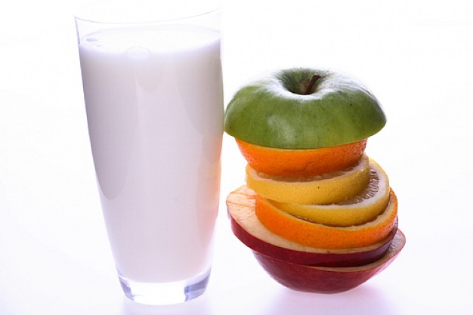
Dental diet

