Slide 1
Жирова Ольга Николаевна
Идентификатор: 100-735-693

Slide 2
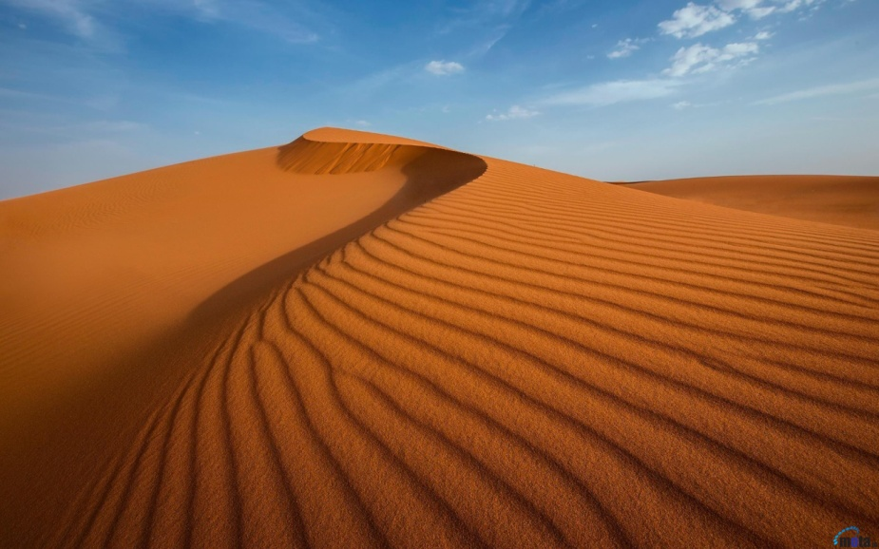
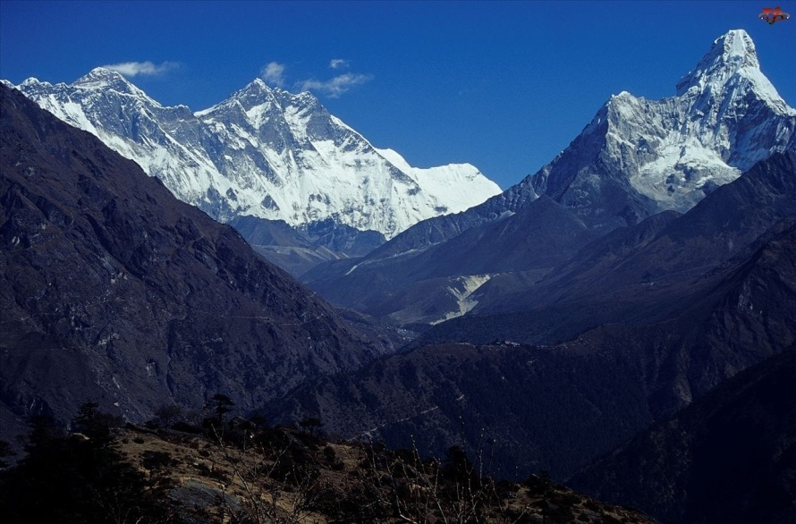
desert mountain

Slide 3
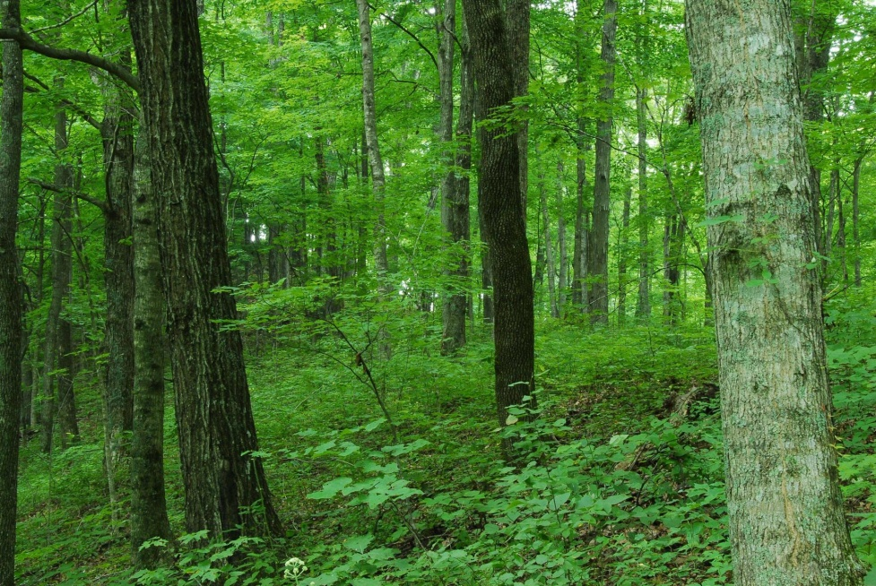
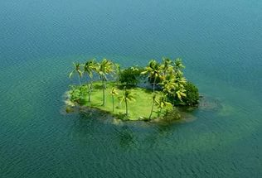
forest island

Slide 4
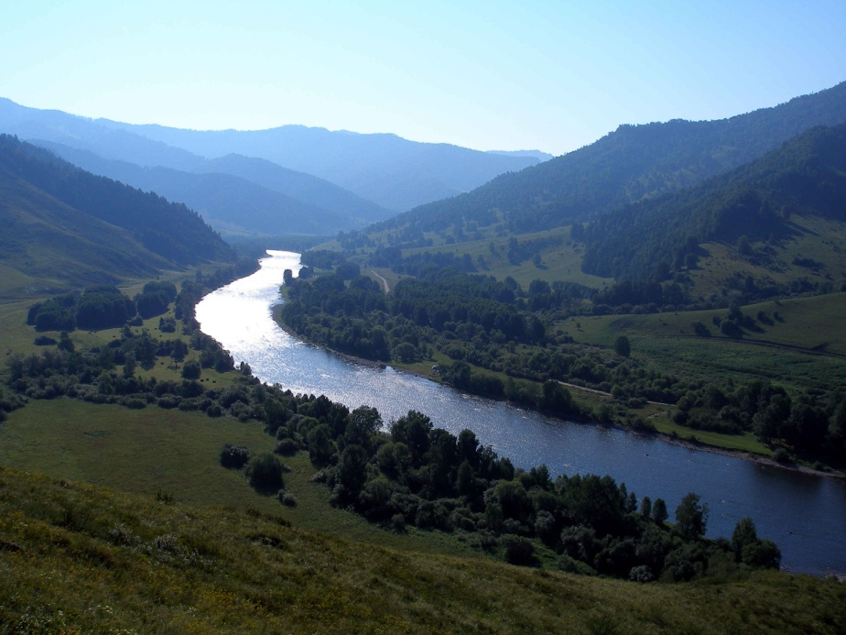
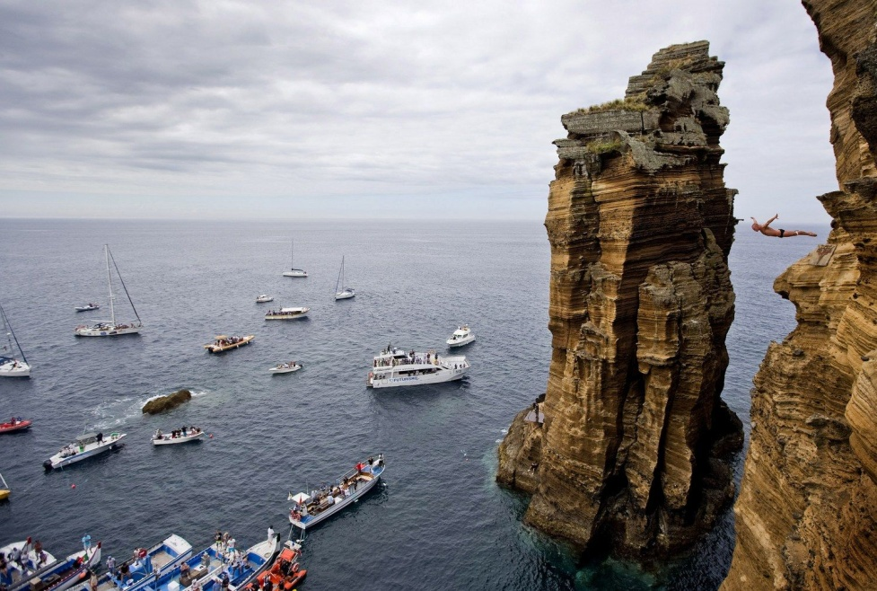
river cliff

Slide 5
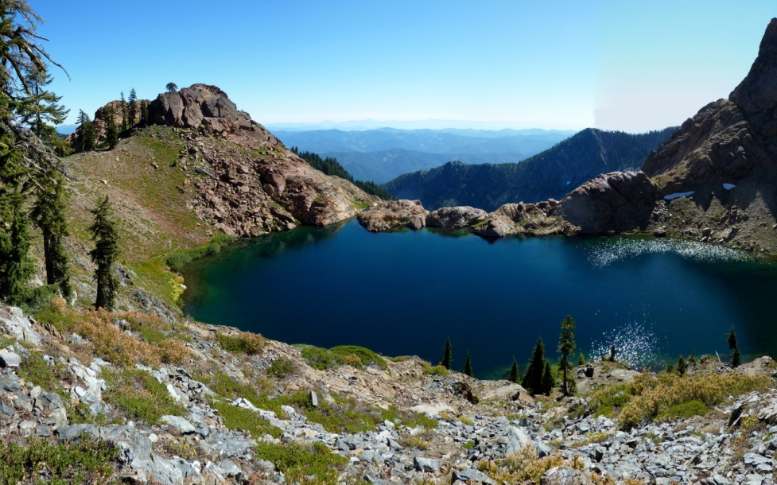
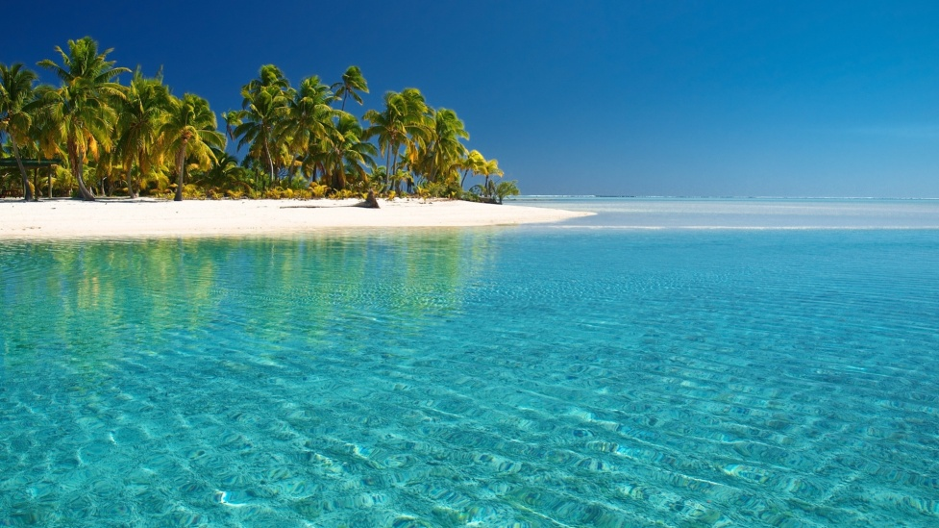
lake sea

Slide 6
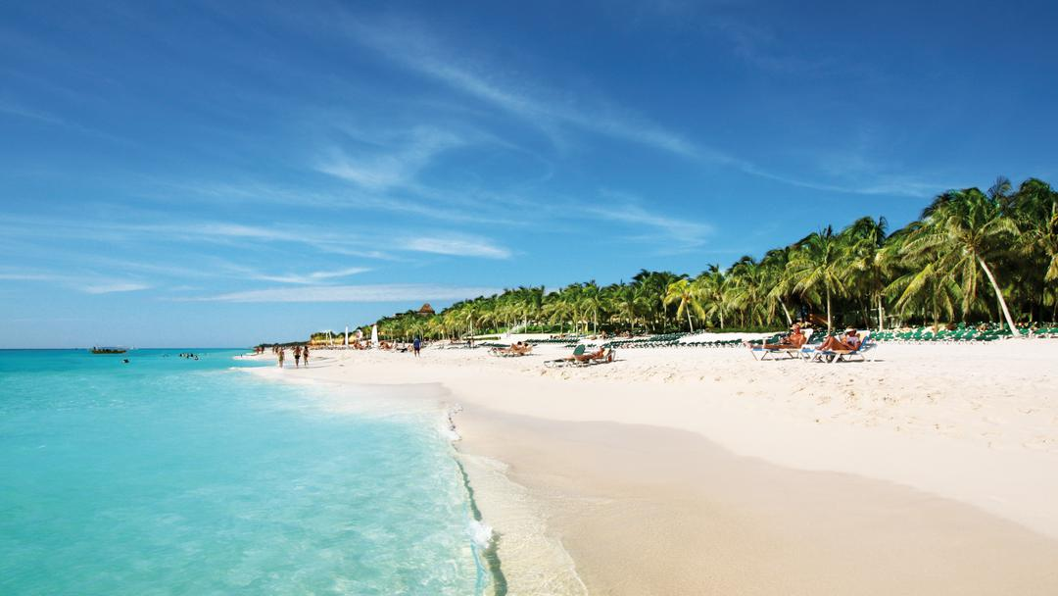
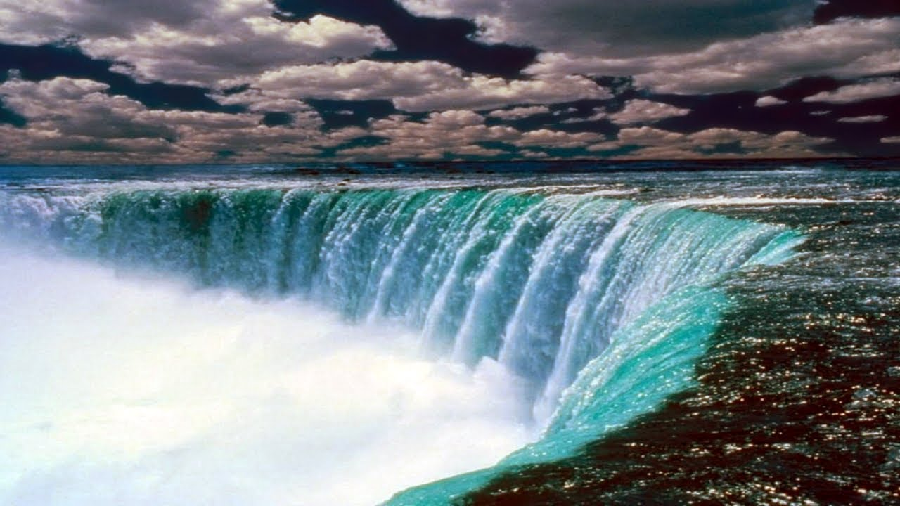
beach waterfall

Slide 7
The theme is
The floating islands
of Lake Titicaca

Slide 8
New words:
sea, beach, floating islands, place, home to, soft, wet, totora reeds, heating,
river, cliff, simple, fishermen, reed boats, hospital,
nearby, popular with, tourists, experience a unique way of life,
lake, forest, water, desert, mountain

Slide 9
It’s time to have a rest:
Head and shoulders, knees and toes, knees and toes,
Head and shoulders, knees and toes, knees and toes,
And eyes, and ears, and mouth, and nose,
Head and shoulders, knees and toes, knees and toes,

