Slide 1
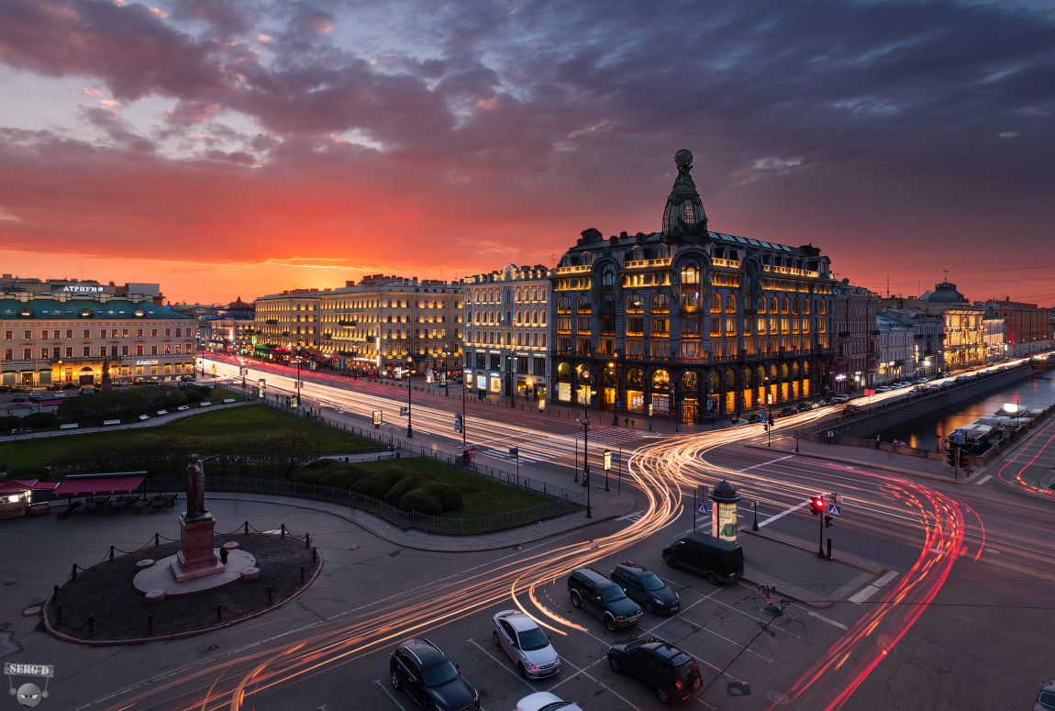
Nevsky prospeCt

Slide 2
history
history

Slide 3
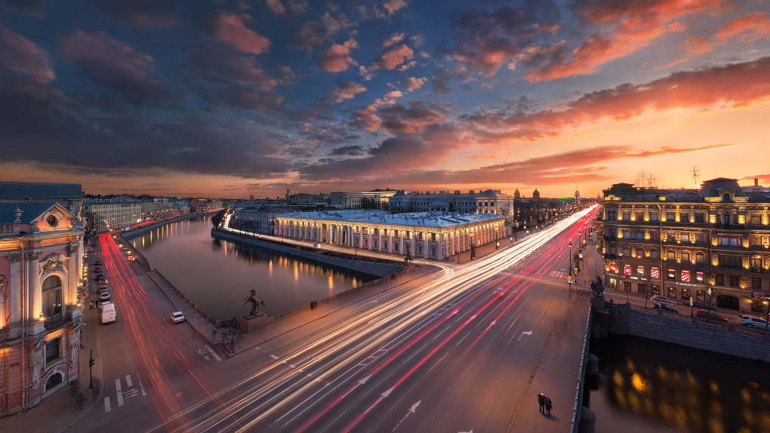
history

Slide 4
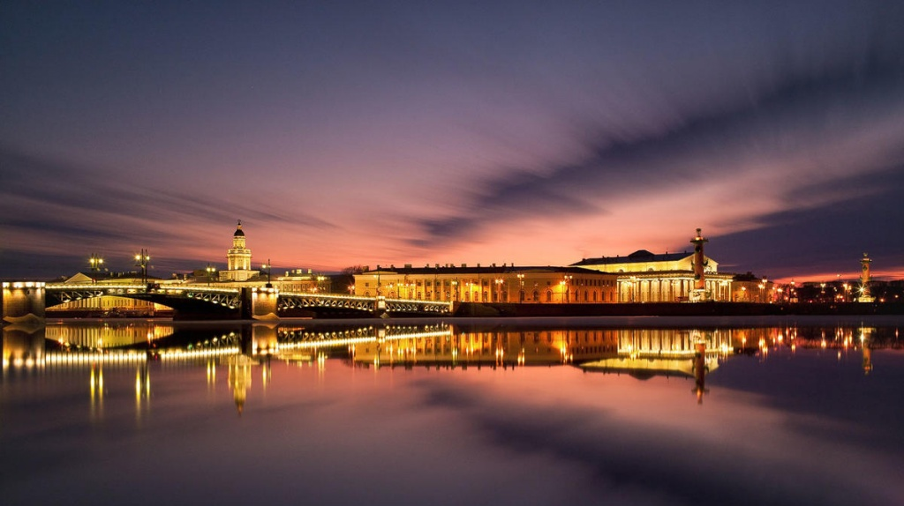
it’s interesting
The Prospekt has five Metro stations along it, which connected with events and people of Russian history.

Slide 5
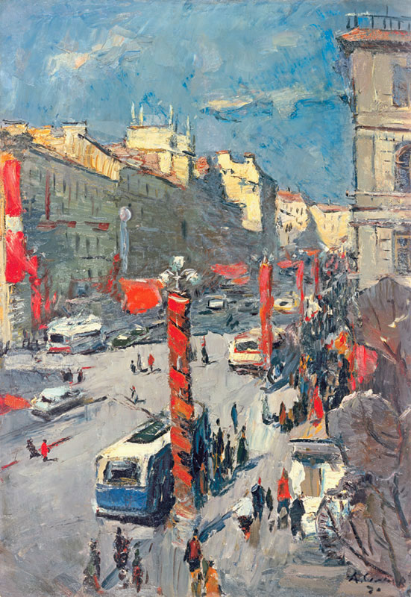
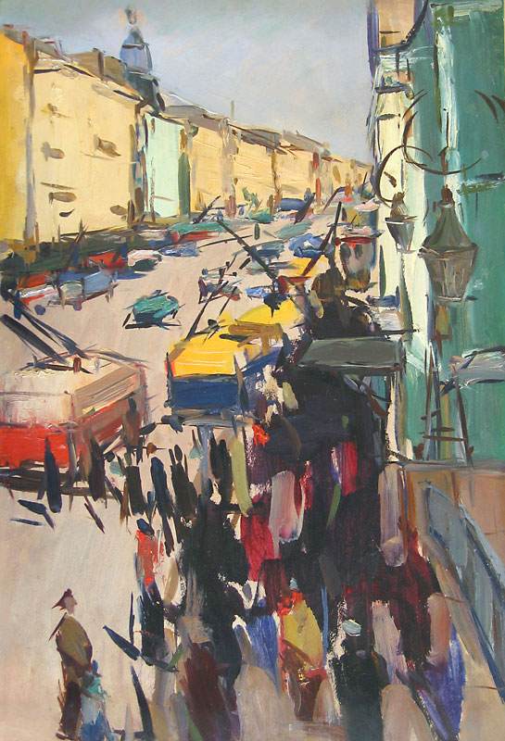
it’s interesting
A.Semenov: Holidays
A. Semenov: Nevsky Prospekt
A. Semenov: Nevsky Prospekt

Slide 6
now

