Slide 1
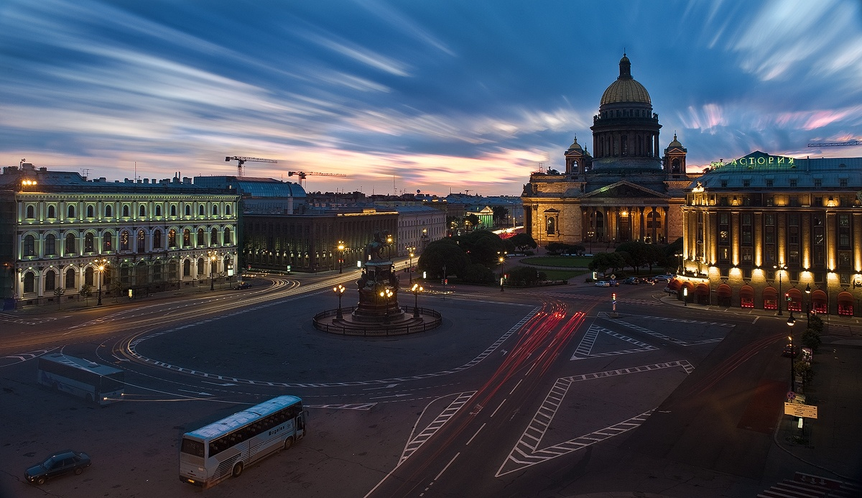
St. Isaac's Square

Slide 2
It is located in the Admiralty district of St. Petersburg .
St. Isaac's Square is surrounded by beautiful buildings .The most remarkable are St. Isaac's Cathedral, Mariinsky Palace, the hotel Astoria and Angliter.

Slide 3
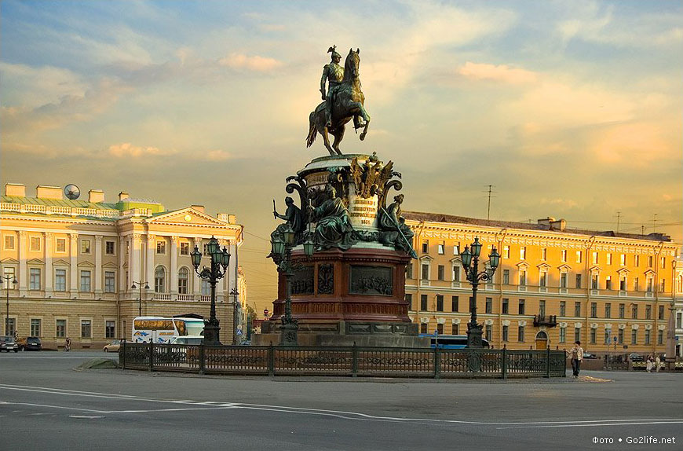
There is a mounted Statue to Nicholas I in the middle of the square.

Slide 4
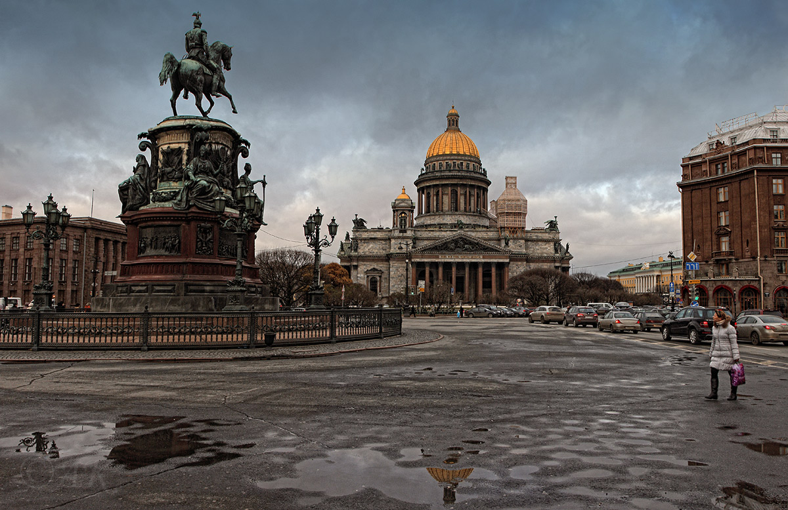
Saint Isaac's Cathedral
The cathedral was built for 40 years during the reign of three Russian Emperors by the architect Auguste Montferrand.

Slide 5
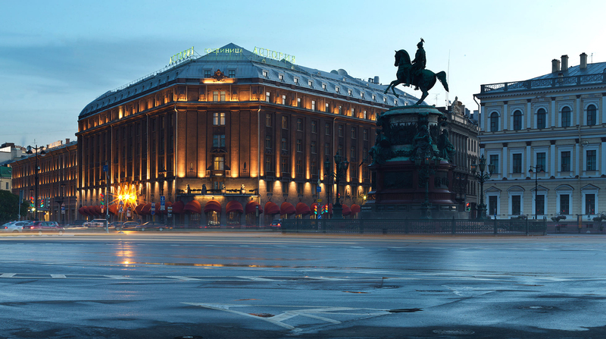
Hotel Astoria
The hotel was built in 1912 by architect Lidval. Since opening the hotel was one of the best in St. Petersburg and in Europe.
During the war it housed a hospital.

Slide 6
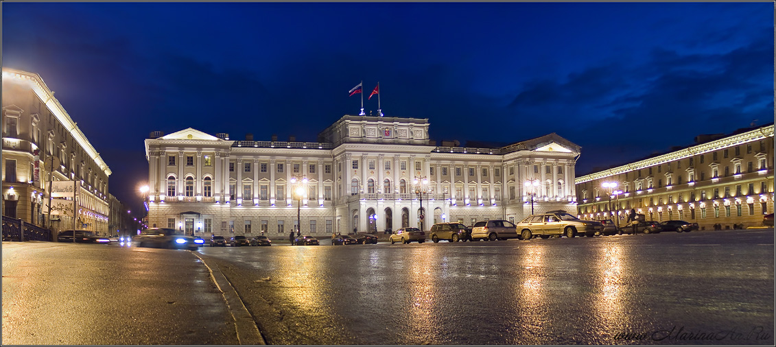
Mariinsky Palace
It was built in 1839-1844 by the architect Shtakenshnejder.

Slide 7
Interesting facts:
Earlier there were shopping rows on St. Isaac's Square, and it was called –Trade Square. The names of the area often changed.
During the war the area was occupied by kitchen gardens.
The great Russian poet Yesenin spent his last days at the hotel Angleterre.
Blue bridge over the Moika River is the widest in the city. Its width is 97 meters.
The first tram line in the city was built across the square in 1907.

Slide 8
Now St. Isaac's Square is one of the most beautiful places in St. Petersburg.

