Slide 2
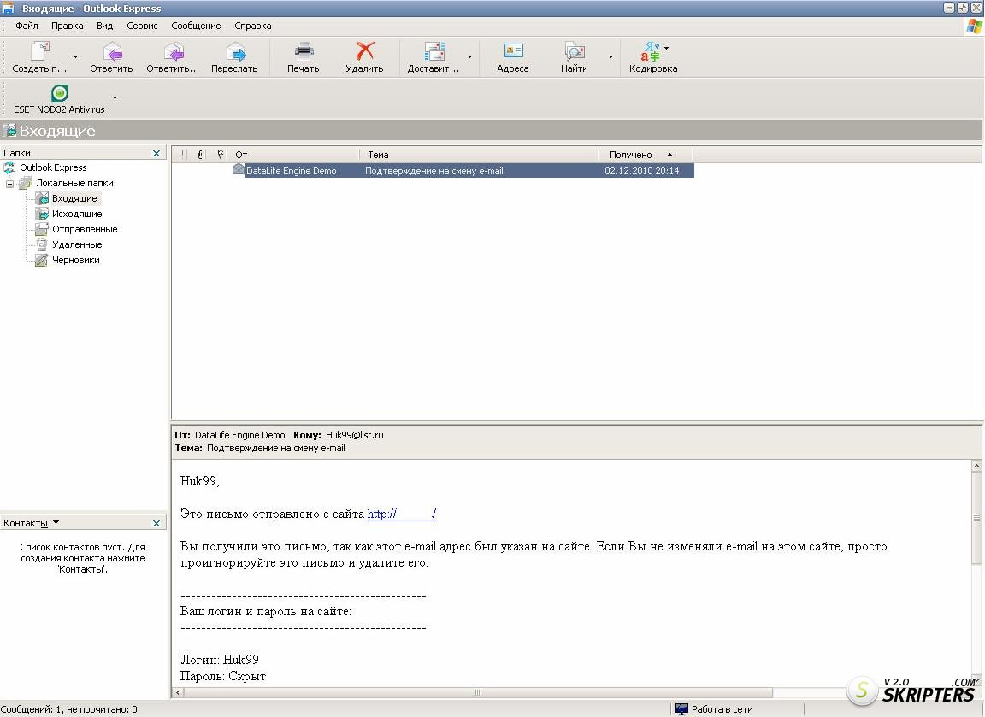
Dear friends,
I’m Andrew Jones. I’m 10 years old,
from Liverpool in the UK.
I’ve got some questions about
Russian schools…

Slide 3
Students Book, Spotlight on Russia
How old are Russian schoolchildren in Year 1?
How many years are there in Year 1?
What about the teachers?
What about lessons times and holidays?
What school subjects do the children have in primary and in secondary school?
Do children in Russian schools wear a uniform?

Slide 4
Questions for groups:
Group 1. What is common between schools in Russia and in Britain?
Group 2. How are schools in Russia and in Britain different?
Group 3. Do you like your school?
Group 4. Do you like schools in Britain?

Slide 5
Group 1
Group 2
Group 3
Group 4

Slide 7
Slide Title
Product A
Product B
Feature 1
Feature 2
Feature 3
Feature 1
Feature 2
Feature 3

