Slide 1
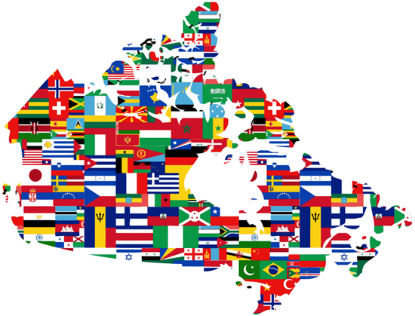
European countries
Сlass 11
ГБОУ СОШ №5 ОЦ «ЛИДЕР»
Блинова О. Д.

Slide 2
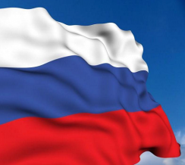
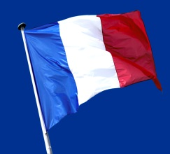
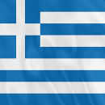
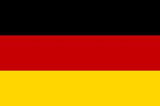
Russia | 10 | 20 | 30 | 40 | 50
France | 10 | 20 | 30 | 40 | 50
Poland | 10 | 20 | 30 | 40 | 50
Greece | 10 | 20 | 30 | 40 | 50
Germany | 10 | 20 | 30 | 40 | 50

Slide 3
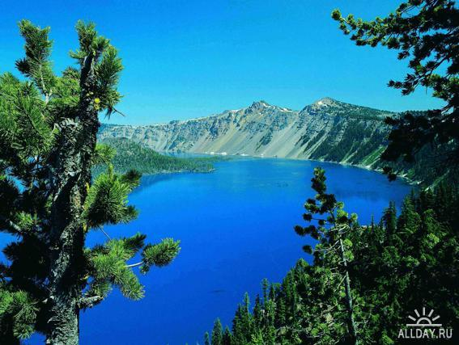
Russia 10
What is Russia’s deepest lake?

Slide 4
Russia 10
What is Russia’s deepest lake?
Lake Baikal

Slide 5
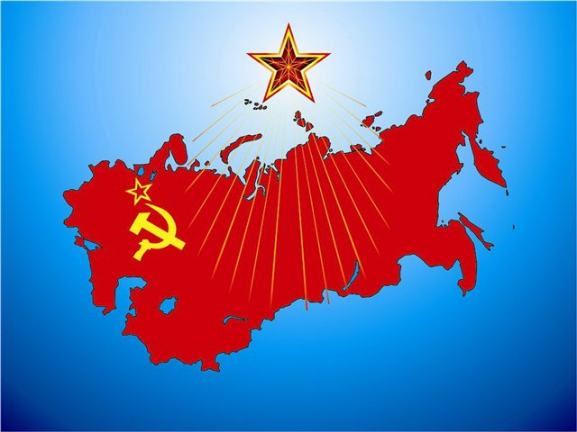
Russia 20
Who was the first leader of the USSR?

Slide 6
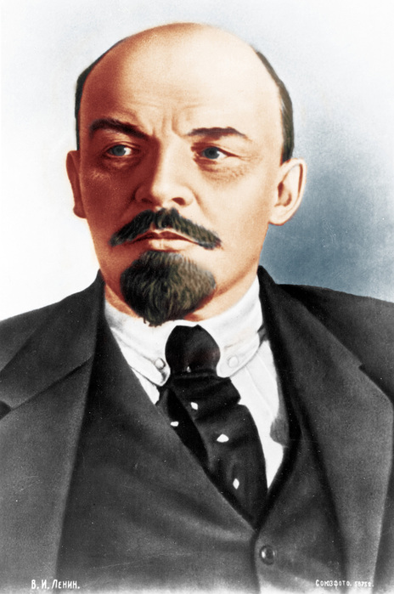
Russia 20
Who was the first leader of the USSR?
V. I. Lenin

Slide 7
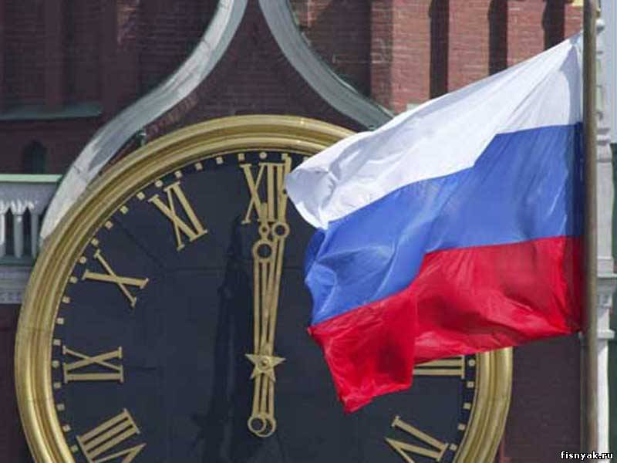
Russia 30
Who was the first democratically elected president of Russia?

Slide 8
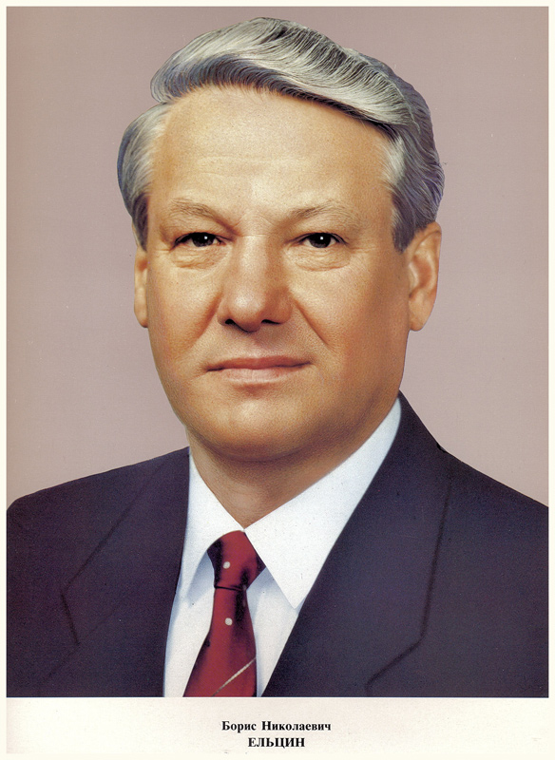
Russia 30
Who was the first democratically elected president of Russia?
B. N. Eltsin

Slide 9
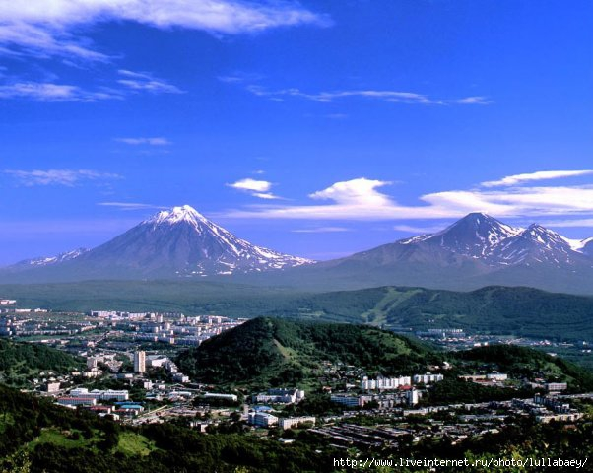
Russia 40
What is Russia’s largest peninsula?

Slide 10
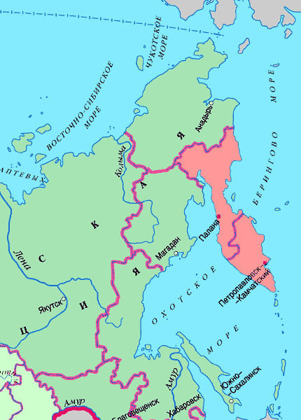
Russia 40
What is Russia’s largest
peninsula?
Kamchatka

Slide 11
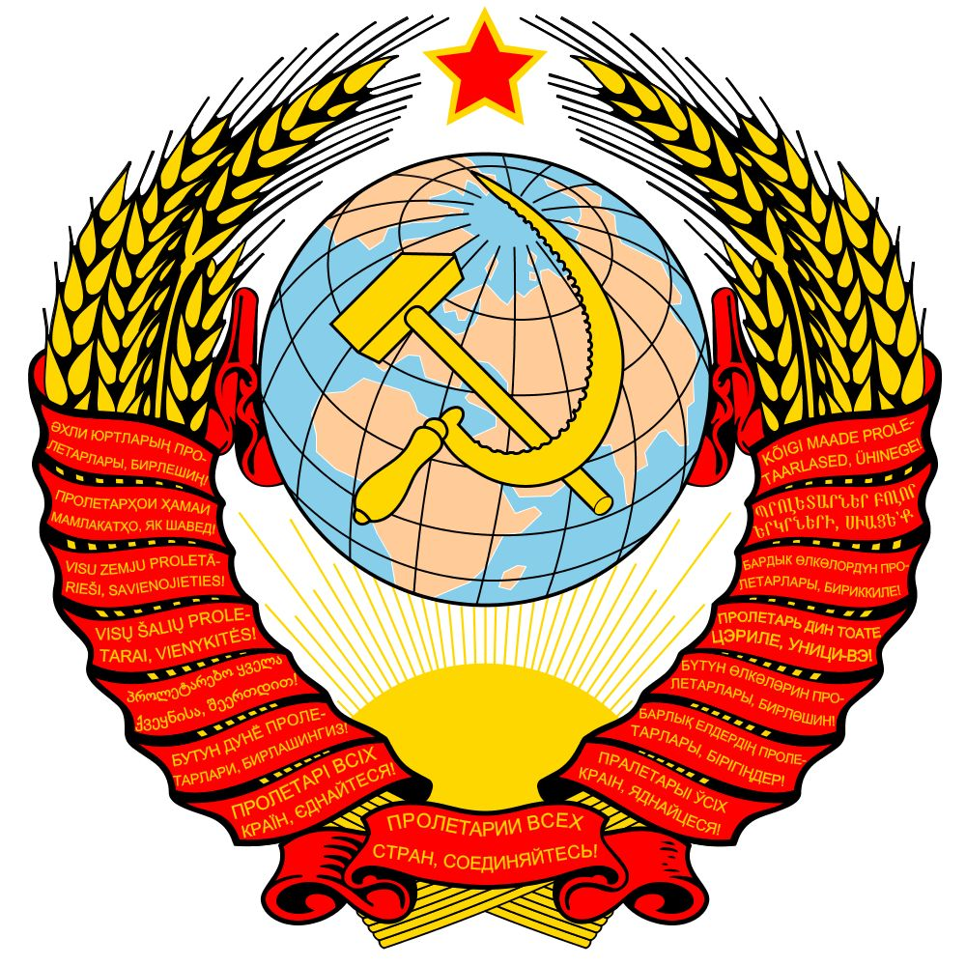
Russia 50
When did the USSR dissolve into 15 independent republics?

Slide 12
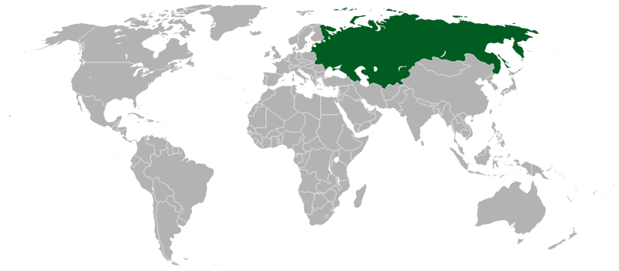
Russia 50
When did the USSR dissolve into 15 independent republics?
In 1991

Slide 13
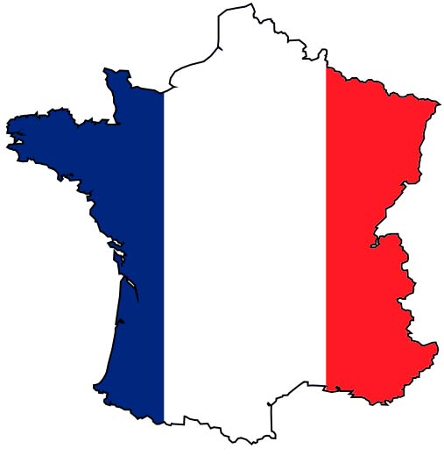
France 10
What is the Sorbonne?

Slide 14
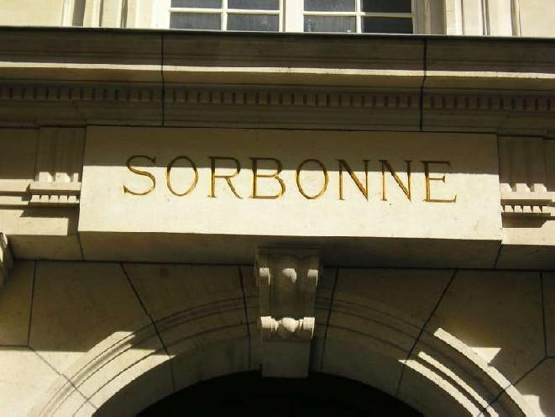
France 10
What is the Sorbonne?
The University of Paris
often known as
the Sorbonne

Slide 15
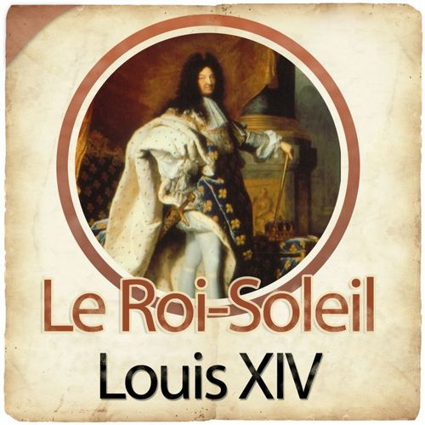
France 20
What was Louis XIV’s favourite place?

Slide 16
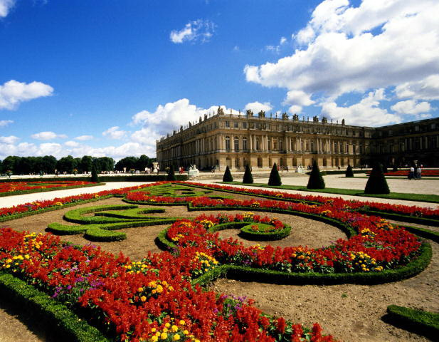
France 20
What was Louis XIV’s favourite place?
the Versailles

Slide 17
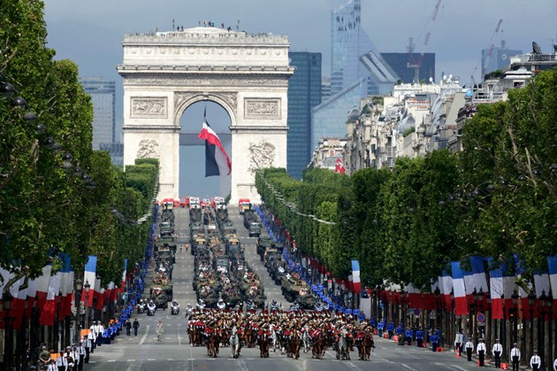
France 30
When is Bastille Day celebrated?

Slide 18
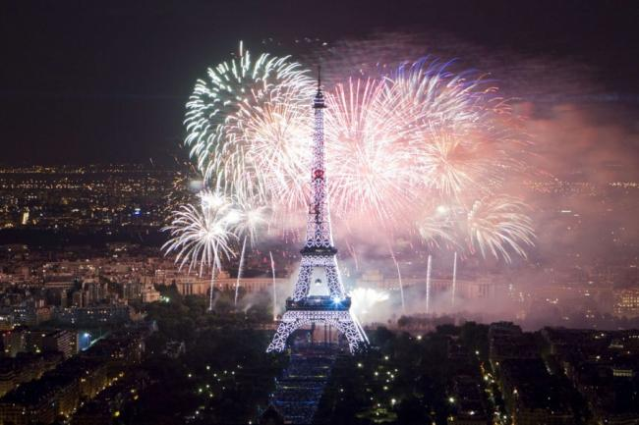
France 30
When is Bastille Day celebrated?
14th July

Slide 19
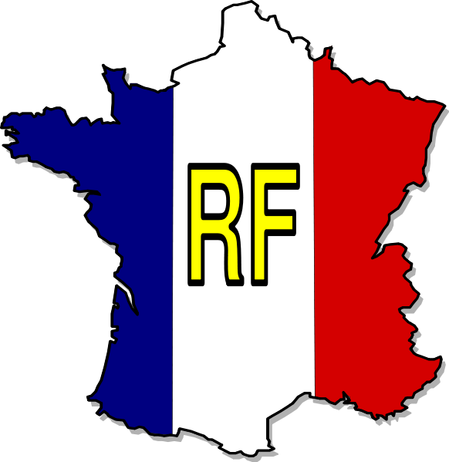
France 40
What is the motto of the French Republic ?

Slide 20
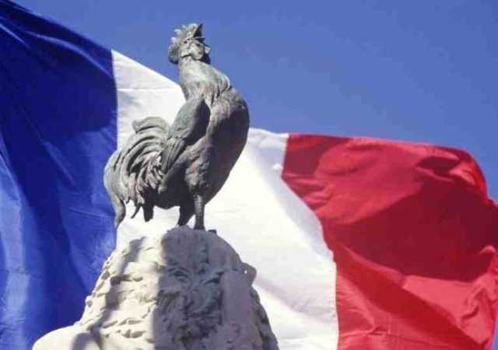
France 40
What is the motto of the French Republic ?
«Liberty, Equality, Fraternity»

Slide 21
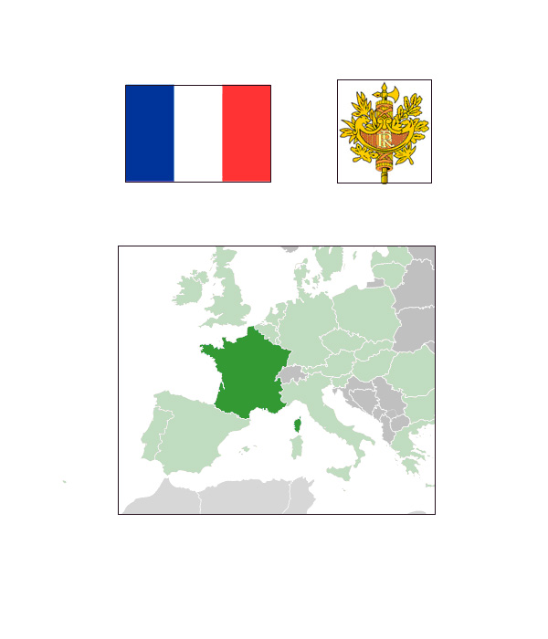
France 50
Who was the French leader during the Second World War?

Slide 22
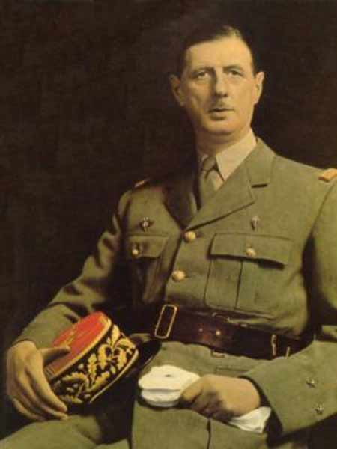
France 50
Who was the French leader during the Second World War?
Charles de Gaulle

Slide 23
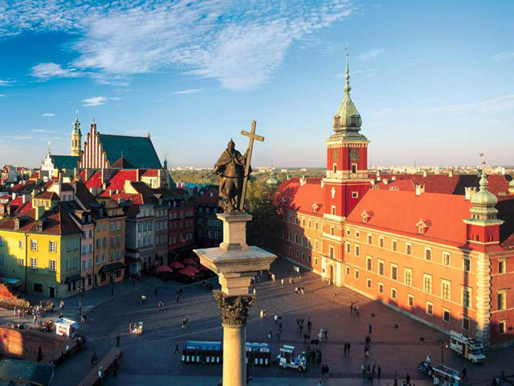
Poland 10
What is the capital city of Poland?

Slide 24
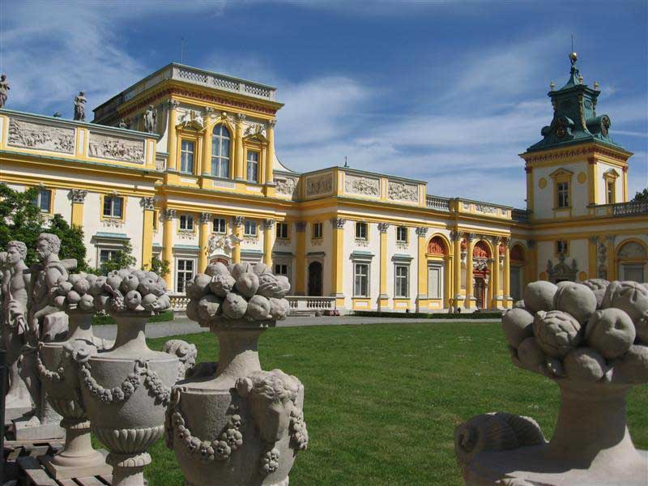
Poland 10
What is the capital city of Poland?
Warsaw

Slide 25
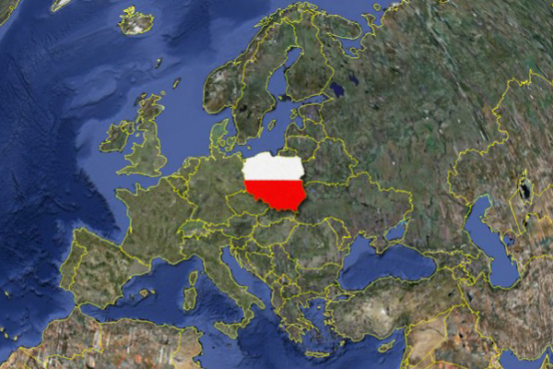
Poland 20
What sea is Poland washed by in the north-west?

Slide 26
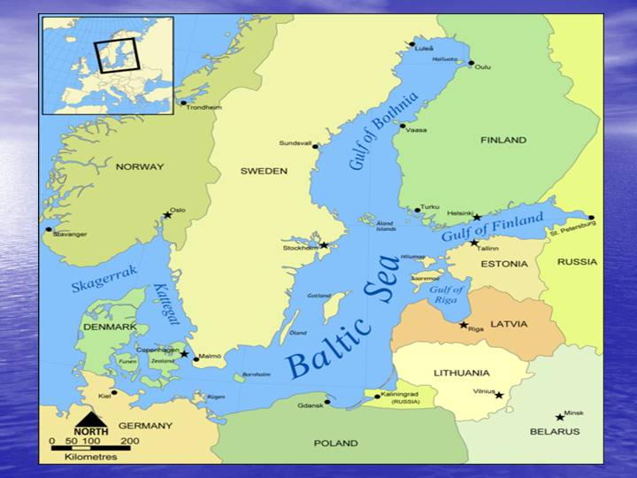
Poland 20
What sea is Poland washed by in the north-west?
The Baltic Sea

Slide 27
Poland 30
Polonez is the name of:
polish dish
polish bird
polish dance

Slide 28
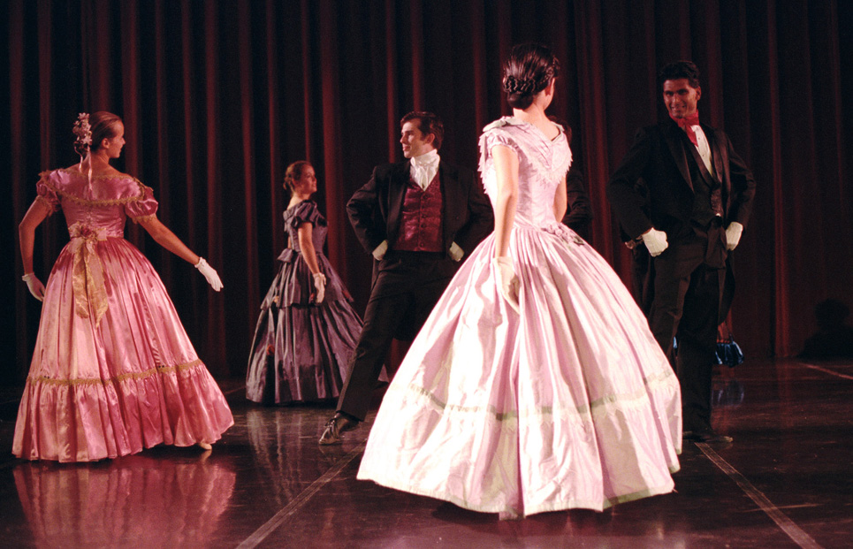
Poland 30
Polonez is the name of:
polish dish
polish bird
polish dance

Slide 29
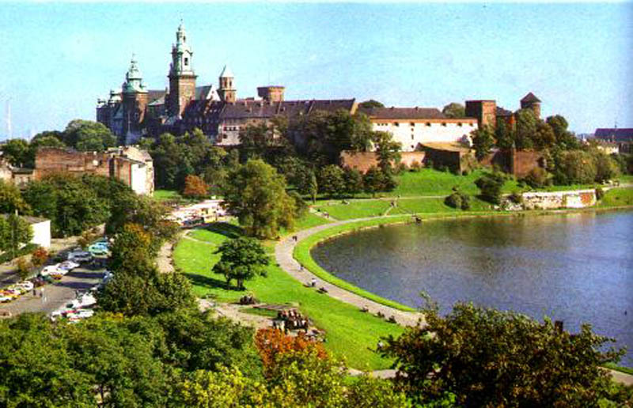
Poland 40
Which of these cities is Polish?
Prague
Lisbon
Krakow

Slide 30
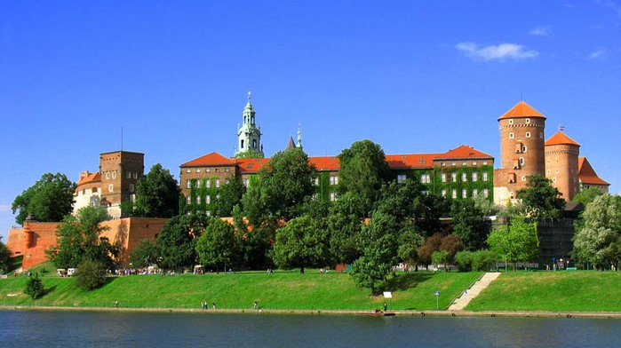
Poland 40
Which of these cities is Polish?
Prague
Lisbon
Krakow

Slide 31
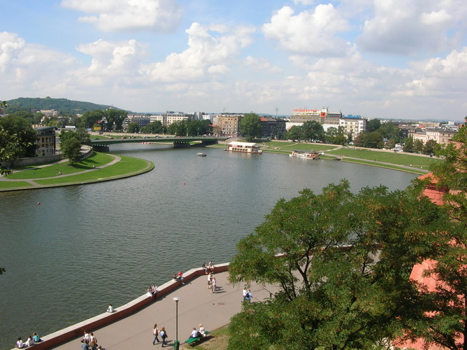
Poland 50
Which of these rivers is Polish?
The Elbe
The Vistula
The Loire

Slide 32
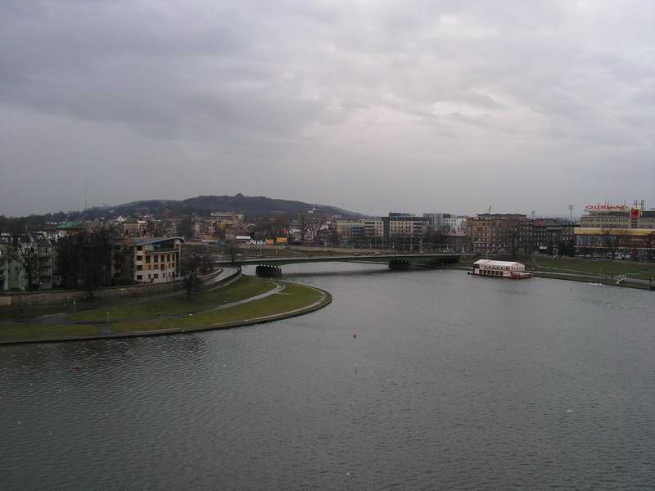
Poland 50
Which of these rivers is Polish?
The Elbe
The Vistula
The Loire

Slide 33
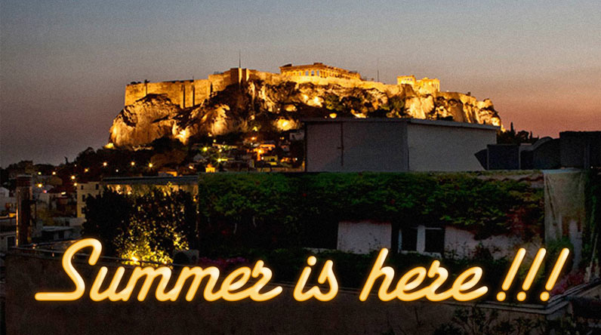
Greece 10
What is the capital of Greece?

Slide 34
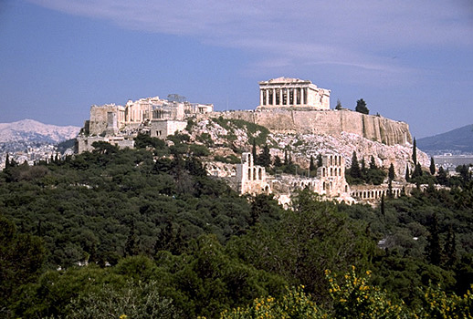
Greece 10
What is the capital of Greece?
Athens

Slide 35
Greece 20
What language is spoken in Greece?

Slide 36
Greece 20
What language is spoken in Greece?
Greek ("Greek language") is an independent branch of the Indo-European family of languages, native to the southern Balkans. It has the longest documented history of any Indo-European language, spanning 34 centuries of written records.

Slide 37
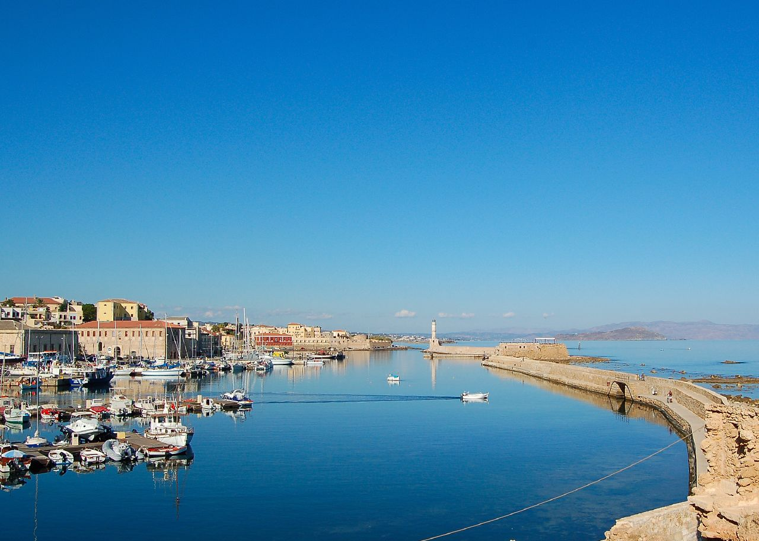
Greece 30
What is Crete?

Slide 38
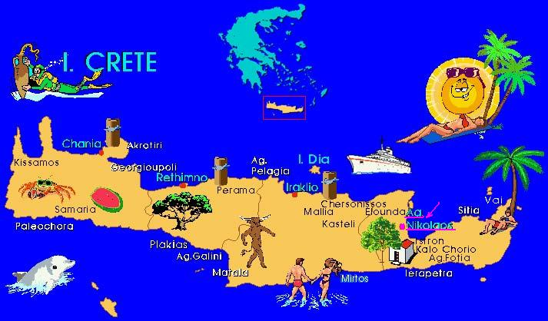
Greece 30
What is Crete?
Crete is the largest and most populous of the Greek islands, the fifth-largest island in the Mediterranean Sea, and one of the 13 administrative regions of Greece.

Slide 39
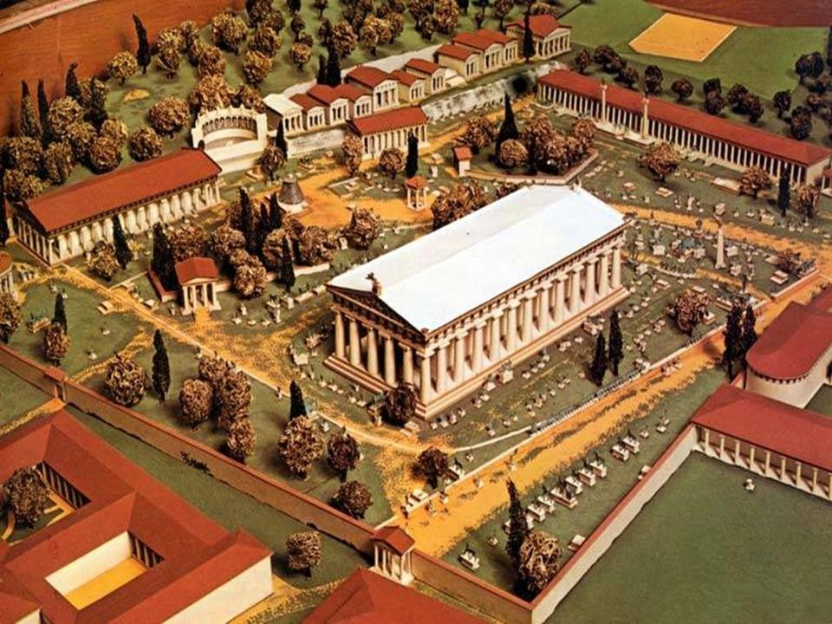
Greece 40
What popular contest originated from Greece?

Slide 40
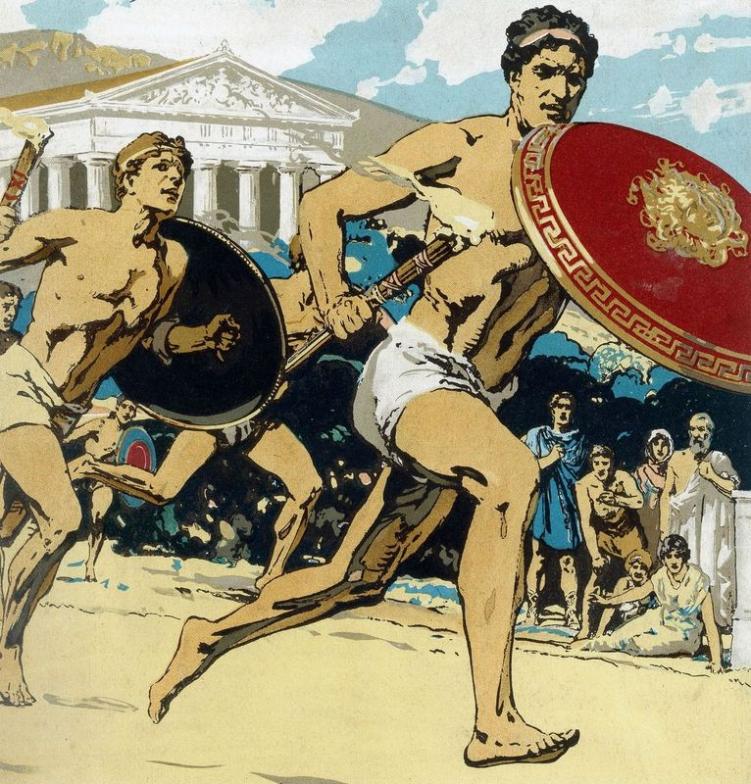
Greece 40
What popular contest originated from Greece?
Olympic Games

Slide 41
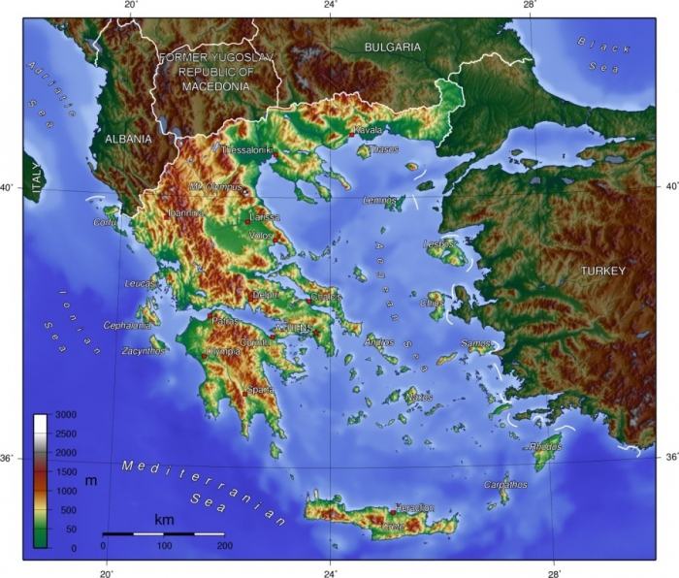
Greece 50
In which peninsula is Greece situated?

Slide 42
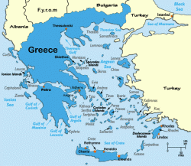
Greece 50
In which peninsula is Greece situated?
Balkans

Slide 43
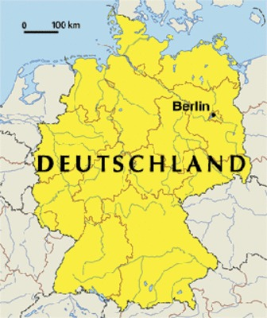
Germany 10
What sea borders Germany in the North?

Slide 44
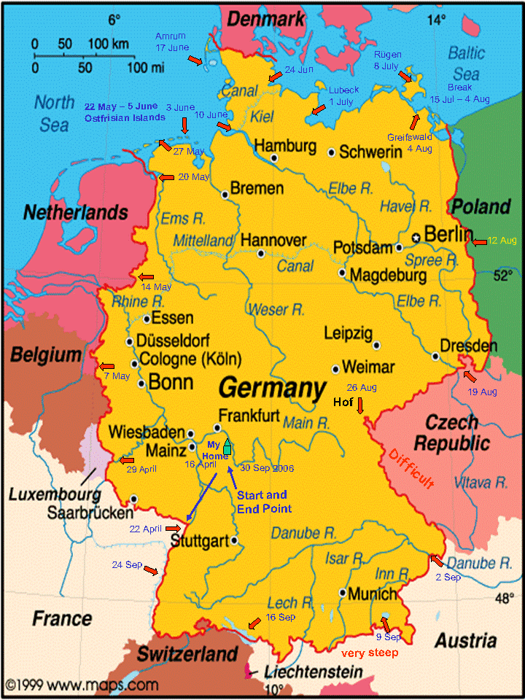
Germany 10
What sea borders Germany in the North?
the North Sea in the northwest and the Baltic Sea in the northeast

Slide 45
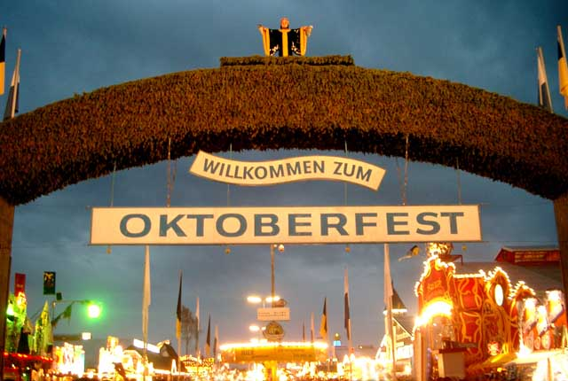
Germany 20
Where is Oktoberfest celebrated?

Slide 46
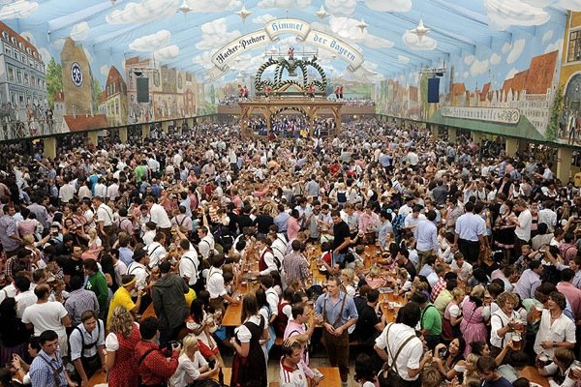
Germany 20
Where is Oktoberfest celebrated?
Oktoberfest is the world's largest funfair held annually in Munich, Bavaria, Germany.

Slide 47
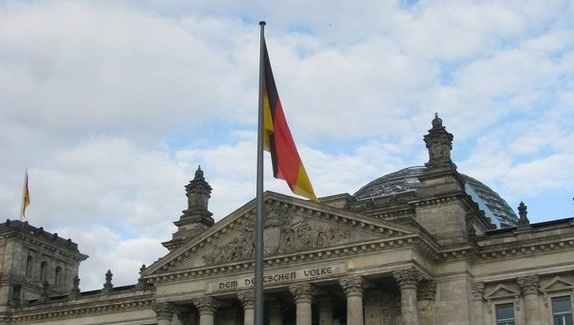
Germany 30
What is the Bundestag?

Slide 48
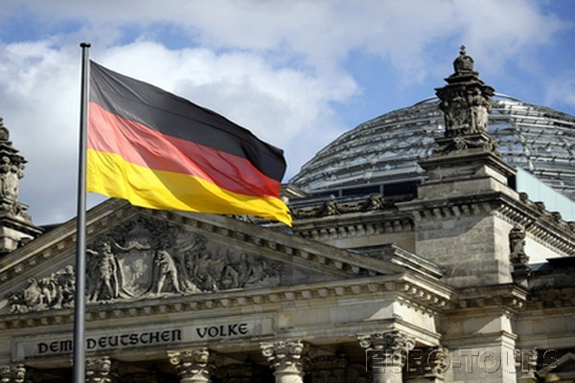
Germany 30
What is the Bundestag?
The Bundestag is a constitutional and legislative body in Germany.

Slide 49
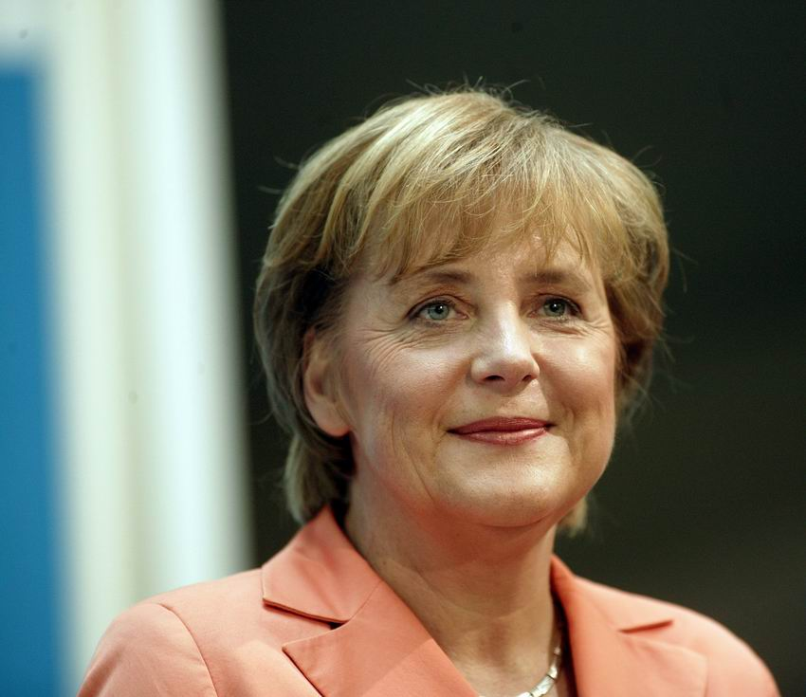
Germany 40
What do you call the head of government in Germany?

Slide 50
Germany 40
What do you call the head of government in Germany?
The Chancellor

Slide 51
Germany 50
Who was the leader of the Reformation of the church in Germany?
Wilhelm Tell
Martin Luther
Wolfgang A. Mozart

Slide 52
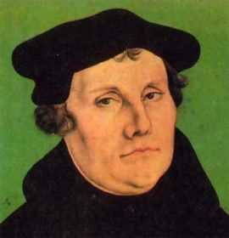
Germany 50
Who was the leader of the Reformation of the church in Germany?
Wilhelm Tell
Martin Luther
Wolfgang A. Mozart

Slide 53
Интернет-источники
https://en.wikipedia.org/wiki/Russia
https://ru.wikipedia.org/wiki/%D0%E0%F1%EF%E0%E4_%D1%D1%D1%D0
http://en.wikipedia.org/wiki/Poland
http://en.wikipedia.org/wiki/France
https://en.wikipedia.org/wiki/University_of_Paris
http://en.wikipedia.org/wiki/Greece
https://en.wikipedia.org/wiki/Germany
https://en.wikipedia.org/wiki/Oktoberfest

