Slide 1
Ecological problems Climate change
English lesson

Slide 2
Vocabulary
Environment,
pollution,
wildlife,
nature,
ecology,
to protect,
to reuse,
to reduce,
cut down,
litter,
to recycle
Destroy
Damage
Throw away
Take care of
Окружающая среда
Загрязнение
Живая природа
Природа
экология
защищать
повторно использовать
уменьшать
вырубать (деревья)
мусор
повторно перерабатывать
разрушать
вредить, повреждать
выкидывать
заботиться ( о ком-либо/чем-либо)

Slide 3
Destroy wildlife
Throw away litter
Reduce pollution
Spoil the environment
Protect nature
Damage nature
Disturb wild animals

Slide 4
“If you don’t think about
the future
you will not have it.”
John Galsworthy

Slide 5
Modal verbs
Must должен (обязан)
We must…
Should должен (советую)
You should..
Can можем (умеем, способны)
I can…

Slide 6
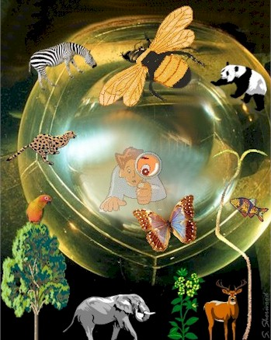
- Hello! - Hello! - Now tell me please what we can reduce? - We can reduce (reuse, recycle)… - What must we reduce at home? - What must we reduce… - And what about you?

Slide 7
Discussing of ecological problems
.
If we want to keep the earth clean, we must/mustn’t:
- plant more trees,
- build factories on river banks
- feed animals
- cut down trees
- help animals to survive
- pour toxic waste into rivers
- burn (сжигать) toxic waste
- clean rivers and lakes
- use rivers for washing cars
- water the plants
- etc. (your examples)

Slide 8
Code of Ecological Rules
-Don’t break trees.
-Don’t leave litter.
-Keep the country tidy…
Continue these rules

