Slide 2
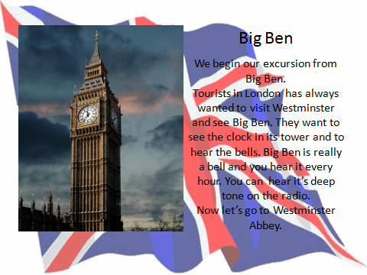

Slide 3
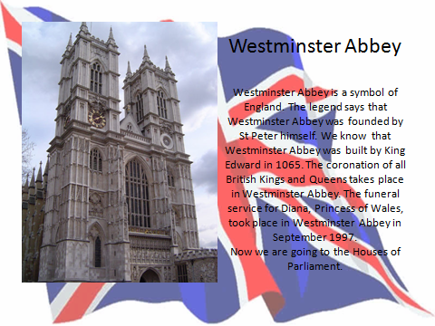

Slide 4
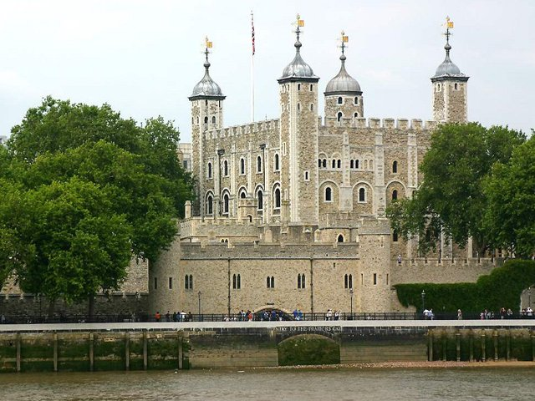
Tower
You can see Tower of London from the river Thames. The Tower is very old. Now the King and the Queen of Britain don’t live in the Tower.
Let’s walk to MOMI and enjoy London’s streets and avenues.

Slide 5
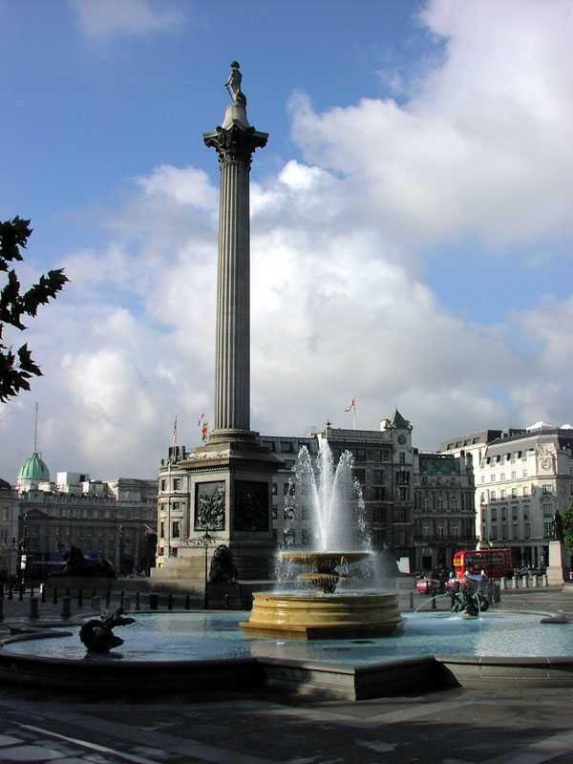
Trafalgar Square
Trafalgar Square is the geographical centre of London. It was named in memory of Admiral Nelson’s victory in the battle of Trafalgar in 1805. The tall Nelson’s Column stands in the middle of the square.
Now we are going to Tower by bus.

Slide 6
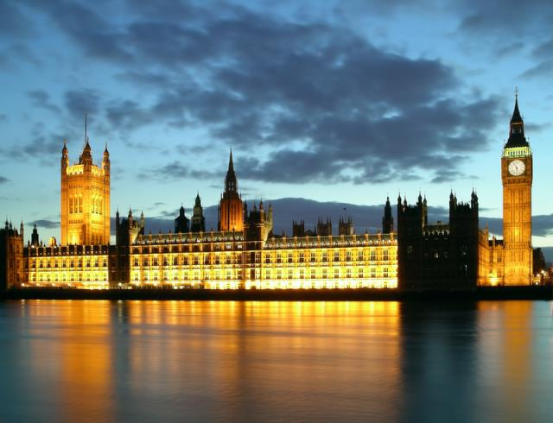
Houses of Parliament
The Houses of Parliament stand near the famous clock Big Ben. The country’s leaders speak in the Houses of Parliament. The men and women there are the voice of British people.
Now let’s get on the bus. We are going to Buckingham Palace.

Slide 7
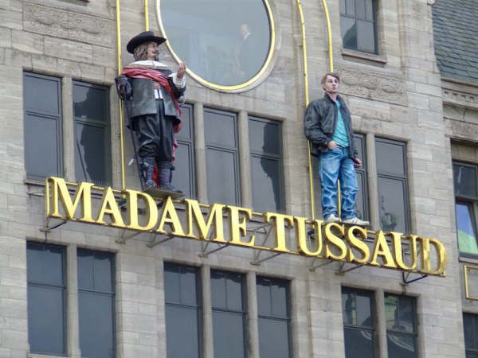
Madame Tussaud’s
It is one of the sights of London. It’s the famous waxworks museum which has one of the largest collections of wax models in the world. You can meet great characters of history and art. Here actors, film stars, pop singers, and sportsmen come face to face with famous politicians. There is a special place for the Queen’s family: the Queen, her husband, their children and other members of the Royal family.
I hope you enjoyed my excursion.

Slide 8
Thanks for attention!

